Slide 1

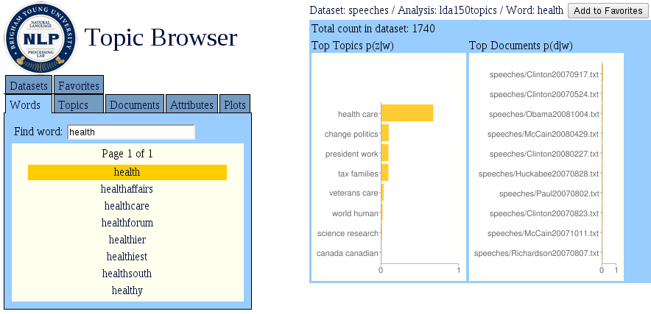
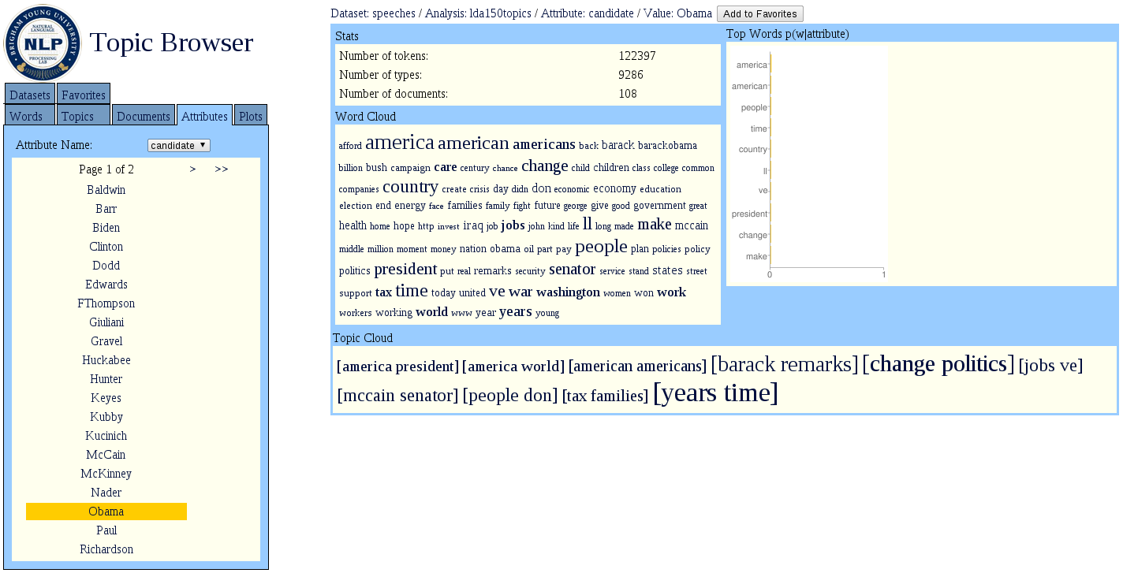
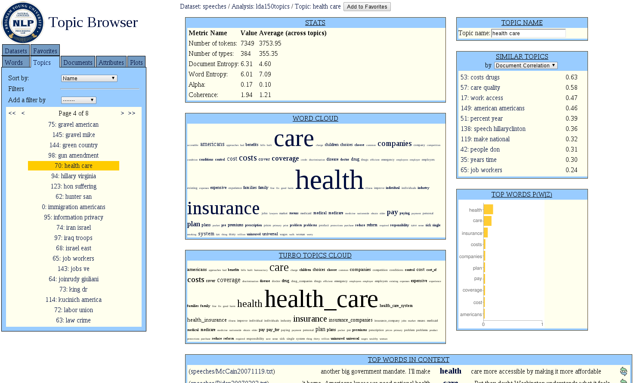
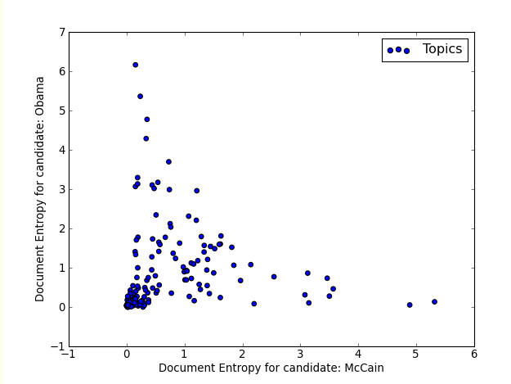
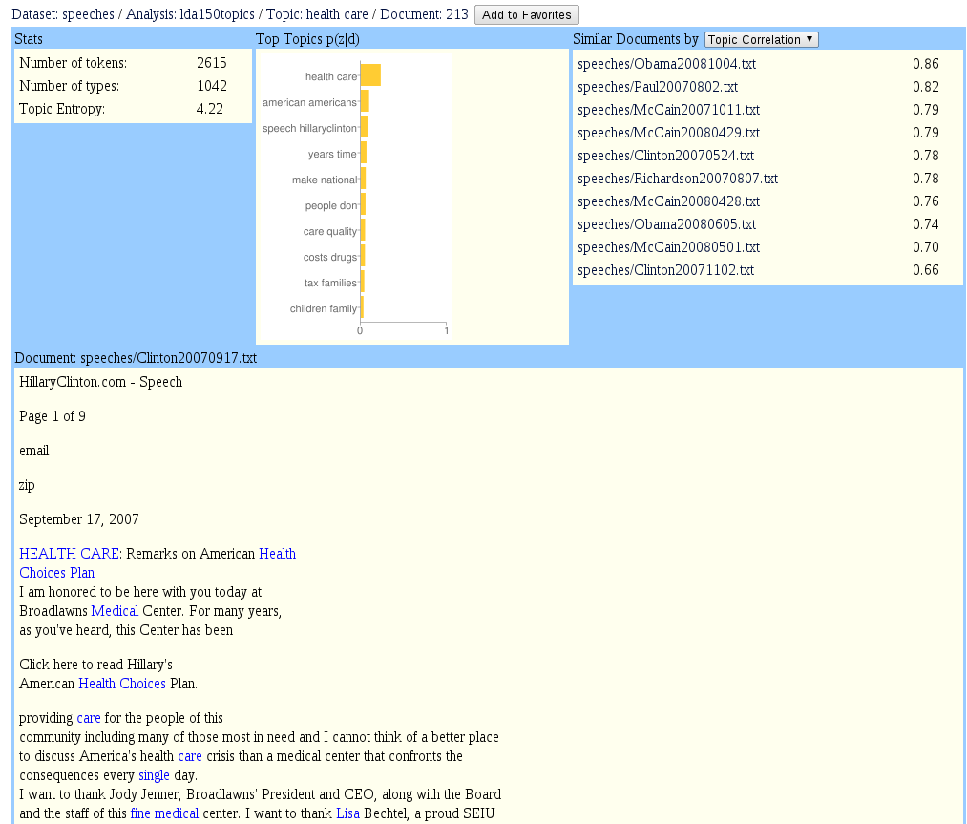
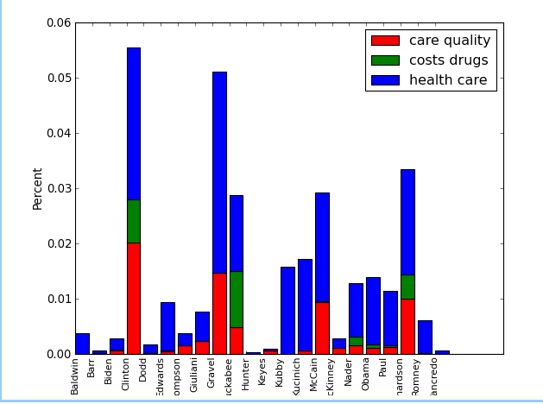
The Topic Browser: An Interactive Tool for Browsing Topic Models
Matthew Gardner (mjg82@byu.edu), J. Lutes, J. Lund, J. Hansen, D. Walker, E. Ringger, and K. Seppi
Department of Computer Science, Brigham Young University, Provo, Utah 84604 USA
0 working ll class dream credit americans middle retirement debt families income wealth social
1 party democrats republican democratic republicans candidates candidate nominee policy
2 state vote issues respect question understand power talking based asked decisions found live
3 plan small jobs people businesses business create job fix meeting creating bad investment buy
4 military war iraq troops force end defense guard security political power prepared combat peace
5 government federal power citizens private public process political congress case interest control
6 speeches newsroom president bill mexico richardson richardsonforpresident id nation work
7 political campaign run people parties candidates ralph media votes york politics campaigns
8 government spending congress dollars money spend federal budget problems programs run
9 israel middle east peace terror terrorism state palestinian jewish arab commitment support
10 iraq troops iraqi plan iraqis political government violence oil region civil sectarian forces interests
11 states united work international important countries political north move lives allowed areas
12 heart god life america truth hearts illinois hope innocent world remember spirit terrible lives
13 governor romney america mitt news speeches remarks mittromney nation military strength
14 innovation national research technology invest infrastructure century sector agenda st science
15 security threat time years today support terrorists allies threats long freedom common dangers
16 situation problem fact policy terms issues experience dealing understanding community
17 today didn fear courage celebrate doors howard cross friends rock face fight forget impossible
18 applause laughter cheers freedom constitution call care life president audience office level
19 years country back people lot ve important today ago history world times long year live good
20 america today fight live wrong makes true line equal test free times put generation full give
vs.

