Slide 1

Mindset, Attitudes, and Success in Statistics
MATTHEW ISAAC and DR. KADY SCHNEITER

Slide 2

Image Source: www.prometheusresearch.com

Slide 3
MINDSET (Fixed or Growth)
General Mindset
ATTITUDES (Positive or Negative)
Enjoyment/Comfort with statistics
Perception of Utility
Statistical Mindset
Notes:
Composite scores were calculated for each mindset and attitude category.
Responses associated with growth mindset were given positive values (1,2). Responses associated with fixed mindset were given negative values (-1, -2).
Responses associated with positive attitudes were given positive values (1,2). Responses associated with negative attitudes were given negative values (-1, -2).
Positive composite scores were classified as growth mindset/positive attitudes. Negative composite scores were classified as fixed mindset/negative atttudes.

Slide 4
Mindset Results:
95% growth mindset (statistical and general)
Statistically significant difference in course score between growth and fixed mindset groups

Slide 5
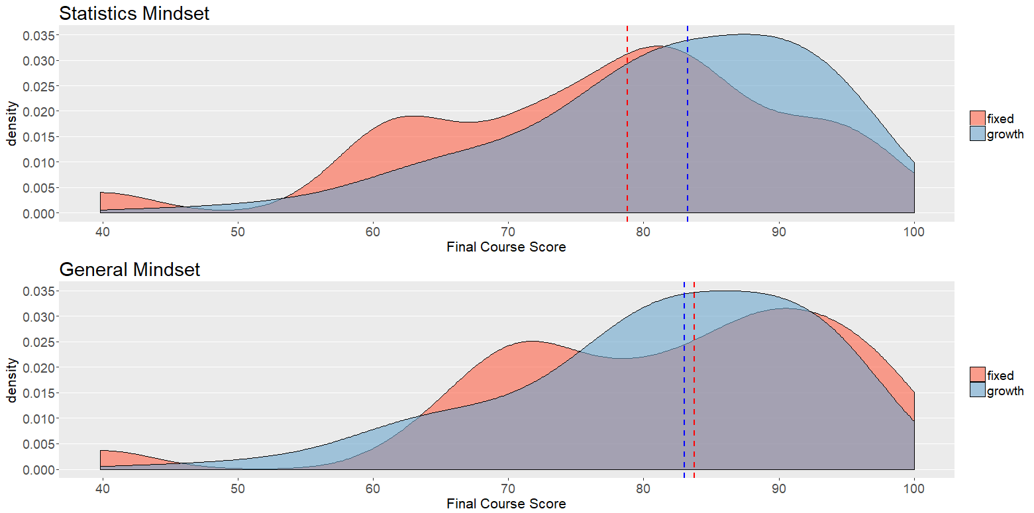
Notes:
Inference was performed to understand if there was a significant difference in final course score between growth and fixed mindsets.
Significant response (p<0.0001) detected for both types of mindset.
Visualization to help better understand these differences.
For statistics mindset – more students doing better with a growth mindset than with a fixed mindset.
General growth mindset – not as much of a distinction.
This makes sense that statistics mindset would be more indicative of performance in a statistics course.
However, the estimated shift in location was < 2 for both types of mindset. This does not seem like a contextually significant difference.
This suggests that mindset may not be as strongly associated with academic performance.

Slide 6
Attitude Results:
About 64% positive attitudes (enjoyment/comfort)
About 84% positive attitudes (utility)
Statistically significant difference in course score between different levels of attitude

Slide 7
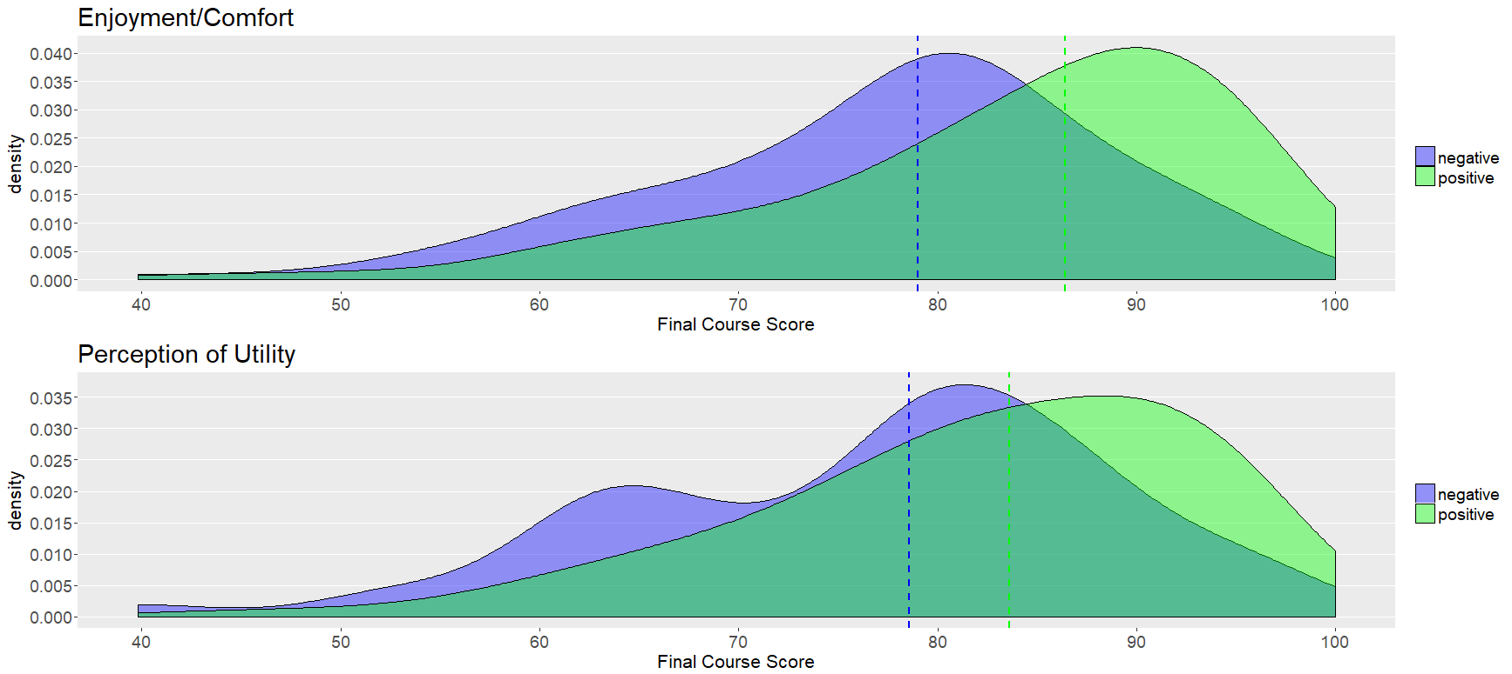
Notes:
Remove neutral distribution if it is distracting? Only 6 and 4% of students were classified as neutral, so there’s not actually very much data there.
Threshold for neutral group.
Inference performed to determine if there is a significant difference in final course score between students with different attitudes. A highly significant difference (p<0.0001) was detected between students with positive attitudes and students with negative attitudes in both attitude categories.
Larger shift detected between positive/negative attitudes than was detected between growth/fixed mindset groups. Indicates findings that agree with other publications - that attitude does have a significant impact on academic achievement. (Review sources)

Slide 8
Key Results and Next Steps
Large proportion of growth mindsets
Did not observe a strong association between growth and academic achievement
More positive attitudes surrounding statistics than expected
Positive attitudes associated with better performance in course

