Slide 1

Adverse Recommender
Team #1:
Kluska, Matthew
Trinh, Christopher
Wan, Ning
Zhao, Shiping
Notes:
Hi everyone, today we will be presenting our research on adversarial recommendation systems:
First I want to introduce who made this project possible. I’m Matthew Kluska and currently in Boston.
I’m Christoper and also in Boston.
Furthermore we want to recognize 2 team mates currently in different time zones Thank you Shiping and William for helping us present from California and Beijing respectively.

Slide 2
Overview
Recommendation engines are usually designed to increase engagement (time), upsell customers ($), etc. with the platform they’re implemented on
An interesting question is posed on how can we find the opposite
“What is something that the user will absolutely dislike?”
One interesting use case for a negative recommendation would be in ensemble learning (Chaining multiple ML algorithms)
We can use negative recommendations to filter examples and decrease our sample space for a customer facing recommendation system
Notes:
So everyone has seen typical recommendation systems on Amazon or other e-commerce sites. It’s also implemented into every streaming service to get us to click on the next episode, next story, or next tic toc.
Today we will be presenting our idea on a system that wants to disincentive you from using the service.
What if Facebook placed an ad that you hate, or Netflix recommended the opposite of what you wanted to see.
This subject came of interest to us because as scientists in machine learning we are generally interested in optimal solutions but sometimes data/information is hard to come by. We may not have the information to solve the problem but there may exist data that solves the converse.

Slide 3
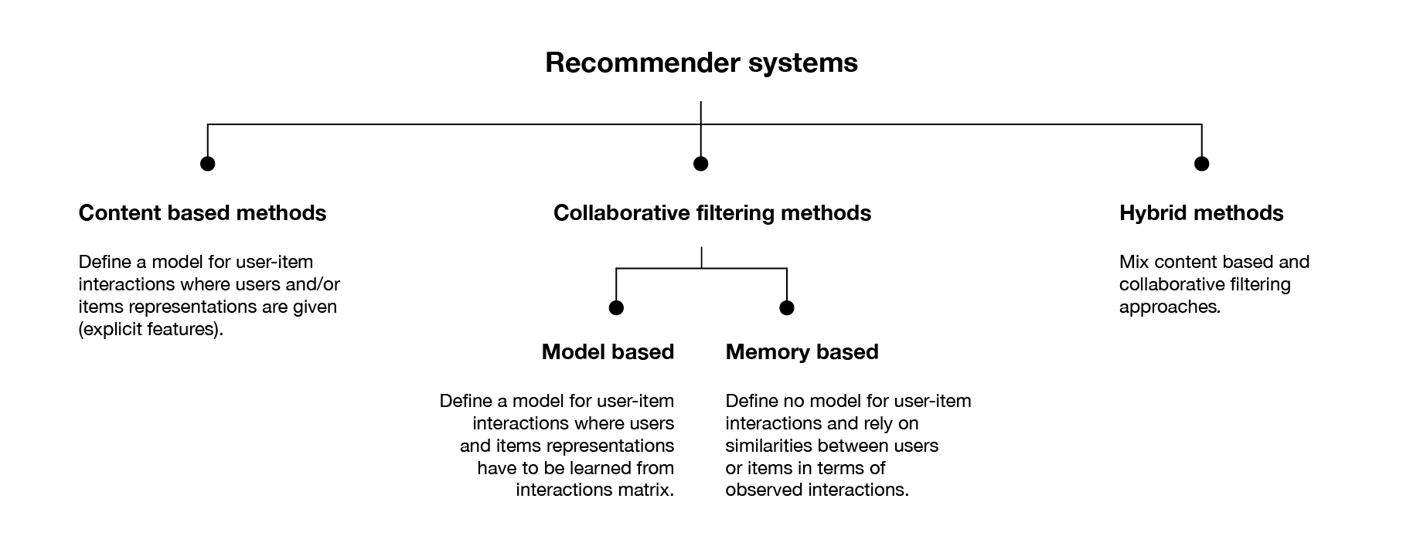
How do traditional Recommendation Systems work?

Slide 4
How do traditional Recommendation Systems work?
Content Based
Use labels to do prediction
Collaborative Filtering
Memory Based
No pre-training, make predictions based on data
Model Based
Train the model based on data, then make predictions using this model
Hybrid Methods
Taking advantage of both Models and Labels

Slide 5

What we want to do
Negative Recommendation
The target is to find the items that user dislike
This way we can reduce the search space for further predictions

Slide 6

How we do it
Model
Matrix factorization
Error Function
Inverse of Mean square error
Optimizer
Stochastic Gradient Descent

Slide 7
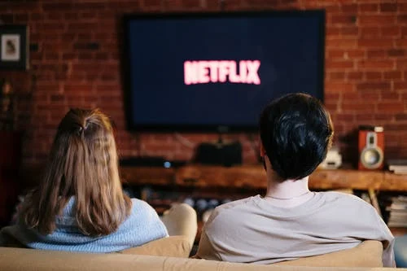
Dataset we are using
Parquet format
We trimmed our dataset size
from 2GB to 300MB
Netflix Rating Dataset
12,000 movies
480,000 users
66,000,000 ratings
Notes:
EDA stuff here :
Don’t say exact numbers, round pls
Total number of rating: 66,663,300
Total number of users: 479,101
total number of movie: 12,171
Concise happy numbers:
Almost 500,000 users gave 66 million ratings on 12k different movies.

Slide 8


New Idea-Algorithms for Sports Games
Battles generated based on different ratings for the same item
Each (X, y) is a battle between two features in X and we mark the winner feature to be 1, loser feature -1, tie or other features 0
y is the created score of the team, which can indicate the importance of this battle
Then use LR or some other models

Slide 9
Closing remarks
Negative Recommendations can unlock novel use cases not served effectively by other anomaly detection algorithms
Negative Reinforcement in the psychological sense to persuade users/people to leave an application
Developing negative rewards in RL
Notes:
We are currently working on results and can circle back to you on our findings at a later point.

Slide 10
References
https://blog.fastforwardlabs.com/2018/04/10/pytorch-for-recommenders-101.html
https://www.researchgate.net/publication/274323737_Ranking_rankings_An_empirical_comparison_of_the_predictive_power_of_sports_ranking_methods

