Slide 1

Planck scale physics
W'
SUSY
Higgs doublets
extra dimensions
Z'
Measurement of Top Spin Asymmetries in t-channel Single Top Quark Production
Master Colloquium
Matthias Komm

Slide 2
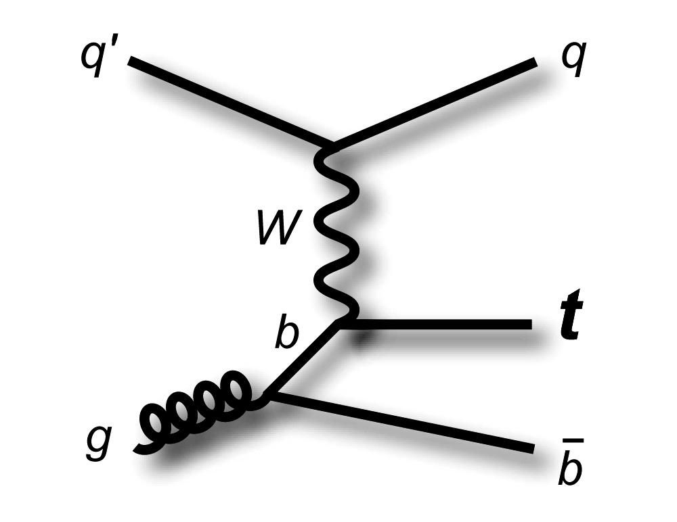
Introduction
outline
  theory
    top quark & Standard Model (SM)
    anomalous couplings
    top quark spin asymmetries
    simulation of anom. couplings
  event signature & selection
  analysis strategy
    multivariate classification
    unfolding
  measurement
    procedure & optimization
    systematic uncertainties
    results
    limits to anom. couplings
  conclusion
motivation
Planck scale physics
W'
new particles or
interactions
SUSY
Higgs doublets
Z'
extra dimensions
energy
scale
anomalous couplings
may influence
Standard Model (SM) expectations
top quark spin asymmetries in
single top
quark t-channel
production

Slide 3

Theory
Standard Model electroweak top quark couplings
  Lagrangian
  projection operator allows only couplings to
  left-handed fermions
  Wtb-vertex has a V-A structure influences kinematics (angles!)
what about possible new physics?
vector
axialvector

Slide 4
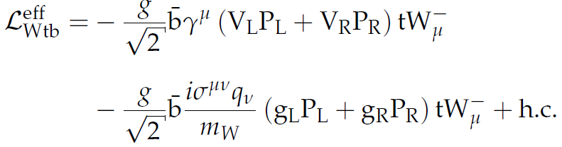
Effective Extension
anomalous top quark couplings
(in SM: )
Lagrangian
quantize top quark spin
  differential cross section
  angle between spin analyzer X (top quark decay product) and spin basis
  B in top rest frame
  polarization denotes how often top spin coincide with spin basis B
  spin analyzing power depends on anomalous couplings

Slide 5
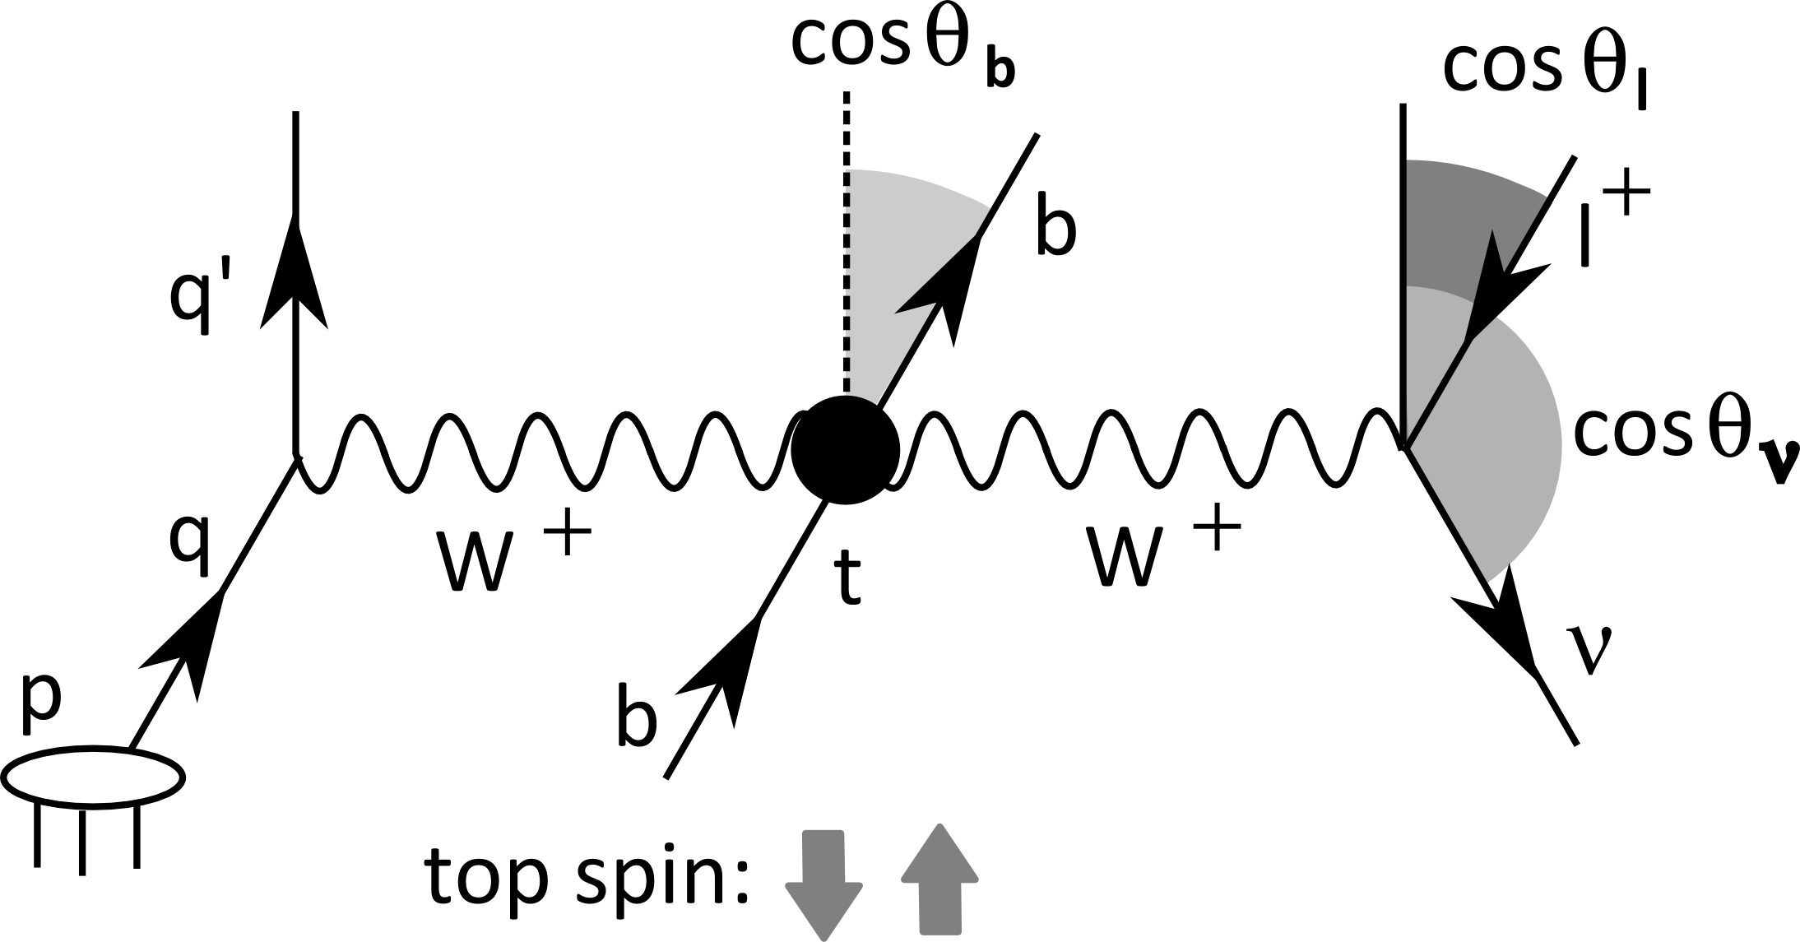
Top Quark Spin Asymmetries
definition
analysis:
  t-channel single top quark production
  spin analyzer X = muon, bottom quark,
  neutrino
  spin basis B = spectator quark, beamline
    (high polarization ~ 99%)
observables
spectator
beamline
 |  | spin analyzer
 |  | muon | bottom quark | neutrino
spin basis | spectator basis
 | beamline basis

Slide 6
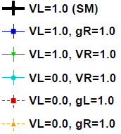
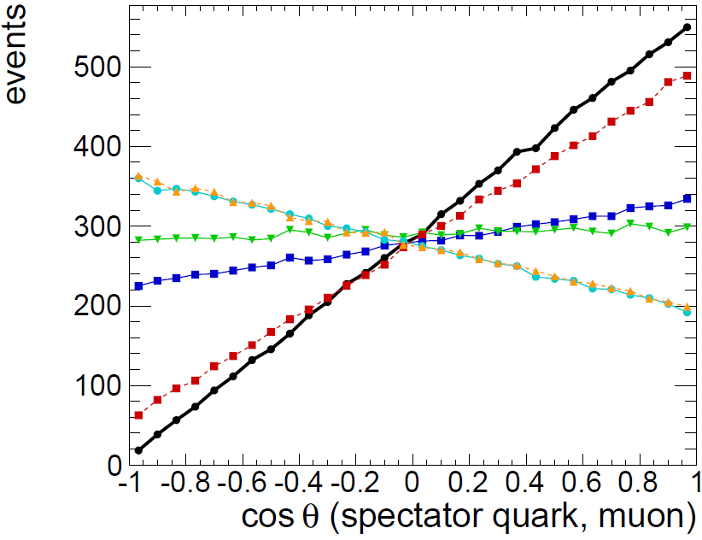
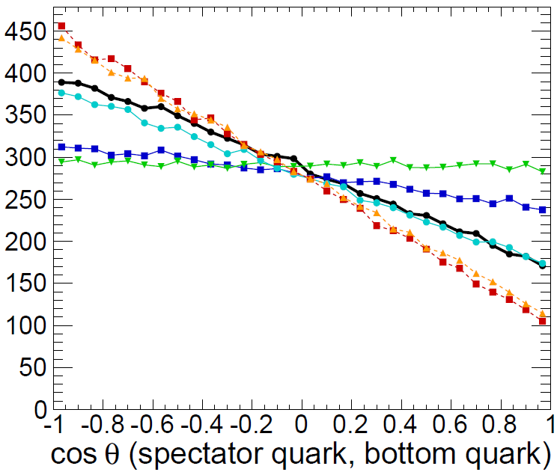
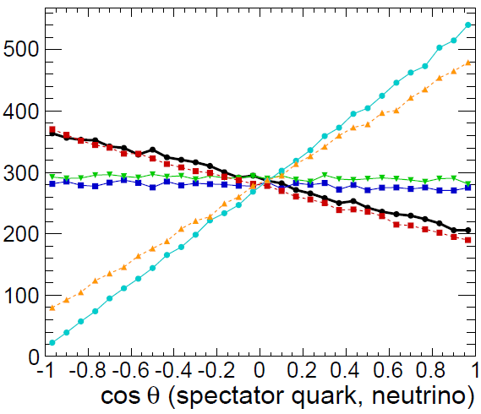
Simulation of anom. couplings
WHIZARD MC leading order event generator
  generate inclusive single top quark t-channel process
  interfaced with TAUOLA event generator for subsequent tau decays
  FastSim for CMS detector simulation
some generated coupling scenarios
  in total: 8 simulated coupling scenarios are used to cross check the analysis

Slide 7
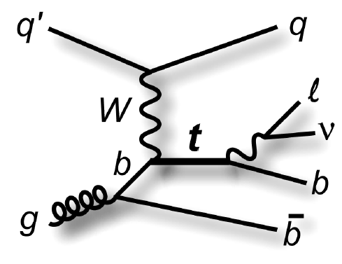
Event Signature & Samples
single top quark t-channel production (signal process)
background processes
  dominant
  tt-pair production, W+jets,
  minor
  single top quark s-, tW-channel production, Drell-Yan (Z/ +jets), diboson
data
  of pp-collision at 7 TeV from first half of 2011 recorded by CMS
light jet (mostly from u,d,s quarks); also called spectator
charged lepton (here: muon)
missing transverse energy (MET)
1st b-tagged jet
2nd b-tagged jet (mostly not in detector acceptance)

Slide 8
Event Selection
muon
    transverse momentum > 20 GeV
    within pseudorapidity range of
    relative isolation of < 0.15 within cone of R=0.4
    additional quality requirements
    exactly one muon, veto against additional leptons
MET
jets
    transverse momentum > 30 GeV
    within pseudorapidity range of
    additional quality requirements (e.g. neutral, and charged EM fractions < 0.99)
b-tagging:
    track counting high purity algorithm (TCHP) with its tight working point of 3.41
    b-tagged jet measured within the tracker ( )
2 jets with 1 b-tag category

Slide 9
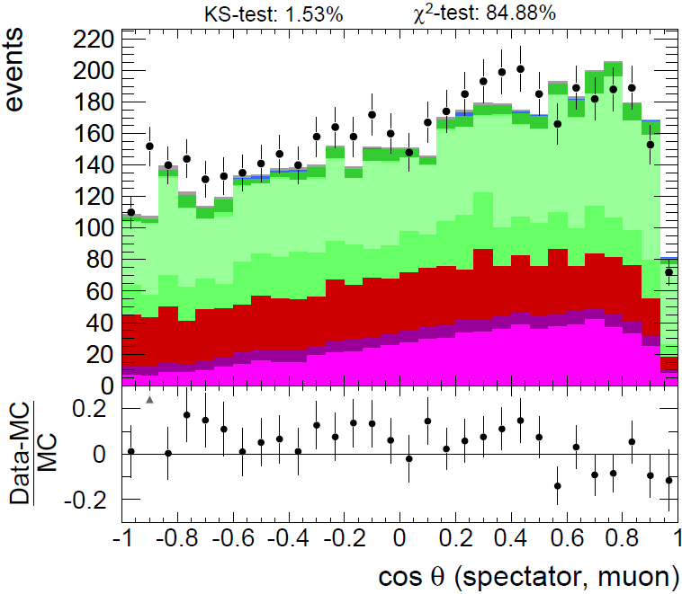
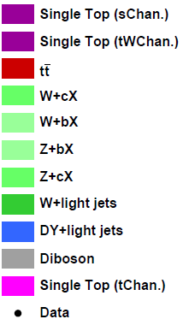
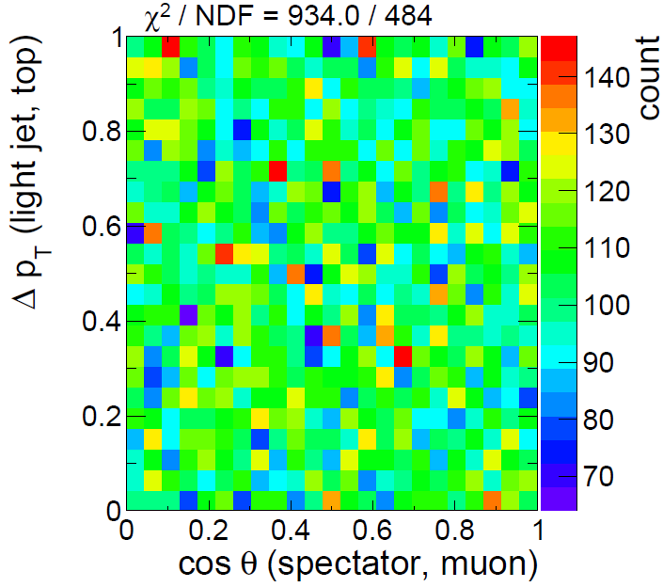
Analysis Strategy
after event selection
  still very high
  contributions
  from background
  processes
train Boosted Decision Trees (BDT)
  find independent variables
  to angular distributions
  suppresses potential bias
  input = sets of 5,10,15..100
  uncorrelated variables
  [1]
  test compatibility
  with 2d uniform
  distribution
[1] Michael Feindt et. al. , An algorithm for quantifying dependence in multivariate data sets, arXiv:1207.0981 [physics.data-an]

Slide 10
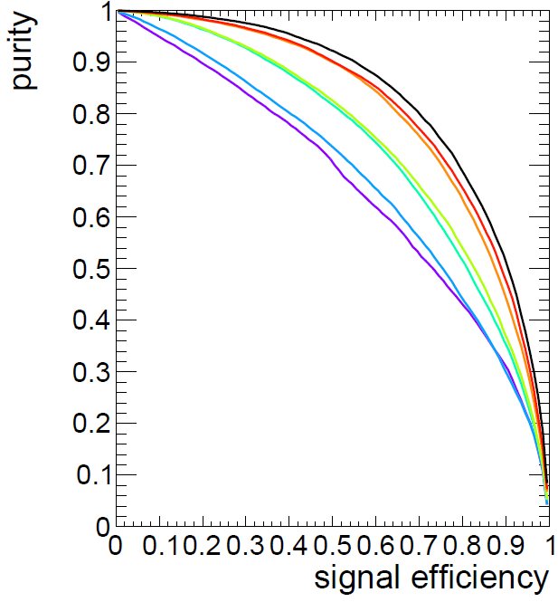
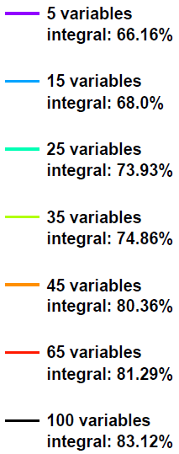
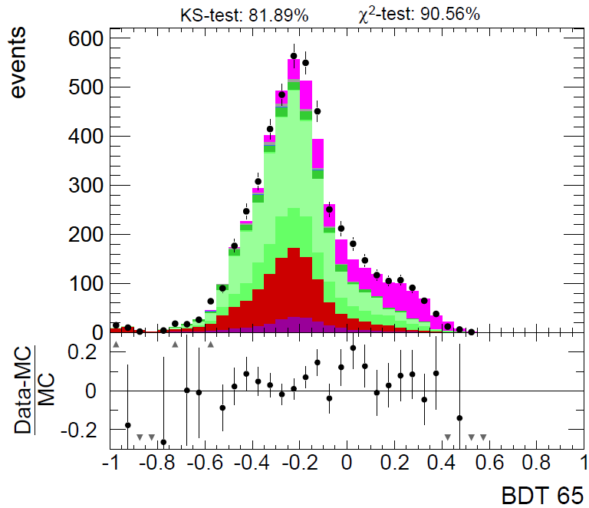
Multivariate Classification
ROC curves
  integral measures separation power
  saturation effect > 45 variables
exemplary discriminator output
  select signal enhanced
  phase space
  find tradeoff: high discrimination
  power, low correlation to
  angular distributions
  optimization
working
point

Slide 11
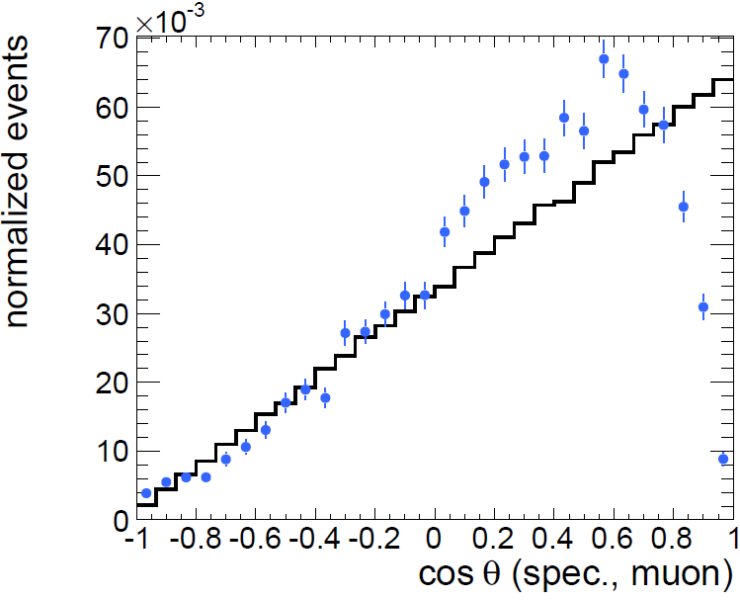

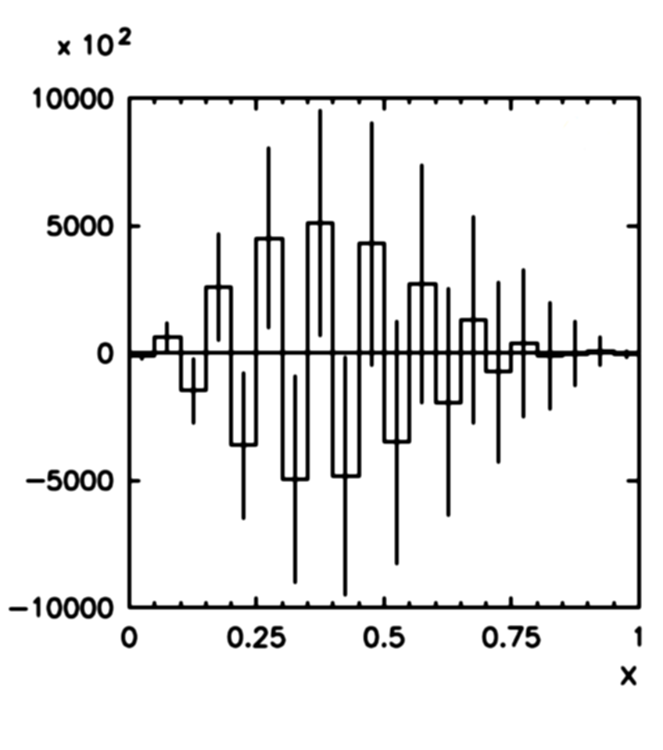
Analysis Strategy (2)
Unfolding
  correct for selection, reconstruction, & resolution effects
Challenge
  simple inversion oscillations [1]
folding
discretization
response
matrix
measured
distribution
resolution
function
true
distribution
unfolding
[1] Glen Cowan, A survey of unfolding methods for particle physics, p248, Proc. Conf. on Advanced Statistical Techniques in Particle Physics

Slide 12
Regularized Unfolding
singular value decomposition (SVD)
  exemplary response matrix
  SVD:
unfolding
  solution:
  suppress oscillations by regulariztion
diagonal
matrix
- statistical fluctuations are
unphysically amplified
- negative correlation
oscillations!
problem for
estimate regularization
parameter
covariance
matrix
suppress large curvatures
through 2nd derivatives in L

Slide 13
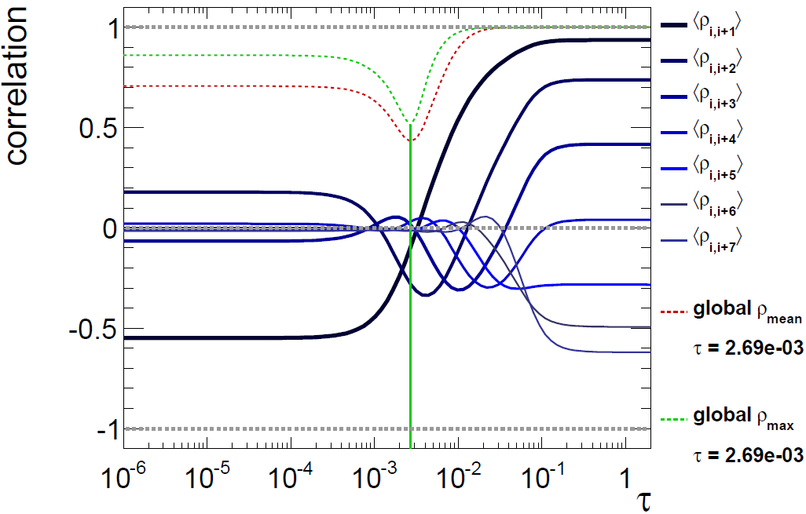
Regularization Estimation
bin-by-bin correlations
large negative
correlations not
sufficiently
suppressed
distribution biased
towards solution
with smallest
curvature
choose with respect to minimal
global correlation coefficients

Slide 14
Measurement Procedure
simulated background
samples
WHIZARD anomalous
coupling samples
BDT
discriminator
construct response
matrix
pseudo experiments
within sys. + stat.
uncertainties
estimate
regularization
probability
distribution for
asymmetry
unfolding
calculate asymmetry
unfolded
asymmetry
Neyman construction
generated
asymmetry

Slide 15
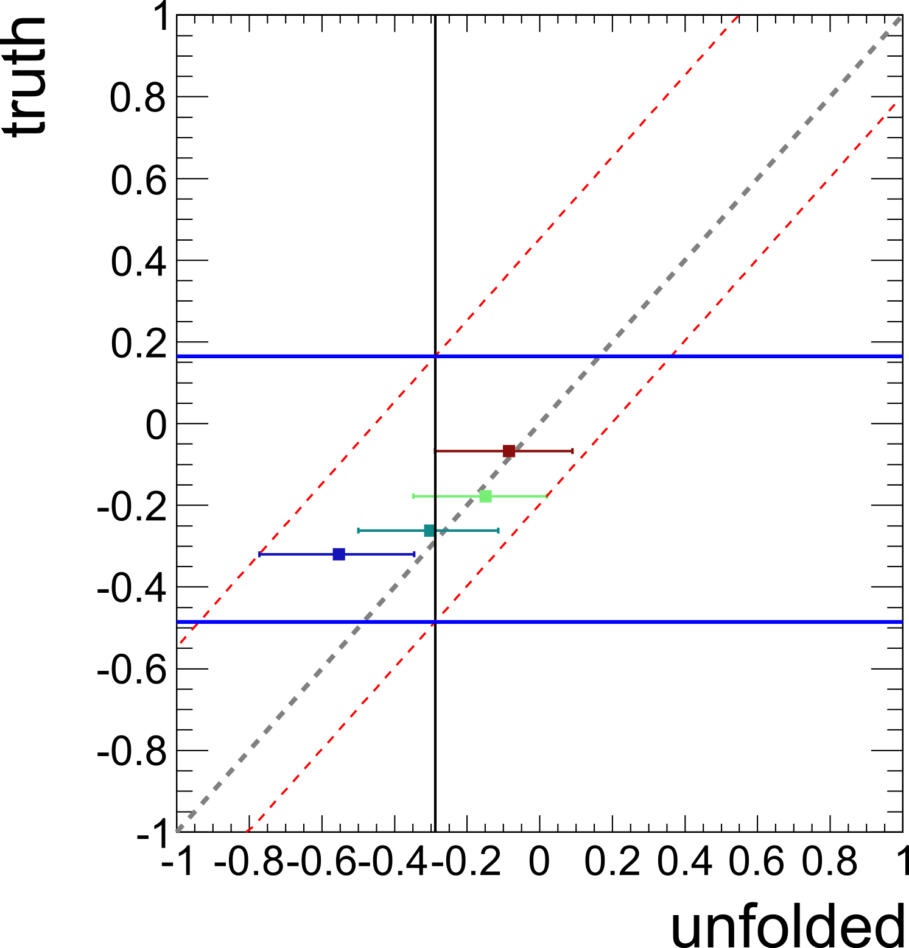
Neyman Construction
example
- uncertainty belt
through max 68% quantiles
among all scenarios,
- only discrete scenarios tested
conservative estimation
significance
different anomalous
coupling scenarios
SM
uncertainty on asymmetry
measurement
asymmetry from
unfolded data
angle
bisector

Slide 16
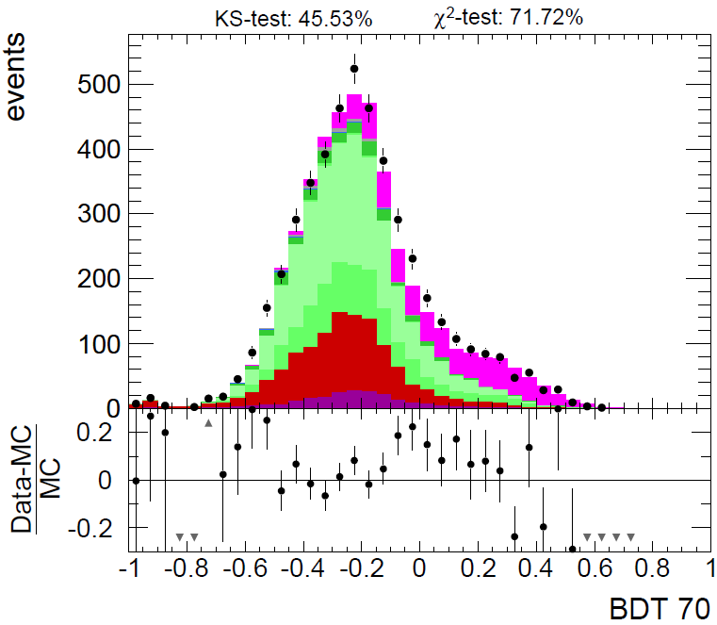
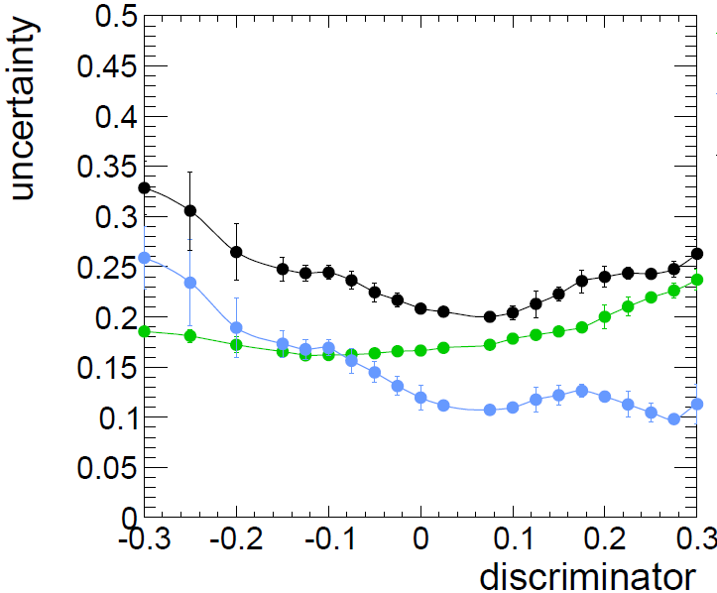
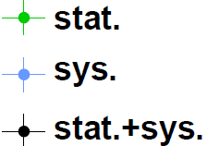
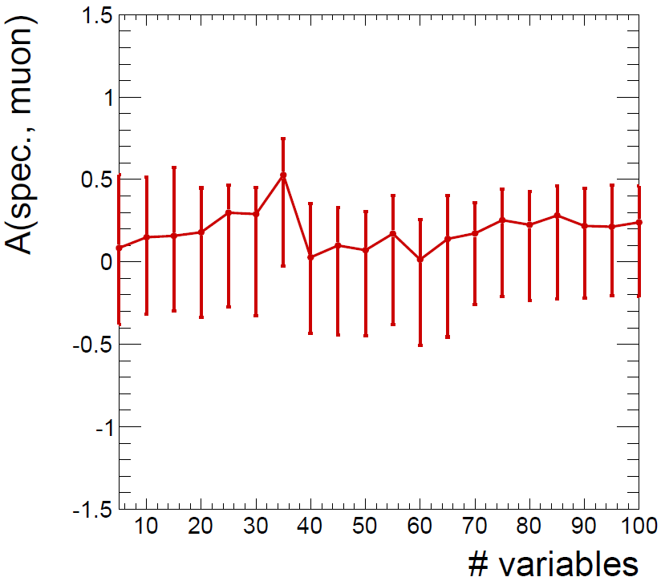
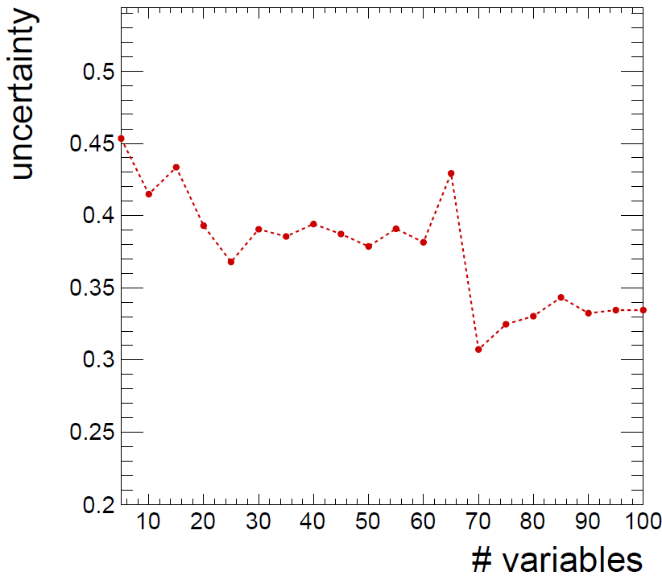
Optimization
tradeoff between
stat. & sys. uncertainties
best BDT working points
best BDT (5,10,15,...100)
minimum
scan all BDTs for
minimal uncertainty on
unfolded asymmetry
perform
measurement
for all BDTs at
their best working
points
minimum
best result with BDT
trained with 70 variables
and working point
of 0.075

Slide 17
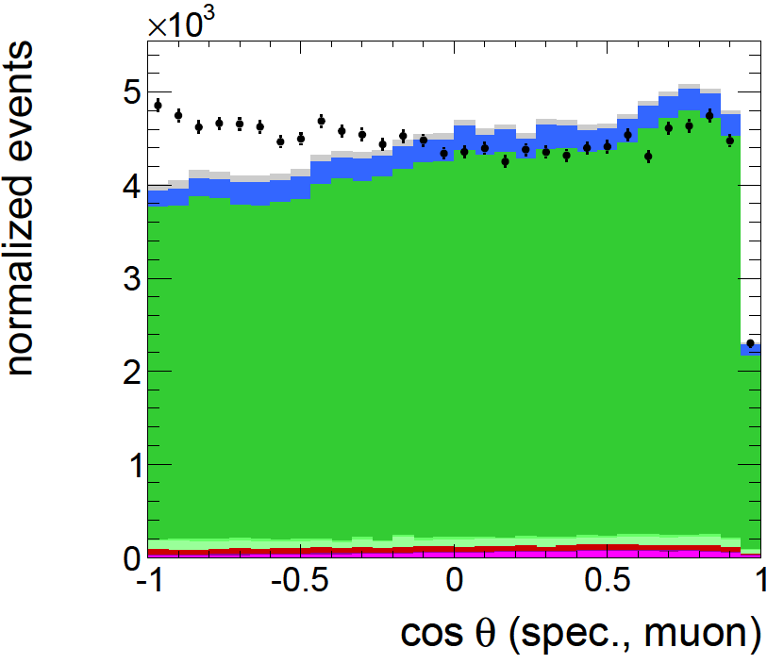
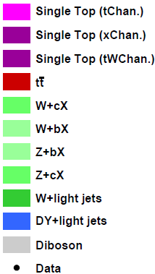
Systematic Uncertainties
sources
  jet energy scale
  jet energy resolution
  b-tagging/ mis-tagging efficiencies: migration of events between number of
  b-tagged jet categories
  unclustered energy: variations of the missing transverse energy
  pile up: reweighting of simulated events to the number of interactions estimated in data
  W+jet shape: mismodeled shape in 2 jets and
  0 b-tagged jet control region
  luminosity measurement: 2,2%
  muon trigger, id, & isolation efficiency: 3%
  event yields on signal and background:
  signal: 10%, single top quark s-, tW-channel,
  DY+jets, diboson: 30%, tt-pair: 15%,
  W+light jets: 50%, W+c flavored jet: 100%,
  W+b flavored jet: 100%
  control region

Slide 18
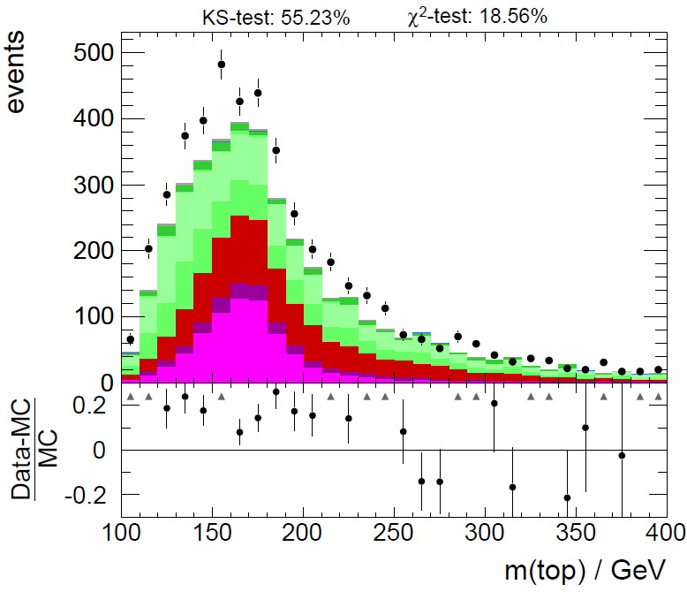
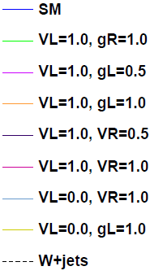
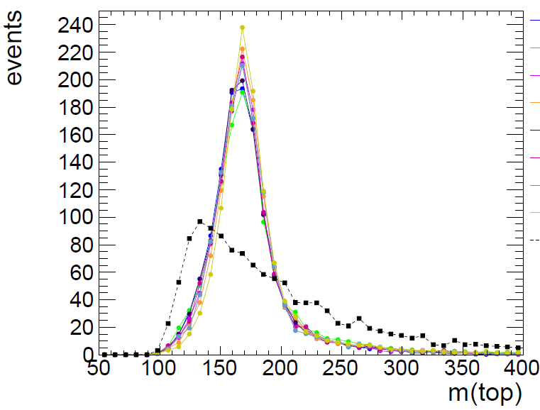
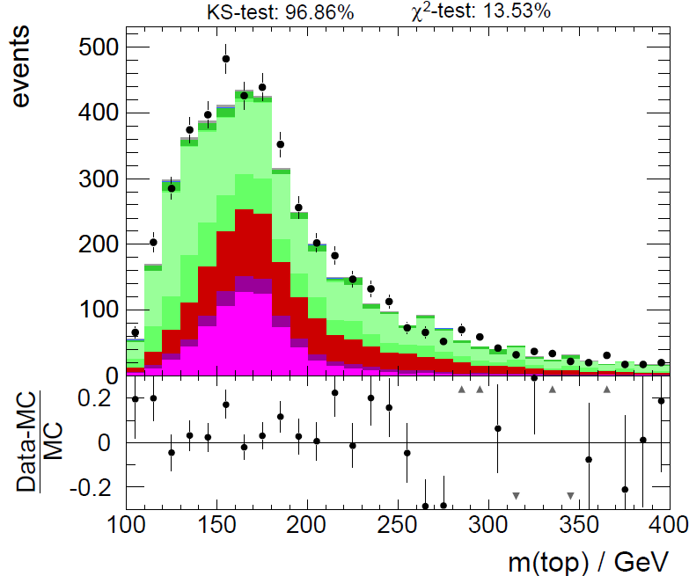
Data-Driven W+jets Estimation
maximum likelihood fit to top quark mass distribution
result:
  underestimated W+b flavored jet
  background by factor of 1.65,
  W+bX uncertainty: 100% 52%
  W+cX uncertainty: 100% 60%
  uncertainties correlated: -0.86
pre-fit
- compare W+jets & signal:
different shape
independent constraint
- no bias: same shape for
anom. coupl. scenarios
post-fit
good agreement
between simulation
and data now

Slide 19
Results

Slide 20
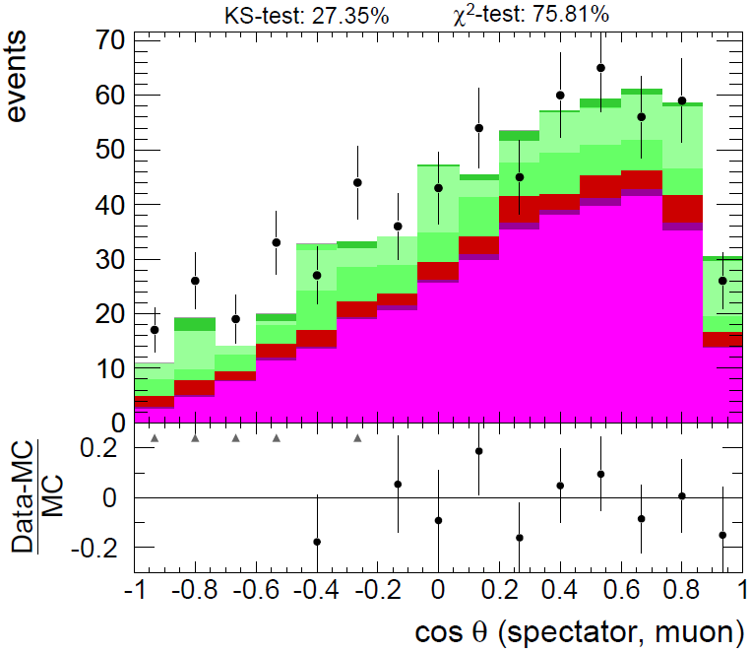

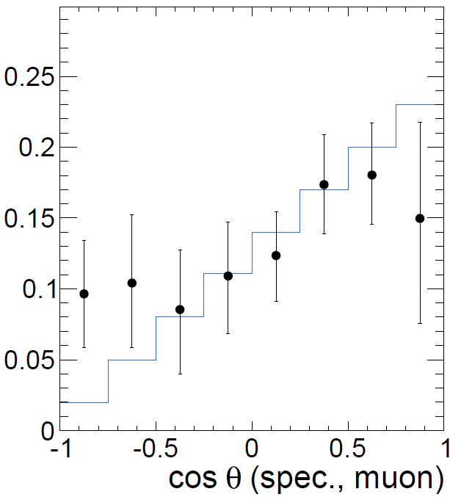
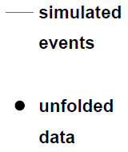
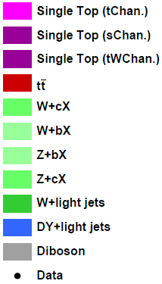
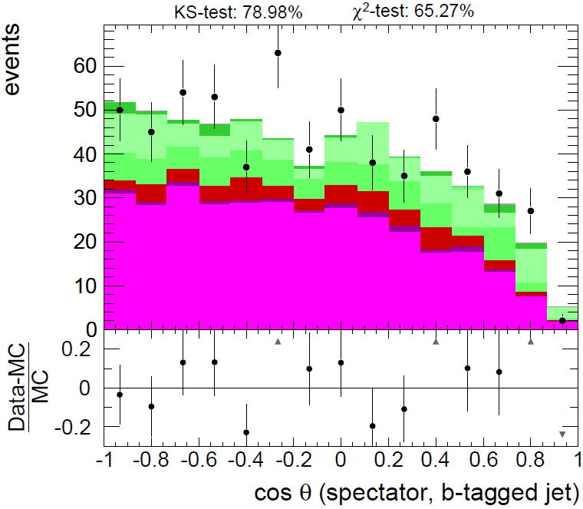
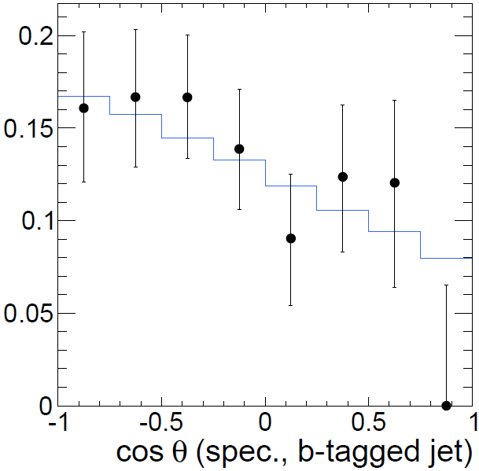
Unfolded distributions compared to SM
small
deviations
at -1.0
good
agreement

Slide 21
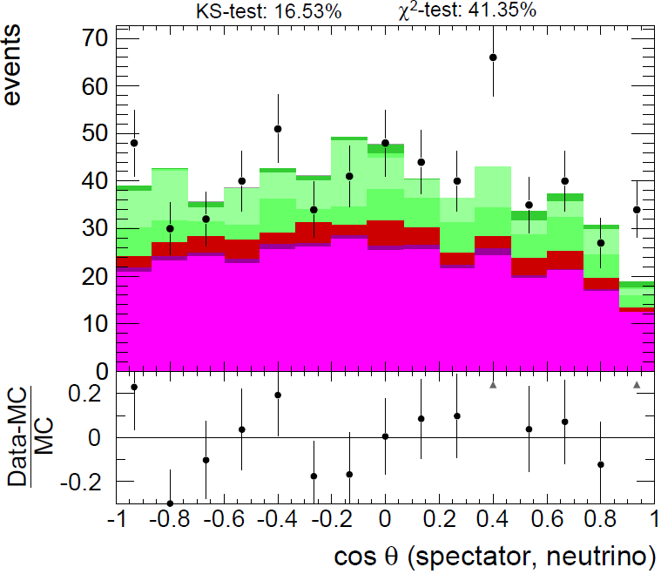
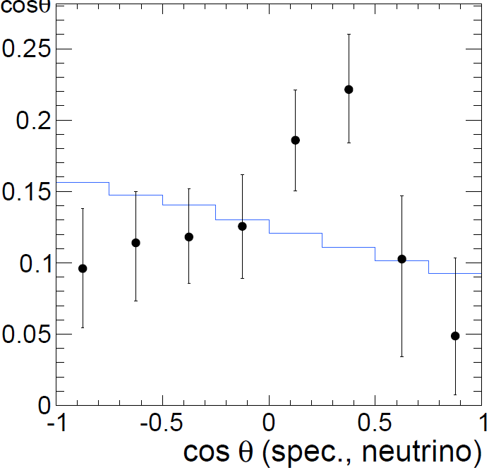
Unfolded distributions compared to SM (2)
compatible with SM

Slide 22
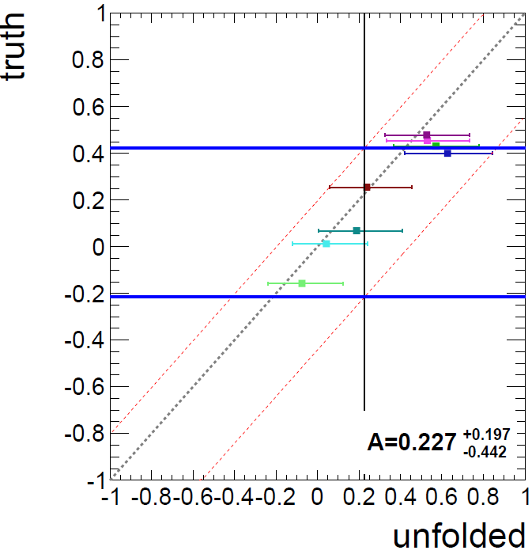
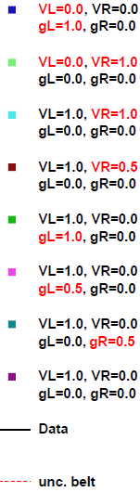
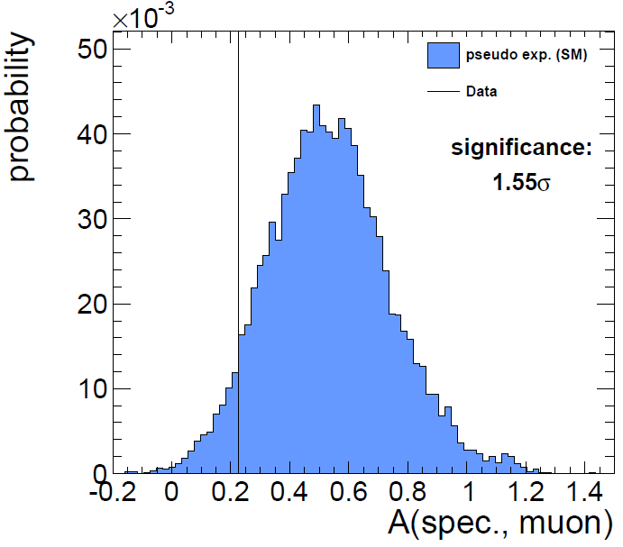

Top Quark Spin Asymmetries
significance with SM in the spectator basis
  muon spin analyzer:
  b-tagged jet spin analyzer:
  neutrino spin analyzer:
  well compatible with the SM expectation
 |  | spin analyzer
 |  | muon | bottom quark | neutrino
spectator basis | theo.
 | meas.
beamline basis | theo.
 | meas.
spectator muon:

Slide 23
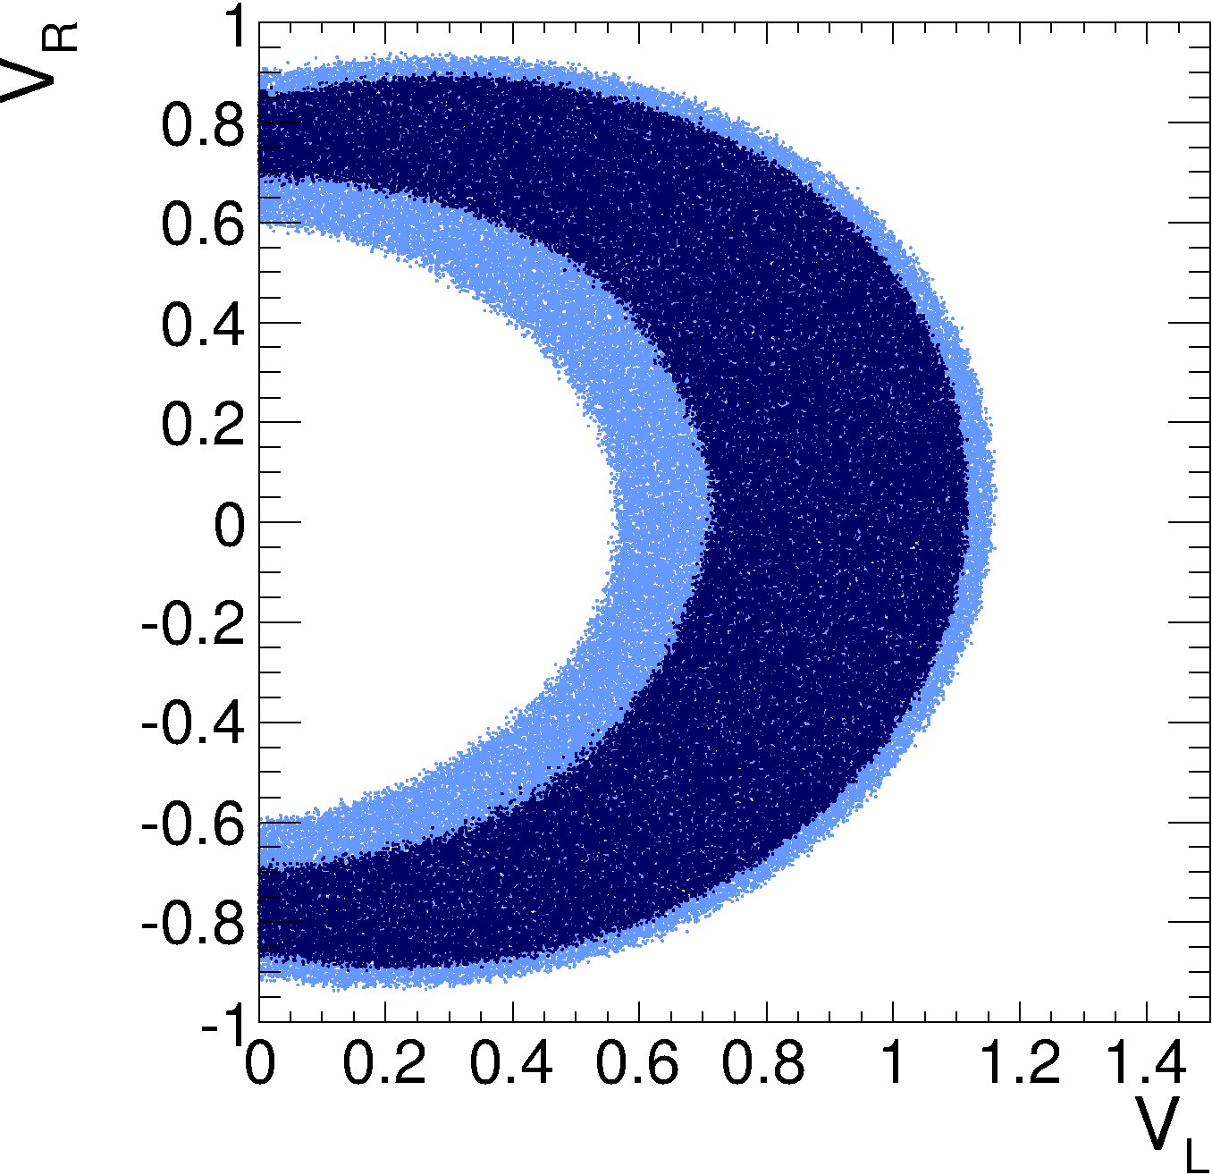
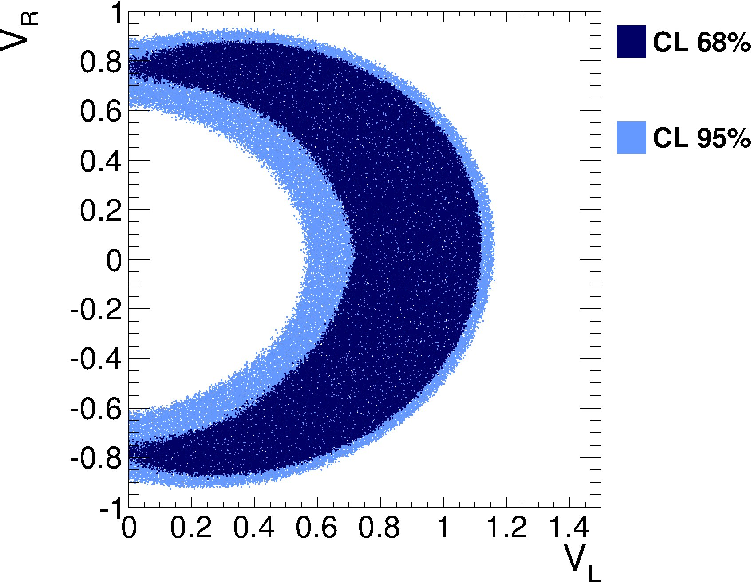
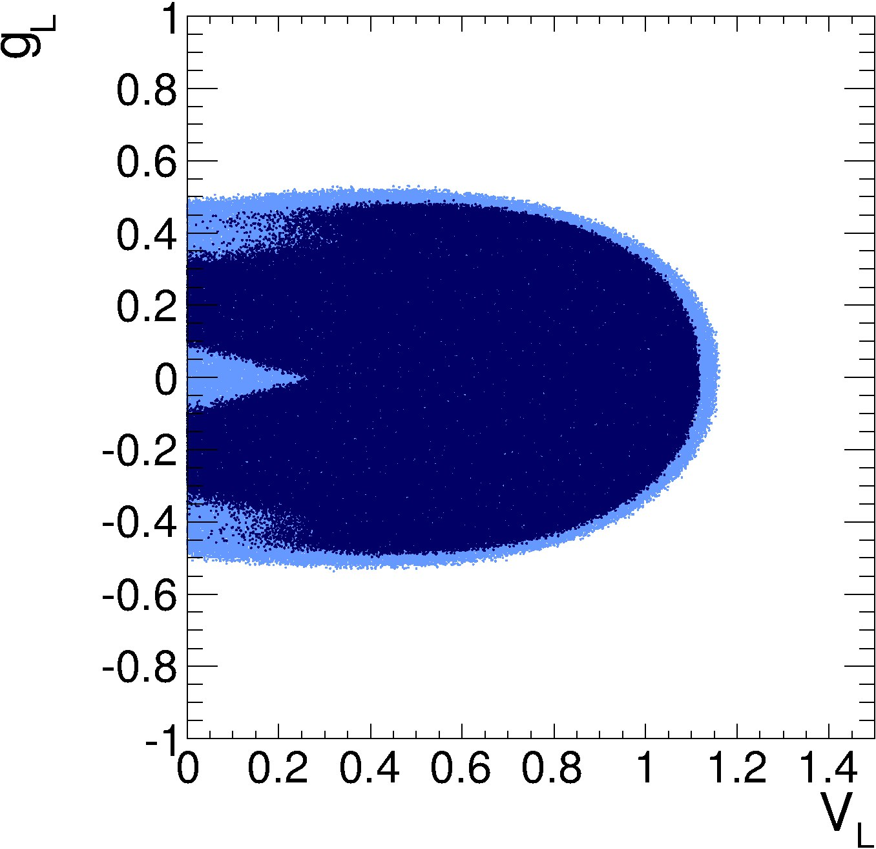
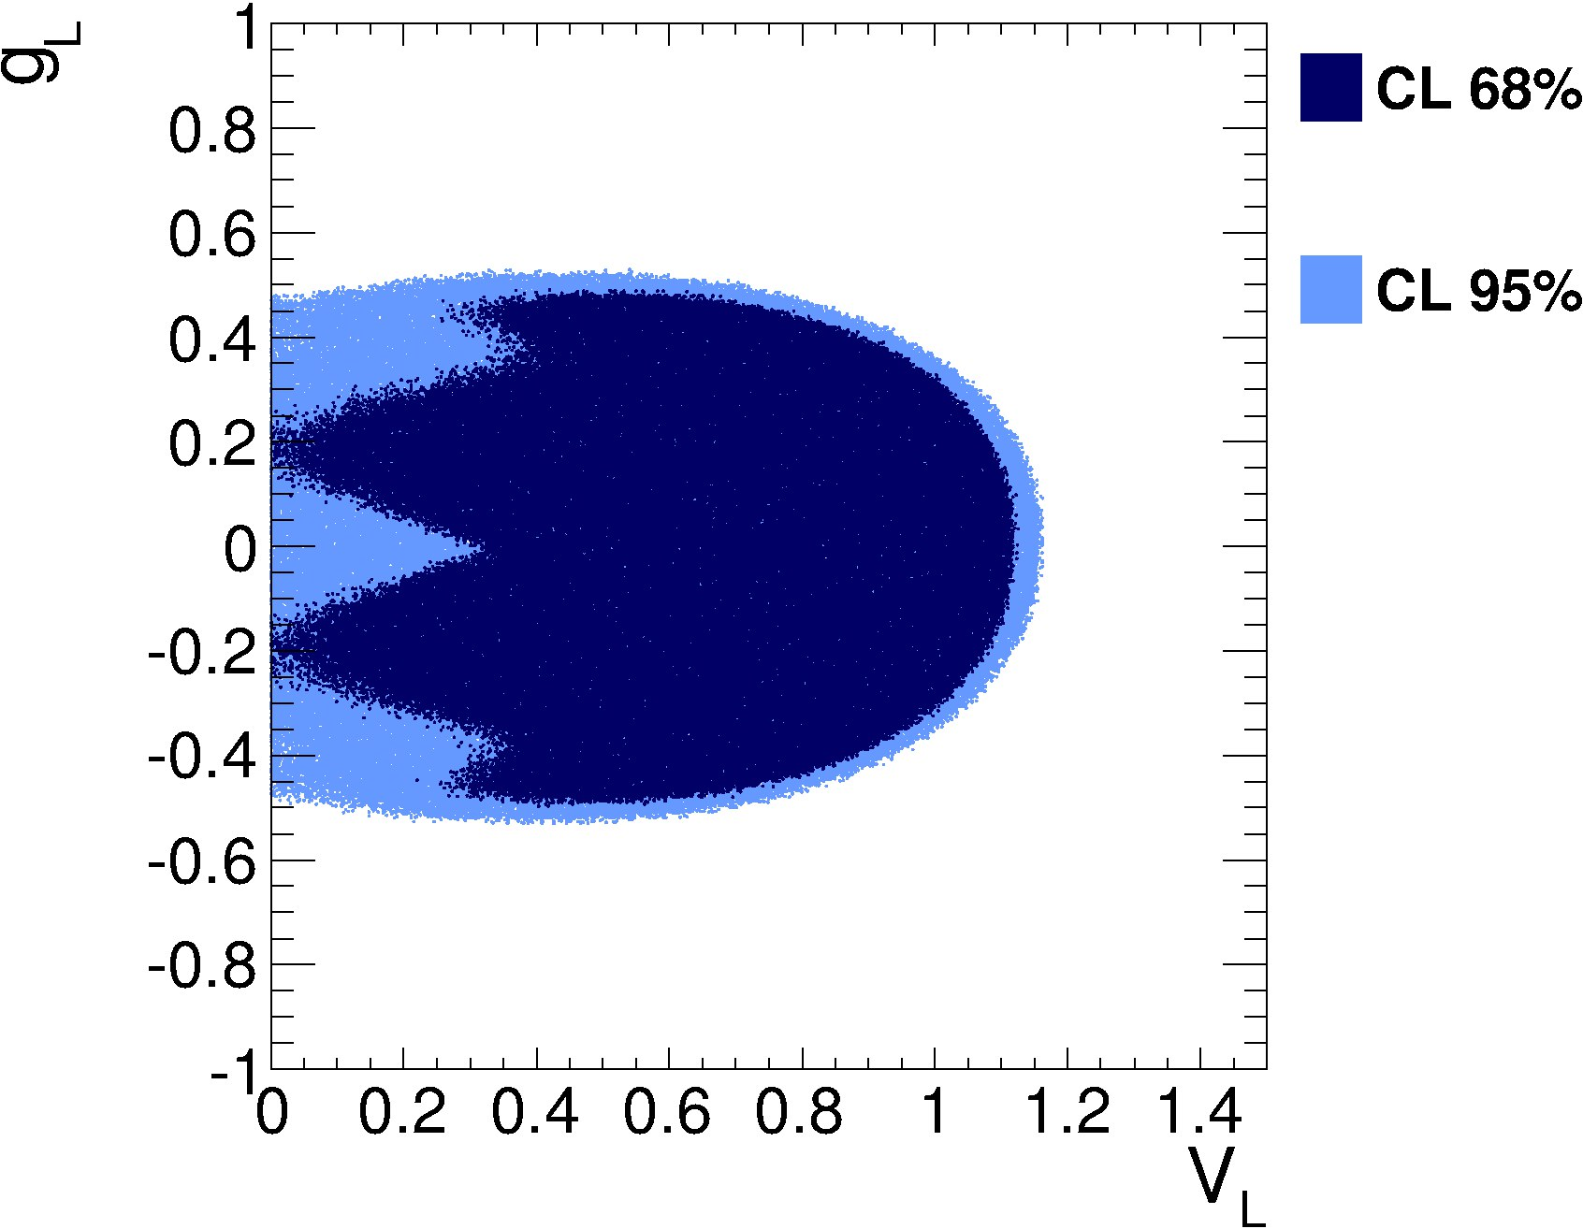
Limits
  without measured top quark spin asymmetries
  with measured top quark spin asymmetries
TopFit
  program for fitting anom.
  top quark couplings
input:
  single top quark t-,tW-channel
  cross section [1,2]
  W boson helicity
  fractions [3]
  asymmetries from
  muon, b-tagged jet in
  spectator basis
  already sensitive to with
[1] CMS Collaboration, Measurement of the single-top-quark t-channel cross section in pp collisions at sqrt(s) = 7 TeV, arXiv:1209.4533 [hep-ex]
[2] CMS Collaboration, Evidence for associated production of a single top quark and W boson in pp collisions at 7 TeV, arXiv:1209.3489 [hep-ex]
[3] CMS Collaboration, W helicity in top pair events, CMS Physics Analysis Summary CMS-PAS-TOP-11-020

Slide 24
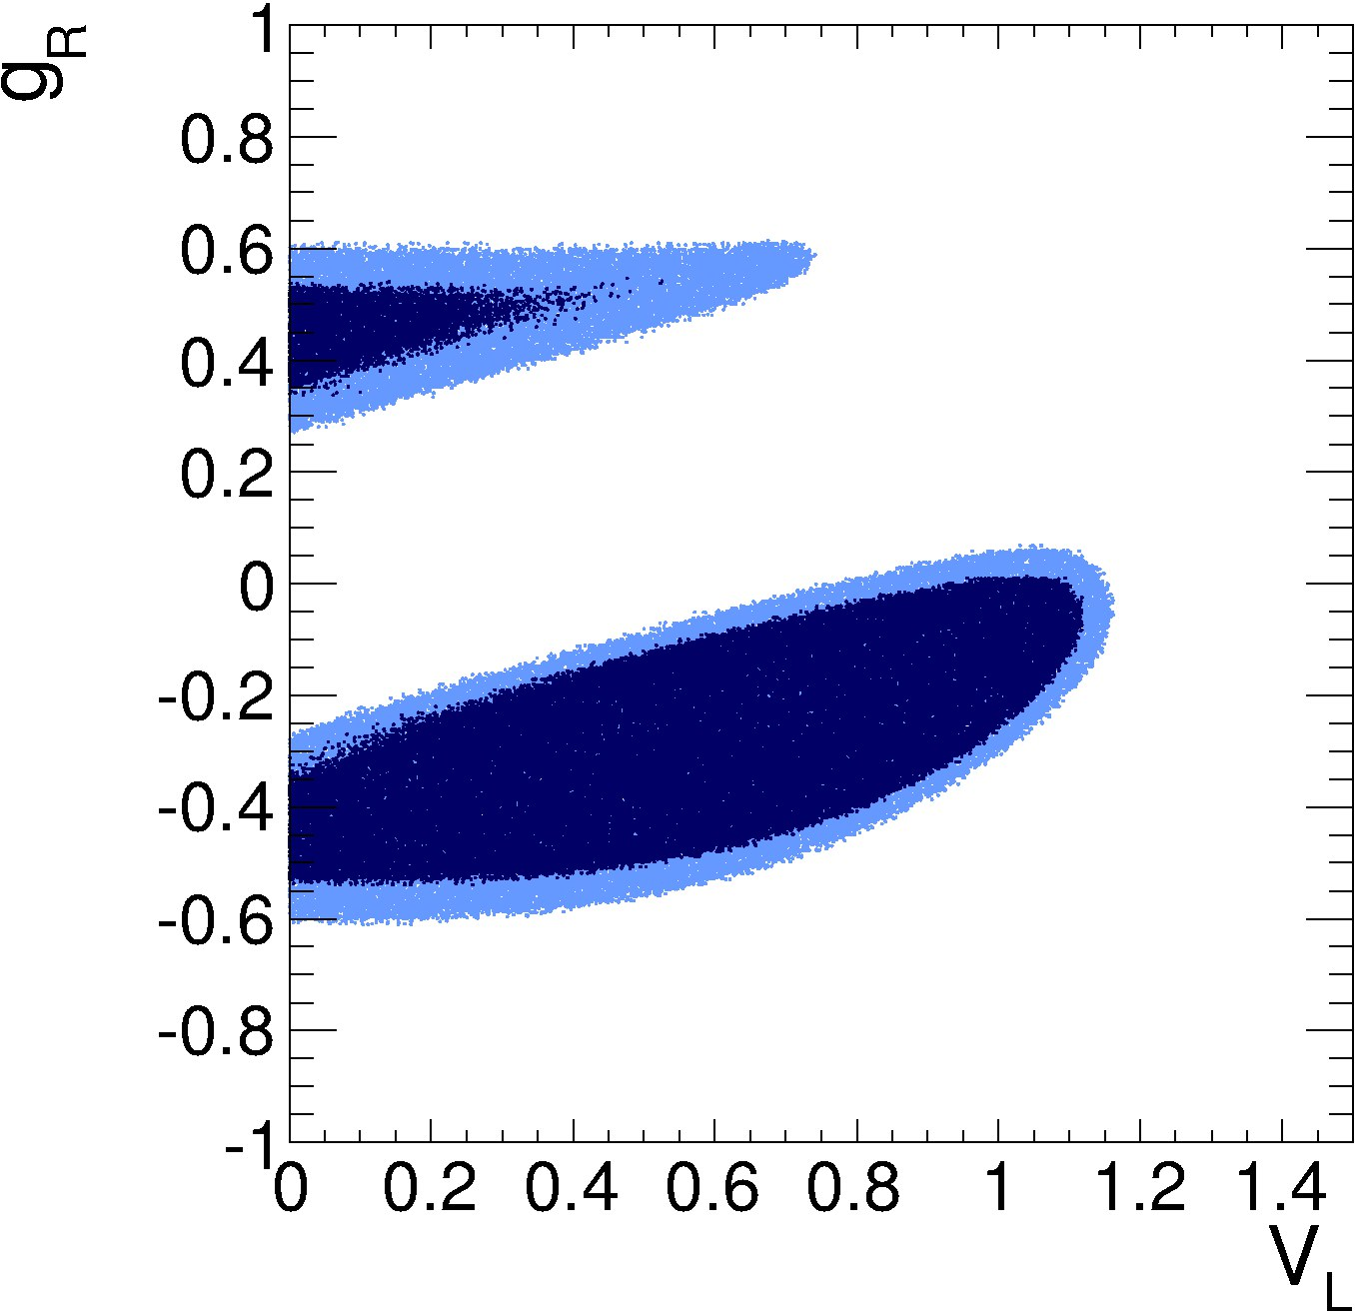
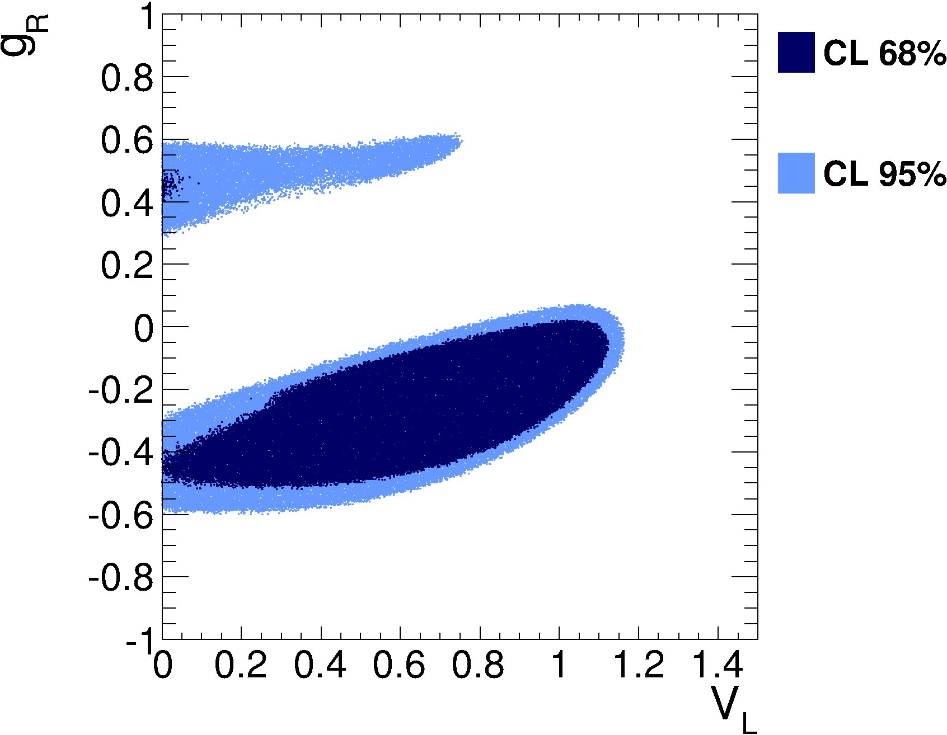
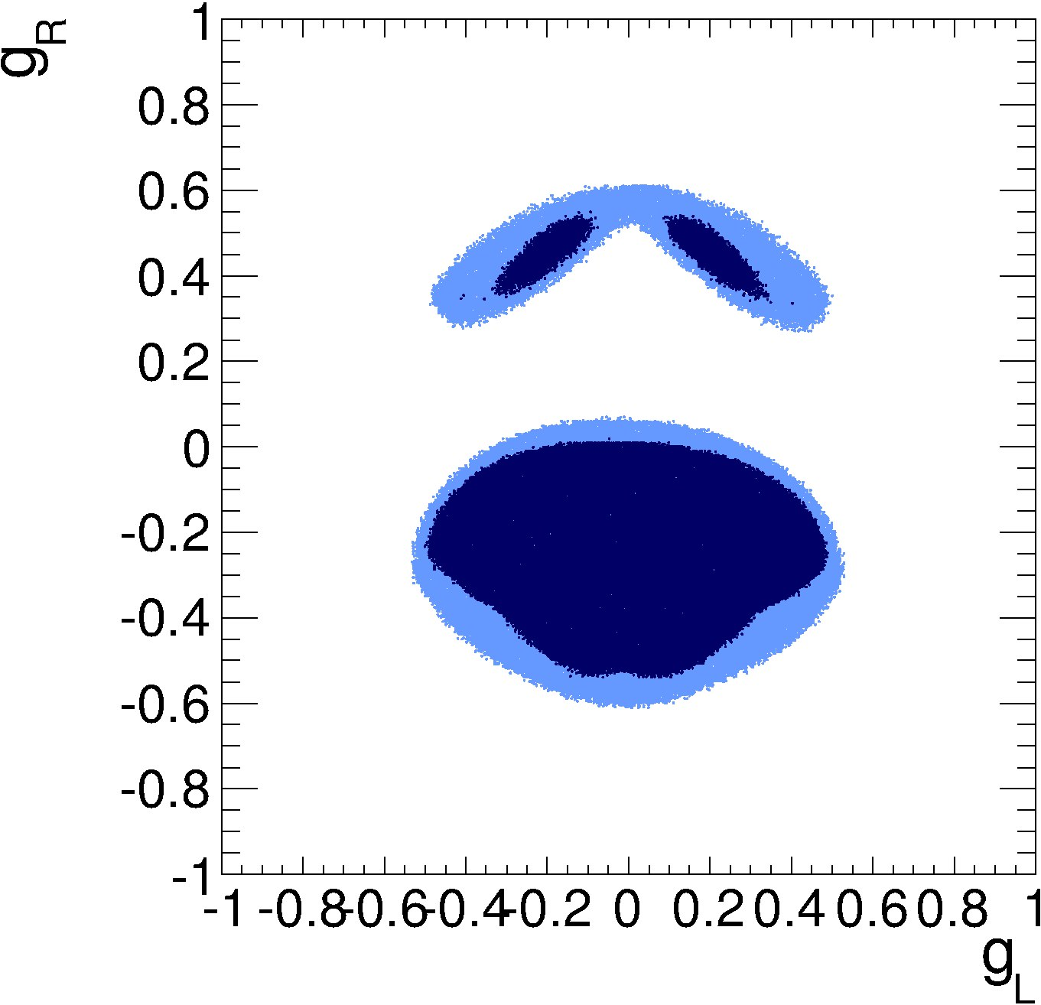
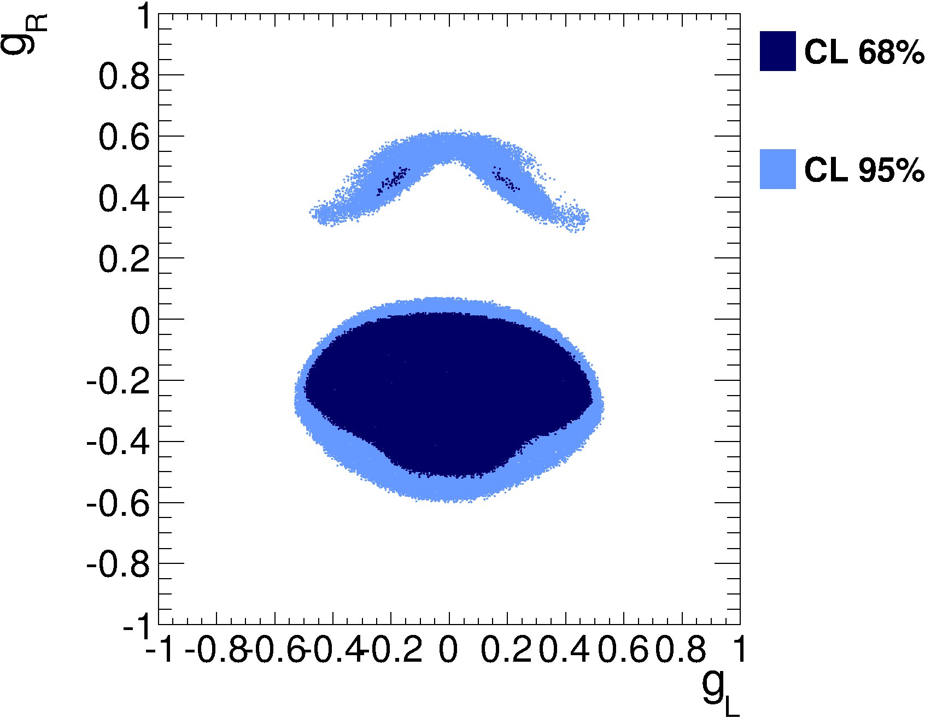
Limits (2)
  without measured top quark spin asymmetries
  with measured top quark spin asymmetries
coupling space extremely constrained when using results from this measurement!

Slide 25
Conclusion
  developed new analysis strategy
    multivariate classification for signal and background separation
    unfolding to correct for reconstruction & detector effects
    cross check procedure with simulated anomalous coupling samples
    with WHIZARD
  first measurement of top quark spin asymmetries
    minimal uncertainties by finding optimal analysis parameters
    measurement well compatible with Standard Model expectation
  improved limits on anomalous couplings
 | muon | bottom quark | neutrino
spectator basis
beamline basis

Slide 26
Backup

Slide 27
Event Selection
muon
    transverse momentum > 20 GeV
    within pseudorapidity range of
    less than < 0.02cm away from beamspot (2D impact parameter)
    relative isolation of < 0.15 within cone of R=0.4
    “Global Muon”
    > 10 hits in inner tracker
    at least 1 hit in pixel tracker
    veto against addition leptons
MET
jets
    transverse momentum > 30 GeV
    within pseudorapidity range of
    additional quality requirements (... neutral, and charged EM fractions < 0.99 ...)
b-tagging:
    track counting high purity (TCHP) with its tight working point of 3.41
    b-tagged jet measured within the tracker ( )

Slide 28
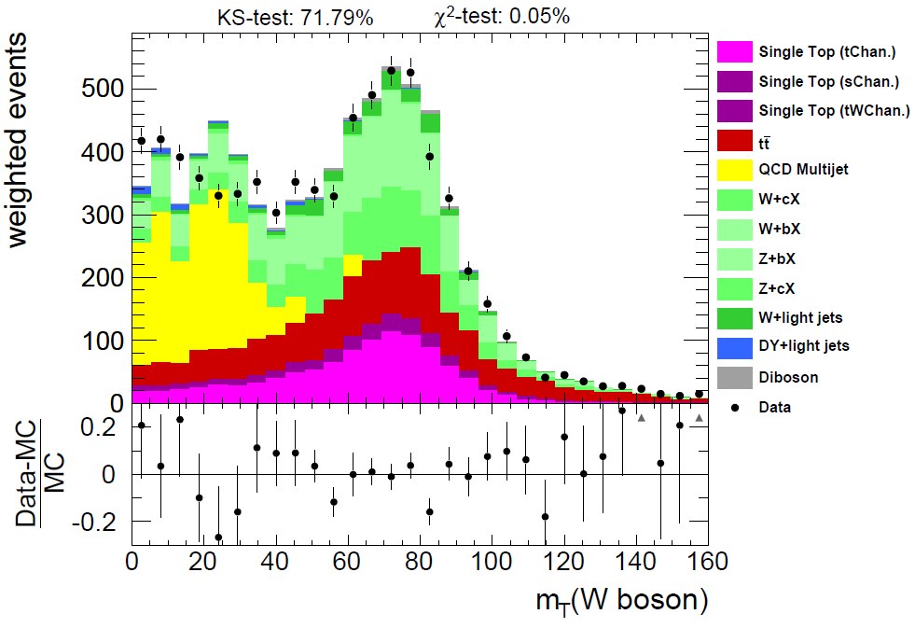
QCD background
distribution of transverse W boson mass
  QCD background after selection requirement MTW>40 GeV includes only very few MC events
  will result in large unphysical uncertainties
  simulation & data agree well, QCD background excluded!

Slide 29
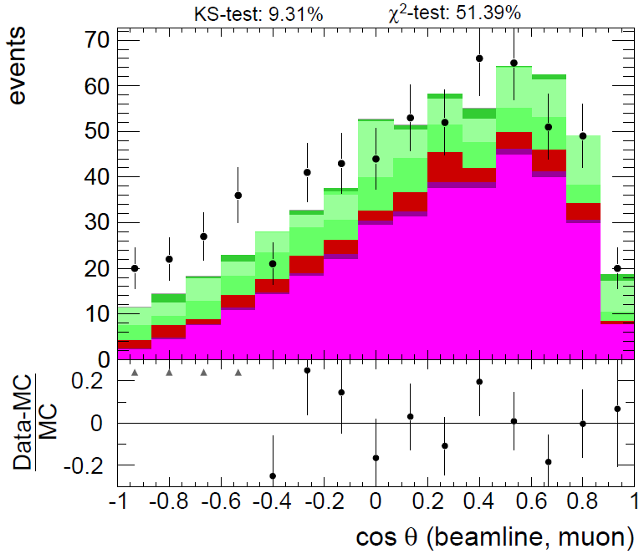







Slide 30



Slide 31





Neyman Construction
spectator muon
spectator b-tagged jet
spectator neutrino
beamline muon
beamline b-tagged jet
beamline neutrino

