Slide 1

How does Infectious Disease Propagate?
Presenter: Matthew Kwok

Slide 2
Why is this important?
One of the world’s deadliest problems
$8.3 billion (CAD) in total costs (Diener et al., 2016)
~ $8.7 billion (CAD) in today’s costs
High mortality rates

Slide 3
H1N1 (H1N1pdm09 virus/Swine Flu)
Type of deadly lung influenza (bacteria)
Particular strain discovered in 2009
Worldwide mortality:
152K – 575K deaths (first year)
80% for ages < 65
80% - 90% for ages ≥ 65
(CDC, 2019)

Slide 4
Classical Modelling Method
SIR (Susceptible, Infected & Recovered) - 1927
Developed by Kermack & Mckendrick
(Zhang, 2016)

Slide 5
Problems with Current & Old Modelling Methods
Does not account for spatial and microscopic variations
Long simulation times
Propagation of disease in
Public Transit
Workplace
Residential Areas
Environmental Influences
Pollution
Sanitation
Hygiene
(Zhang, 2016)

Slide 6
Objectives
Assessing risk of airborne infectious disease propagation in cities
Treat problem like a mass transport problem
Modelling based on SIR model
Considering both static and dynamical factors
Comprehensive Risk Analysis
(Zhang, 2016)

Slide 7
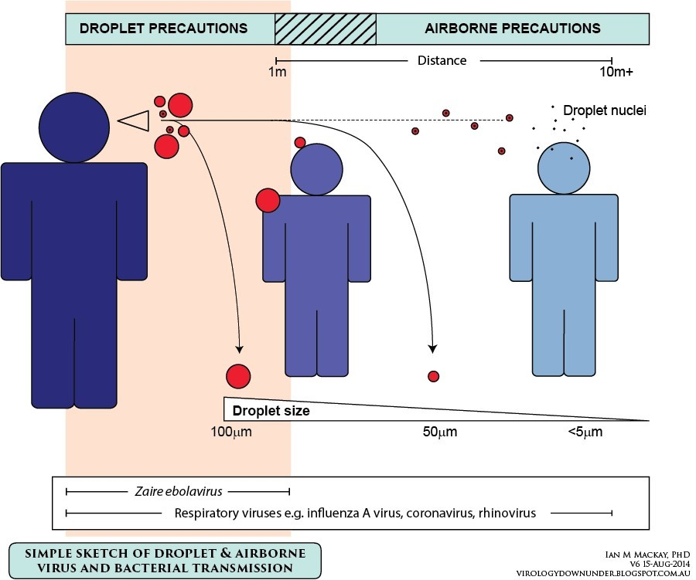
Infectious Disease Transmission

Slide 8
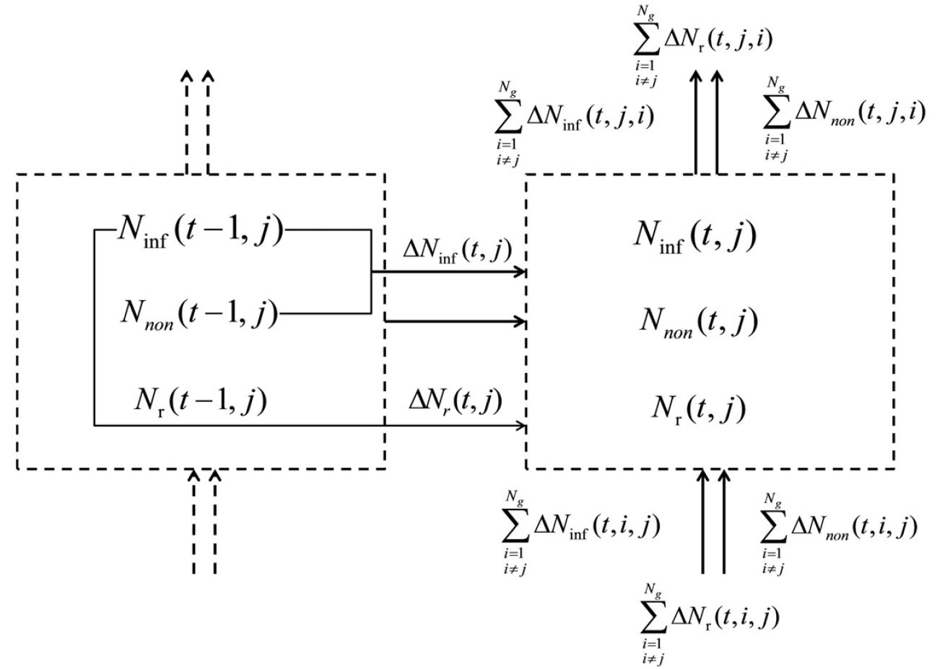
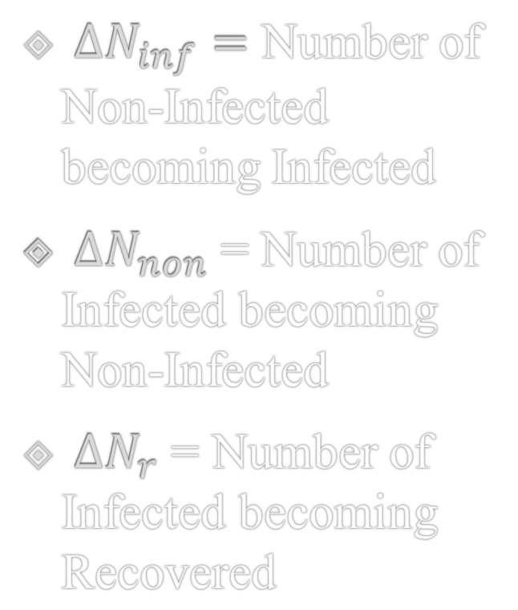
$∆N_{inf}=$ Number of Non-Infected becoming Infected
$∆N_{non}$ = Number of Infected becoming Non-Infected
${∆N}_{r}$ = Number of Infected becoming Recovered
(Zhang, 2016)

Slide 9

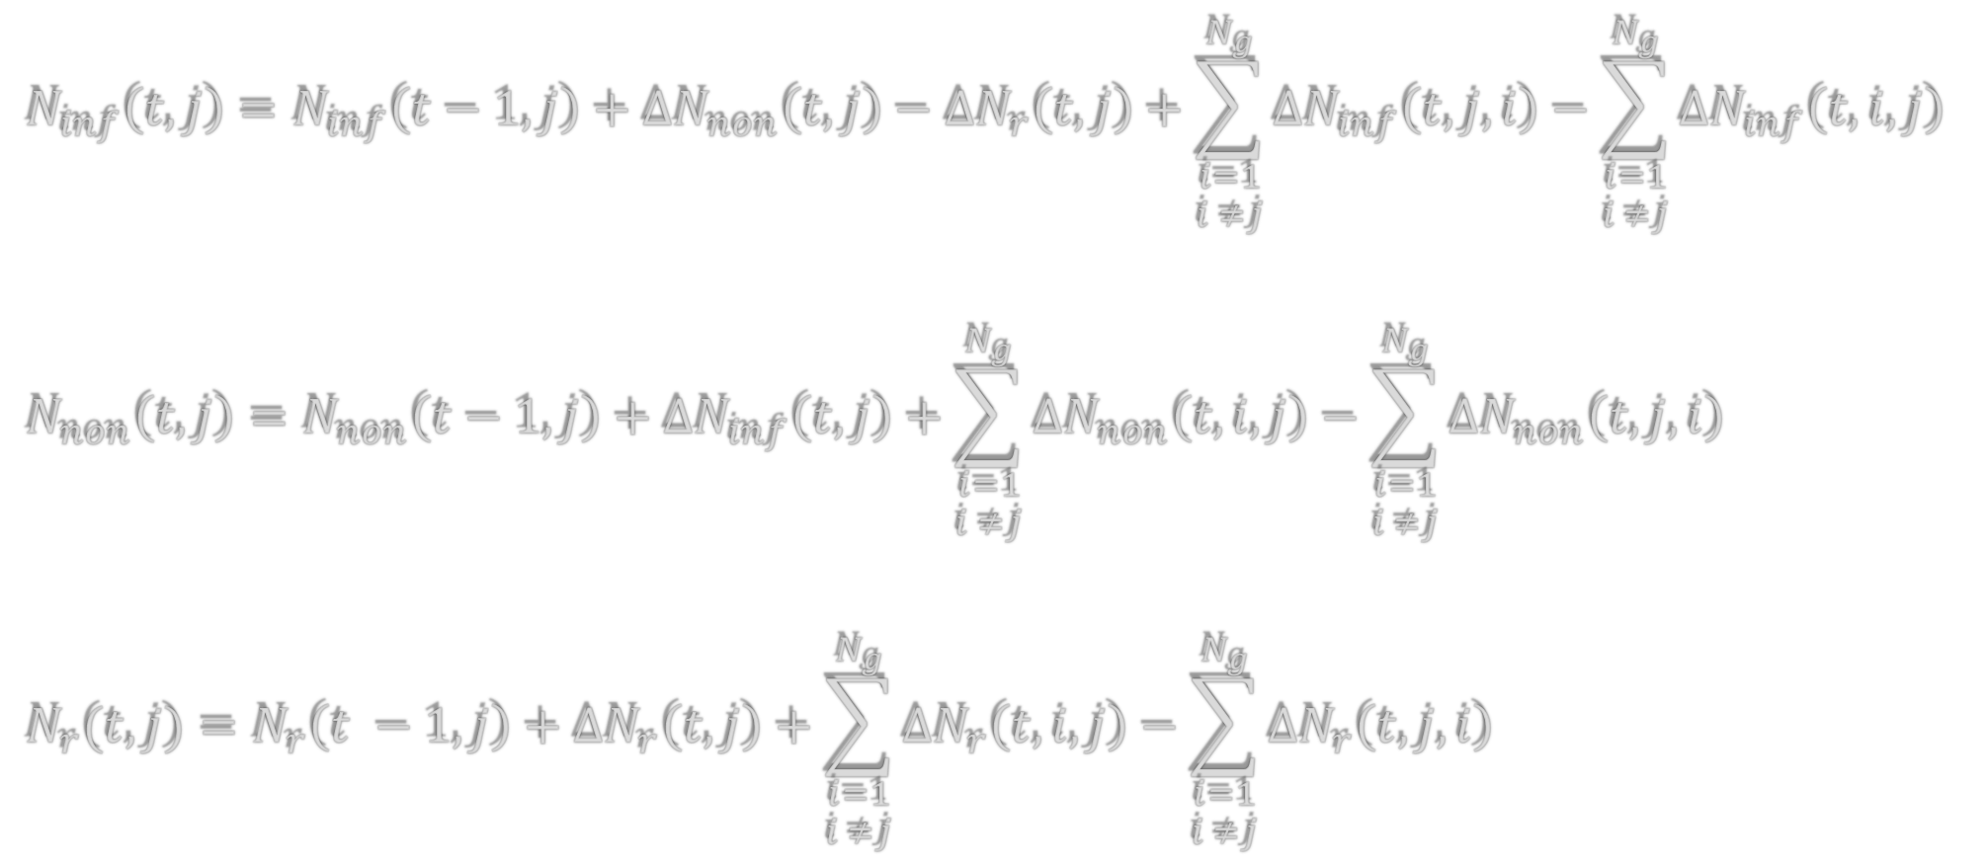
$$N_{inf}\left(t,j\right)=N_{inf}\left(t−1, j\right)+∆N_{non}\left(t, j\right)−{∆N}_{r}\left(t, j\right)+\sum_{\begin{aligned}i=1 \\ i ≠j\end{aligned}}^{N_{g}}{{∆N}_{inf}\left(t, j, i\right)}−\sum_{\begin{aligned}i=1 \\ i ≠j\end{aligned}}^{N_{g}}{{∆N}_{inf}\left(t, i, j\right) }$$
$$N_{non}\left(t,j\right)=N_{non}\left(t−1, j\right)+∆N_{inf}\left(t, j\right)+\sum_{\begin{aligned}i=1 \\ i ≠j\end{aligned}}^{N_{g}}{{∆N}_{non}\left(t, i, j\right)}−\sum_{\begin{aligned}i=1 \\ i ≠j\end{aligned}}^{N_{g}}{{∆N}_{non}\left(t, j, i\right) }$$
$$N_{r}(t,j)=N_{r}\left(t −1, j\right)+∆N_{r}\left(t, j\right)+\sum_{\begin{aligned}i=1 \\ i ≠j\end{aligned}}^{N_{g}}{{∆N}_{r}\left(t, i, j\right)}−\sum_{\begin{aligned}i=1 \\ i ≠j\end{aligned}}^{N_{g}}{{∆N}_{r}\left(t, j, i\right) }$$
$$\left[N\right]=\frac{infected person}{\min{∙ grid}}$$
(Zhang, 2016)

Slide 10


Number of Recoveries from Infection
$$\left[α\right]=\frac{person from infected}{person to recovery}$$
$$∆N_{r}\left(t, j\right)= α∙N_{inf}(t−1,j)$$
(Zhang, 2016)

Slide 11


Comprehensive Risk Equation
$$∆N_{inf}= \frac{N_{inf}\left(t −1, j\right)∙ N_{non}\left(t −1, j\right)∙σI ∙f\left(T\right)∙f(RH)}{\overline{R_{P}\left(t −1, j\right)}}+N_{h}\left(t, j\right)$$
R(t, j)
$σ$
$I$
$f\left(T\right)$
$f\left(RH\right)$
$R_{B}$
$N_{H}$
Comprehensive risk at time t in grid j
Augment coefficient relating infectivity to sanitation & hygiene
Virus Infectivity ~ I = 1 implies 100% chance of infection
Temperature influence
Humidity Influence
Personal Resistance
Newly infected caused by hospitals in grid j
(Zhang, 2016)

Slide 12
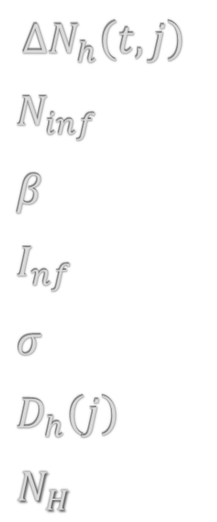

Number of Infections from getting Hospitalized
$$∆N_{h}\left(t, j\right)=\frac{βN_{inf}\left(t\right)∙ N_{non}\left(t, j\right)∙σI_{nf}}{\overline{R_{P}\left(t, j\right)}}∙\frac{D_{h}\left(j\right)}{\sum_{i=1}^{N_{h}}{D_{h}\left(i\right)}}$$
$$∆N_{h}\left(t, j\right)$$
$N_{inf}$
$β$
$I_{nf}$
$σ$
$D_{h}\left(j\right)$
$N_{H}$
Comprehensive risk at time t in grid j
Total number of infected individuals in city
Probability infected person will be in isolation in a hospital
Viral Infectivity
Augment coefficient relating infectivity to environmental parameters
Scale of hospitals
Total number of hospitals in city
(Zhang, 2016)

Slide 13
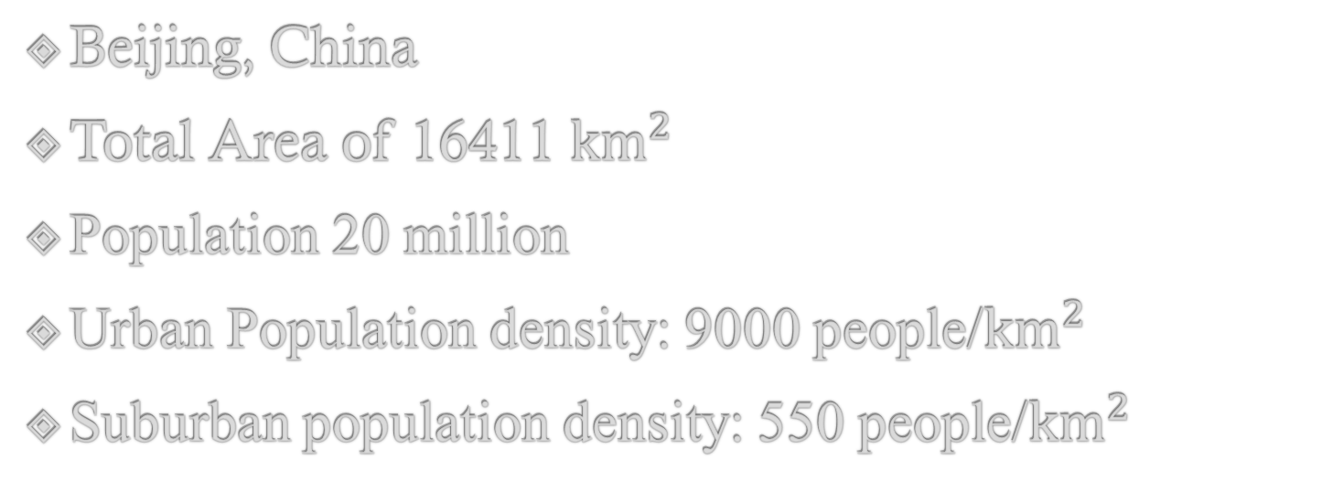
Study Area
Beijing, China
Total Area of 16411 ${km}^{2}$
Population 20 million
Urban Population density: 9000 people/${km}^{2}$
Suburban population density: 550 people/${km}^{2}$
(Zhang, 2016)

Slide 14


Assumptions
Viral infectivity ($I_{nf} or I)$ is $\frac{1}{100, 000}$
Still some diverse influenza
$\left[I\right]= \frac{person}{infected ∙min}$
(Zhang, 2016)

Slide 15
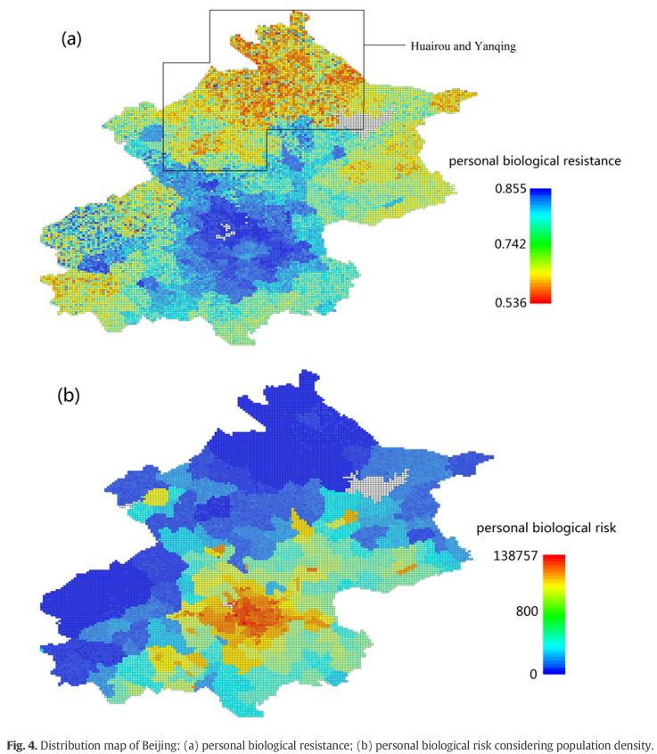

Distribution of
Biological Resistance
$$R_{B}=G∙f\left(A\right)∙ \frac{f(E)}{S ∙C}$$
(Zhang, 2016)

Slide 16
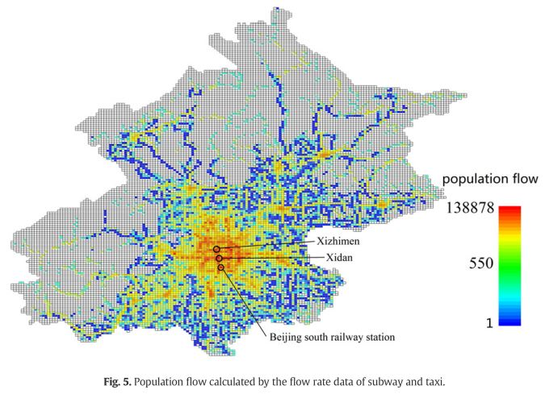
Transportation
Flow Diagram
(Zhang, 2016)

Slide 17
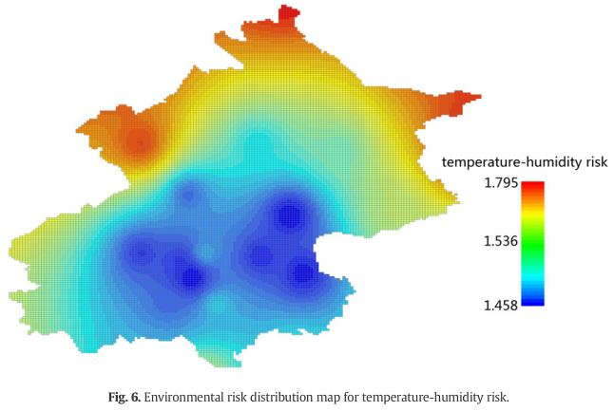

Distribution of Environmental Risk
$f\left(T\right)=1.34775+0.13811\cos\left(0.1509T\right)+0.29952sin⁡(0.1509T)$
$f\left(RH\right)=1=0.005∙RH$
(Zhang, 2016)

Slide 18
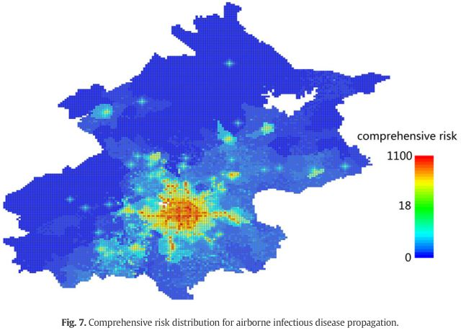
Distribution of Comprehensive Risk
(Zhang, 2016)

Slide 19
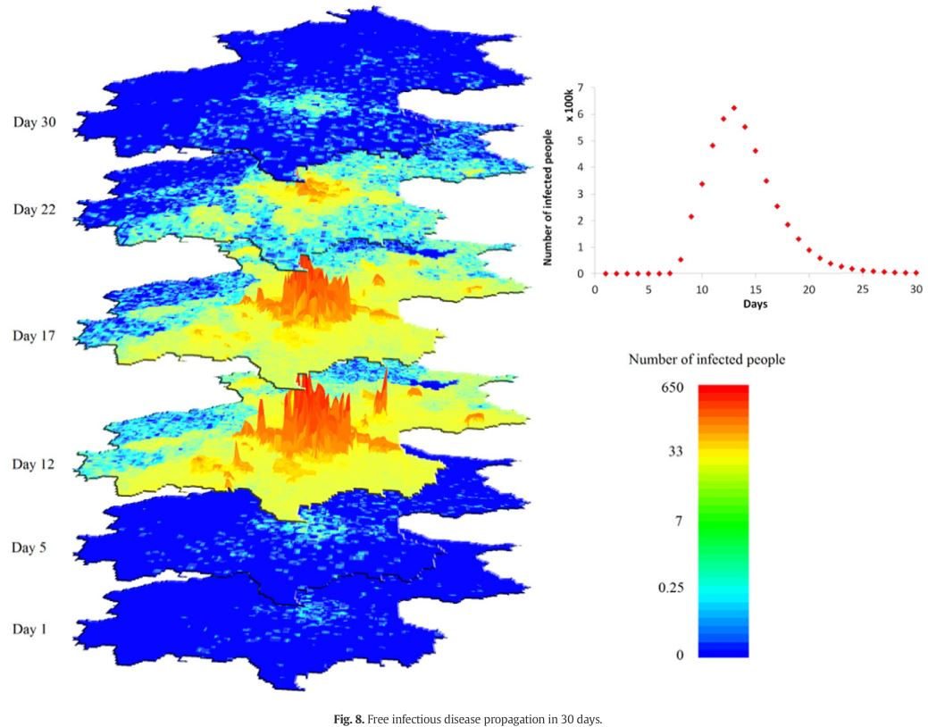
Distribution of Free Infectious Disease
(Zhang, 2016)

Slide 20
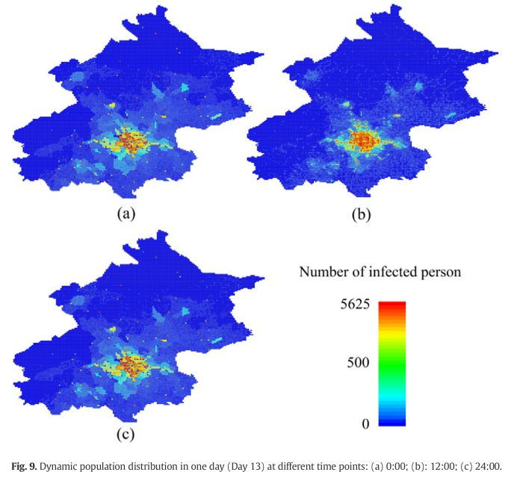
Distribution of Dynamic Population Influence
(Zhang, 2016)

Slide 21
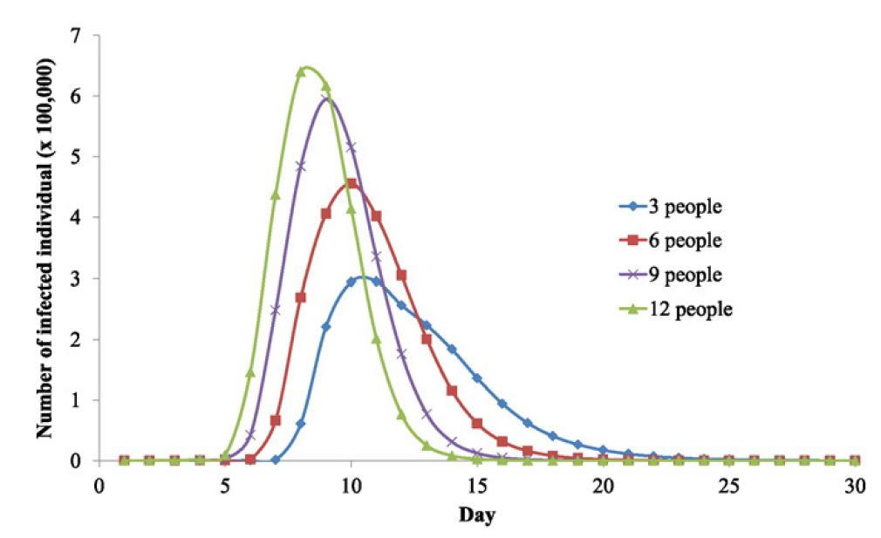
Sensitivity Analysis:
Households
(Zhang, 2016)

Slide 22
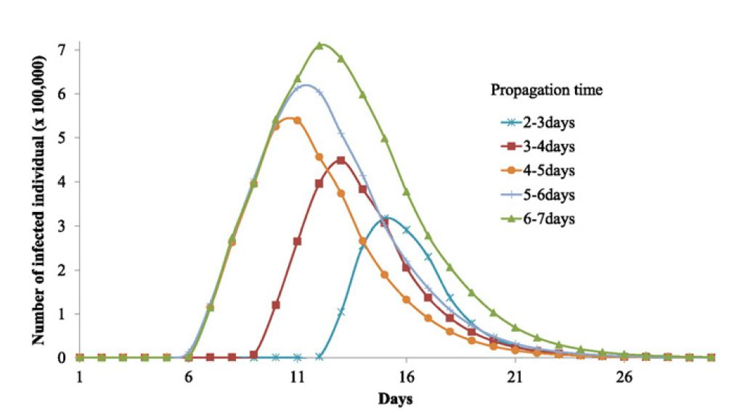
Sensitivity Analysis:
Government Response
(Zhang, 2016)

Slide 23
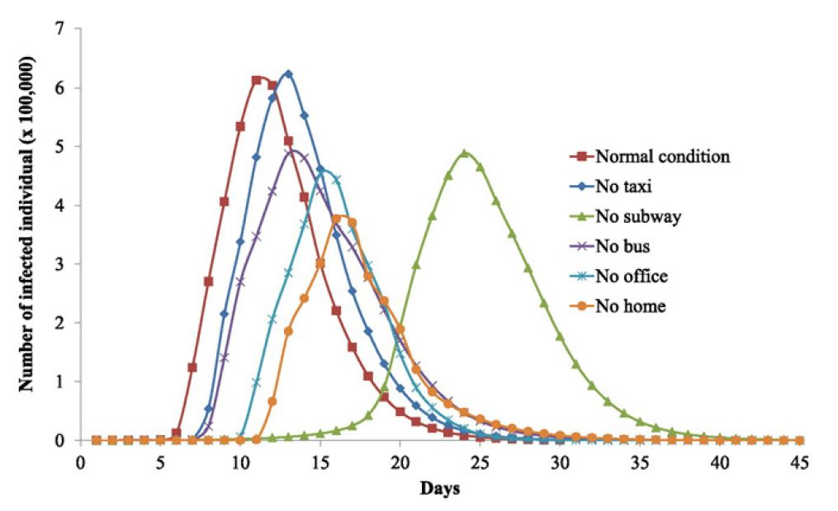
Sensitivity Analysis:
Transportation & Workplace
(Zhang, 2016)

Slide 24
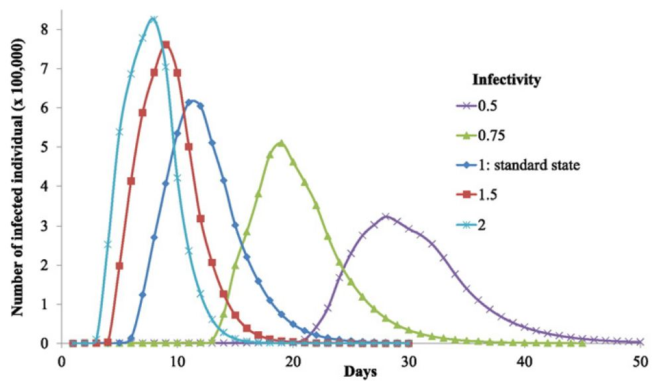
Sensitivity Analysis:
Different Infectivity Values
(Zhang, 2016)

Slide 25
Summary
Four Main factors analyzed:
Biological Risk
Dynamic Population Flow
Environmental Risk
Risk Source
Urban Areas are the most at risk of an airborne infectious disease
Due to public transportation, close vicinity of individuals
Mitigation Measures
Reduce personal contact
Quarantine the sick
Immediate intervention
Proper population management
Improving Air quality

Slide 26
Bibliography
CDC. (2019, June 11). 2009 H1N1 Pandemic (H1N1pdm09 virus). Retrieved from CDC website: https://www.cdc.gov/flu/pandemic-resources/2009-h1n1-pandemic.html
Diener, A. Dugasn J. (2016, Feb 18). Inequality-related economic burden of communicable diseases in Canada. 42- S1. https://doi.org/10.14745/ccdr.v42is1a02
CHS. (2011, Oct 19). Yersina pestis (Plague). Retrieved from Center for Health Security website: http://www.centerforhealthsecurity.org/resources/fact-sheets/pdfs/plague.pdf
Mackay, M. I. (2018, Jan 14). Influenza virus transmission: with or without symptoms, you’re dropping flu virus. Retrieved from Virology Down Under website: https://virologydownunder.com/influenza-virus-transmission-with-or-without-symptoms-youre-dropping-flu-virus/
Zhang, N., Huang, H., Duarte, M., & Zhang, J. (2016, Feb 24). Dynamic population flow based risk analysis of infectious disease propagation in a metropolis. Environment International, 94, 369–379. doi: 10.1016/j.envint.2016.03.038

