Slide 1
Tweeting about climate change
Using computational and qualitative techniques to analyse social media
Matthew Andreotta^{1,2}, Robertus Nugroho^{2,3}, Mark Hurlstone³,
Fabio Boschetti⁴, Simon Farrell¹, Iain Walker⁵, & Cecile Paris²
[1] School of Psychological Science, University of Western Australia
[2] Data61, CSIRO
[3] Soegijapranata Catholic University
[4] Ocean & Atmosphere, CSIRO
[5] School of Psychology and Counselling, University of Canberra

Slide 2
Public perceptions of climate change
Public is a heterogeneous mix of climate-related perceptions, motivations, & behaviours¹
Change is required on political, societal, and individual levels²
Public commentary can inform decision making
Improve communication of climate policy and science
[1] (Hine, Reser, Morrison, Phillips, Nunn, & Cooksey, 2014)
[2] (Lorenzoni & Pidgeon, 2006)
Notes:
As far as you know, do you think Australia is doing enough, not enough or too much to address climate change?
Not doing enough (53%), doing enough (24%), doing too much (9%), don’t know (14%)
Typically, we would measure these using surveys or interviews
With current technology, its possible to analyse social media

Slide 3

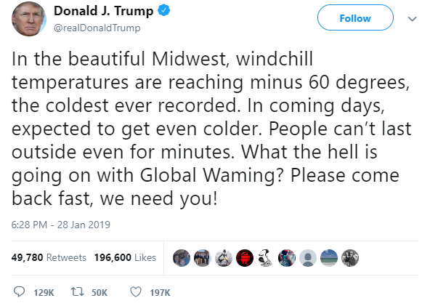
Twitter
Microblogging platform
Many tweets in public domain
Users interact
(ReTweet, Mention, Like, Reply)
Large in volume
Notes:
Typically, public perceptions identified through qualitative work/surveys
Place a tweet here, briefly explain it

Slide 4
AIM
To identify the broad topics of Twitter discussion
201,506 tweets referencing climate change, posted by Australians over the year 2016
DATA
ANALYSIS
A mixed-methods approach, blending machine learning techniques with qualitative analysis
Notes:
Queries: “climate” AND “change”; (2) “#climatechange”; (3) “#climate”; (4) “global” AND “warming”; and (5) “#globalwarming”
Emphasis the big data nature
Data61, access to archives of tweets

Slide 5
Results
Climate change action
Consequences of climate change
Conversations on climate change
Climate change deniers
The legitimacy of climate change and climate science

Slide 6
Results
Prevention, mitigation, and adaption
Critical of government
Desire action
Deprioritise climate policy
Climate change action
Consequences of climate change
If a foreign country did half the damage to our country as #climatechange we would declare war.
Conversations on climate change
Climate change deniers
Malcolm Turnbull will never have a credible climate change policy
The legitimacy of climate change and climate science

Slide 7
Results
Physical, biological, human systems
Generally negative
Climate change action
Australia experiencing more extreme fire weather, hotter days as climate changes
Consequences of climate change
Conversations on climate change
Reefs of the future could look like this if we continue to ignore #climatechange
Climate change deniers
You and your friends will die of old age & I’m going to die from climate change
The legitimacy of climate change and climate science

Slide 8
Results
Lack of discussion
Futility, morality of discussions
Political and ideological bias
Climate change action
not so gripping from No Principles Malcolm. Not one mention of climate change in his pitch.
Consequences of climate change
Conversations on climate change
Yes let’s all debate whether climate change is happening...
Climate change deniers
Maybe governments will actually listen if we stop saying “extreme weather” & “climate change” & just say the atmosphere is being radicalized
The legitimacy of climate change and climate science

Slide 9
Results
Individuals or groups perceived to deny climate change
Climate change action
Malcolm Roberts, funded by climate change skeptic global groups loses the plot when nobody believes his findings
Consequences of climate change
Conversations on climate change
You know I just don’t see any point engaging with climate change deniers like Roberts.
Ignore him
Climate change deniers
The legitimacy of climate change and climate science
Notes:
Mostly talk of Malcolm Roberts. Additionally, mining companies, Trump, Malcolm Turnbull

Slide 10
Legitimacy of climate science (CSIRO)
Reality of climate change
Climate change action
#CSIROcuts will damage Aus ability to understand, respond to & plan for #climatechange
Consequences of climate change
Conversations on climate change
Do we have an international convention on ‘Cloud Seeding’? Or
it comes under United Nation’s climate change agreement?
Climate change deniers
The legitimacy of climate change and climate science

Slide 11
Discussion
Users want action on climate change
Some users are engaged
Discussion of climate risks (e.g., biodiversity)
Discussion of discussions
Need to:
Counter scepticism
Promote messages of self-efficacy and hope
This research was supported by an Australian Government Research Training Program Scholarship from the University of Western Australia and a scholarship from the CSIRO Research Office and Data61
https://psyarxiv.com/bynz4/
matthew.Andreotta@research.uwa.edu.au
@MattAndreotta
Notes:
Add paper links

