Slide 1

Tweeting about climate change
Blending data science and psychology to analyse social media
Matthew Andreotta^{1,2}, Robertus Nugroho^{2,3}, Mark Hurlstone³,
Fabio Boschetti⁴, Simon Farrell¹, Iain Walker⁵, & Cecile Paris²
[1] School of Psychological Science, University of Western Australia
[2] Data61, CSIRO
[3] Soegijapranata Catholic University
[4] Ocean & Atmosphere, CSIRO
[5] School of Psychology and Counselling, University of Canberra
https://bit.ly/2kxBF9d
https://psyarxiv.com/bynz4/
matthew.andreotta@research.uwa.edu.au
@MattAndreotta

Slide 2
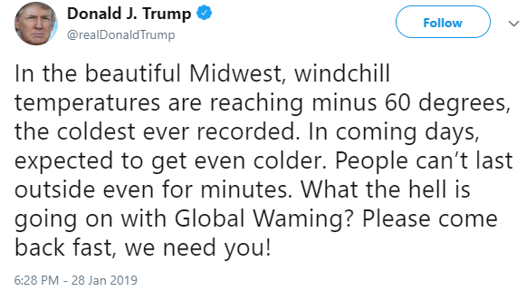

Public perceptions & social media
Members of the public differ in their opinions of important policy issues
Public commentary can influence policy agenda
Large volume
+ = Large and diverse data
Dynamic content

Slide 3
AIM
Identify the common commentary of Australian’s tweets about climate change
Thematic analysis to identify themes
DESIRED ANALYSIS
PROBLEM
Data set is exceeds the capabilities of traditional qualitative approaches

Slide 4
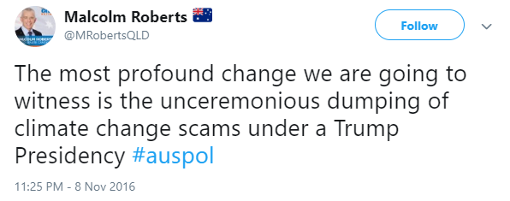
Framework
1. Compile a corpus
2. Compress corpus along a dimension of relevance
3. Extract a subset of data (from relevant spaces)
4. Perform qualitative analysis subset of data
Australian location
Posted in 2016
References climate change
201,506 tweets
Notes:
https://twitter.com/MRobertsQLD/status/796252408456224768
Queries: “climate” AND “change”; (2) “#climatechange”; (3) “#climate”; (4) “global” AND “warming”; and (5) “#globalwarming”

Slide 5
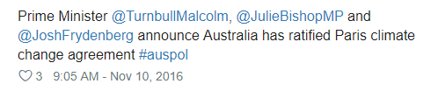
Framework
1. Compile a corpus
Topics are an abstract representations of semantically related words and concepts
Non-negative Matrix inter-joint Factorization (NMijF)¹
Word co-occurrence
Social and temporal co-occurrence
41 batches, 5 topics per batch
Topic alignment algorithm² to detect & group similar topics
22 groups of similar topics
102 topics were rare (similar to ≤ 1 topic)
2. Compress corpus along a dimension of relevance
3. Extract a subset of data (from relevant spaces)
4. Perform qualitative analysis subset of data
pari ratify agreement govern time #parisagr serio storm amend action
[1] (Nugroho, Zhao, Yang, Paris, & Nepal, 2017)
[2] (Chuang et al., 2015)

Slide 6

Framework
1. Compile a corpus
57.50%
Corpus of tweets
2. Compress corpus along a dimension of relevance
22 groups of common topics
groups of
rare topics
3. Extract a subset of data (from relevant spaces)
10 tweets per
group
4. Perform qualitative analysis subset of data
220 tweets

Slide 7
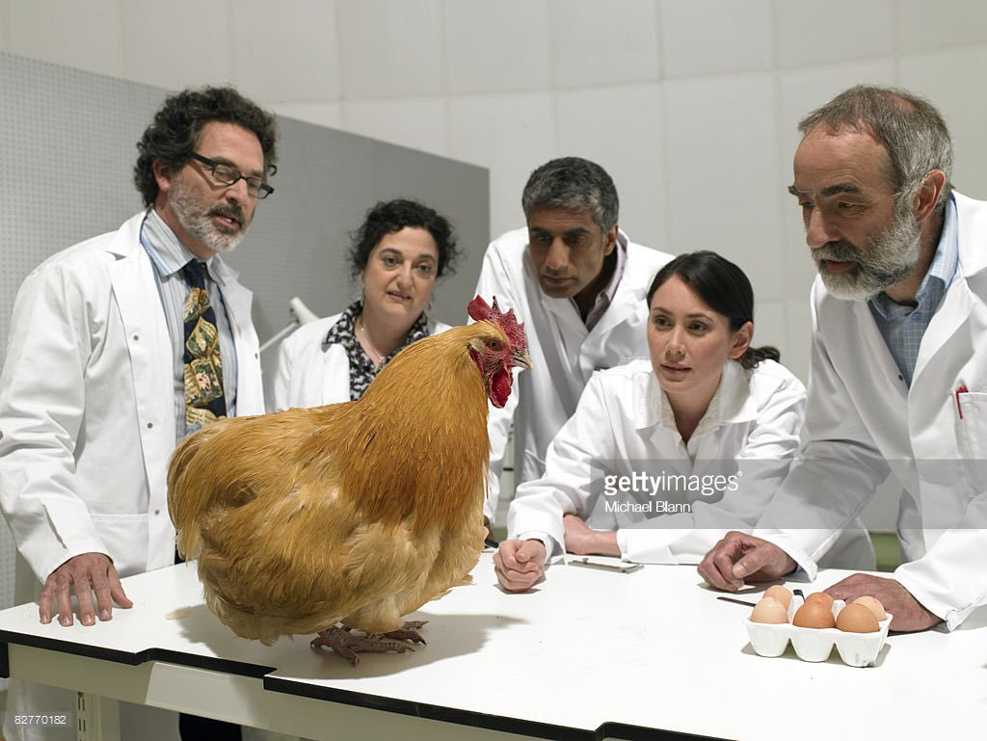
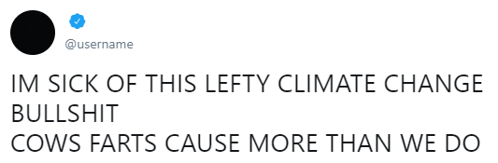
Framework
1. Compile a corpus
2. Compress corpus along a dimension of relevance
3. Extract a subset of data (from relevant spaces)
4. Perform qualitative analysis subset of data

Slide 8
Results
Climate change action
Yes! Let’s start working together for real solutions on climate change #QandA
Consequences of climate change
Reefs of the future could look like this if we continue to ignore #climatechange
Conversations on climate change
not so gripping from No Principles Malcolm. Not
one mention of climate change in his pitch.
Climate change deniers
According to Senator elect Malcolm Roberts, NASA fiddles the figures on Climate Change.
The legitimacy of climate change and climate science
Do we have an international convention on ‘Cloud Seeding’? Or it comes under United Nation’s climate change agreement?

Slide 9
Conclusion
Users want action on climate change
Some users are engaged
Discussion of climate risks (e.g., biodiversity)
Discussion of discussions
Need to:
Counter scepticism
Promote messages of self-efficacy and hope
https://bit.ly/2kxBF9d
This research was supported by an Australian Government Research Training Program Scholarship from the University of Western Australia and a scholarship from the CSIRO Research Office and Data61
https://psyarxiv.com/bynz4/
matthew.andreotta@research.uwa.edu.au
@MattAndreotta

