Slide 1




Blending psychology and data science
A mixed-methods framework for analysing social media with an application to climate change tweets
Matthew Andreotta
School of Psychological Science, University of Western Australia
Data61, CSIRO
(insert link/qr code to download these slides)

Slide 2
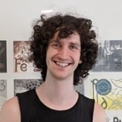





Everyone involved
Matt Andreotta
Dr. Cecile Paris
Dr. Mark Hurlstone
UWA & CSIRO
Data61, CSIRO
Behavioural Economics Laboratory, UWA
Dr. Fabio Boschetti
Prof. Simon Farrell
Dr. Iain Walker
Oceans & Atmosphere, CSIRO
Memory and Decision Making Laboratory, UWA
University of Canberra
Notes:
The empirical work done today was made possible by Robertus Nugroho (Faculty of Computer Science, Soegijapranata Catholic University, Semarang, Indonesia) who assisted with the topic modelling.

Slide 3
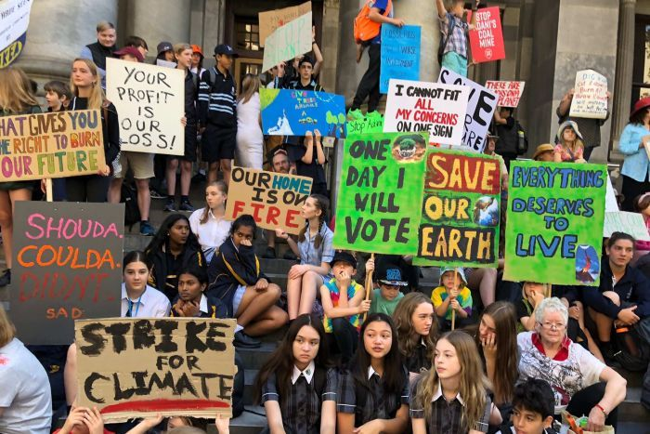
How does the public conceptualise climate change?
Climate change is one of the greatest challenges for humanity (Schneider, 2011).
Public perceptions are critical.
How can we monitor, understand, and communicate with the public?
Students striking on the steps of South Australia's Parliament House.
(Gabriella Marchant for ABC News, 2019)
Notes:
Effective mitigative action for climate change requires international collaborations. In democratic societies, the perceptions of voters can be critical to adopting costly policies.
Examine how society constructs climate change as an issue (or not)
Public perceptions can be influential in a democracy
Monitor changes
Comparison with other countries

Slide 4
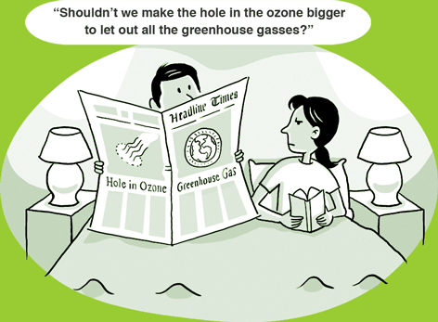
A mental model perspective
Mental models are internalised models of a world, can be simulated and generate inferences
A legacy of our interactions with the world and our combined understanding of it’s dynamics
Mental models attempt to mirror the world, but often fall short (constrained cognitive capacity, constraints from ideology)
Differences in mental models of climate change correspond to differences in policy support. E.g., ‘Good Environmental Practice’ model (Bostrom et al., 2012; Read et al., 1994; Reynolds et al., 2010)
(Ian Webster for CRED, 2009)
Notes:
MM(CC) can be non-specific
*’Wider social context’

Slide 5
Mental models
Greenhouse gas
model
Reducing greenhouse gas emissions
(e.g., carbon tax)
Greenhouse gases
(e.g., CO₂)
+
Climate change
-
causes
mitigation
‘Good Environmental Practice’ model
(Bostrom et al., 2012; Read et al., 1994)
Good environmental practices
(e.g., recycling, planting trees)
Bad environmental practices
(e.g., pollution)
+
Climate change
-
causes
mitigation
Different mental models of climate change generate different inferences
Notes:
Non-specific version of GGM

Slide 6



Collecting public perceptions
Quantitative
Qualitative
Observation/Naturalistic
Surveys, experiments
Interviews, focus groups
Social media
Easier to analyse
Controlled environment
Questionable ecological validity
Intrusive data collection
Intensive to collect, transcribe, and analyse data
Controlled environment
Environment not controlled by experimenter
Diverse data
No probes required to generate data
Can be difficult to understand meaning
Notes:
With greater environmental control, we can test theories

Slide 7
Our Study
Research Question
When Australian users tweet about climate change, what are the topics being discussed?
Analysis
Topic modelling
Notes:
A quick detour into the nature of modelling topics...

Slide 8
Topic modelling
Identifying abstract representations of semantically related words and concepts (topics)
Popular approaches (e.g., LDA, PLSA)
Non-Negative Matrix inter-joint Factorization (NMijF; Nugroho et al., 2017)
Relies on patterns of word co-occurrence between tweets
Represent topics as a list of keywords
Word co-occurrences are limited on Twitter (tweets are short)
Popular approaches suffer (Nugroho, Zhao, Yang, Paris, & Nepal, 2017)
Relies on patterns of word co-occurrence
and on patterns of social and temporal information
Outperforms popular approaches (Nugroho et al., 2017)
Notes:
Latent Dirichlet Allocation
Probabilistic Latent Semantic Analysis
Non-negative Matrix Factorization
Example of topic (animal), ea. tweet assigned to one (and only one) topic

Slide 9
Social interactions
Tweet #1
Tweet #2
Tweet #3
Tweet #1, #2, and #3 may fall within the same topic

Slide 10
A quick detour into psychology

Slide 11
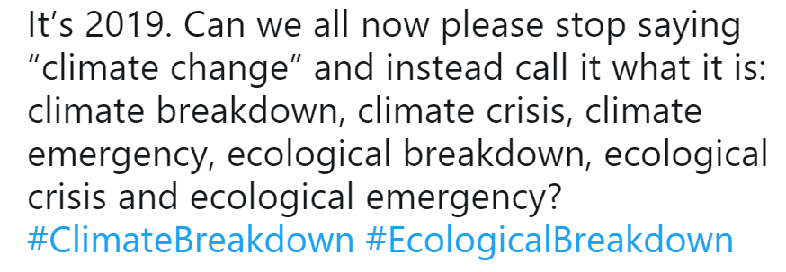
Social interactions
its NOT just climate - its total ENVIRONMENTAL EMERGENCY - pollution, species extinction, mono-crop agriculture, pesticides, emissions etc. all resulting from our insane drive for short term economic gain under private/public/state capitalism
Climate hysteria?
Tweet #1, #2, and #3 may fall within the same topic
(Naming climate change / Defining climate change)
Notes:
Homogeneity in topic, heterogeneity in psychological antecedents

Slide 12
Causal layered analysis (CLA)
Litany
tweets, media articles
(Inayatullah, 2003, 2004)
Social causal
mental models
Litanies: issues presented as public description/social truth
Social causal: issues presented as systematic &/or technical explanations
Worldview/discourse: issues presented as deep, complex understandings which shape the way meaning is constructed
Worldview/discourse
worldviews, ideology
Notes:
CLA is a useful framework for breaking down the inherent complexity and meaning of language.
It’s certainly not the only framework.

Slide 13
CLA
The tweet
Litany
tweets, media articles
its NOT just climate - its total ENVIRONMENTAL EMERGENCY - pollution, species extinction, mono-crop agriculture, pesticides, emissions etc. all resulting from our insane drive for short term economic gain under private/public/state capitalism
Social causal
mental models
Worldview/discourse
worldviews, ideology

Slide 14
CLA
The tweet
Litany
Climate change is an environmental emergency
its NOT just climate - its total ENVIRONMENTAL EMERGENCY - pollution, species extinction, mono-crop agriculture, pesticides, emissions etc. all resulting from our insane drive for short term economic gain under private/public/state capitalism
Social causal
mental models
The litany
Climate change is an environmental emergency
Worldview/discourse
worldviews, ideology

Slide 15
CLA
The tweet
Litany
Climate change is an environmental emergency
its NOT just climate - its total ENVIRONMENTAL EMERGENCY - pollution, species extinction, mono-crop agriculture, pesticides, emissions etc. all resulting from our insane drive for short term economic gain under private/public/state capitalism
Social causal
pollution, species extinction, mono-crop agriculture, pesticides, emissions
The social causal
Climate change will destabilise and destroy many biological and human systems
User has a mental model which considers these systems interlinked and sensitive to changes in climate
Worldview/discourse
worldviews, ideology

Slide 16
CLA
The tweet
Litany
Climate change is an environmental emergency
its NOT just climate - its total ENVIRONMENTAL EMERGENCY - pollution, species extinction, mono-crop agriculture, pesticides, emissions etc. all resulting from our insane drive for short term economic gain under private/public/state capitalism
Social causal
pollution, species extinction, mono-crop agriculture, pesticides, emissions
The worldview/discourse
Left-wing ideology
Low Free-Market Endorsement (Heath & Gifford, 2006)
‘Environment is ductile’ worldview (Price et al., 2014)
Worldview/discourse
left-wing ideology,
low FMI,
‘environment is ductile’,

Slide 17
CLA
The tweet
Litany
Climate change is a symptom of hysteria
its NOT just climate - its total ENVIRONMENTAL EMERGENCY - pollution, species extinction, mono-crop agriculture, pesticides, emissions etc. all resulting from our insane drive for short term economic gain under private/public/state capitalism
Social causal
?
Another tweet (same topic)
Climate hysteria?
Worldview/discourse
‘environment is elastic’, Promethean discourse
Notes:
Tweets belonging to the same topic may have different psychological underpinnings (layers)
Through inspecting the output of a topic model, we may not gather insight into social causal or worldview/discourse layers

Slide 18
Back to the study

Slide 19
What to use?
How can we understand a large data set whilst capitalising on existing theories of human behaviour?
Topic modelling
Qualitative approaches (e.g., CLA)
Provides a semi-automated approach to analysing social media data
Can group content on the basis of semantic relationships
May be difficult to identify the underlying ideas, assumptions, and conceptualisations of users
Constrained to the output of the topic models (not all topics may be meaningful)
Researcher can flexibly apply known theories of behaviour when analysing data (if desired)
Numerous frameworks exist, each ensuring a particular type of insight is derived from the analysis
Qualitative approaches are laborious (and often infeasible) to apply over Twitter
Our research question
When Australian users tweet about climate change, what are the topics being discussed?
Answered with: topic modelling and thematic analysis (Braun & Clarke, 2006, 2012)
Notes:
Transition into the 4PF. Need to combine Quant. and Qual., but how?

Slide 20
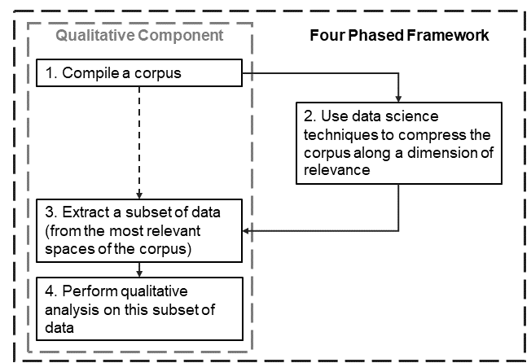
Four-Phased Framework (Andreotta et al., 2019)
We benefited from our topic solution, without being constrained to it.
Through a qualitative analysis we can identify themes to answer our research question
However, qualitative analyses are intensive, and we must select a subset of data to analyse.

Slide 21
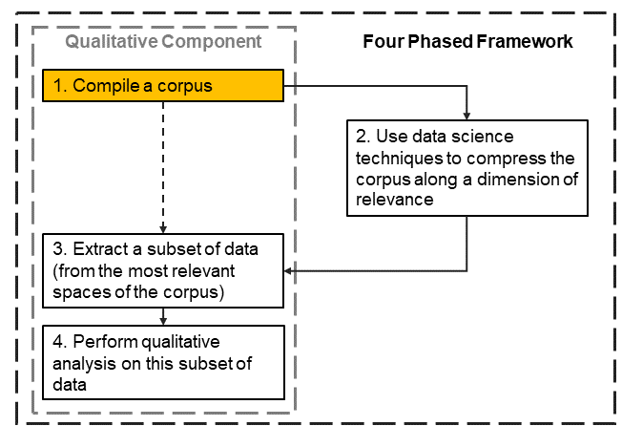
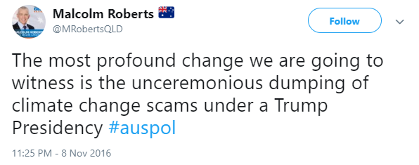
Our data
Collected through ESA (Cameron et al., 2012; CSIRO, 2019)
Had to satisfy three criteria:
Australian location
Posted in 2016
References climate change (e.g., “#climatechange”)
201,506 tweets
Notes:
CSIRO’s Emergency Situation Awareness (ESA) platform.
Thanks to: Bella Robinson & David Ratcliffe
The platform was originally built to detect, track, and report on unexpected incidences related to crisis situations (e.g., fires, floods; see Cameron, Power, Robinson, & Yin, 2012). To do so, the ESA platform harvests tweets based on a location search that covers most of Australia and New Zealand. The platform archives Australian/NZ tweets for internal projects.
If time, briefly mention the addition of removing stop words related to

Slide 22
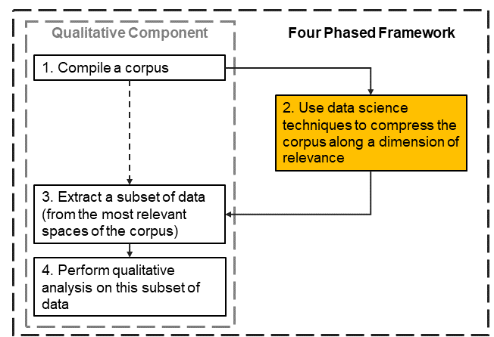
Modelling topics
Creating batches
Organised the corpus chronologically, and divided the corpus into 41 batches

Slide 23
Used NMijF process (Nugroho et al., 2017) to create a topic solution for each batch
Varied number of topics per batch
(k = 5, 10, 20)
Pre-processing
Assessing quality
Removed stop words, punctuation, etc.
Stemmed each term
Tokenised each word
A good topic model will create distinct, coherent, meaningful, interpretable topics (Fang et al. 2016a, 2016b).
k = 20 identified topics within the same batch which were conceptually similar (i.e., not distinct).
k = 5 & k = 10 were similar, selected k = 5 (more parisimonious)
Topic modelling
Notes:
1. Removed stopwords, stemmed , and tokenised words
3. I couldn’t identify meaningful differences in the k = 5 and k = 10 solution.
Qualtrics task details (if anyone asks)
M = 6.45/12 judgements
154 participants (35 indifferent, 45 prefer k = 5, 74 prefer k = 10)
-------------
Summary:
Both the 5 and 10 topic/batch solution are sensical, though the latter may have better ‘topics’

Slide 24
Not all topics are equally relevant
Topics were associated with transitory environmental features, such as TV/news cycles (e.g., #insiders, #QandA) and extreme weather events Kirilenko et al., 2015; Sisco et al., 2017)
We were most interested in topics which repeatedly emerged throughout 2016.

Slide 25
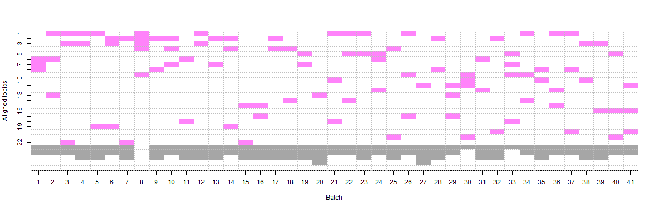

Used a topic alignment algorithm (Chuang at al., 2015) to identify topics which occurred in multiple batches
Common topics defined as topics which shared 3+ keywords
We were interested in topics which occurred throughout the year (i.e., in at least three batches)
Identifying repeated topics
https://github.com/AndreottaM/TopicAlignment
Notes:
Explain figure
(Most popular topic spans 13 batches)
Mention app
k = 5, popular topics cover 57.5% of the corpus
k = 10, popular topics cover 35.14% of the corpus

Slide 26
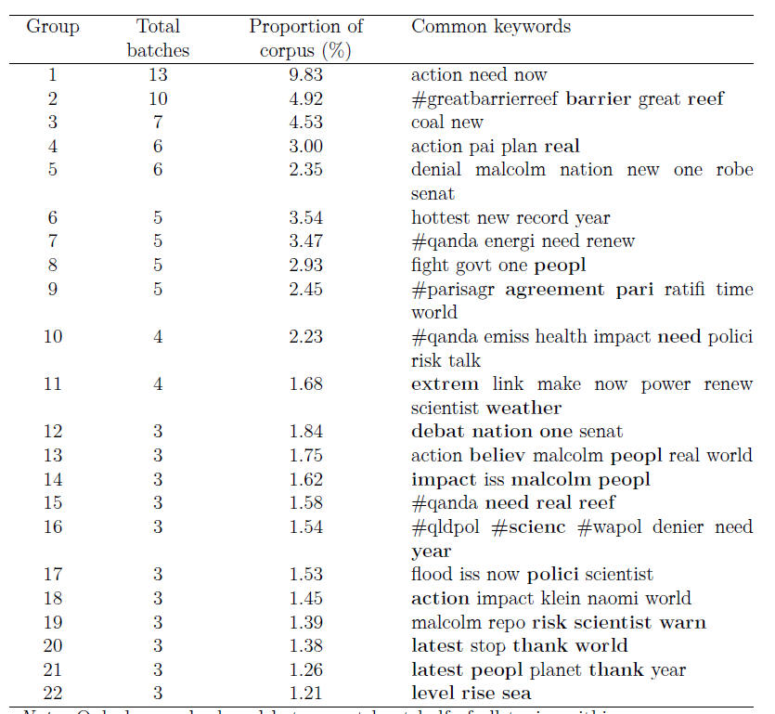
The grouped topics
Notes:
Explain table.
Re: Common keywords.
All keywords are presented in stemmed form
Keywords are present in at least half the topics grouped together
Bolded keywords are presented within all topics

Slide 27
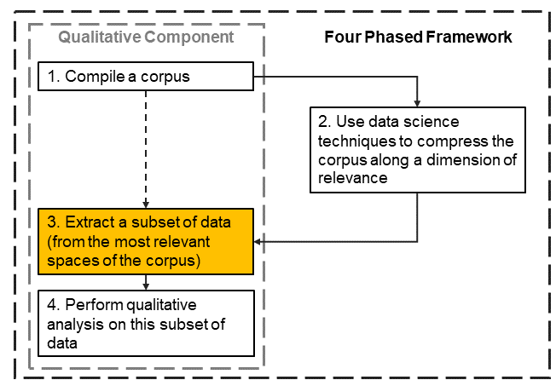
Extracting a subset of data
Randomly sampled 10 tweets from each ‘topic group’
Trade-off between comprehensiveness and feasibility
Allows us to sample from the most informative areas of our corpus (cf., responses to rare events)
Notes:
i.e., rather than superficial topics isolated to rare/unique environmental conditions

Slide 28
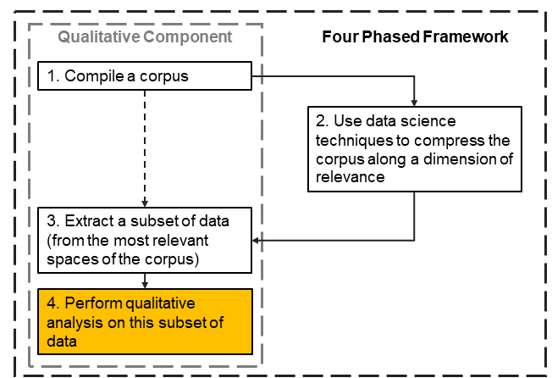
Thematic analysis
Reading the subset of data
Code for themes
Develop a codebook
Have another rater apply codes, reach consensus on each tweet
Use keywords and topics to inform initial generation of themes
Use topics to form abductive hypotheses to test with thematic analysis
Notes:
Thus, not all themes are topics from the topic modelling procedure.
We can code for themes which are more latent/theory-specific/ideologically-based/etc
Thank you Blake Cavve

Slide 29
Themes
Climate change (CC) action
39.6%
“Yes! Let’s start working together for real solutions
on climate change #QandA”
Consequences of CC
19.6%
“Reefs of the future could look like this if we continue to ignore #climatechange”
Conversations on CC
15.9%
“not so gripping from No Principles Malcolm. Not
one mention of climate change in his pitch.”
CC deniers
12.7%
“According to Senator elect Malcolm Roberts, NASA fiddles the figures on Climate Change.”
The legitimacy of CC and climate science
9.1
%
“Do we have an international convention on ‘Cloud Seeding’? Or it comes under United Nation’s climate change agreement?”
Notes:
After all of this, we finally have the answers to what users talk about throughout the year.
Keep in mind, this concerns the most ‘robust’ or ‘common’ points of conversation.
First two themes tended to have clear links to topics. CC deniers had some links.
3.2% were N/A

Slide 30
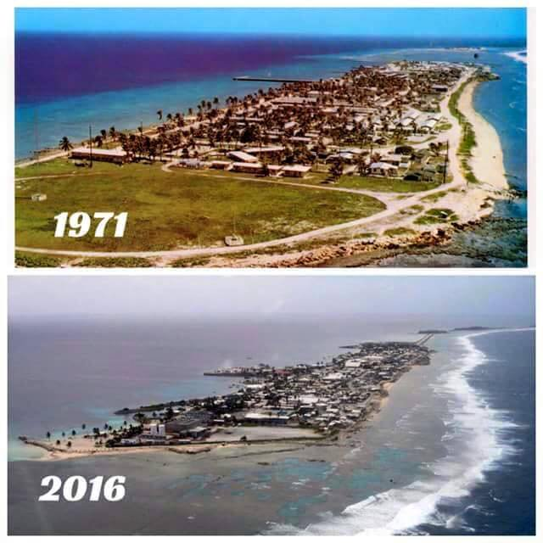
Themes vs. Topics (e.g., sea level rise)
Consequences of CC
“Want to see more flooding in Qld and Paris (& everywhere else)? That s what #climate change is bringing.”
Conversations on CC
“Trouble is climate change deniers use weather info to muddy debate. Careful????????????????”
Notes:
Topics do not map perfectly to the themes we described. For example, the 22nd grouping of topics all pertain to rises in sea level.
If we had stopped at the ‘topic modelling’ stage of the framework, we would have concluded this topic was about rises in sea levels.
However, a closer look indicates many things are being discussed. In topics related to natural disasters and current changes underpinned by climate change, we see some of the strongest calls for action. Alongside that, we see tweets, such as that shown on screen, which talk of the nature of our discussions around climate change.

Slide 31
Mixed-methods framework
How did Qual approaches improve Quant?
How did Quant. approaches improve Qual?
Could conduct analyses with an understanding of socio-political events, context, theories, etc.
Could decide the ‘conceptual granularity’ of a topic/theme
Can control where topics/themes fall on a semantic-latent dimension
Identify the most relevant space of the corpus for answering our research question
Forms the foundation for qualitative explorations of the data set
Andreotta, M., Nugroho, R., Hurlstone, M. J., Boschetti, F., Farrell, S., Walker, I., & Paris, C. (2019). Analyzing social media data: A mixed-methods framework combining computational and qualitative text analysis. Behavior research methods, 1-16. https://doi.org/10.3758/s13428-019-01202-8.
Notes:
Although this mixed-methods is more work, it allows researchers to be more flexible in their analysis, and create a strategy which best suits their needs
Of note, this is only one way of combining quant. and qualitative techniques.

Slide 32
Future for Four-Phased Framework
Only one way of combining qualitative & quantitative analyses for social media data.
Could be generalised to more sophisticated approaches (e.g., Grounded Theory).

Slide 33
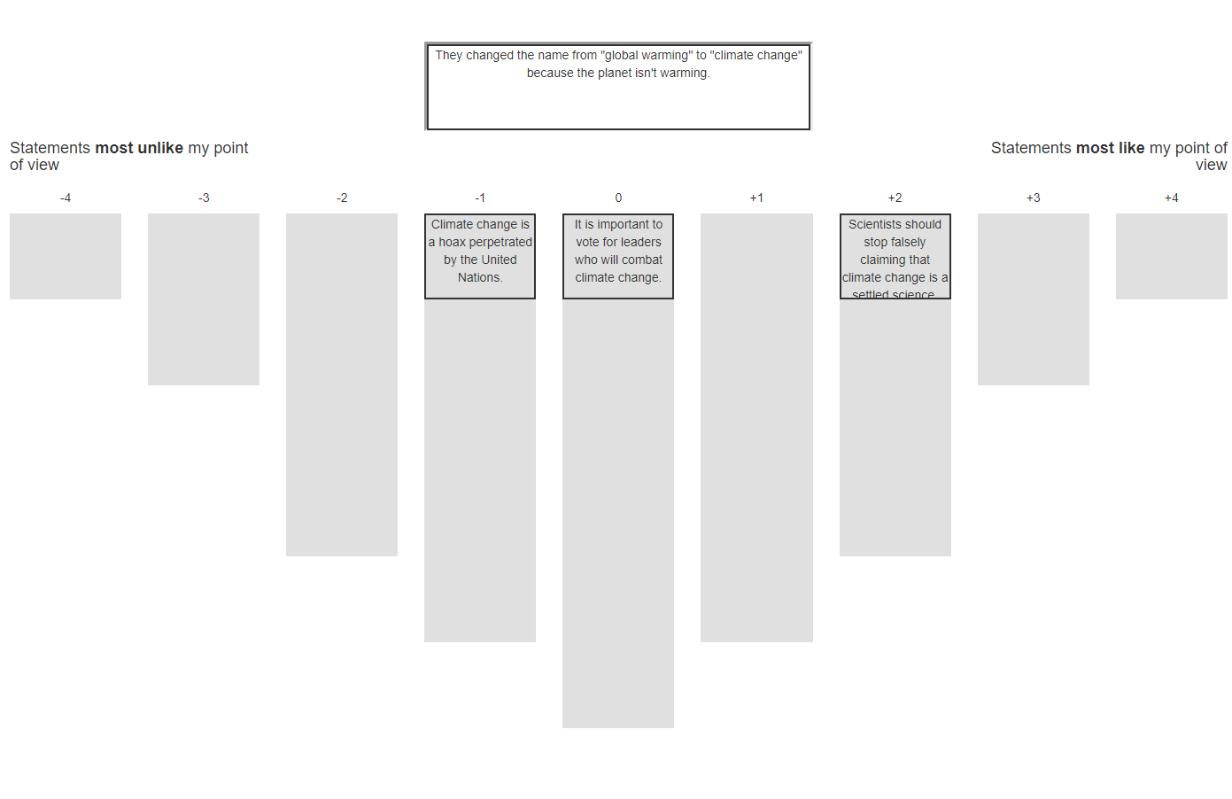
Next study: Segmenting the public
For each theme, we extract 6 litanies (broadly representing the diverse views of Twitter users)
Participants complete a card sorting task.
We will identify unique profiles of climate change interpretations

Slide 34
My future studies
Litany
tweets, media articles
Social causal
mental models
Understand the predictors of interpretative profile membership.
What is a better predictor of climate change perceptions? The explanations people have of the climate, or their underlying political ideology, worldviews, etc.?
Different strategies and challenges for updating beliefs rooted in ideology vs. rooted in explanations.
Worldview/discourse
worldviews, ideology
Notes:
Are our explanations for the world purely a proxy for worldviews or ideology?

Slide 35
Recommended Reading
Causal Layered Analysis (CLA)
Inayatullah, S. (2004). The causal layered analysis (CLA) reader: Theory and Case Studies of an Integrative and Transformative Methodology.
Bishop, B. J., & Dzidic, P. L. (2014). Dealing with Wicked Problems: Conducting a Causal Layered Analysis of Complex Social Psychological Issues. American Journal of Community Psychology, 53(1-2).
Thematic Analysis (TA)
Braun, V., & Clarke, V. (2006). Using thematic analysis in psychology. Qualitative Research in Psychology, 3(2), 77–101.
Notes:
Could add more general readings here on psych. theories, discourse analyses, etc?

Slide 36
Thank you
(insert link to download these slides)
This research was supported by an Australian Government Research Training Program (RTP) Scholarship from the University of Western Australia and a scholarship from the CSIRO Research Office to me, as well as a grant from the Climate Adaptation Flagship of the CSIRO awarded to Dr. Mark Hurlstone and Dr. Iain Walker.

