Slide 1
Implementation
Jacob Bechtel Matt McCarthy
Notes:
Implementation covers the standards used for coding. This involves what makes for both good code, and what forms compliant code. Compliant code is code which adheres to an Application Programming Interface (API)

Slide 2
Characteristics of Good Implementation
Readability
Maintainability
Performance
Traceability
Correctness
Completeness

Slide 3
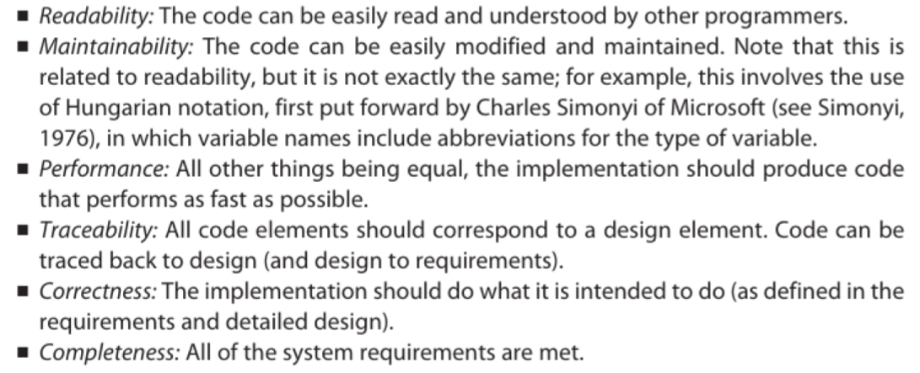
Characteristics of Good Implementation

Slide 4
Readability

Slide 5
JAVADOC
Oracle Source
Notes:
BST
C++ / Heap

Slide 6
Coding Guidelines
Naming (Naming, Variables)
Consistency
Case (Camel, Underscore)
Indentation (DO IT!)
Function Size (RoT: 50 lines)
Comments

Slide 7
Why use an API
Abstraction
Users (Hide Implementation)
Legos (Modularization)
Pencils vs. Pen (Easier to change)
Easier to Optimize
First to contact, first to contract

Slide 8
Software Implementation
Pimpl Idiom
Advantages
Disadvantages
Threading
Notes:
Pimpl: Pointer to Implementation C++
JAVA: Strong Bridge
Advantages:
Information Hiding
Reduced Coupling
Faster Compiling
Greater Binary Compatibility
Lazy Allocation
Disadvantages:
Extra Objects, Performance hit due to extra level of indirection
Developer Inconvenience (prefix all private member accesses with mImpl->
Harder to read / debug
This affects the developer, not the user
Compiler will no longer catch certain errors (changing consts behind the abstraction)
Threading:
Decide beforehand
Choose Decomposition
Design Solution
Implement Serial Version BEFORE parallelizing

Slide 9
Sources
http://www.joelonsoftware.com/articles/Wrong.html
API Design for C++, Martin Reddy
Essentials of Software Engineering,

