Slide 1
Implementation
Jacob Bechtel Matt Mcarthy

Slide 2
Characteristics of Good Implementation
Readability
Maintainability
Performance
Traceability
Correctness
Completeness

Slide 3
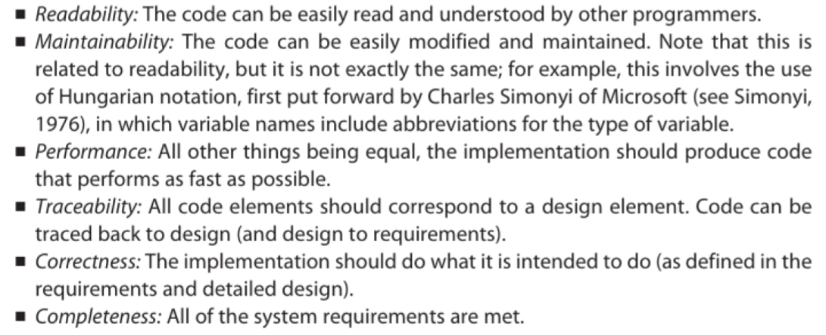
Characteristics of Good Implementation

Slide 4
Readability
Public static int largest(int arr[]){
assert(arr.length>0);
int curLargest=arr[0];
for(int i=0;i<arr.length();++i){
if(arr[i]>curLargest)
curLargest=arr[i];
}
return curLargest;
}
Public static int largest(int arr[]){
assert(arr.length>0);
int curLargest = arr[0];
for(int i=0; i<arr.length(); ++i){
if(arr[i]>curLargest)
curLargest=arr[i];
}
return curLargest;
}
Public static int largest(int arr[]){
assert(arr.length>0);
int curLargest = arr[0];
for(int i=0; i<arr.length(); ++i){
if(arr[i]>curLargest)
curLargest=arr[i];
}
return curLargest;
}

Slide 5
JAVADOC
/** * A class representing a window on the screen.
* For example:
* <pre>
* Window win = new Window(parent);
* win.show();
* </pre>
*
* @author Sami Shaio
* @version 1.13, 06/08/06
* @see java.awt.BaseWindow
* @see java.awt.Button
*/
class Window extends BaseWindow {
...
}
Oracle Source

Slide 6
Coding Guidelines
Naming (Naming, Variables)
Consistency
Case (Camel, Underscore)
Indentation (DO IT!)
Function Size
Comments

Slide 7
Why use an API
Abstraction
Users (Hide Implementation)
Spaghetti is a fine dinner, bad code
Legos (Modularization)
Pencils vs. Pen (Easier to change)
Easier to Optimize
First to contact, first to contract

Slide 8
Software Implementation
Pimpl Idiom
Advantages
Disadvantages
Threading

