Slide 1


Neural Network Engine
A Comprehensive Deep Learning Framework with Automatic Differentiation
and Research Software for Neural Network Education & Experimentation
Author:
Matt Minev
Summer Research School 2025
Varna, Bulgaria

Slide 2

Introduction
From Simple Script to Complete Engine
Started with automatic differentiation and optimization for neural networks
Realized a few Python files weren’t sufficient for my ideas
Built a centralized Engine instead of copy-pasting across applications
Complete framework that powers all demonstrations today
1/10

Slide 3
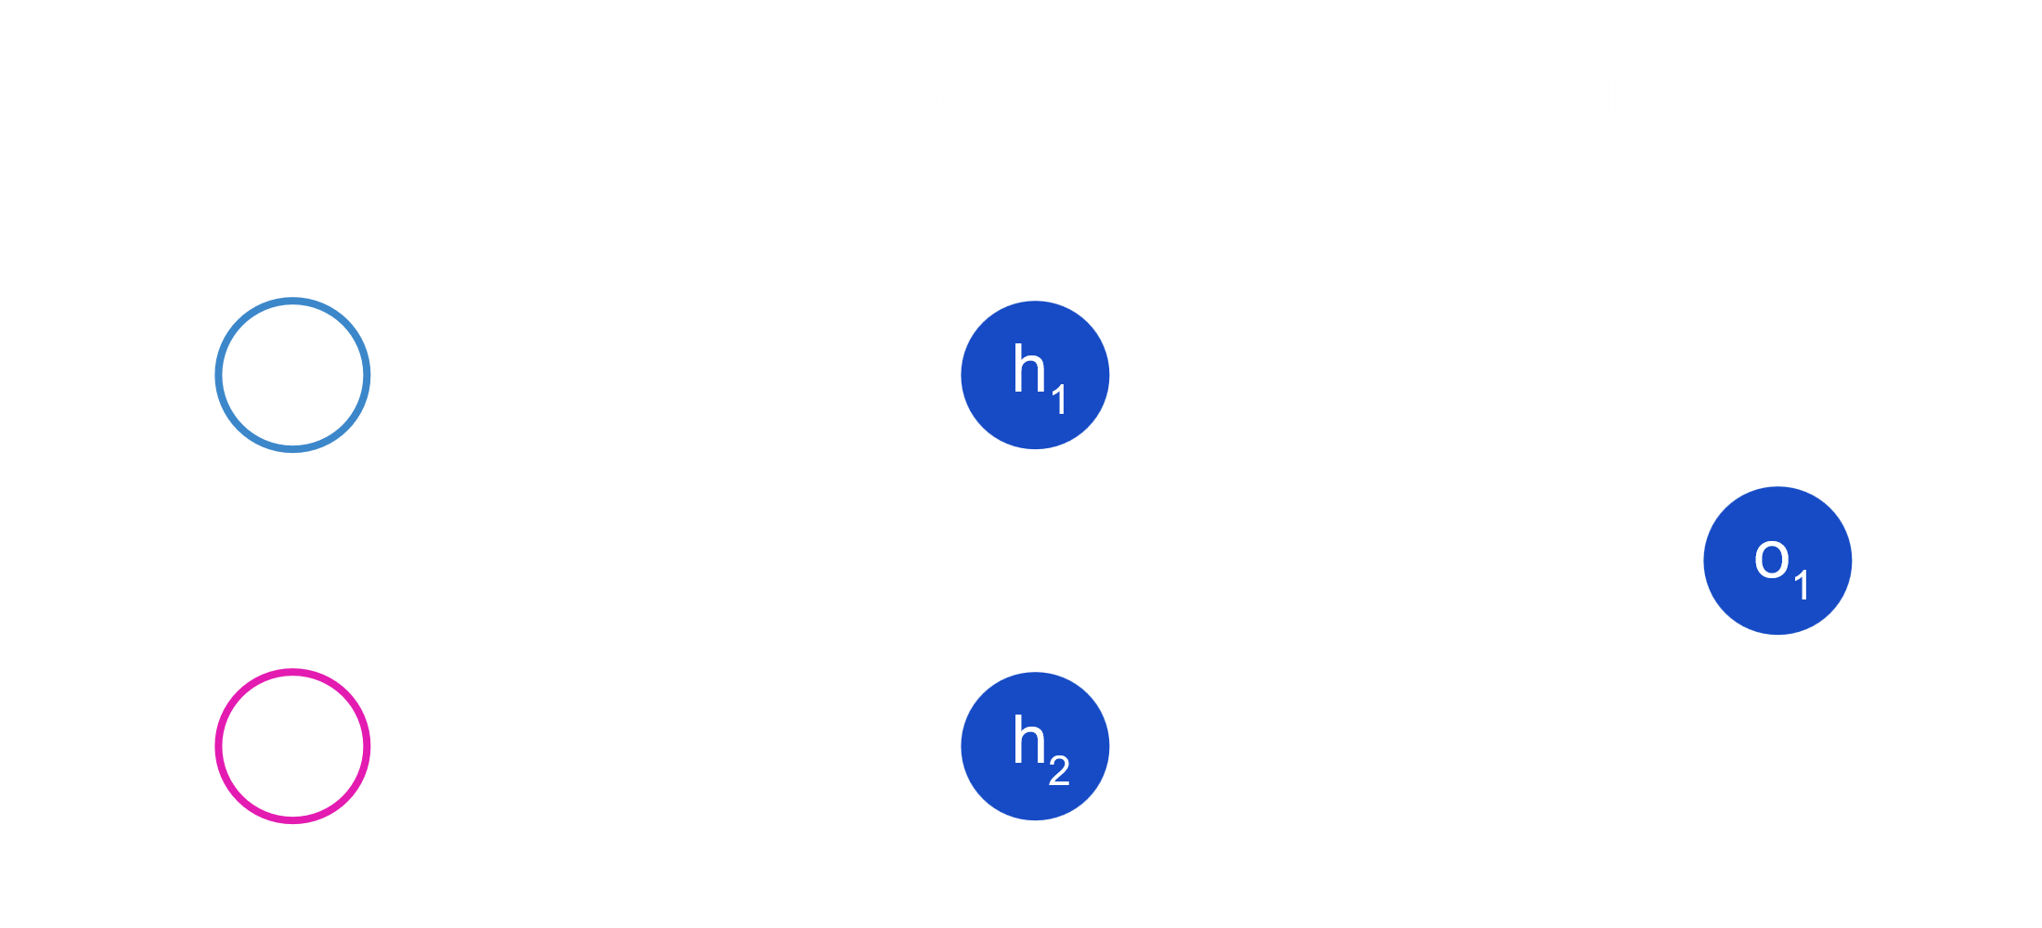
Neural Networks in a Nutshell
Mathematical neurons organized in layers that transform data
Each layer learns increasingly complex patterns and features
Simple operations stacked together create powerful pattern recognition
Universal approximation: can learn any continuous function
The foundation that makes modern AI possible
2/10

Slide 4
What is Automatic Differentiation?
Computes exact gradients efficiently for neural network training
Breaks complex functions into elementary operations with known derivatives
Applies chain rule systematically across
network parameters
Standard method enabling modern deep learning at scale
3/10

Slide 5
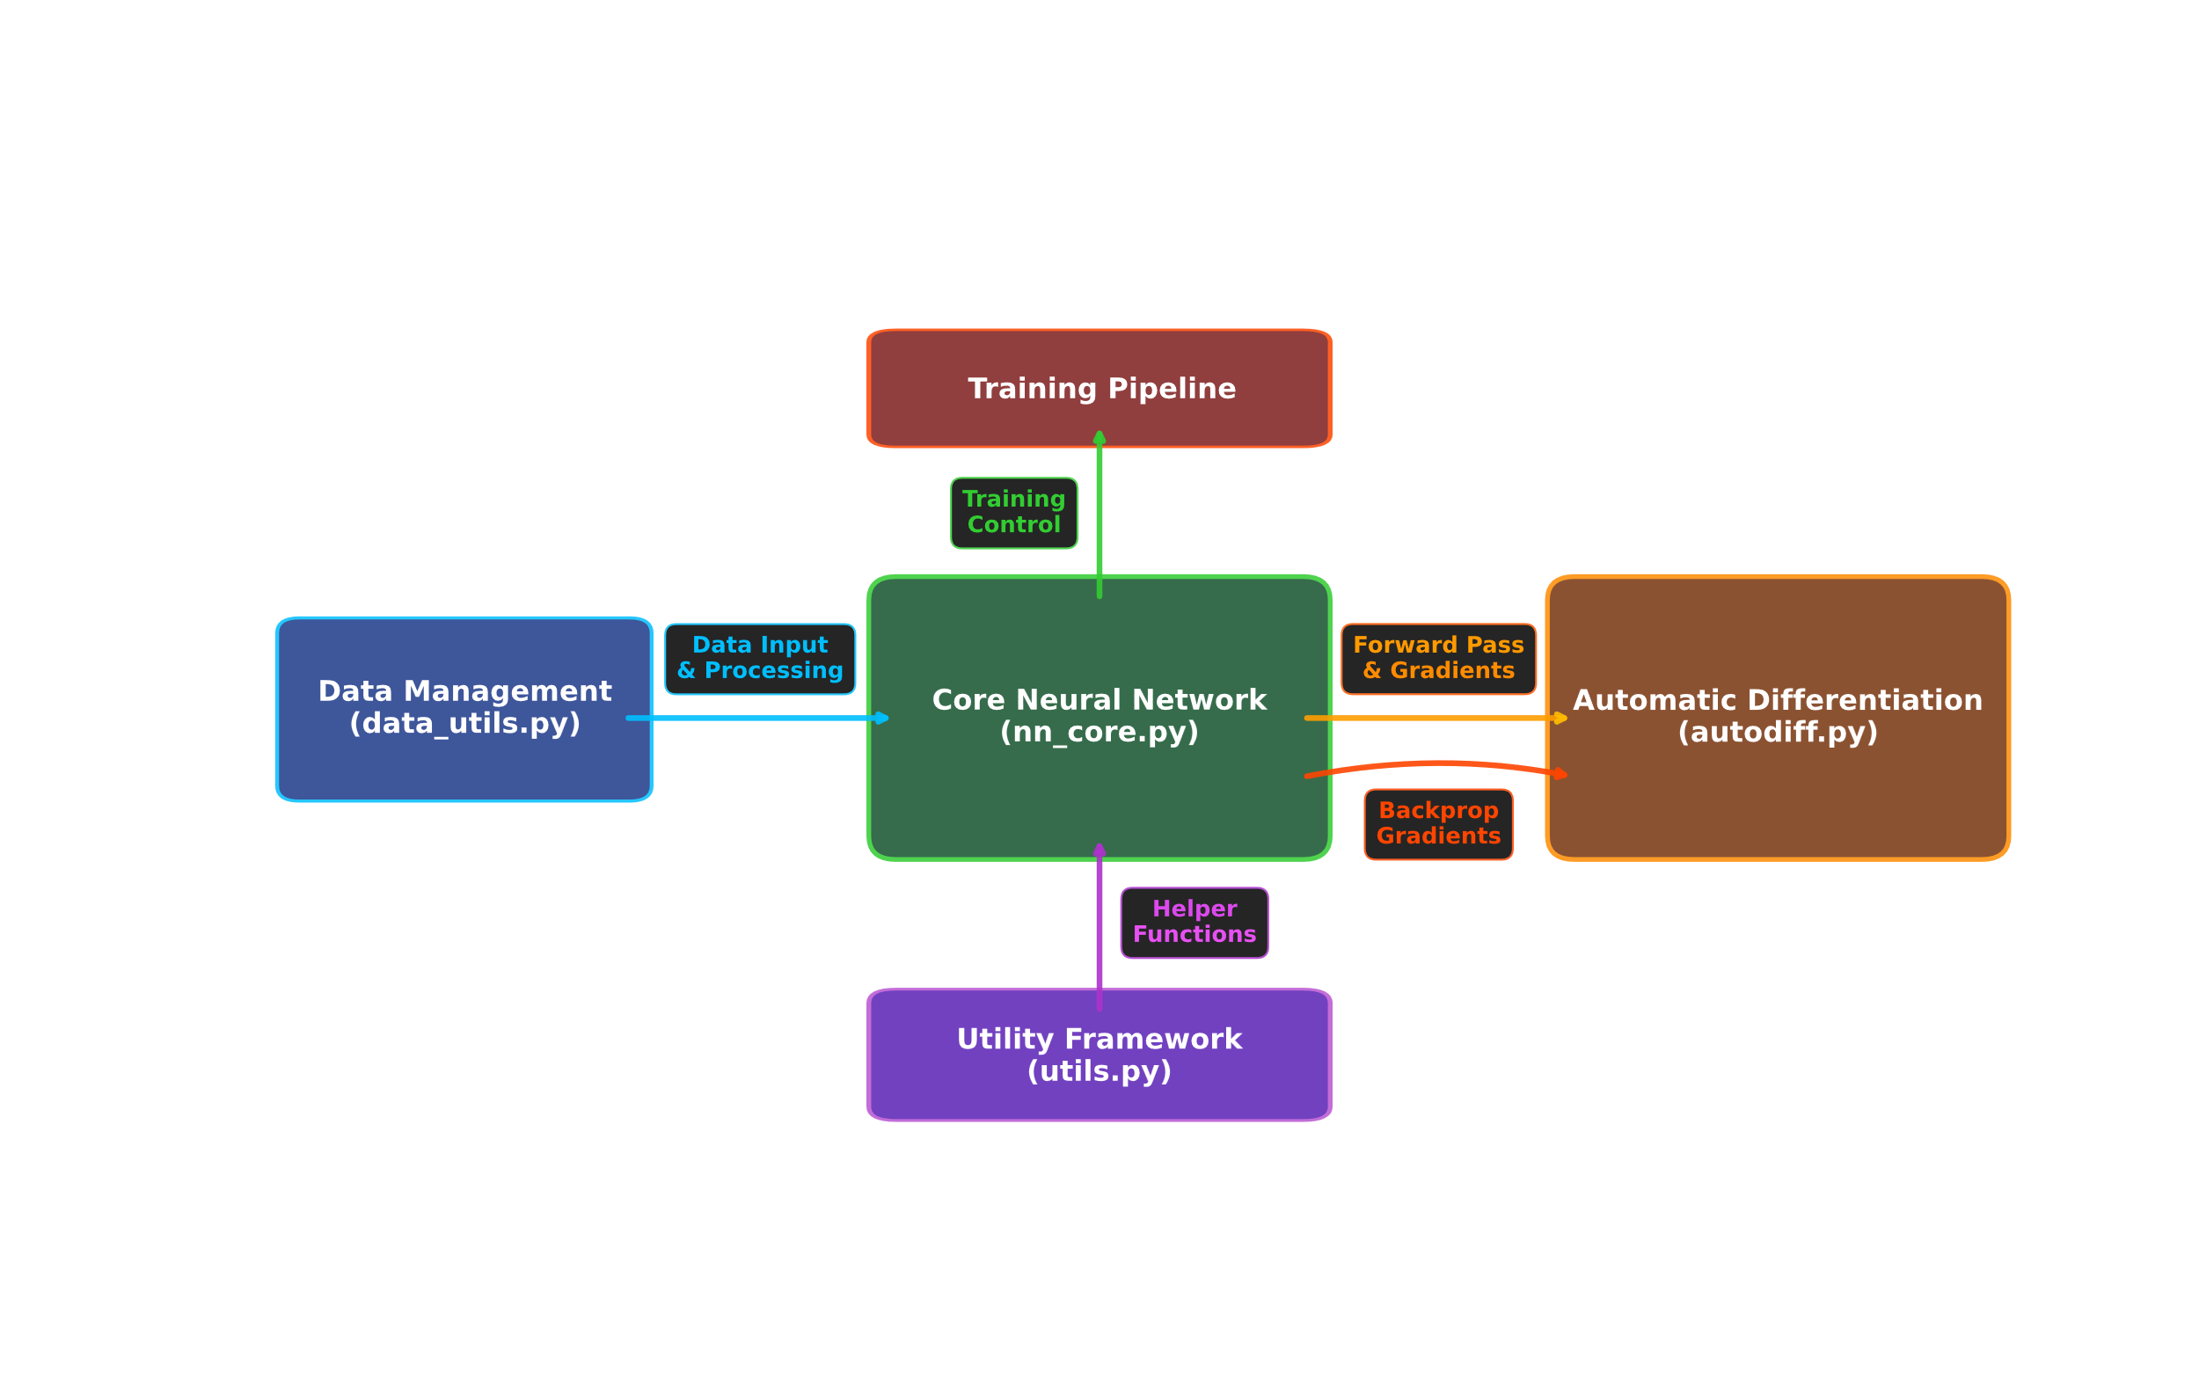
What I Built - Engine Overview
Three working applications proving real-world capability
SGD & Adam
Optimizers
9 activation functions
classics (ReLU, Sigmoid) to modern (Swish, GELU)
4/10

Slide 6
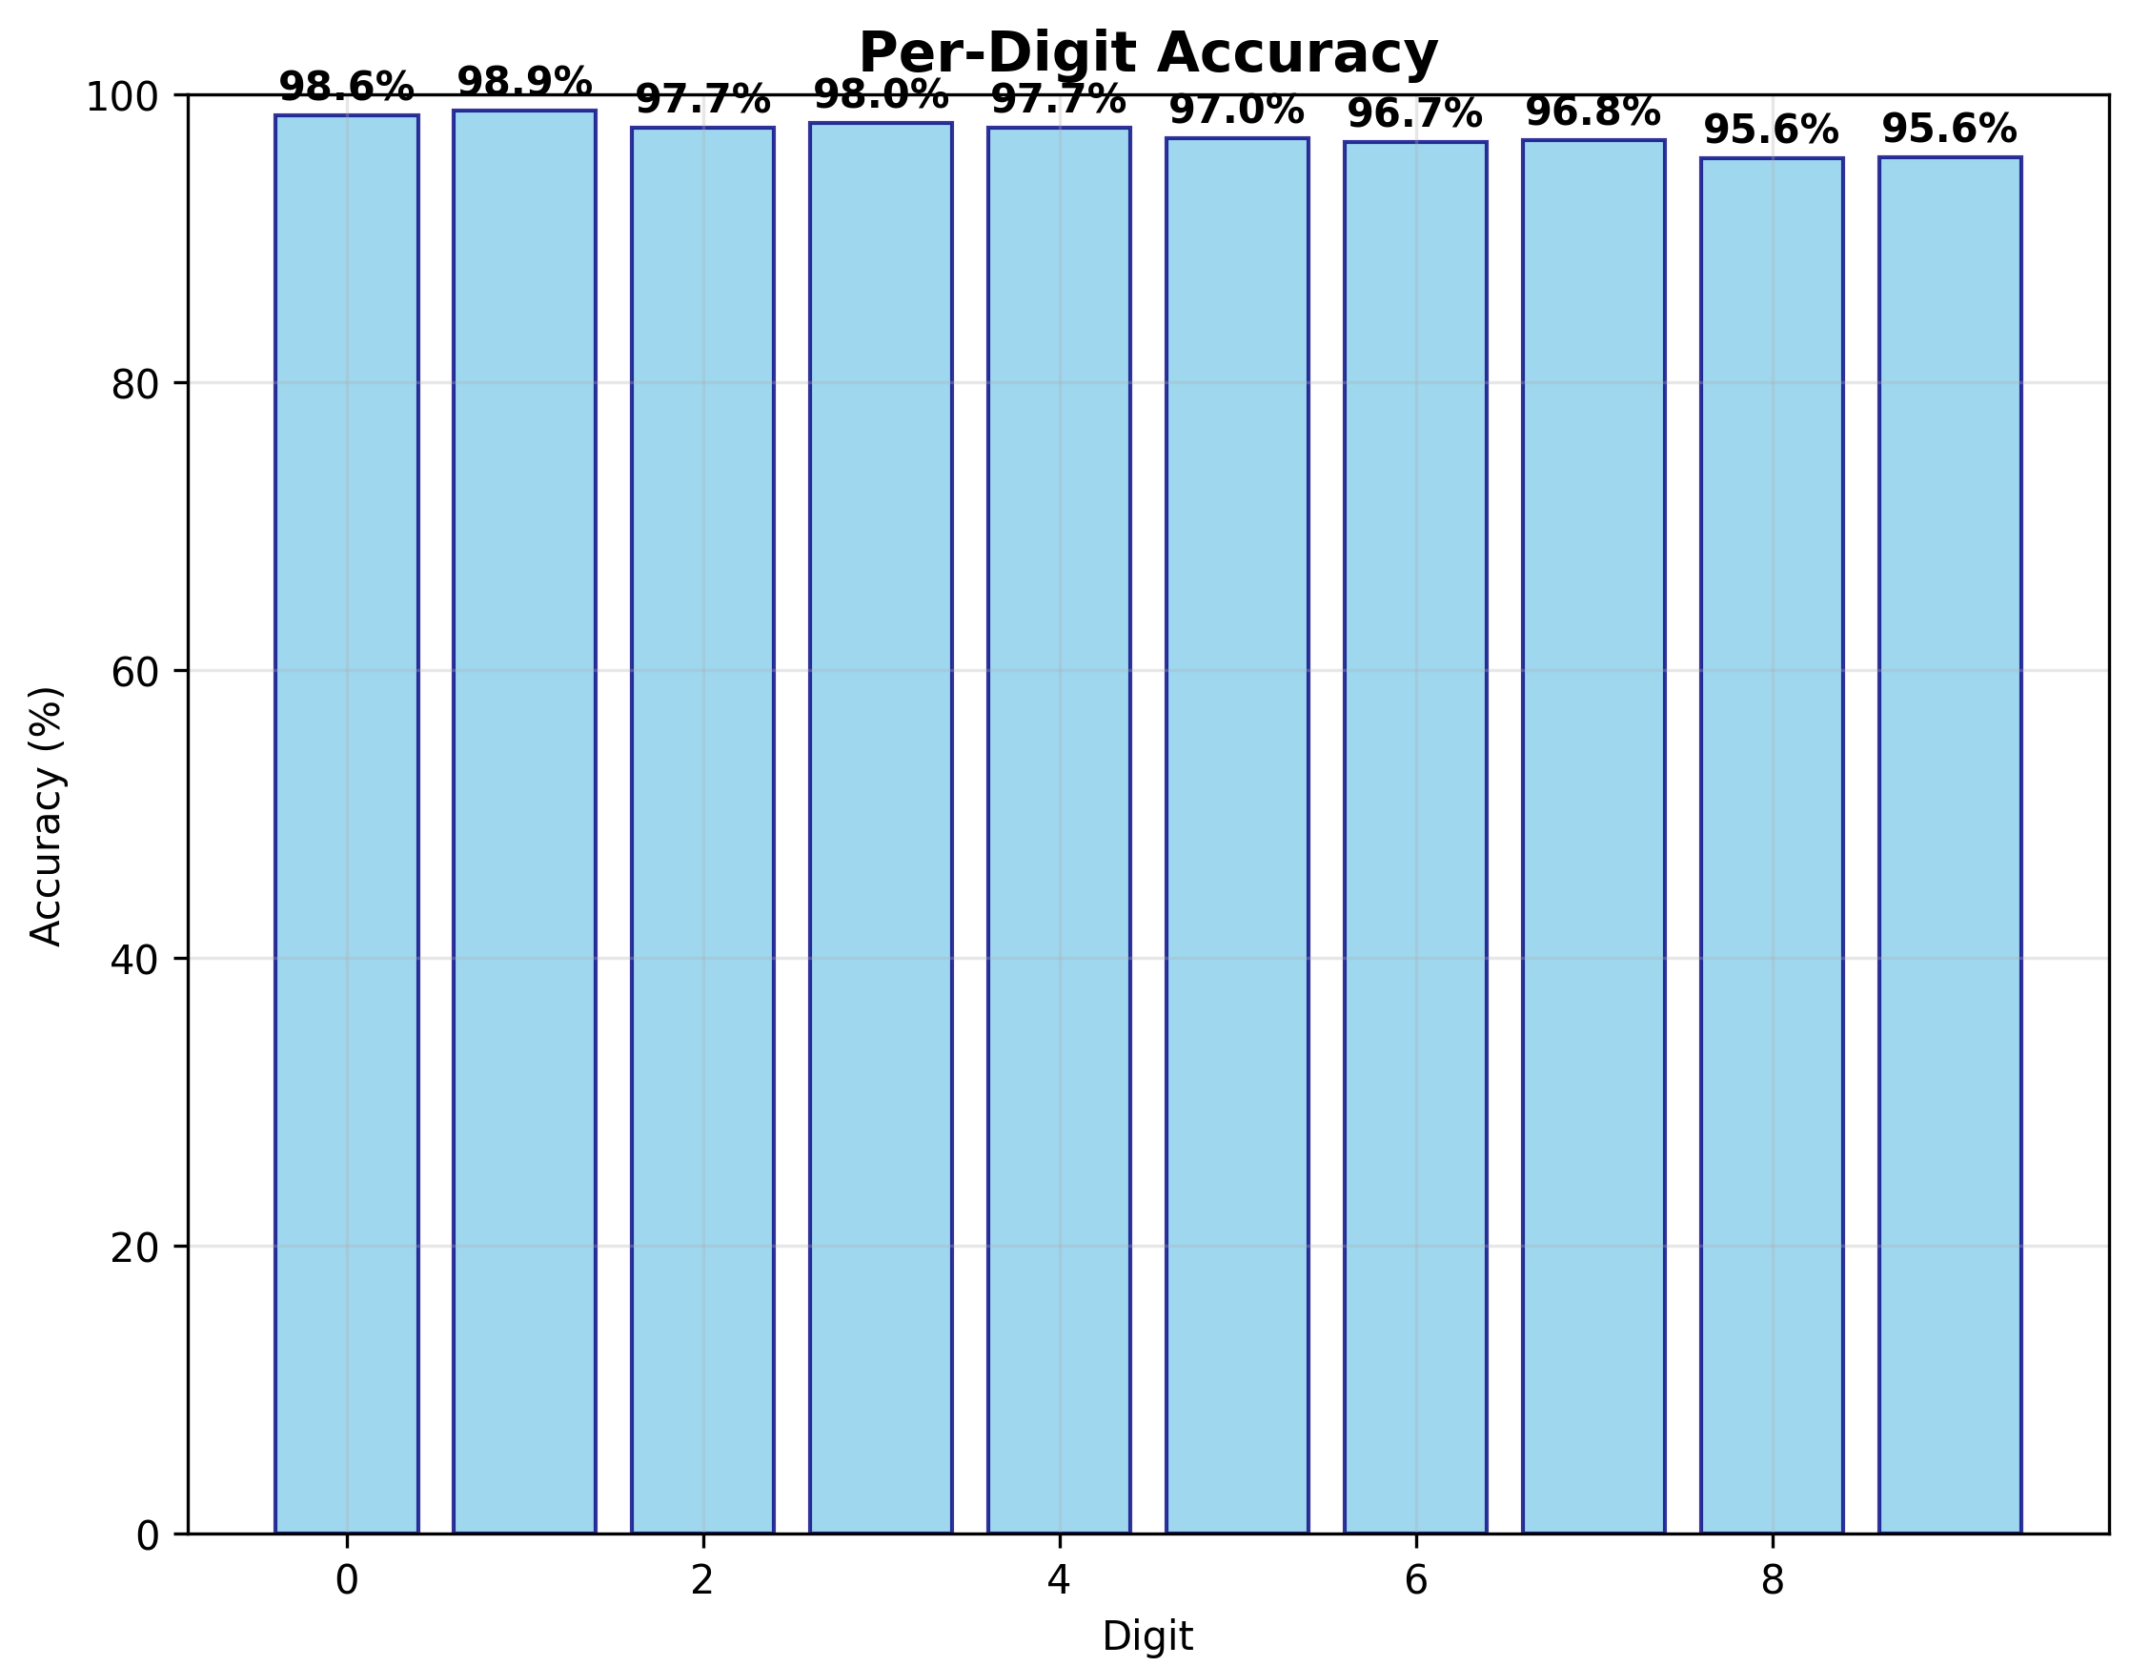
Key Results - Performance Showcase
Digit Recognition: 98.33% accuracy (Enhanced Model with EMNIST)
Universal Character Recognition: 81.45% accuracy across 62 classes (digits + letters)
Mathematical Innovation: Neural networks solving quadratic equations
Performance: >20,000 samples/second on standard hardware
Per-digit Accuracy (Avg. 98.33%)
5/10

Slide 7

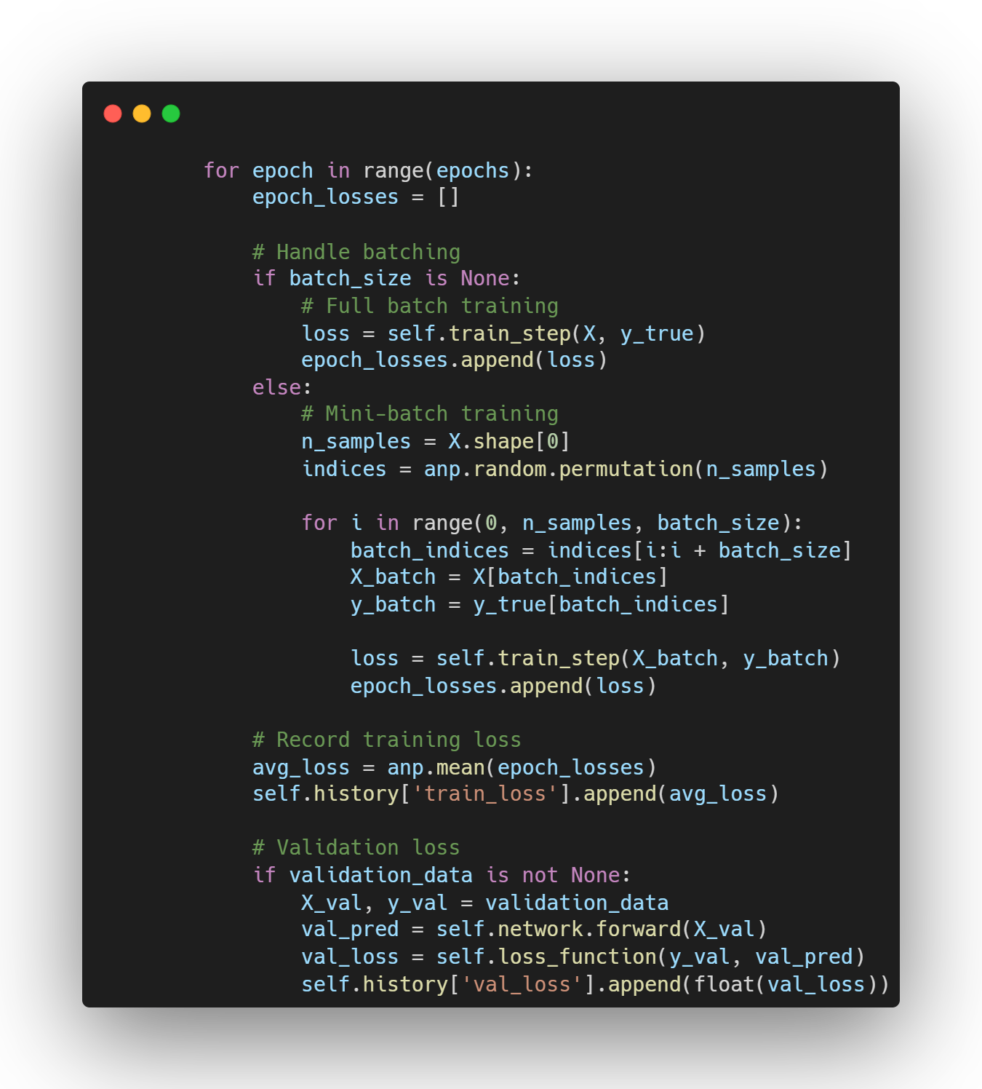
Technical Innovation Highlights
Transparent Implementation: Built from scratch for research and education
Robust Performance: Numerical stability with gradient clipping and overflow prevention
Modular Architecture: Easy component swapping and experimental customization
Proven Applications
6/10

Slide 8



Future Directions & Impact
Mathematical Research: Complete research paper on neural networks solving quadratic equations
Enhanced Recognition: Data augmentation and advanced techniques for superior digit classification
Performance Scaling: GPU acceleration enabling real-time applications and larger datasets
Educational Resource
7/10

Slide 9
DEMONSTRATION
Digit Recognizer
Neural Network Visualizer
Quadratic Equation Software Platform
8/10

Slide 10
Acknowledgements
Emil Kelevedjiev for:
Invaluable mentorship and support
Provision of essential resources
Expert guidance and insightful feedback
Commitment to this research endeavor
9/10

Slide 11


Thanks!
Author:
Matt Minev
matt.minev@gmail.com
Summer Research School 2025
Varna, Bulgaria

