Slide 1
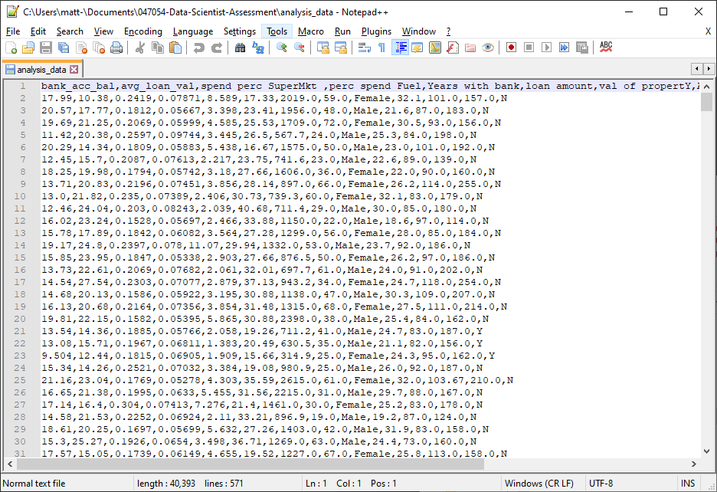
First step – what is the data?
For a simple file like this, first open in Notepad++
First thoughts: comma delimited file with newlines indicating new rows. First row is a header row with no consistent naming structure (some have underscores, some use spaces)

Slide 2
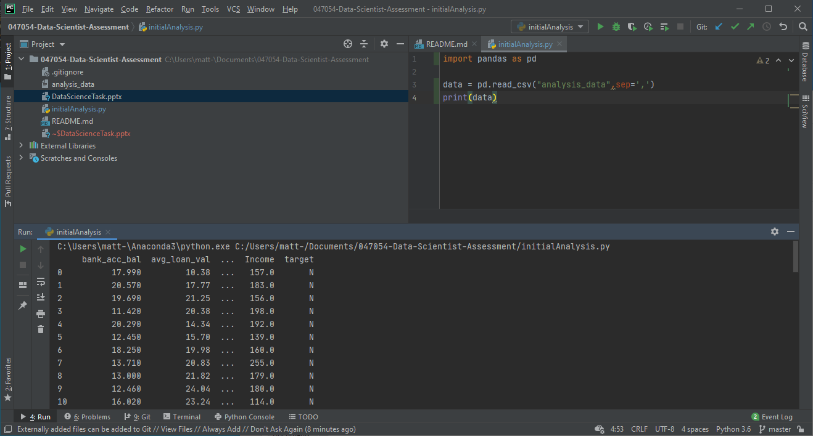
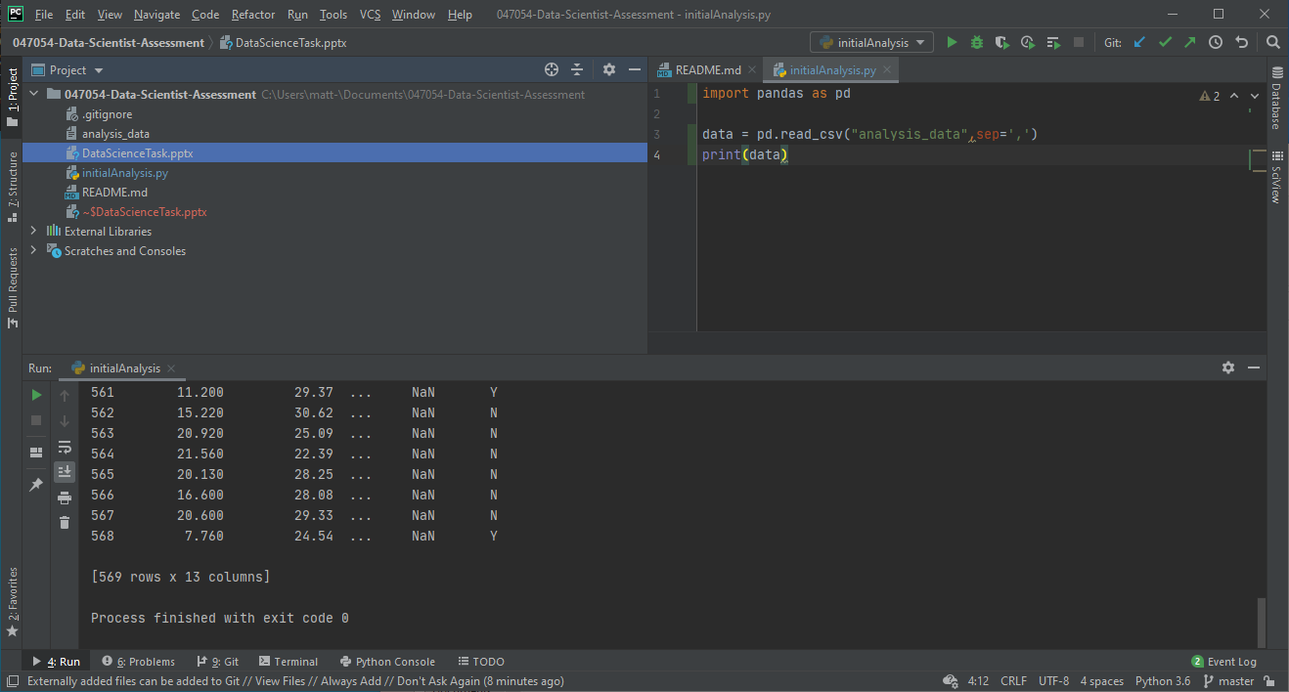
After identifying this is a standard comma delimited data file, import it into your language of choice – here I am using Python with the Pandas module (for simple tabular data handling)
Automatically using the first row as the header (the values of the first row are different from the rest of the column and appear like a header)
One thing I noticed is that the Income field has NaN entries in the income field. Knowing this I did a full check of the data.

Slide 3
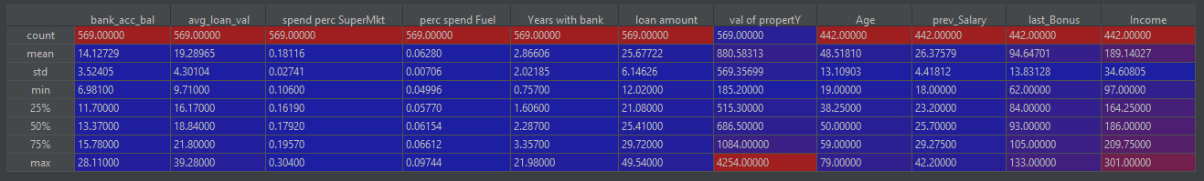
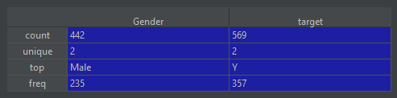
data.info()
<class 'pandas.core.frame.DataFrame'>
RangeIndex: 569 entries, 0 to 568
Data columns (total 13 columns):
bank_acc_bal 569 non-null float64
avg_loan_val 569 non-null float64
spend perc SuperMkt 569 non-null float64
perc spend Fuel 569 non-null float64
Years with bank 569 non-null float64
loan amount 569 non-null float64
val of propertY 569 non-null float64
Age 442 non-null float64
Gender 442 non-null object
prev_Salary 442 non-null float64
last_Bonus 442 non-null float64
Income 442 non-null float64
target 569 non-null object
dtypes: float64(11), object(2)
memory usage: 57.9+ KB
bank_acc_bal 0
avg_loan_val 0
spend perc SuperMkt 0
perc spend Fuel 0
Years with bank 0
loan amount 0
val of propertY 0
Age 127
Gender 127
prev_Salary 127
last_Bonus 127
Income 127
target 0

Slide 4
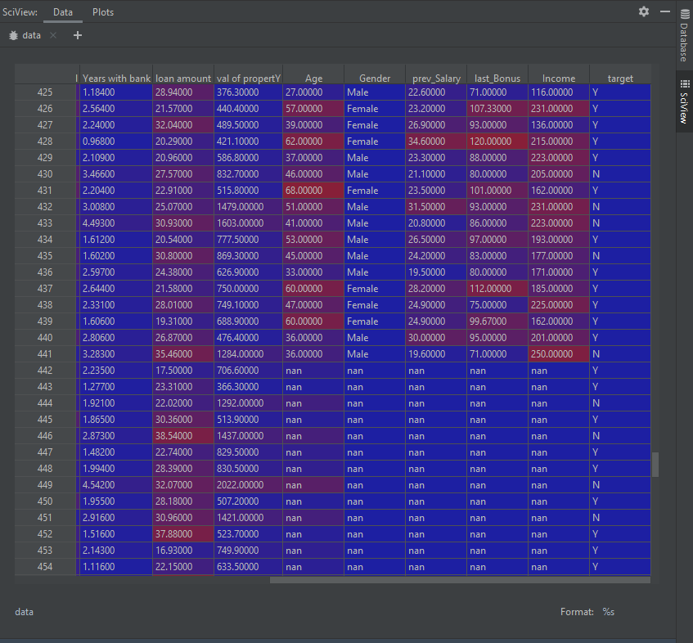
SciView in PyCharm has some very good debug and data review tools, I was looking through the data in table view.
Multiple columns have nan values – primarily rows 443-569

