Slide 1
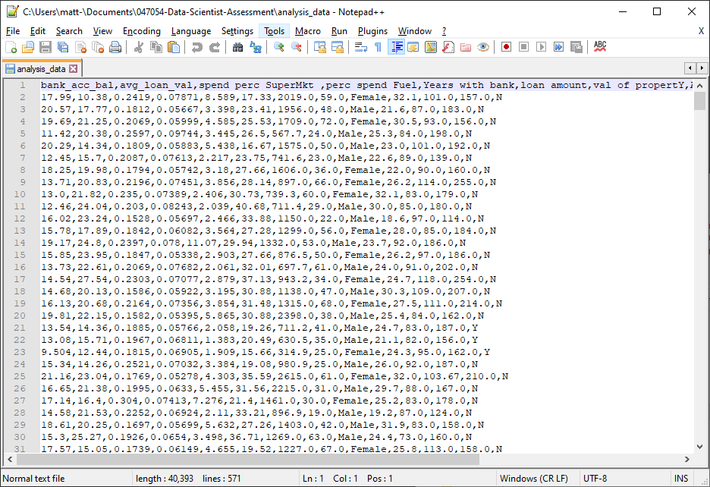
First step – what is the data?
For a simple file like this, first open in Notepad++

Slide 2
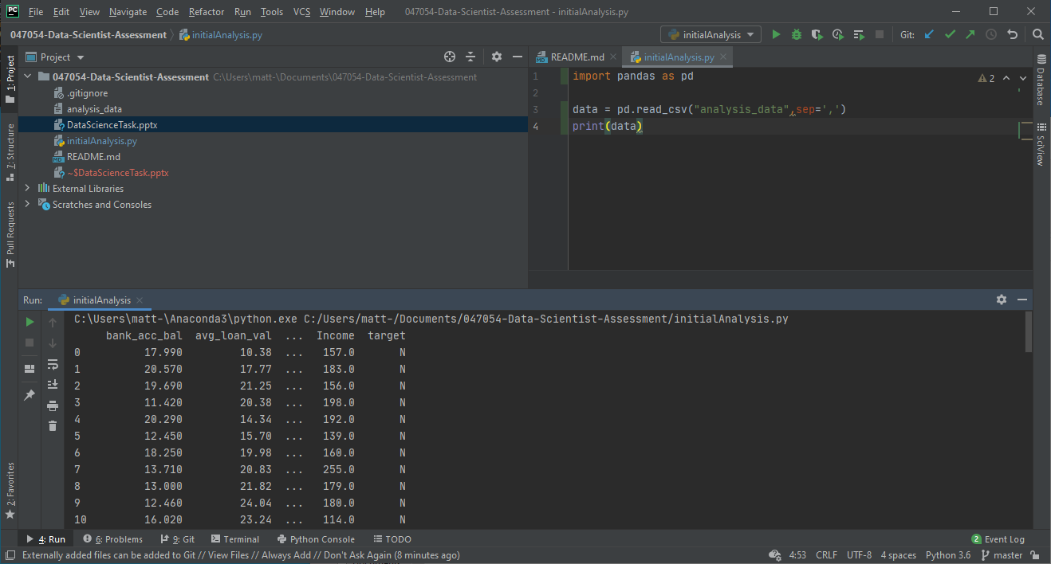
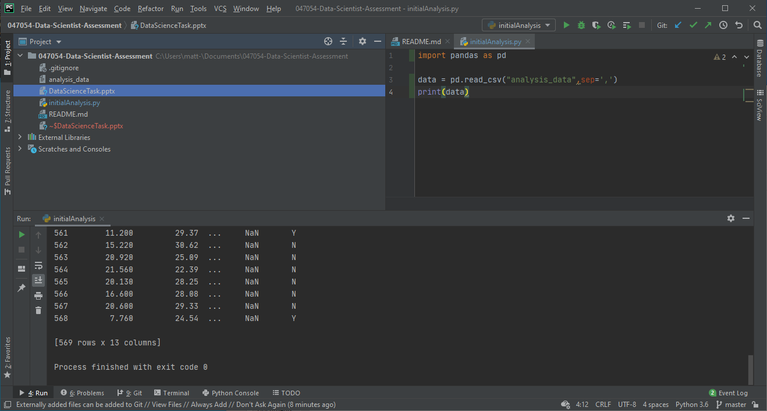
After identifying this is a standard comma delimited data file, import it into your language of choice – here I am using Python with the Pandas module (for simple tabular data handling)
Automatically using the first row as the header (the values of the first row are different from the rest of the column and appear like a header)
One thing I noticed is that the Income field has NaN entries in the income field. Knowing this I did a full check of the data.

Slide 3
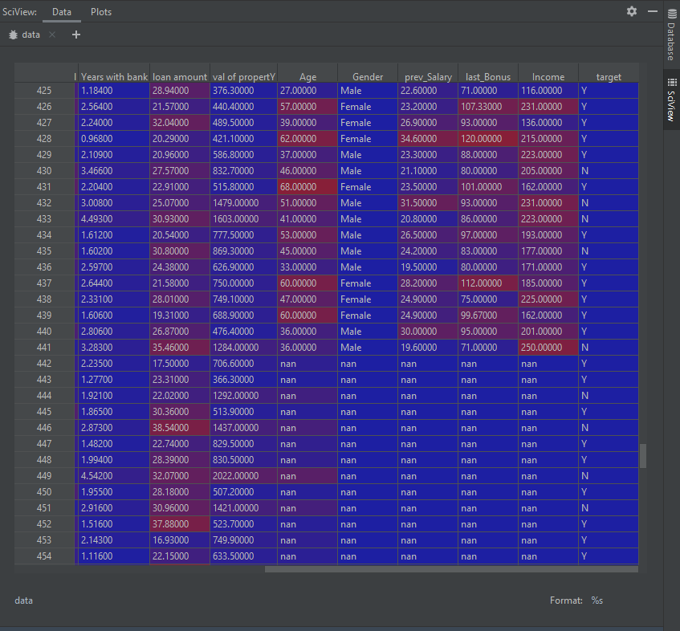
SciView in PyCharm has some very good debug and data review tools, I was looking through the data in table view.
Multiple columns have nan values – primarily rows 443-569

