Slide 1
Census Income Data
Motivation:
Can we accurately predict a person’s income from their demographic information such as age, education, marital status.
Objectives:
Build a model to best predict whether a person’s income will be less than or greater than $50K based on their census data.
Notes:
How's it going. My name is Matt.
My project is about Lumber Prices. Recently I was talking to a friend of mine who is building a house in Maine. She said that the cost of lumber was a big problem for her.
That made me kind of curious so I looked at the charts for lumber prices and there are big swings in price that can have significant impacts on housing prices.
For this project I pulled lumber price data and other economic metrics looking for correlations. My ultimate goal was to build a predictive model but that turned out to be a little bit out of the scope of this project.

Slide 2
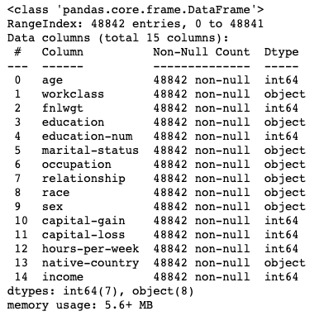





Data and Tools
Notes:
So while working on my data pipeline, I tried a couple different things before ending up with what's on this slide.
Initially, I wanted to use MongoDB but all the data I was getting from webscraping and API's was very structured so it just made sense to use SQL for both data storage and for some processing.
Also, at first I planned on using Docker, AWS, and a Flask App but when I saw how Heroku worked I switched to a Flask App and Heroku and even deployed a simple app for my MVP. However, I went with Streamlit in the end because it was so much easier to work with.

Slide 3
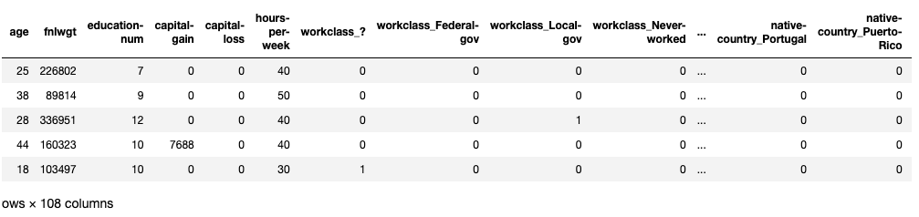
Processing Data and Feature Engineering
Cleaned Data removed 10 lines of nulls
Scaled Data for K-nearest neighbors
Created dummy columns to convert categorical data
Converted >= $50K to 1 and < $50K to 0
Notes:
I wound up with about 20 tables in Snowflake and as I was aggregating and combining the data my biggest problem was getting different date formats and date ranges to join. To solve all the different dates, I made a custom table that let me join each of the other tables and output a consistent date for the final table.
I also scaled the data in python so all the different metrics would be in the 0 to 1 range and could be compared more easily on line charts.

Slide 4
Model Comparison
 | K nearest neighbor | Logistic Regression | Decision Tree | Random Forest | Extra Trees | XG Boost
Optimized for | N_neighbors | Class_weight | Max_depth | Max_depth | Max_depth | Class_weight
Accuracy | 84.2% | 80.3% | 85.5% | 86.9% | 85.3% | 87.5%
F1 | 63.1% | 39.2% | 67.1% | 69.2% | 65.3% | 71.4%
Notes:
Here's a screenshot of the the streamlit app that I deployed to the Cloud.
You can pick time ranges and then pick from one or more of the metrics with the checkboxes. It defaults to lumber prices being picked because of the focus of the project but you can still unselect it if you want to compare other metrics more easily.

Slide 5
Tuning the XGBoost model
Additional tuning Boost included learning_rate = .2, gamma = 7, scale_pos_weight = 2
Randomized Search included learning_rate, n_estimators, min_child_weight, gamma, subsample, max_depth, and scale_pos_weight
 | XG Boost | XG Boost Additional Tuning | XG Boost Randomized Search with F1
Accuracy | 87.5% | 87.8% | 85.6%
F1 | 71.4% | 71.8% | 72.1%
Notes:
So here's another screenshot of the app with two other metrics picked. It's really cool that streamlit / plotly automatically assigns the colors and adds the legend as soon as there is more than one metric picked.
As I mentioned before the data is scaled from 0 to 1 on the Y axis so you can compare trends more easily.

Slide 6
Next Steps
Review column fnlwgt and how that weighting could affect the model.
Explore other ways to tune the Random Forest model.
Implement an Object Oriented Programming approach.
Standardize the train test validate approach used.
Notes:
Really this is mostly Next Steps because this project got mostly to the beginning of Exploratory Data Analysis.
I see some metrics that seem promising but I think there is room to pull in more data sources.
And then as I said before I would like to build a predictive model.
Finally there is more room for automation. I do have a Cron job on AWS that is running a python job to update the data on a weekly basis but there are still manual steps involved in updating the app.

Slide 7
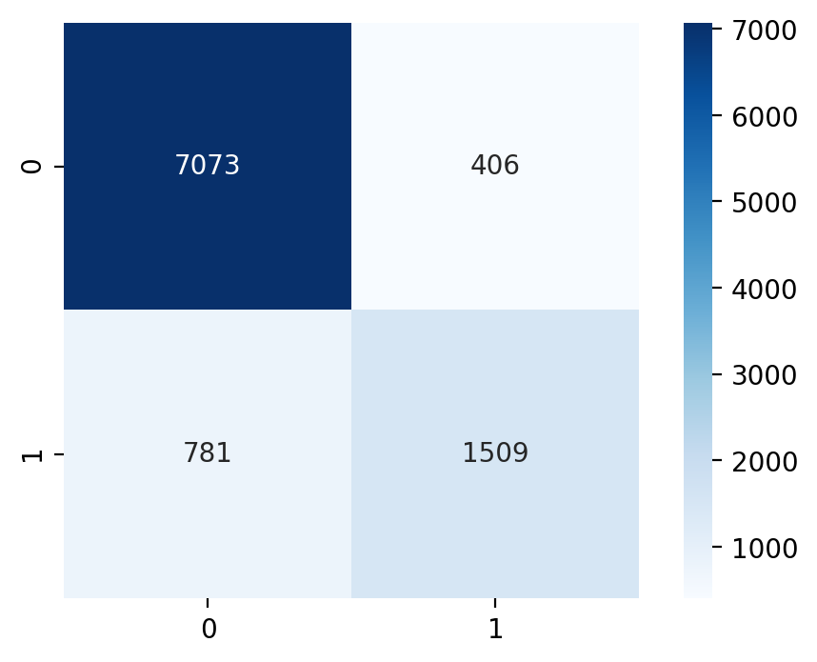
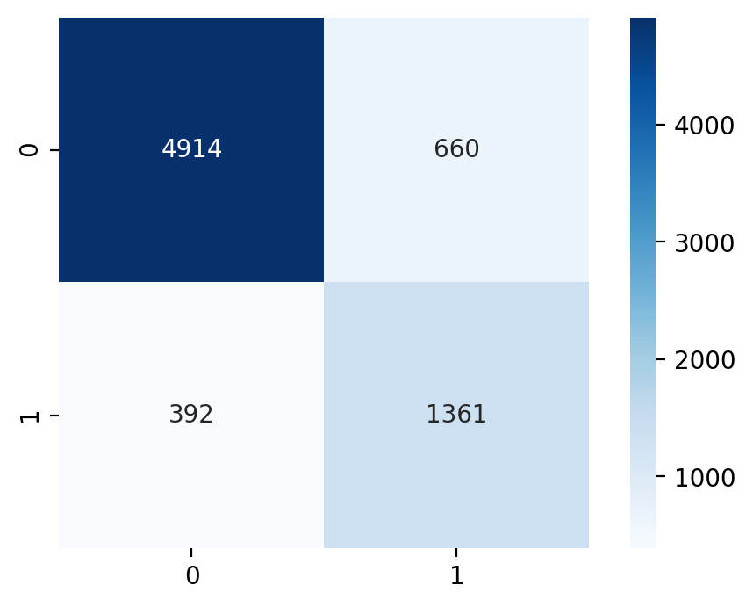
Confusion Matrixes – XG Boost
XG Boost Additional Tuning
XG Boost Randomized Search F1
Notes:
Really this is mostly Next Steps because this project got mostly to the beginning of Exploratory Data Analysis.
I see some metrics that seem promising but I think there is room to pull in more data sources.
And then as I said before I would like to build a predictive model.
Finally there is more room for automation. I do have a Cron job on AWS that is running a python job to update the data on a weekly basis but there are still manual steps involved in updating the app.

Slide 8
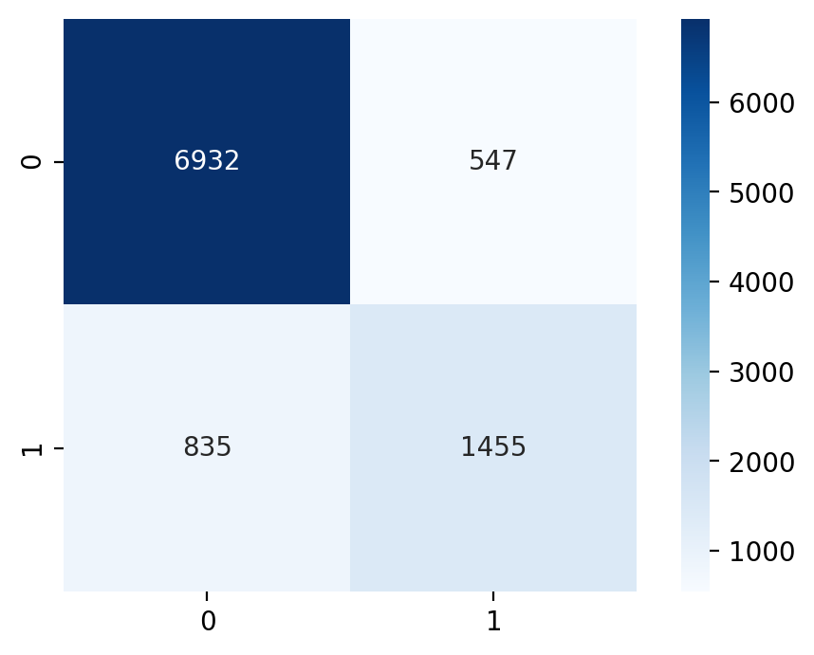
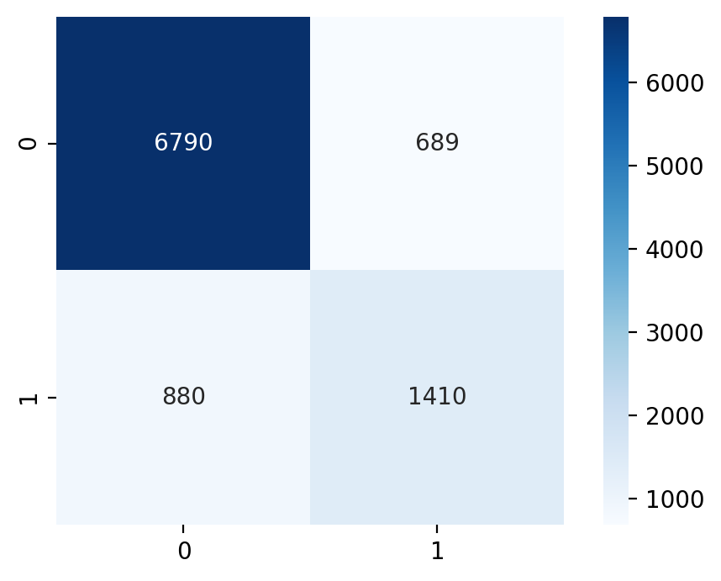
Confusion Matrixes – Random Forest and Extra Trees
Random Forest
Extra Trees
Notes:
Really this is mostly Next Steps because this project got mostly to the beginning of Exploratory Data Analysis.
I see some metrics that seem promising but I think there is room to pull in more data sources.
And then as I said before I would like to build a predictive model.
Finally there is more room for automation. I do have a Cron job on AWS that is running a python job to update the data on a weekly basis but there are still manual steps involved in updating the app.

Slide 9
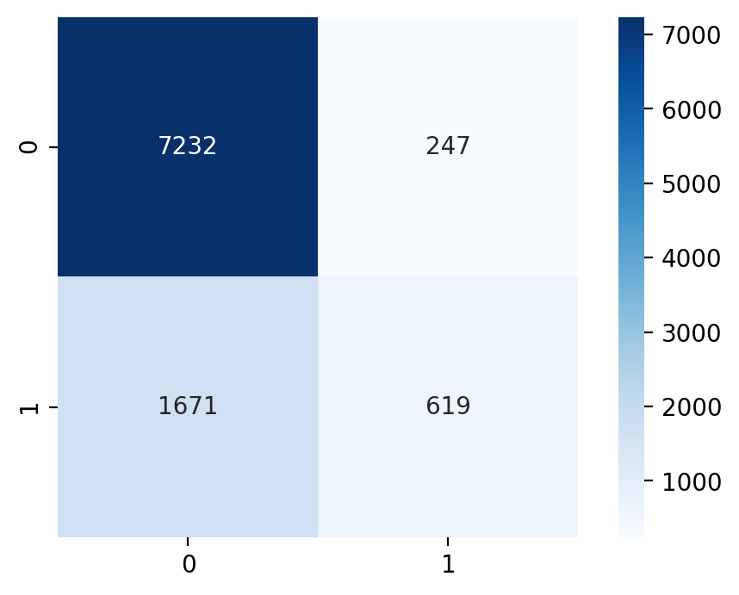
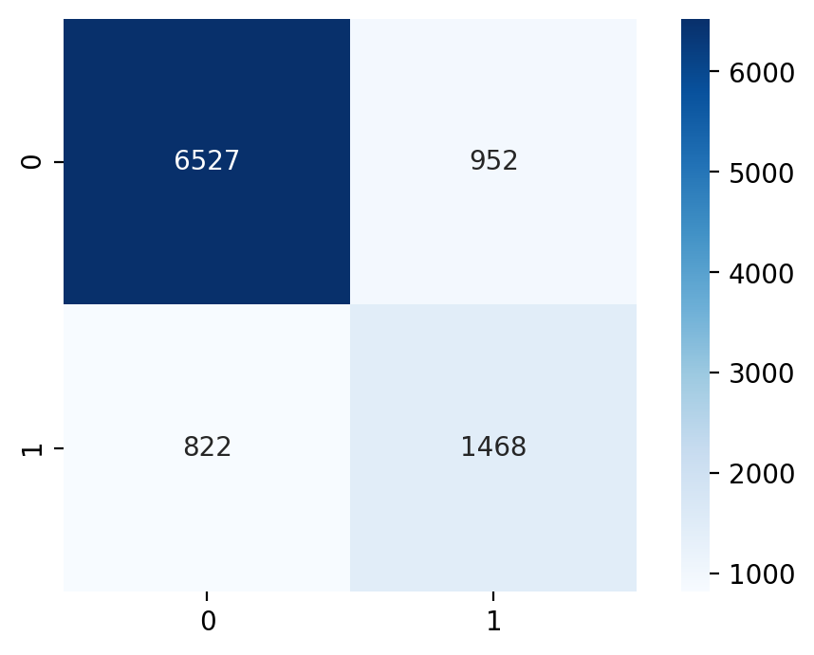
Confusion Matrixes – Logistic Regression and Decision Trees
Logistic Regression
Decision Trees
Notes:
Really this is mostly Next Steps because this project got mostly to the beginning of Exploratory Data Analysis.
I see some metrics that seem promising but I think there is room to pull in more data sources.
And then as I said before I would like to build a predictive model.
Finally there is more room for automation. I do have a Cron job on AWS that is running a python job to update the data on a weekly basis but there are still manual steps involved in updating the app.

Slide 10
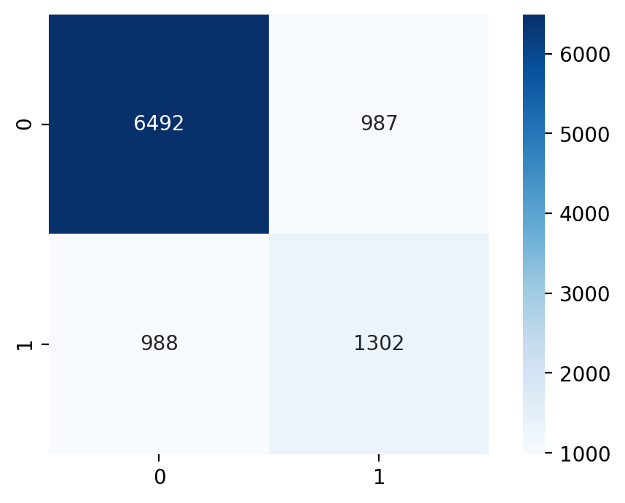
Confusion Matrixes – Knn
Knn
Notes:
Really this is mostly Next Steps because this project got mostly to the beginning of Exploratory Data Analysis.
I see some metrics that seem promising but I think there is room to pull in more data sources.
And then as I said before I would like to build a predictive model.
Finally there is more room for automation. I do have a Cron job on AWS that is running a python job to update the data on a weekly basis but there are still manual steps involved in updating the app.

Slide 11
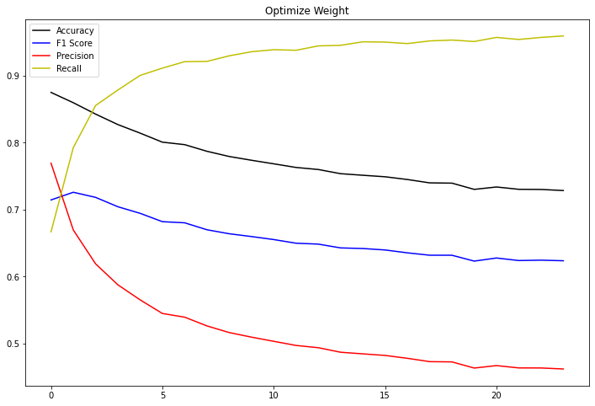
Metrics with Optimize Weight in XGBoost
Notes:
Really this is mostly Next Steps because this project got mostly to the beginning of Exploratory Data Analysis.
I see some metrics that seem promising but I think there is room to pull in more data sources.
And then as I said before I would like to build a predictive model.
Finally there is more room for automation. I do have a Cron job on AWS that is running a python job to update the data on a weekly basis but there are still manual steps involved in updating the app.

Slide 12
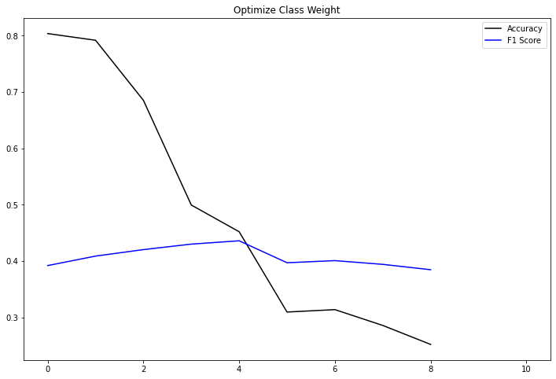
Metrics with Optimize Weight – Log Regression
Notes:
Really this is mostly Next Steps because this project got mostly to the beginning of Exploratory Data Analysis.
I see some metrics that seem promising but I think there is room to pull in more data sources.
And then as I said before I would like to build a predictive model.
Finally there is more room for automation. I do have a Cron job on AWS that is running a python job to update the data on a weekly basis but there are still manual steps involved in updating the app.

