Slide 1
New York Times vs The Onion
Motivation:
With the current climate of “fake” news and strange news, it’s important to be able to distinguish actual news stories from other types like satire.
Objectives:
Can we build a model that can distinguish between a New York Times article and an Onion article?

Slide 2
NLP Workflow
DATA
Pulled Onion and NYT times data from Kaggle
EDA
Python and Scattertext
CLUSTERING
K-means
SUPERVISED LEARNING
Random Forest and XGBoost
PRE-PROCESSING
Nltk, sklearn, and SpaCy to clean, tokenize, remove stop words, and vectorize
DIMENSIONALITY REDUCTION
PCA and topic modeling with LSA, NMF, LDA

Slide 3
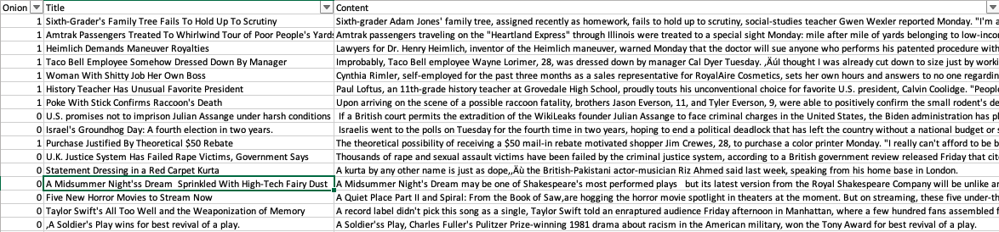
Data

Slide 4
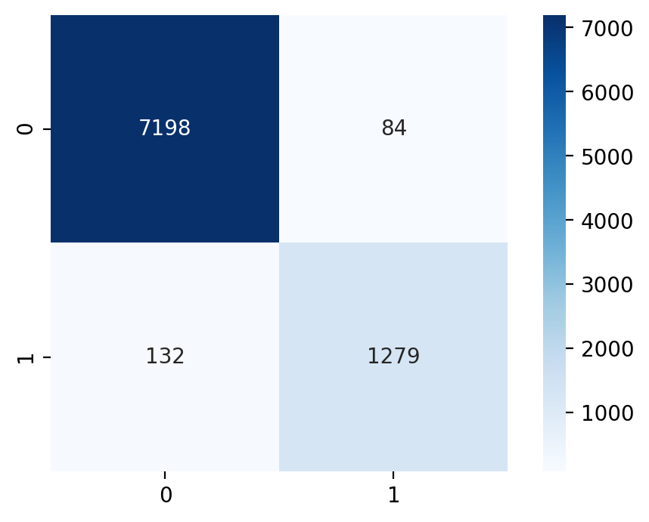
PCA and Random Forest
Accuracy | Precision | Recall | F1
97.5% | 93.8% | 90.6% | 92.2%
False Negatives Examples:
Radical Islamic Extremists Snowboard Into U.S. Embassy Extremist board-trick crew Al-J'Aqasse, the Middle East's most prominent Islamic radical snowboard posse, is taking full props for destroying the American embassy when a member nailed a goofyfoot 720 nosehook from a security-barrier railgrind into its offices while carrying 25 kilos of C4 plastic.
Earth Explodes In a move astronomers are calling ‚surprising, the planet earth violently exploded yesterday, shattering into billions of tiny fragments and killing all life existing on it. ‚From all indications, the planet just spontaneously combusted, said James Frye of Stanford‚ Palomar Observatory. We’ll know more after we examine soil samples.
The Onion Wins Nobel Prize American newspaper The Onion received a Nobel Prize this week in the category of Overall Excellence. The award, which marks the 12th time The Onion has been honored as a Nobel laureate, was presented in recognition of what the prize committee called “The Onion’s massive and enduring contribution to overall excellence in all fields”

Slide 5
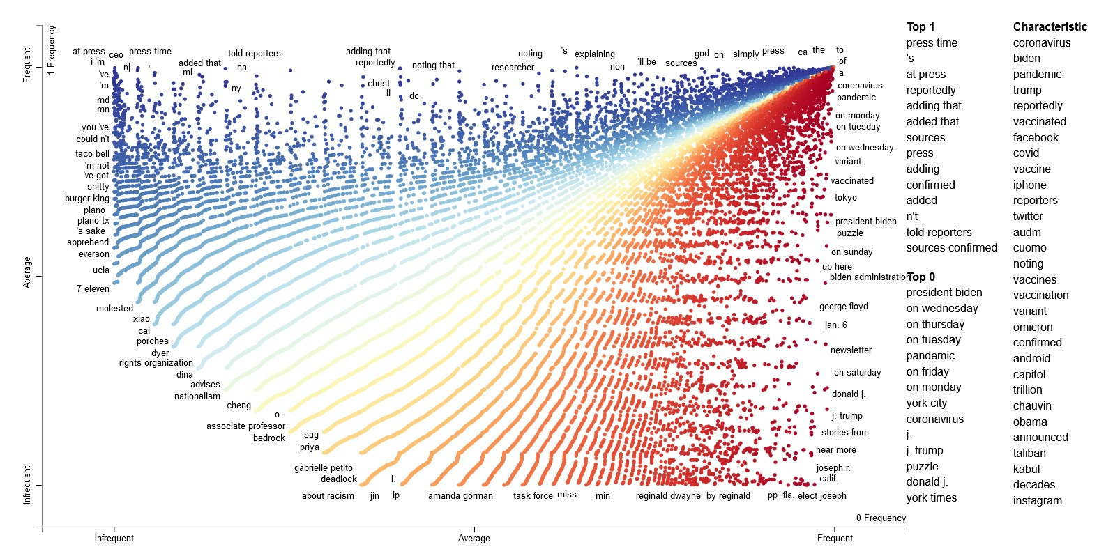
Scatter Text

Slide 6
Conclusions and Next Steps
Definitely possible to use NLP to get good results but false negatives can cause issues
Pursue using n-grams instead of single words based on analysis of the scatter text chart.
Try out additional clustering methods and algorithm tuning.

