Slide 1
Lumber Prices
Motivation:
Since late 2020, lumber prices have seen a large amount of volatility ranging from $300 to $1700 per thousand board feet. About 30% of a new home’s material cost is lumber, so these price changes can have a significant impact on housing costs.
Objectives:
Pull lumber data as well as other economic metrics and build an app to help search for correlations in the price swings.

Slide 2
Data Pipeline
DATA INGESTION
Webscrape and APIs using Python
DATA STORAGE
SQL database using Sqlite
PROCESSING
Data is aggregated and cleaned using SQL, Python with pandas
TESTING/ROBUSTNESS
Scheduled a Cron job on AWS to update the data weekly.
DEPLOYMENT
Deployed a streamlit app on the Cloud with python, plotly, and Git-Hub

Slide 3
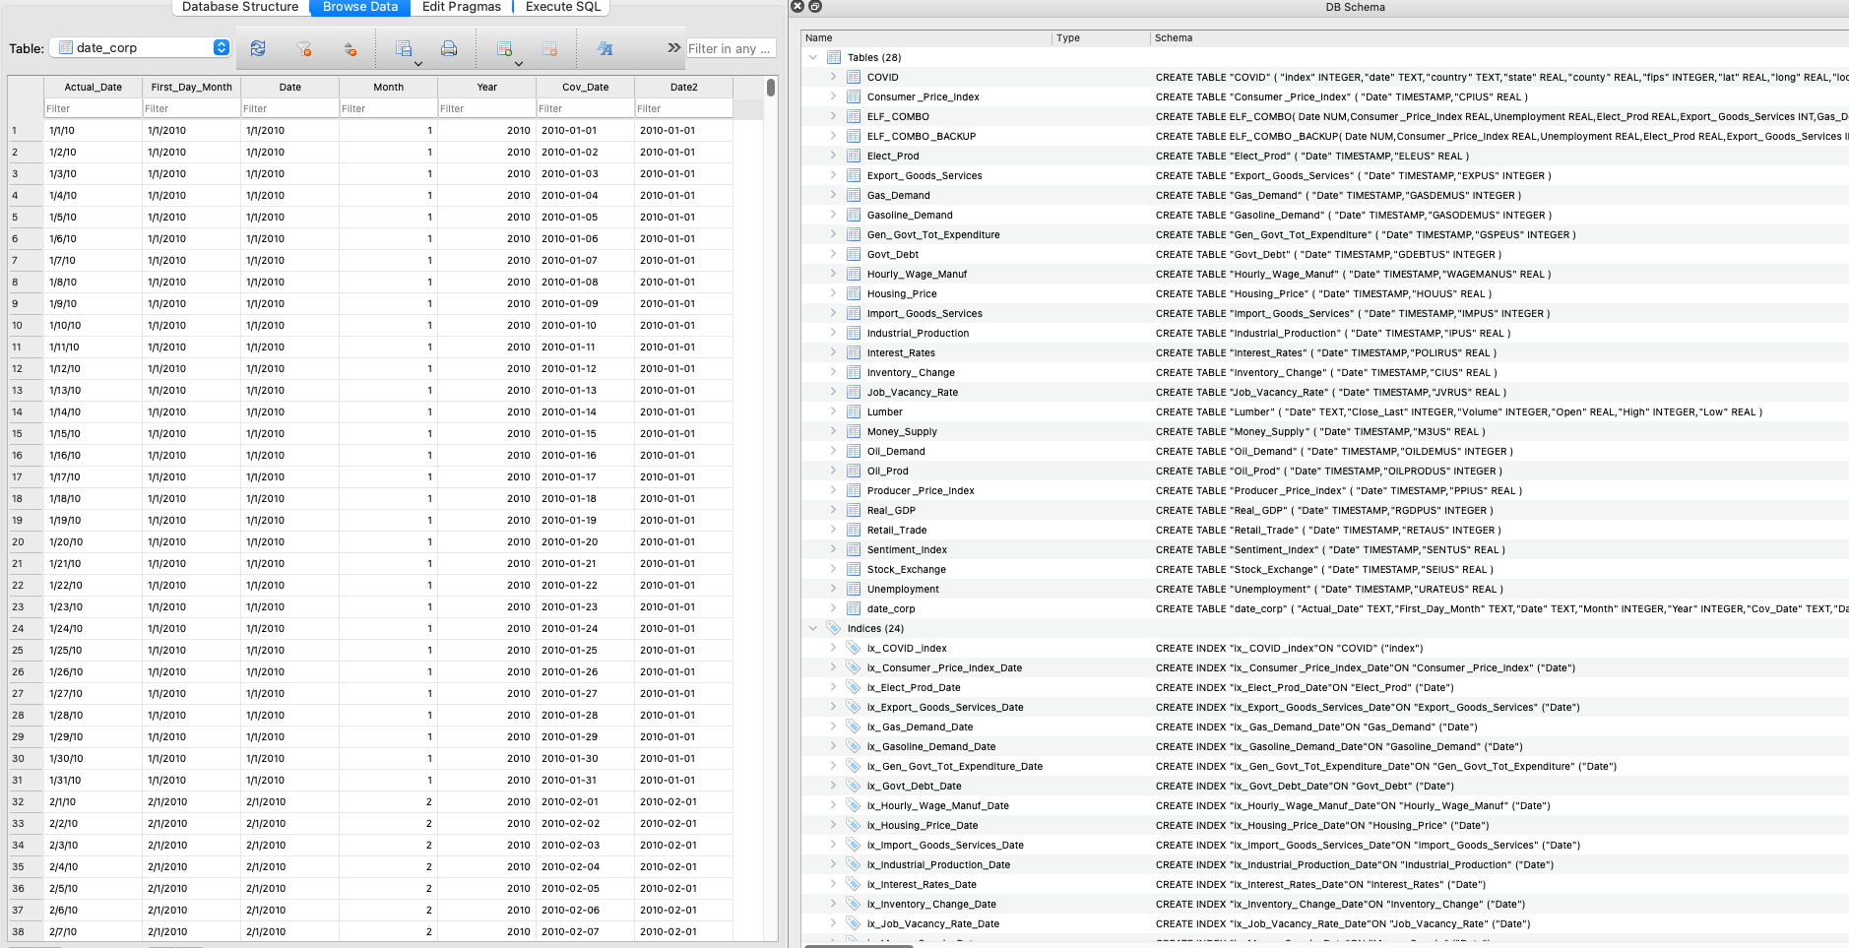
Processing Data
Aggregated Data in SQL
Cleaned and Normalized Data in Python
Utilized Custom Date Table

Slide 4
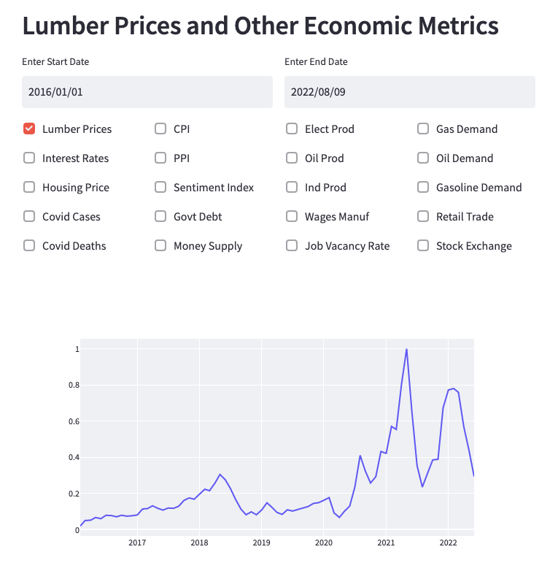
Lumber Prices – Streamlit App
Add or pick Date Range
Add as many additional metrics on the same graph for comparison
https://matt-redmond-eng-streamlitapp-8t78po.streamlitapp.com/

Slide 5
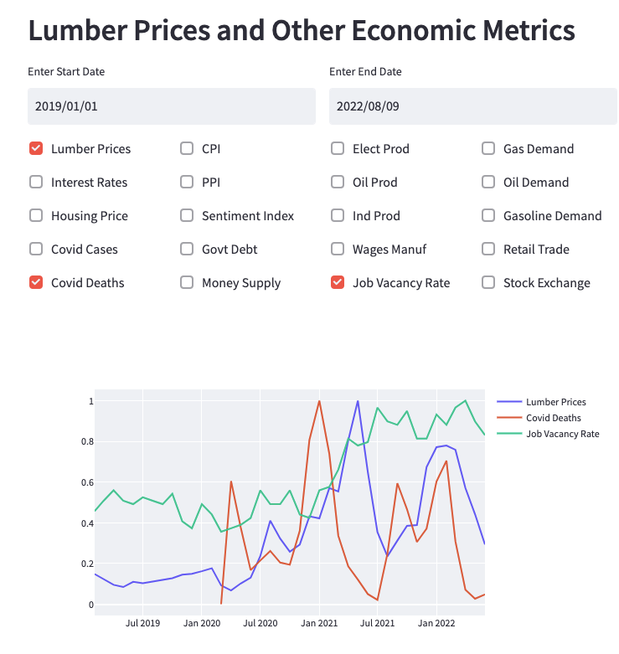
Streamlit App with multiple selections
Normalized Data uses the same scale
Streamlit automatically assigns colors and adds the legend

Slide 6
Conclusions and Next Steps
Explore additional data sources.
Build a predictive model for pricing.
Further Automate the process.

