Slide 1

CAN WE PREDICT SCORES AT RATEBEER.COM
Motivation:
What influences a beer’s score on ratebeer.com and can you predict what the score of a beer will be based on some of its basic attributes?
Objectives:
Pull data from ratebeer.com and use linear regression to analyze it.

Slide 2
Methodology
Webscrape
With BeautifulSoup, requests, selenium, and pandas
EDA
With pandas and seaborn
Model
With sklearn
Predict and Score
With sklearn
Conclusions and Next Steps

Slide 3
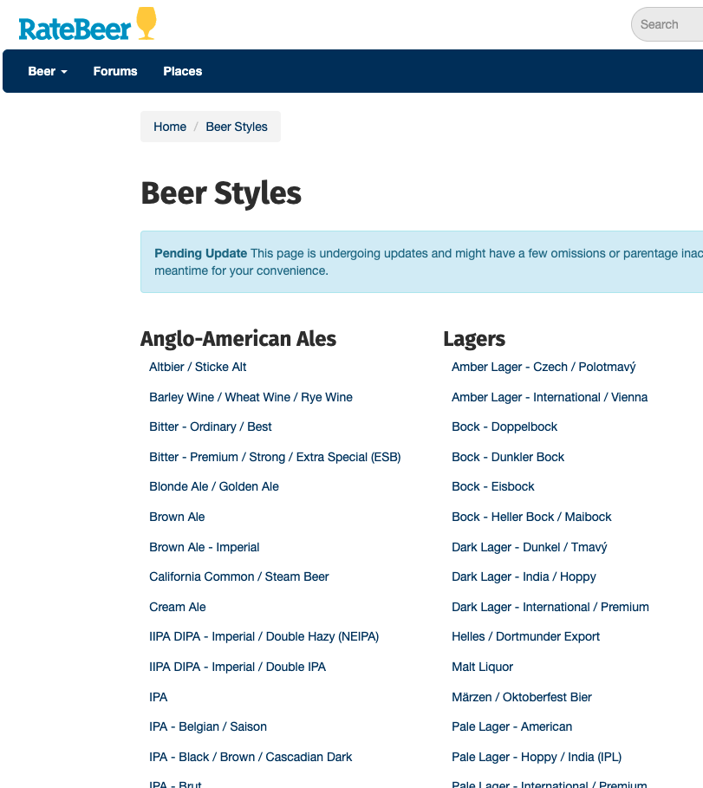
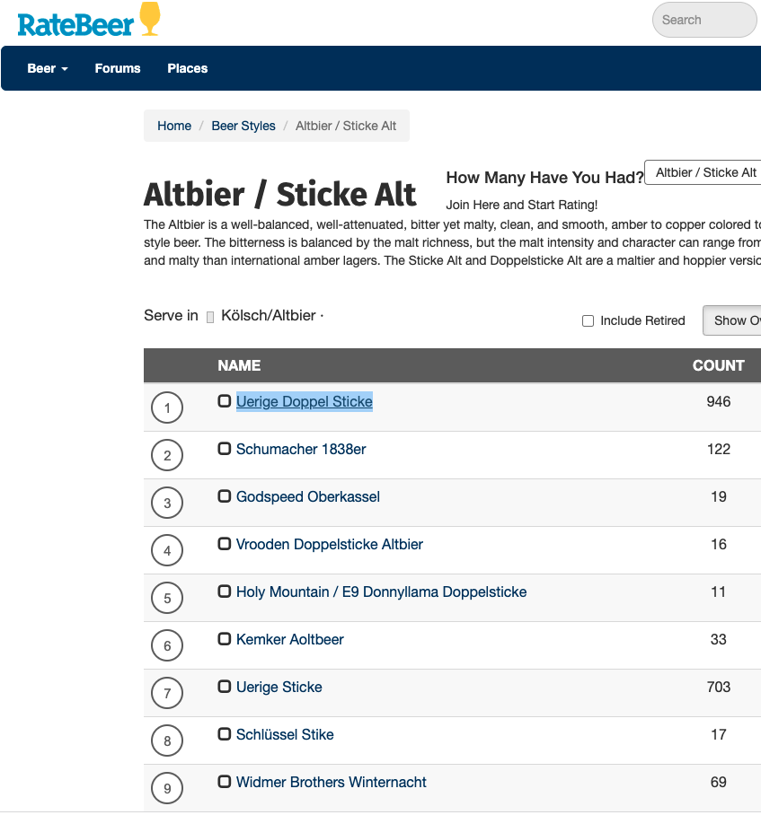
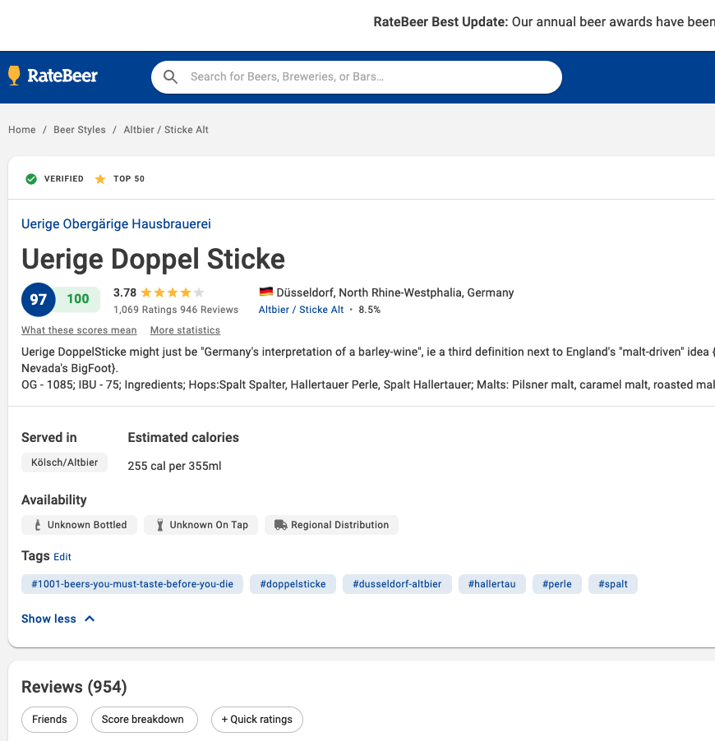
Webscraping Data
Multiple layers of links
Tables only load when webpage loads
Available Tags

Slide 4
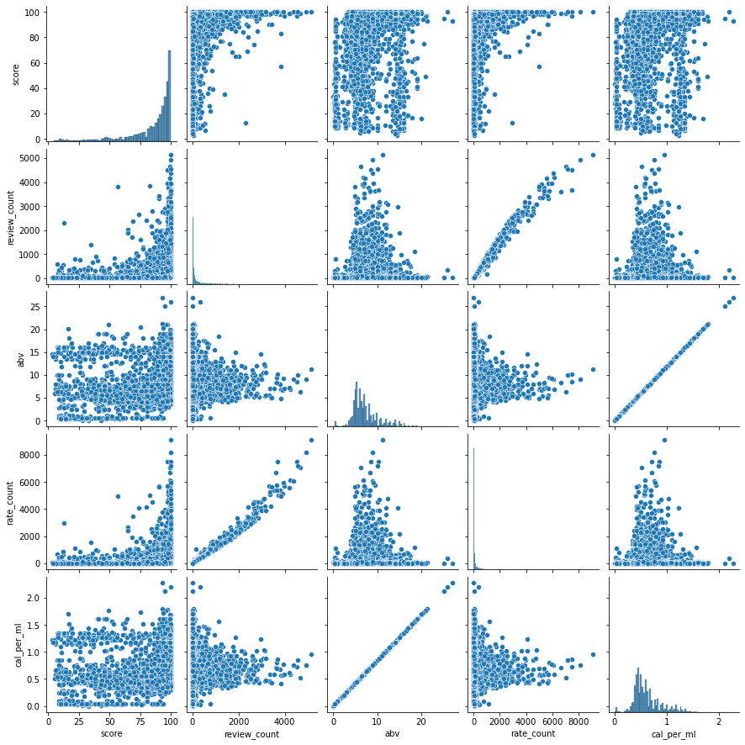
Baseline Model
Multi-collinearity with
abv and calories and also withrate count and review count
Reduced linear features to 2
R-squared for baseline was
Only 0.0508

Slide 5
Adding Nonlinear Features and Finalize Model
Tried feature engineering
Attempted improvement with regularization.
Final model RMSE is 12.3
R-squared on test is 0.54
Non-Linear Feature | R-Squared Improvement on Training Data
Style | .55
Country | .16
Other | .06
Total | .57

Slide 6
Conclusions
The model is underfitted and needs additional or different data.
Root Mean Squared Error of 12.3 points on a scale of 1-100 is too high.
Webscraped data was not sufficient to build a good model

Slide 7
Next Steps
Webscrape the data again using a deeper process pulling words from
reviews instead of tags as well as pulling more/all beers.
Explore additional data sources to get data such as price and
availability.

