Slide 1
BookList
By: Maia Thomas, Cyro Kamogawa, Matt Standley, Payton Dwight, and Jack Miller

Slide 2
Mission Statement
Textbooks and readers for college courses are too expensive. Often times you buy the book for an exorbitantly high price and then are forced to sell it back to the school for a fraction of what you paid originally. Our book exchange will create a platform for students to search by department for students looking to sell or trade books. By giving students an opportunity to collaborate together to provide each other with books, we hope to lessen the financial stress placed on all students at the beginning of each semester. Textbooks and readers for college courses are too expensive. Often times you buy the book for an exorbitantly high price and then are forced to sell it back to the school for a fraction of what you paid originally. Our book exchange will create a platform for students to search by department for students looking to sell or trade books. By giving students an opportunity to collaborate together to provide each other with books, we hope to lessen the financial stress placed on all students at the beginning of each semester.

Slide 3
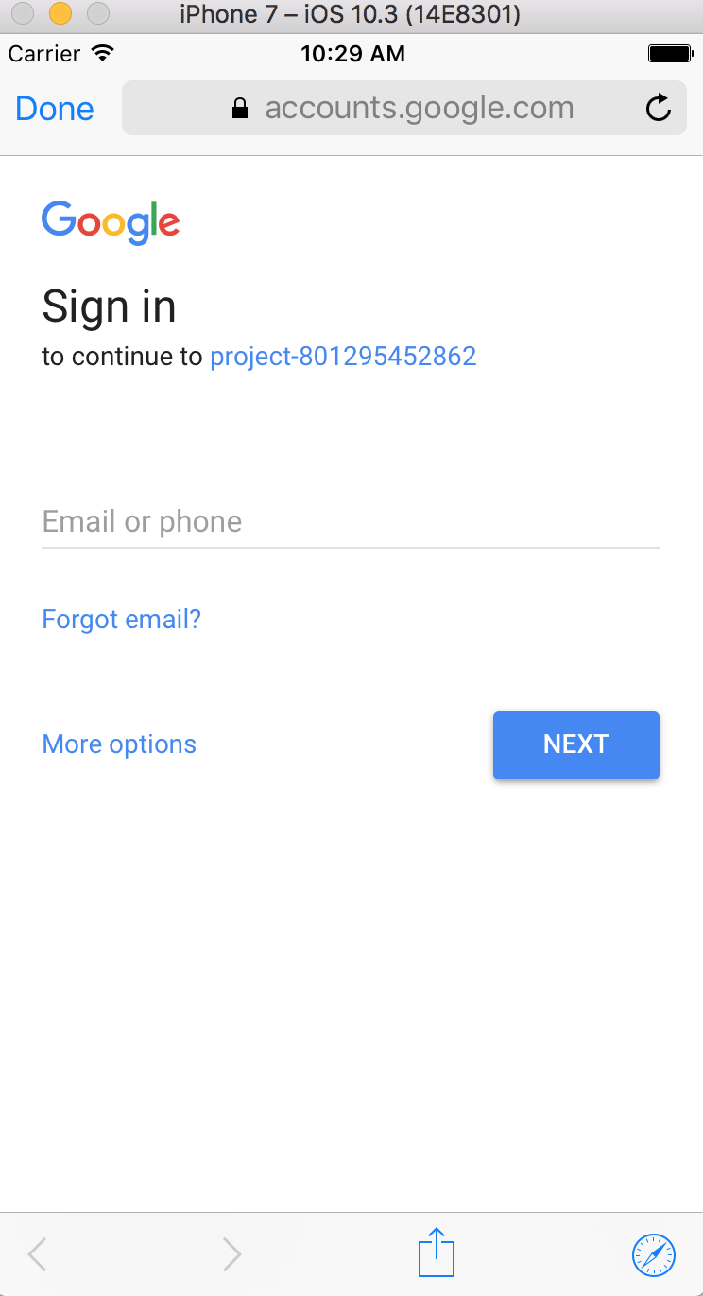
Login With Gmail
All students can gain access with a Gmail account

Slide 4
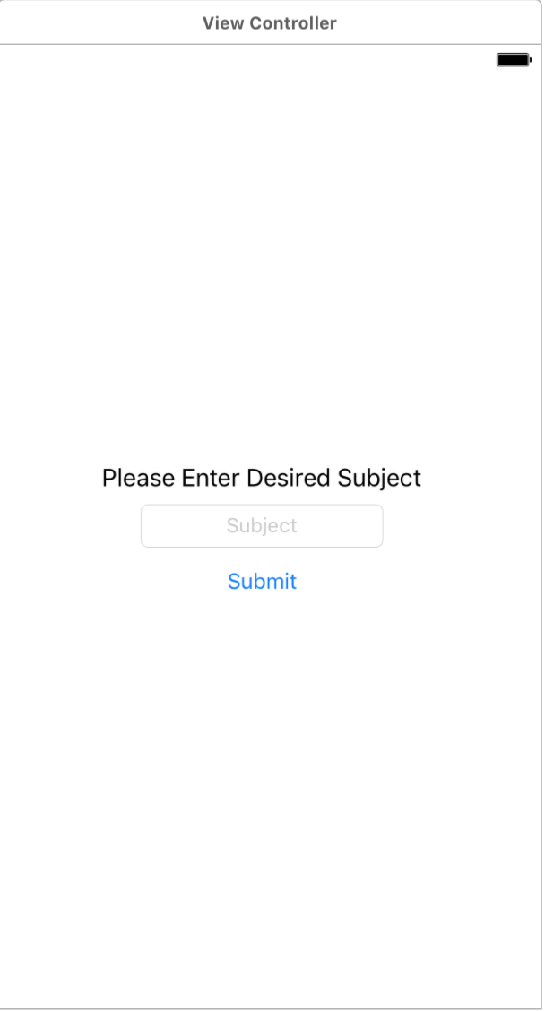
Search Books By Subject

Slide 5
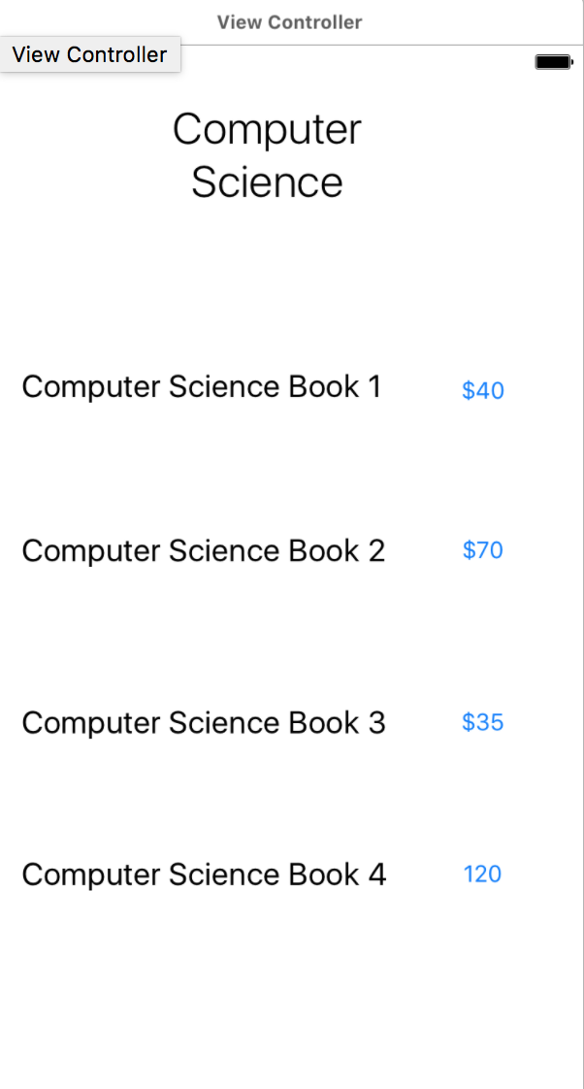
Browse List of Books With Desired Subject

Slide 6
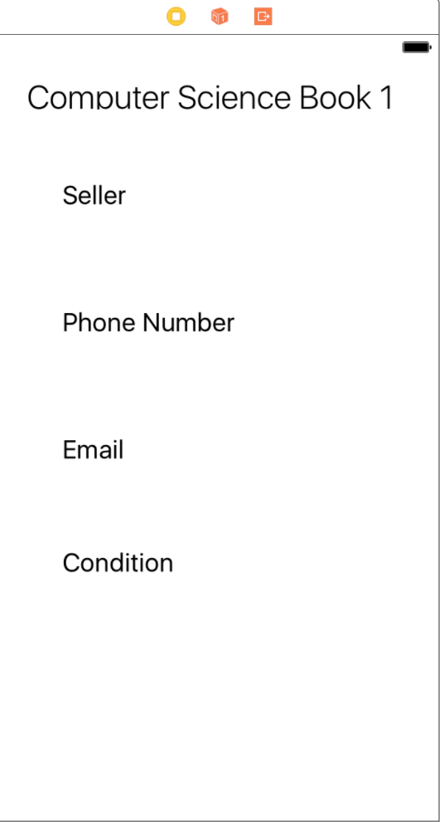
View Seller’s Information

Slide 7
Features To Add Moving Forward
Create post feature
Manage my posts feature
Search by book title
Settings page that allows you to search for multiple subjects

