Slide 1
Quant Workflow: A Scientific Method for Algorithmic Finance
Mathew Thiel
In Collaboration with: Donald Davendra, Dominic Klyve, and Jose Riera

Slide 2




What is Quant Finance?
Defined as a branch of investment management that uses mathematical and statistical models to analyze a wide variety of asset classes [15]
The goal of any Quant is to generate alpha; the measure of excess return of an investment strategy over a benchmark
Some of the best Quant Firms in the industry include: AQR, Renaissance, Jane Street, and Citadel
AQR [21], Jane Street [22], Renaissance [23], Citadel [24]

Slide 3
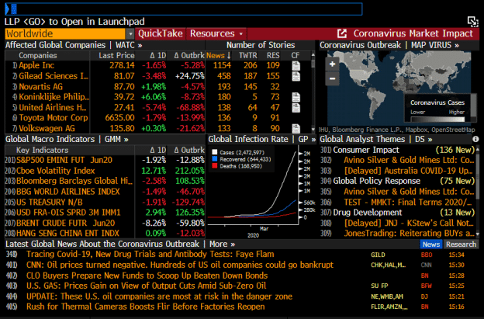
Barriers to Entry in Quant Finance
Barriers to Entry for Individual Traders is quite high:
Most firms expect a minimum of a Master’s degree
Firms use proprietary, in-house software
Finance as a field is very secretive, as companies safeguard strategies
Infrastructure and data costs are high
Bloomberg terminal, industry standard for financial data, news and analytics is about ~$20,000 a year per user
Bloomberg Terminal example, sourced from [25]

Slide 4
Project Background
Self-learning Quantitative Finance for over 4 years
Very little professional tools available for up-and-coming Quants
Easy to create false, overfit models without the right workflow
This project aims to:
Provide an accessible framework for creating algorithmic trading strategies
Test using proper scientific methods free of bias
Reduce overfitting

Slide 5
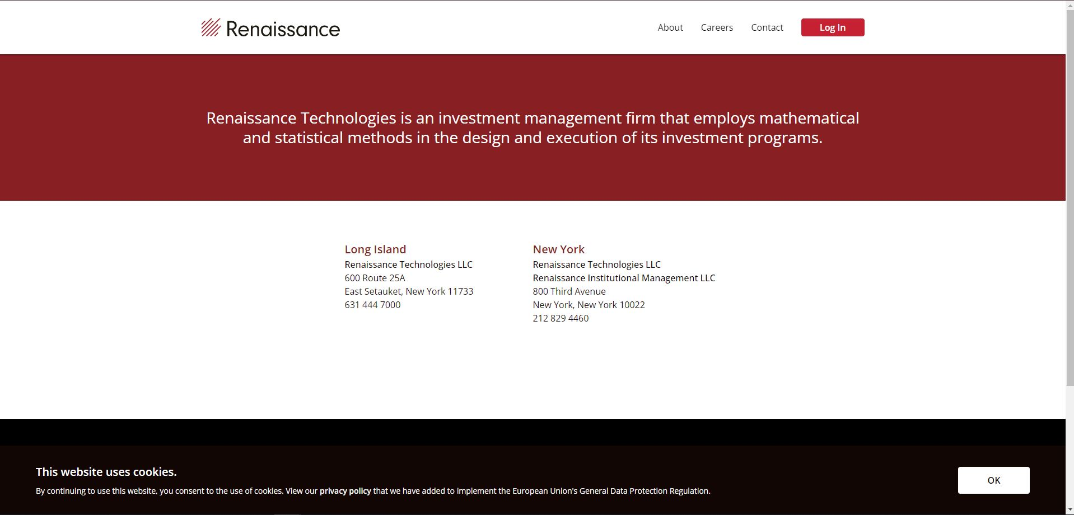
Secrecy in Finance (Renaissance Example)

Slide 6
Overfitting: One of The Biggest Problems in Finance

Slide 7
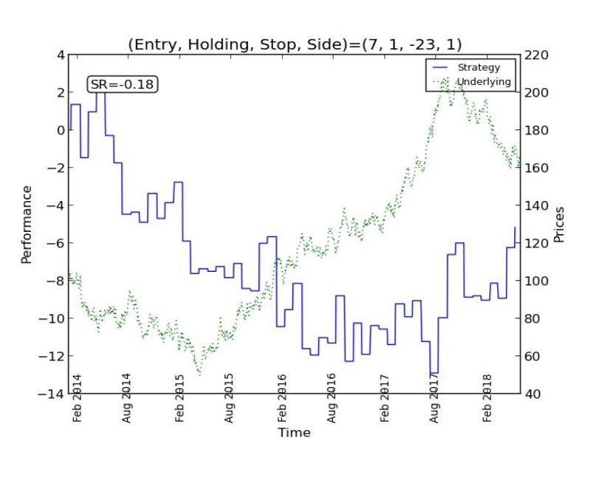
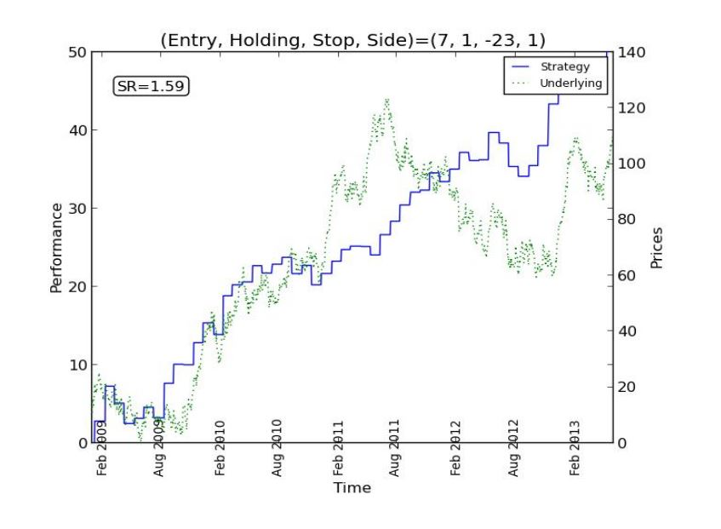
Multiple testing and Overfitting
Two common issues with finance are that [10]:
Research is not reproducible
Selection bias commonly occurs under multiple testing
Overfitting occurs when a model is fit too strictly on a dataset and doesn’t perform well out of sample.
The more times a strategy is backtested, the more likely it is to be overfit [14]
Most academic studies report in-sample statistics, and claimed findings are likely false [14]
Figure 8: An out of sample test (top) versus an in-sample test of the same strategy (bottom), sourced from [26]

Slide 8
Workflow Methods

Slide 9
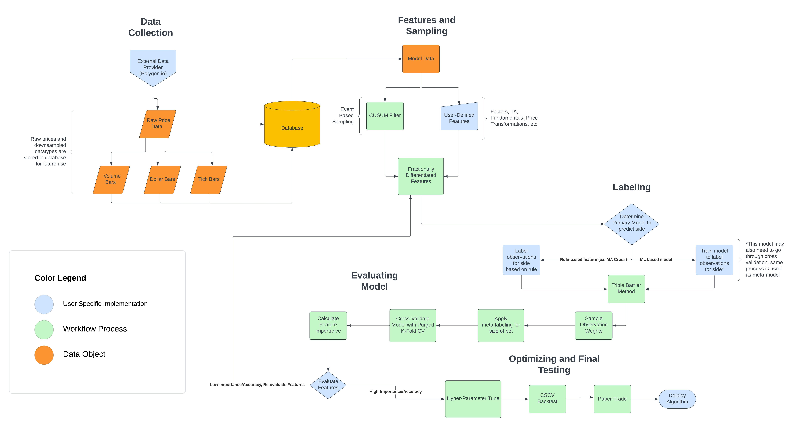
Workflow Overview

Slide 10
Data Preparation

Slide 11
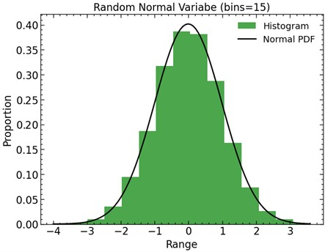
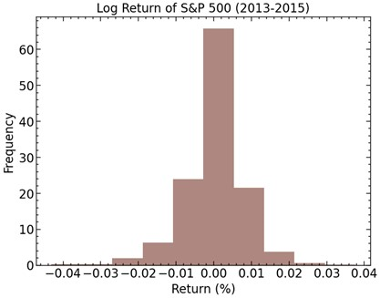
Financial Data and Fat Tails
Many statistical methods used in finance assume data is normally distributed [12]
Returns are not normal and fail to exhibit normality at higher frequencies [16]
Log returns have “fat tails”, where events at the edges of the distribution are more likely.
Conceptually, this makes sense, as it is common for prices to increase or decrease by a large amount in response to some catalytic event
Figure 1: Normal Distribution (top) versus the Log Return of the S&P 500 (bottom

Slide 12
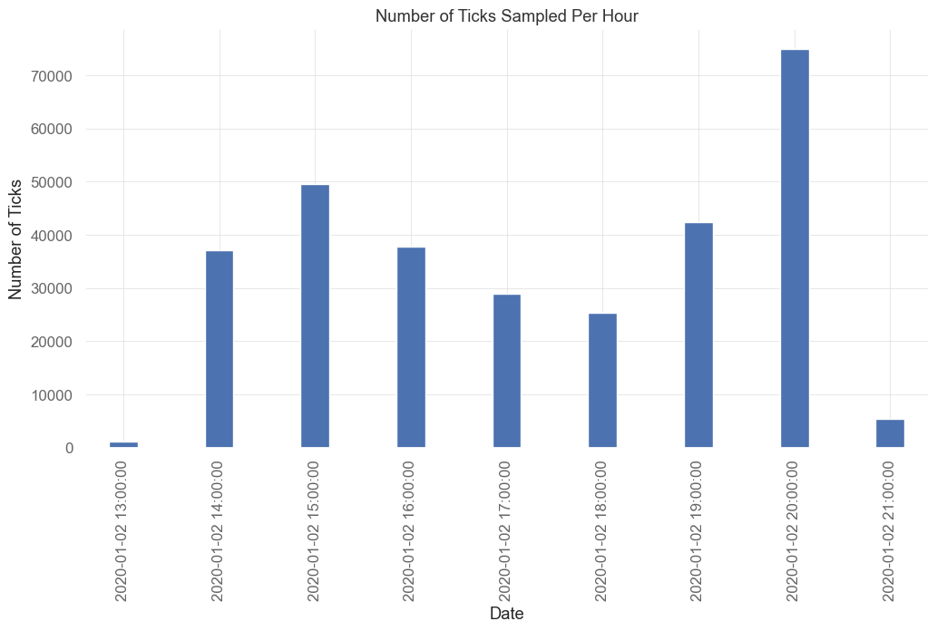
Sample Inconsistency
Generally, even in ML models, financial data is represented as time bars
Markets don’t process information in constant time intervals, and activity levels fluctuate throughout the day [14]
In time bars, times that are more active (market open) are under sampled and less active times (noon) are oversampled
Figure 2: Number of ticks sampled per hour for the S&P 500
Notes:
Give plot at number of ticks in each bar during the day for one day

Slide 13
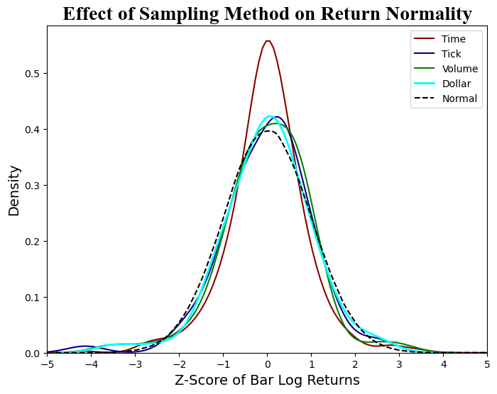
Advantages of Transaction-Based Sampling
Sampling as a function of volume is “much closer to normal, exhibits less serial correlation, and is less heteroskedastic” [4].
Transaction-Based Sampling Methods:
Tick Bars: Sample after n transactions
Volume Bars: Sample after n shares exchanged
Dollar Bars: Sample after n dollars exchanged
Dollar bars have the unique advantage that unlike tick and volume bars, they tend to be robust against actions like new share issues and buybacks [14].
Figure 3: A graph of the distributions of each bar type against a Normal PDF, with time, tick, volume, and dollar bars sampled at 1 hour, 1.2 × 10⁵, 3 × 10⁷, and 1.1 × 10¹⁰ respectively.

Slide 14
Features & Labeling

Slide 15
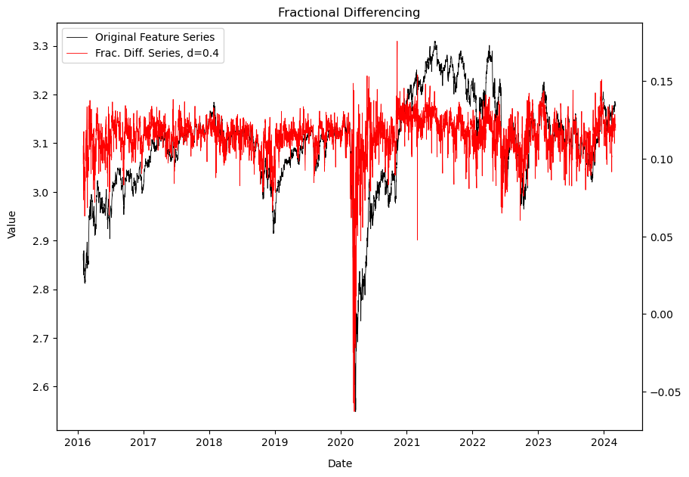
Fractional Differencing
A series is said to be stationary if the mean and variance are constant over time
Stationary series are necessary for most inferential analyses and supervised learning algorithms [6]
Prices have memory, because every value is dependent upon a history of previous values [6]
Simple differencing like returns removes all memory before the current datapoint [6]
Fractional Differentiation finds a minimum level of differentiation k that makes the series stationary while preserving as much memory as possible [6]
(1)
(2)
(3)
Figure 4: Underlying series before and after Fractional Differentiation is applied

Slide 16
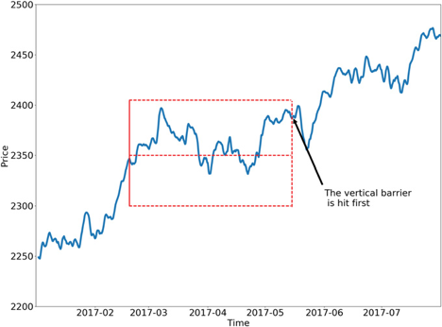
Labeling Observations
In finance, observations are generally labeled by a specified return threshold.
Instead, the triple-barrier method should be used, which allows for profit taking, stop loss, and a time expiry for labels
Meta-labeling generates labels ~[0,1] which can be combined with probability of the label to get the size to allocate to that bet.
Meta-labeling is useful in the context of finance, as we can create separate models for side and sizing
Model for side can be anything from technical analysis to fundamental-based rules, allowing ML to be applied to any existing strategy [14]
Another advantage is that separate features can be used for signal generation and risk management
Figure 5: Example of the triple barrier method given in [14]

Slide 17
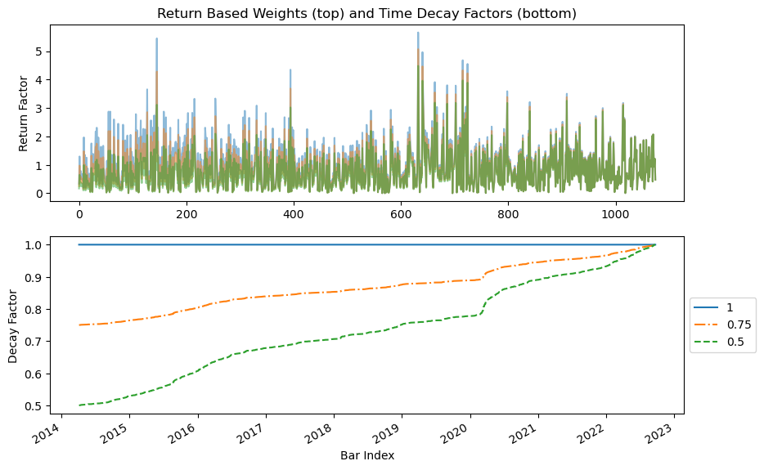
Sample Weights
When labeling financial data, overlap is common as one label could be predicted from data used to predict a future label.
Deal with overlap by weighting a label by a function of its uniqueness [14]
Return-based weights [14]:
Labels with high return are more significant than low return labels
Implementing a time decay factor [14]:
The factors the drive the performance of a market generally change over time
To reflect this in our model, we can introduce a decay factor that assigns more importance to recent datapoints
This factor can be linear or exponential
Figure 6: Sample weights by return (top) and time decay factors (bottom)
Notes:
If we tried to combat overlap by only labeling when the prediction horizon passes the previous label, the minimum allowed unique data for each label would be restricted to the largest feature aggregation window.
For example, if monthly volatility was used as a feature, only one label could be produced per month.
This is not very realistic in finance, so overlap should be allowed but corrected for with sample weights.

Slide 18
Evaluation & Testing

Slide 19
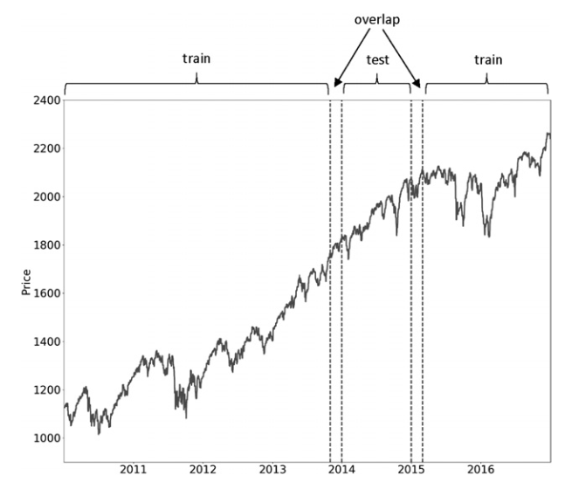
Cross Validation: Purge and Embargo
In ML, Cross-Validation (CV) is a method to evaluate the generalized performance of a model [5]
CV assumes that samples are Independent and Identically Distributed (I.I.D), which is not the case for financial data
Label overlap causes leakage from testing sets to training sets, artificially inflating performance and contributing to overfitting [6]
This problem can be combatted by [6]:
Purging: Removes labels from the training set that overlap with labels in the testing set
Embargo: Remove a small portion of data after a testing set for cases where purging cannot prevent all leakage
Figure 7: Train and test set overlap, found in [14]

Slide 20
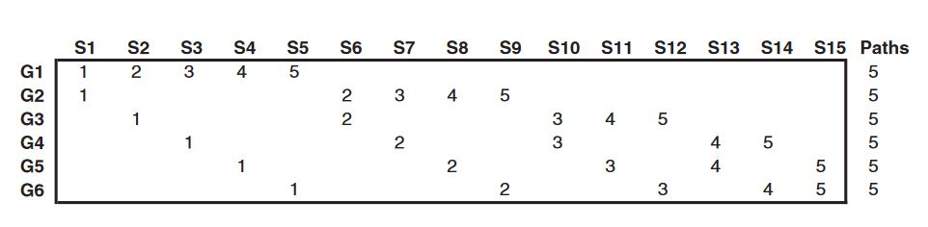
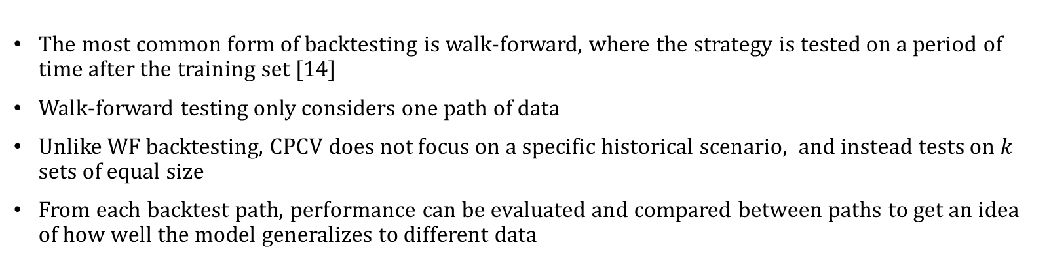
Combinatorial Purged K-Fold Cross Valiation (CPCV) as a Backtesting Tool
The most common form of backtesting is walk-forward, where the strategy is tested on a period of time after the training set [14]
Walk-forward testing only considers one path of data
Unlike WF backtesting, CPCV does not focus on a specific historical scenario, and instead tests on $k$ sets of equal size
From each backtest path, performance can be evaluated and compared between paths to get an idea of how well the model generalizes to different data
Figure 8: Backtest paths generated by CSCV with 6 groups and a k of 2. Sourced from [14]

Slide 21
Preliminary Results

Slide 22
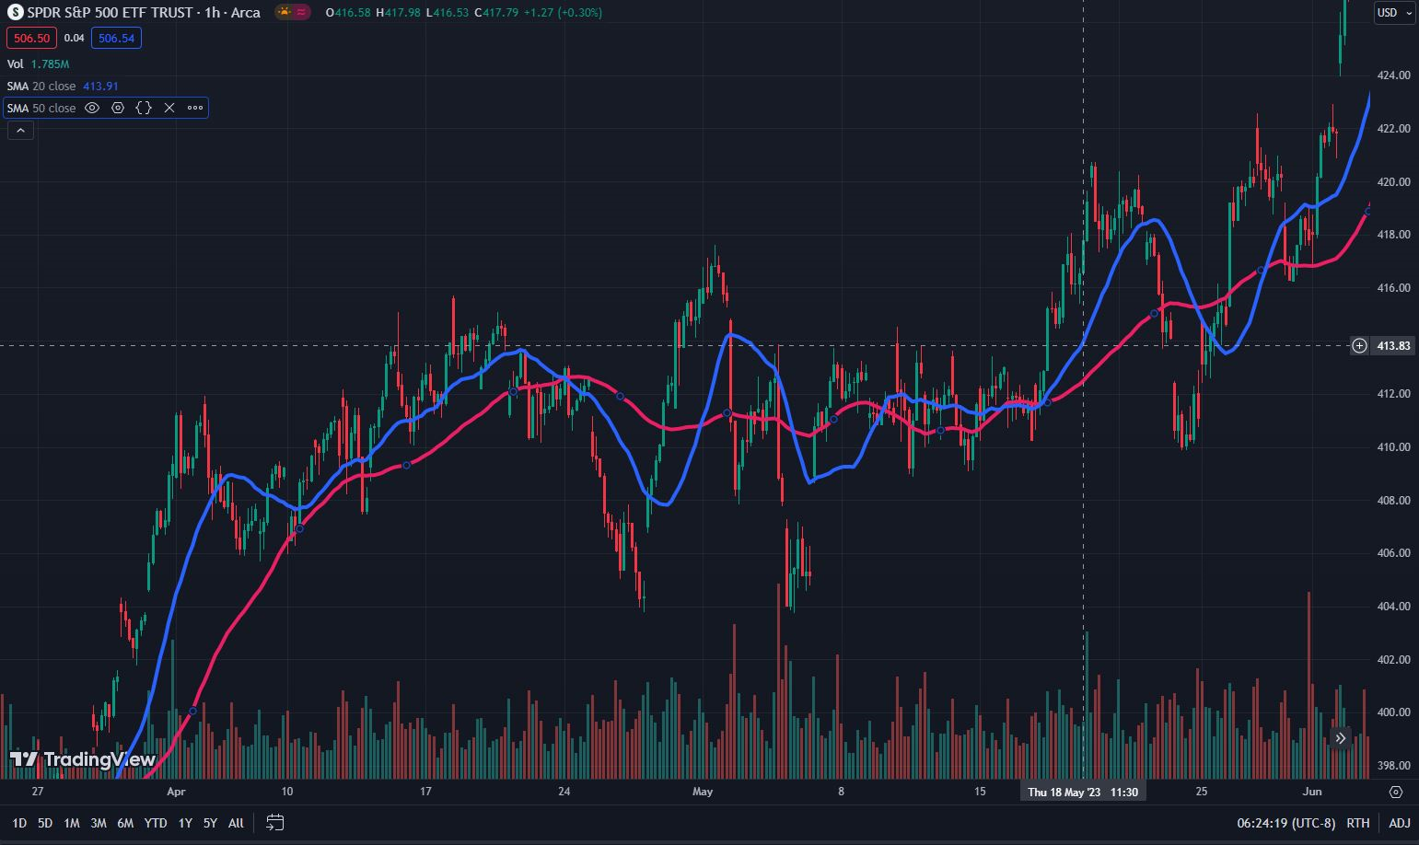
Test Strategy: SMA Cross

Slide 23
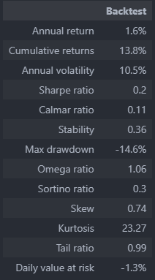
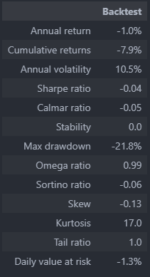
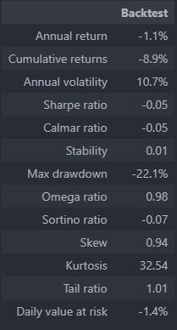
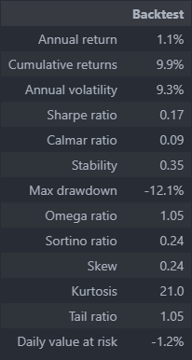
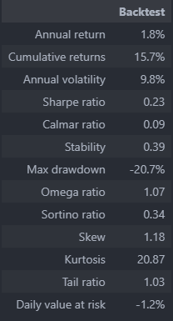
CPCV Backtest Results
Average Sharpe Ratio: ~0.10

Slide 24
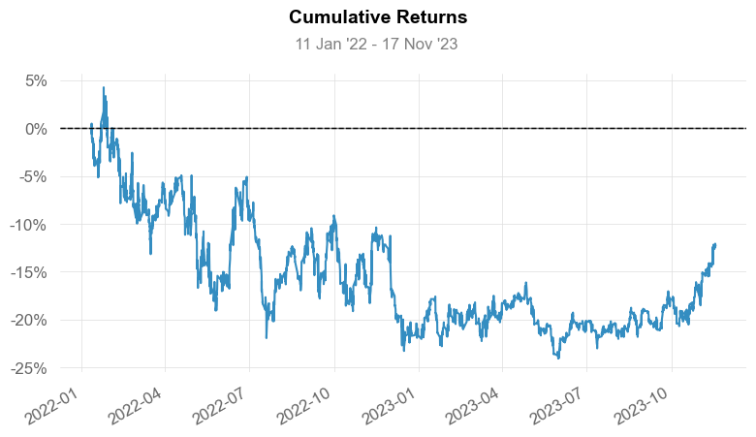
Final Validation Test Results: Base Strategy

Slide 25
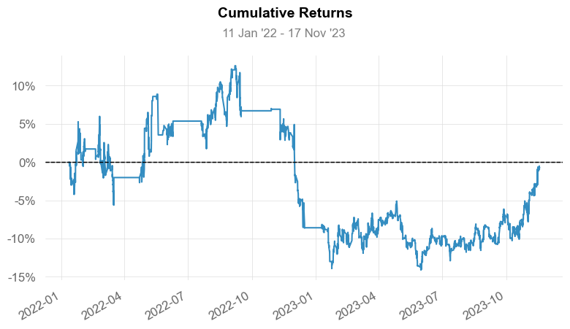
Final Validation Test Results: Quant Workflow

Slide 26
References
[1] Ashley, R. A., & Patterson, D. M. (1986). A Nonparametric, Distribution-Free Test for Serial Independence in Stock Returns. The Journal of Financial and Quantitative Analysis, 21(2), 221–227. https://doi.org/10.2307/2330739
[2] Bailey, D. H., Borwein, J., Lopez de Prado, M., & Zhu, Q. J. (2014). Pseudo-Mathematics and Financial Charlatanism: The Effects of Backtest Overfitting on Out-of-Sample Performance (SSRN Scholarly Paper 2308659). https://doi.org/10.2139/ssrn.2308659
[3] Black, F., & Scholes, M. (1973). The Pricing of Options and Corporate Liabilities. Journal of Political Economy, 81(3), 637–654.
[4] Easley, D., Lopez de Prado, M., & O’Hara, M. (2012). Flow Toxicity and Liquidity in a High Frequency World (SSRN Scholarly Paper 1695596). https://doi.org/10.2139/ssrn.1695596
[5] Fama, E. F. (1970). Efficient Capital Markets: A Review of Theory and Empirical Work. The Journal of Finance, 25(2), 383–417. https://doi.org/10.2307/2325486
[6] Harvey, C. R. (2017). Presidential Address: The Scientific Outlook in Financial Economics (SSRN Scholarly Paper 2893930). https://doi.org/10.2139/ssrn.2893930
[7] James, G., Witten, D., Hastie, T., Tibshirani, R., & Taylor, J. (2023). An Introduction to Statistical Learning: With Applications in Python. Springer International Publishing.
[8] Lo, A. W., & MacKinlay, A. C. (1999). A Non-Random Walk down Wall Street. Princeton University Press. http://ebookcentral.proquest.com/lib/cwu/detail.action?docID=819621
[9] Lopez de Prado, M. (2018). The 10 Reasons Most Machine Learning Funds Fail (SSRN Scholarly Paper 3104816). https://doi.org/10.2139/ssrn.3104816
[10] Lopez de Prado, M., & Bailey, D. H. (2018). The False Strategy Theorem: A Financial Application of Experimental Mathematics (SSRN Scholarly Paper 3221798). https://papers.ssrn.com/abstract=3221798

Slide 27
References Cont.
[11] Mandelbrot, B., & Taylor, H. M. (1967). On the Distribution of Stock Price Differences. Operations Research, 15(6), 1057–1062. https://doi.org/10.1287/opre.15.6.1057
[12] Mota, P. P. (2012). Normality assumption for the log-return of the stock prices. Discussiones Mathematicae Probability and Statistics, 32(1–2), 47. https://doi.org/10.7151/dmps.1143
[13] Müller, A. C., & Guido, S. (2016). Introduction to Machine Learning with Python: A Guide for Data Scientists. O’Reilly Media, Inc.
[14] Prado, M. L. de. (2018). Advances in Financial Machine Learning. John Wiley & Sons.
[15] Quantitative Finance: Definition & History | CQF. (n.d.). Retrieved October 11, 2023, from https://www.cqf.com/blog/what-quantitative-finance-brief-history
[16] Quigley, L. (n.d.). Statistical Analysis of the Log Returns of Financial Assets.
[17] Sklearn.utils.class_weight.compute_class_weight. (n.d.). Scikit-Learn. Retrieved February 27, 2024, from https://scikit-learn/stable/modules/generated/sklearn.utils.class_weight.compute_class_weight.html
[18] Stefan, A. M., & Schönbrodt, F. D. (2023). Big little lies: A compendium and simulation of p-hacking strategies. Royal Society Open Science, 10(2), 220346. https://doi.org/10.1098/rsos.220346
[19] Wang, S., Luo, Y., & Alvarez, M.-A. (2014). Seven Sins of Quantitative Investing. Signal Processing.
[20] Zhang, Z., & Pfister, T. (2021). Learning Fast Sample Re-weighting Without Reward Data (arXiv:2109.03216). arXiv. http://arxiv.org/abs/2109.03216

Slide 28
Image References
[21] AQR Capital Management. (n.d.). Retrieved February 27, 2024, from https://www.aqr.com/
[22] Home: Jane Street. (n.d.). Retrieved February 27, 2024, from https://www.janestreet.com/
[23] Renaissance Technologies. (n.d.). Retrieved February 27, 2024, from https://www.rentec.com/Home.action?index=true
[24] Citadel—Identifying the Highest and Best Uses of Capital. (n.d.). Citadel. Retrieved February 27, 2024, from https://www.citadel.com/
[25] Bloomberg. (2020, June 25). Top 5 Bloomberg Terminal “Hacks” To Help Traders Navigate the Markets from Home. Traders Magazine. https://www.tradersmagazine.com/departments/commentary/top-5-bloomberg-terminal-hacks-to-help-traders-navigate-the-markets-from-home/
[26] Backtest example. (n.d.). Retrieved February 27, 2024, from https://datagrid.lbl.gov/backtest/index.php

Slide 29
Q & A
Email:
thielm@cwu.edu
matt.thiel@outlook.com
LinkedIn:
Mathew Thiel: https://www.linkedin.com/in/mathew-thiel-9ab339239/

