Slide 1
Quant Workflow: A Scientific Method for Finance
Mathew Thiel
In Collaboration with: Donald Davendra, Dominic Klyve, and Jose Riera

Slide 2




What is Quant Finance?
Defined as “a branch of investment management that employs mathematical and statistical methods to analyze investment opportunities across a range of asset classes.” [15]
Composed of three main fields: Computer Science, Statistics, and Finance.
“Quants” use ML models, complex math, image processing, data mining, fundamentals, high frequency trading (HFT), asset pricing, etc. to trade markets
The goal of any Quant is to generate alpha; the measure of excess return of an investment strategy over a benchmark
Some of the best Quant Firms in the industry include: AQR, Renaissance, Jane Street, Citadel,
Most industry Quants aim to find hard to process, unique alternative data to use for models
AQR [21], Jane Street [22], Renaissance [23], Citadel [24]

Slide 3
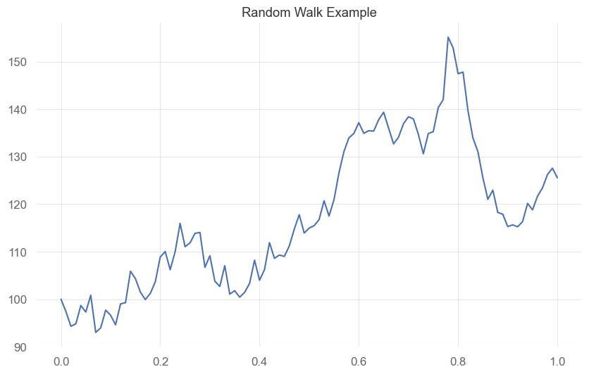
Random Walk and the Efficient Market Hypothesis
“A market in which prices always ‘fully reflect’ available information is called efficient’” – from seminal paper Efficient Capitial Markets, Eugene Fama, 1970 [5]
Random Walk: changes in the price of a security are random and therefore unpredictable [5]
Topic has seen heavy debate over the years, and still continues today
Practitioners think markets can be exploited, while academics think markets are efficient, creating two schools of thought

Slide 4
State of the Field of Finance
The EMH is a fundamental discussion in finance and highlights the separation between practitioners and academics
Combined with common multiple testing and reporting errors, research is commonly irreproducible/disregarded.
Two authors, Lo and MacKinlay, presented research rejecting the Random Walk Hypothesis and were told with “great confidence that we had made a programming error” by a senior colleague [8].
“Academic investigation and publication are divorced from practical application to financial markets, and many applications in the trading/investment world are not grounded in proper science.” [7]
Even finance books contain “elegant mathematics that describe a world that does not exist” [14] or explanations of actual observations that are “absent of rigorous academic theory” [14]
Many practitioners present false positives represented by overfit tests or eventually settle with fundamental models with poor performance that are at least rooted in academic theory [14]

Slide 5
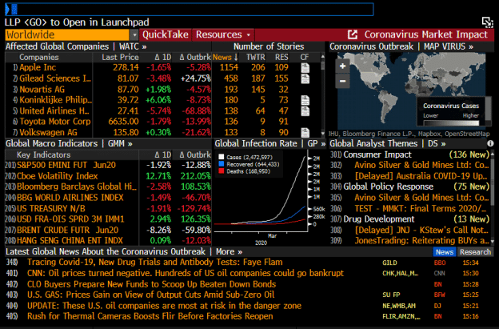
Project Importance and Barriers to Entry in Finance
Barriers to Entry for Individual Traders is quite high:
Most firms expect a minimum of a Master’s degree
Firms use proprietary, in-house software
Finance as a field is very secretive, as companies safeguard strategies
Infrastructure and data costs
Bloomberg terminal, industry standard for financial data, news and analytics is about ~$20,000 a year per user
“It takes almost as much effort to produce one true investment strategy as to produce a hundred, and the complexities are overwhelming: data curation and processing, HPC infrastructure, software development, feature analysis, execution simulators, backtesting, etc.” [14]
The purpose of this project is to provide an accessible framework for creating algorithmic trading strategies, rooted in proper science and testing methods.
Bloomberg Terminal example, sourced from [25]

Slide 6
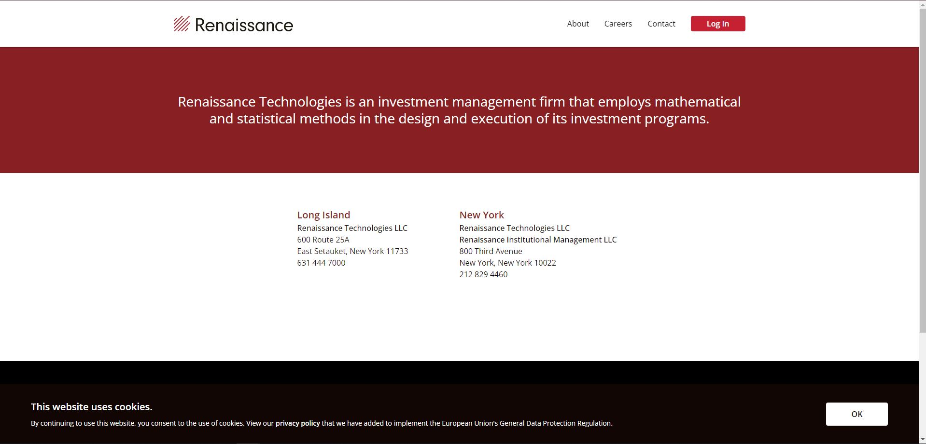
Secrecy in Finance (Renaissance Example)

Slide 7
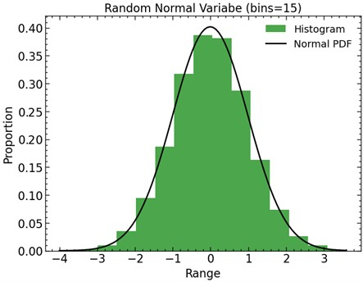
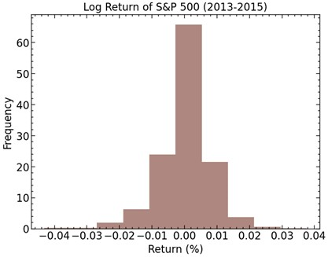
Financial Data and Fat Tails
Asset returns are hard to model, but are generally assumed to follow a Geometric Brownian Motion, as seen in a fundamental model for options pricing, the Black-Scholes model [3]
A key assumption of the Geometric Brownian Motion is that the underlying data follows a random walk and is normally distributed [12]
In most cases, returns are not normal and fail to exhibit normality at higher frequencies [16]
Log returns generally exhibit a phenomenon called fat tails, where events at the edges of the distribution are more likely.
Conceptually, this makes sense, as it a common occurrence of some asset prices to increase or decrease by a large amount in response to some catalytic event
Assuming normality could work for low-resolution, low-volatility asset data like an ETF, but becomes increasingly more problematic as data resolution and volatility increase
Figure 1: Normal Distribution (top) versus the Log Return of the S&P 500 (bottom

Slide 8
Financial Data is Not Independent and Identically Distributed (I.I.D)
I.I.D: Each term in the sequence of a random variable follows the same probability distribution and is mutually independent from one another. [14]
This is not the case in financial data, as prices exhibit serial correlation, which means that the price at a given time is related to a price at some time before that.
Evident in research, as a 1986 paper by Ashley and Patterson conclude: “daily stock returns are not serially independent and that the market value of the corporations studied has a tendency to return to an interval around the trend value.” [1].
This adds a layer of complexity when using Machine Learning (ML) with financial data, as labels generated from outcomes created by multiple observations will overlap in time. [9]
This overlap also makes it more challenging to determine what features are important for the label. [9]

Slide 9
Common Testing Biases
Survivorship Bias: one of the most common mistakes, survivorship bias is when stocks that survived the test of time (i.e. were not delisted) are used and tested on [19]
Look-ahead Bias: Using information that wasn’t available at the time of the observation. An obvious example are earnings, which is generally not released until a coupe months after the reporting period [19]
Confirmatory Bias: Searching for information that supports a claim while disregarding refuting evidence [19]
Data Mining and Data Snooping Bias: Manipulating data and models to find specific patterns that work well in-sample [19]

Slide 10
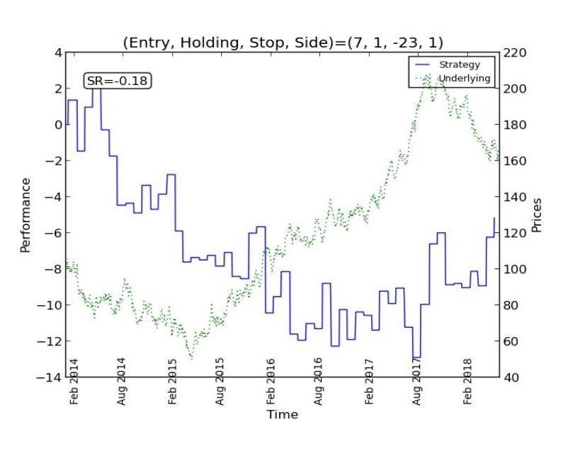
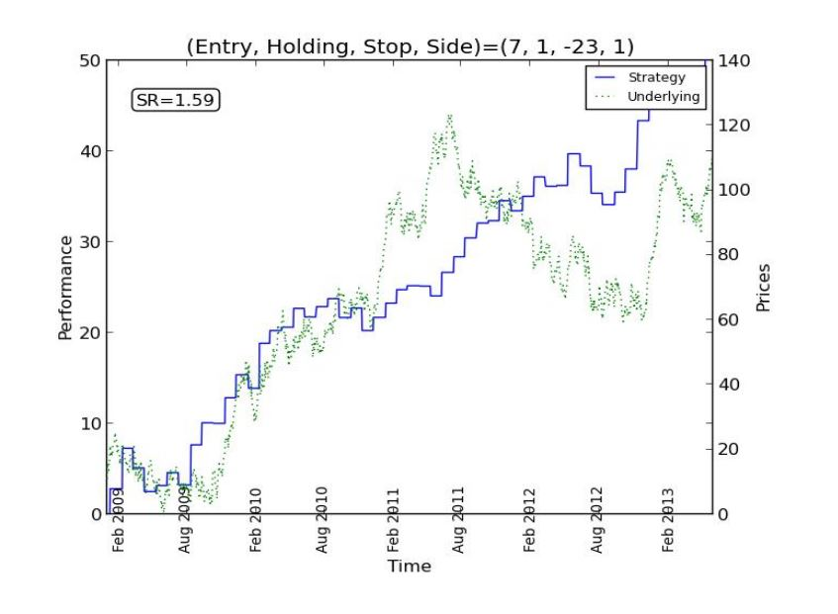
Multiple testing and Overfitting
Two common issues with finance are that [10]:
Research is not reproducible
Selection bias commonly occurs under multiple testing
Most finance journals don’t require trail reporting, and even popular textbooks disregard issues of selection bias from multiple testing [10]
Overfitting occurs when a model is fit too strictly on a dataset and doesn’t perform well out of sample.
Overfitting is extremely easy, as “recent computational advances allow investment managers to methodically search through thousands or even millions of potential options for a profitable investment strategy” [10]
The more times a strategy is backtested, the more likely it is to be overfit [14]
Most academic studies report in-sample statistics, and claimed findings are likely false [14]
Figure 8: An out of sample test (top) versus an in-sample test of the same strategy (bottom), sourced from [26]

Slide 11
P-Hacking in Finance
Finance is laden with false reporting, misjudged performance, and out of sample degradation.
In recent years, the issue of p-hacking has been prevalent in many different scientific fields, and finance is one of them.
P-hacking is defined as “a compound of strategies targeted at rendering non-significant hypothesis test results significant.” [10].
When testing a strategy that forms portfolios based on the letters in each stock ticker, Harvey et. al. finds that “under a large enough choice set, the long -short strategy has a ‘significant’ t-statistic” [6]
Journals also contribute to datamining due to focus on publishing papers with the most significant results [6]

Slide 12
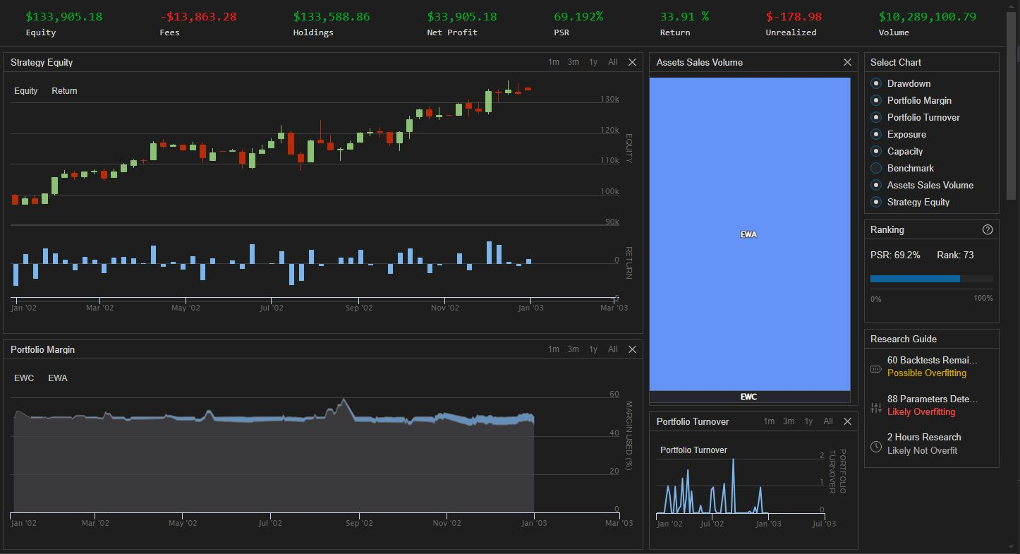
Walk-Forward Backtesting Example: In-Sample

Slide 13
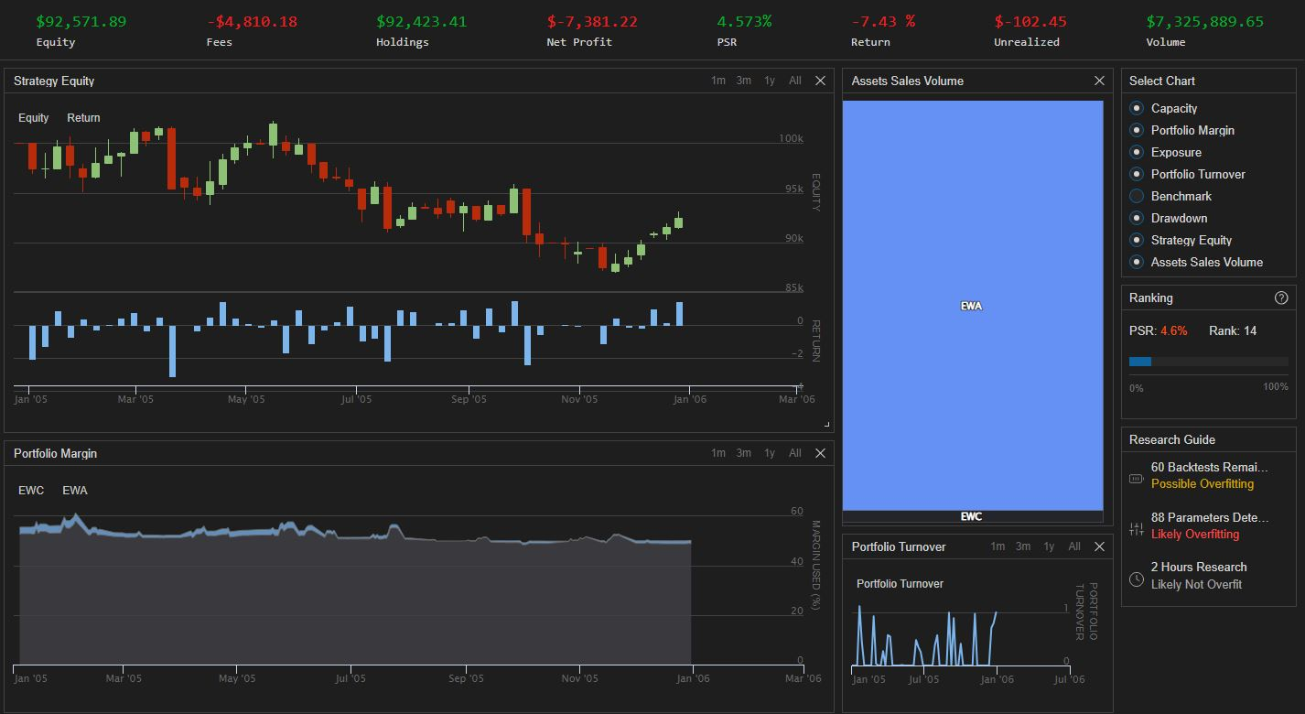
Walk-Forward Backtesting Example: Out of Sample

Slide 14
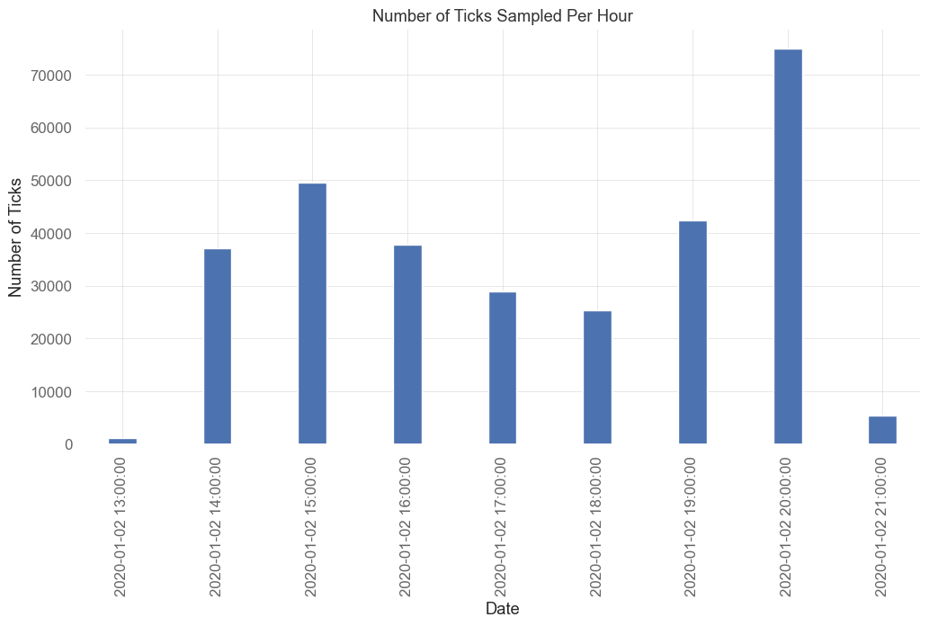
Sample Inconsistency
Financial data is normally represented by time bars, where each observation is sampled at a fixed time, i.e., daily closing price.
However, ““markets do not process information at a constant time interval. The hour following the open is much more active than the hour around noon (or the hour around midnight in the case of futures).” [14].
In time bars, times that are more active (market open) are under sampled and less active times (noon) are oversampled.
Creating strategies and ML models on time bars with inconsistent sampling poses issues as these bars reflect varying levels of information
Times with higher volume are under sampled, while times with lower volume are oversampled
Figure 2: Number of ticks sampled per hour for the S&P 500
Notes:
Give plot at number of ticks in each bar during the day for one day

Slide 15
Sampling Methods
Tick Bars [14]:
Tick data is one of the lowest resolutions of data available
A tick represents one trade submitted to an exchange
Each bar is sampled after a given number of ticks occur
Each tick can have a different number of shares exchanged
Volume Bars [14]:
Volume refers to the number of shares exchanged at a given period
Volume bars are sampled after a given number of shares are exchanged
Dollar Bars [14]:
Similar to volume bars, dollar bars are sampled after a given number of currency is exchanged
Currency exchanged can be found by the price of the asset multiplied by volume.

Slide 16
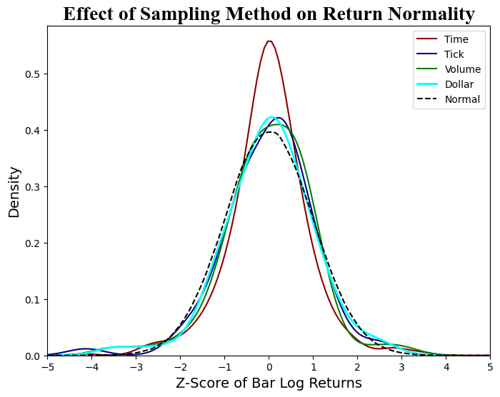
Advantages of Transaction-Based Sampling
Sampling as a function of volume is “much closer to normal, exhibits less serial correlation, and is less heteroskedastic” [4].
Further confirmed in the seminal paper by Mendelbrot and Taylor on the subject as “price changes over a fixed number of transactions may have a Gaussian distribution. Price changes over a fixed time period may follow a stable Paretian distribution, whose variance is infinite” [11].
Dollar bars have the unique advantage that unlike tick and volume bars, they tend to be robust against actions like new share issues and buybacks [14].
Figure 3: A graph of the distributions of each bar type against a Normal PDF, with time, tick, volume, and dollar bars sampled at 1 hour, 1.2 × 10⁵, 3 × 10⁷, and 1.1 × 10¹⁰ respectively.

Slide 17
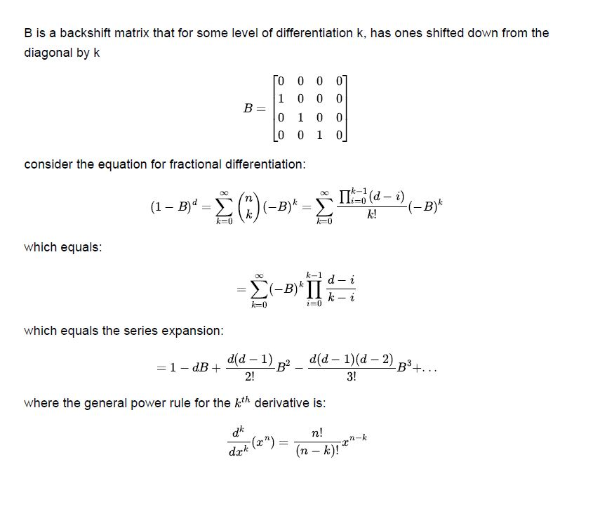
Fractional Differencing
Prices have memory, because every value is dependent upon a history of previous values [6]
A series is said to be stationary if the mean and variance are constant over time
Stationary series are necessary for inferential analyses and is generally a requirement for supervised learning algorithms[6]
A common way to create a stationary series in finance is to take the return of an asset
However, simple differencing like returns removes all memory before the current datapoint [6]
We want to preserve memory so our model can learn from the data
Fractional Differentiation takes a fractional difference of the underlying series.
This allows for a minimum level of differentiation k that makes the series stationary while preserving as much memory as possible [6]
(1)
(2)
(3)
(4)

Slide 18
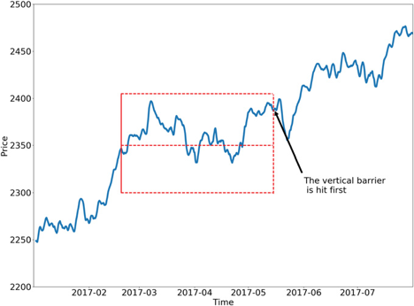
Labeling Observations: The Triple Barrier Method
In finance, observations are generally labeled by a specified return threshold.
For example, emit a 1 if the return of the label generation period is positive, or -1 if the return is negative
This method is commonly used in Financial ML studies
Problematic due to properties of data and use of fixed return thresholds
Instead, the triple-barrier method should be used, which creates two horizontal barriers for profit taking and stop loss, and a vertical barrier for expiration after a specific time or number of bars has passed [14]
Horizontal profit taking and stop loss barriers are a dynamic function of volatility
This method allows for more realistic labels that better model the changing properties of financial data
Figure 4: Example of the triple barrier method given in [14]

Slide 19

Meta-labeling: Bet Confidence and Sizing
If a model for the side of the prediction is defined, we can create a secondary model to solely determine the size of the bet [14]
Meta-labeling generates labels ~[0,1], where zero labels mean that we don’t take that bet.
Labels are then combined with the probability of the prediction to form the size to allocate to that bet.
Meta-labeling is useful in the context of finance, as we can create separate models for side and sizing
Model for side can be anything from technical analysis to fundamental-based rules, allowing ML to be applied to any existing strategy [14]
Another advantage is that separate features can be used for signal generation and risk management
Meta-labeling filters out false positives, which could be considered as riskier bets
Meta-labeling increases F1-scores, which is the harmonic average between recall and precision [14]
Recall [13] = $\frac{True Positves}{True Positives+False Positives}$
Precision [13] = $\frac{True Positves}{True Positives+False Negatives}$
In the context of finance, bet sizing is extremely import as high allocations to losing bets will ruin even a good strategy.

Slide 20
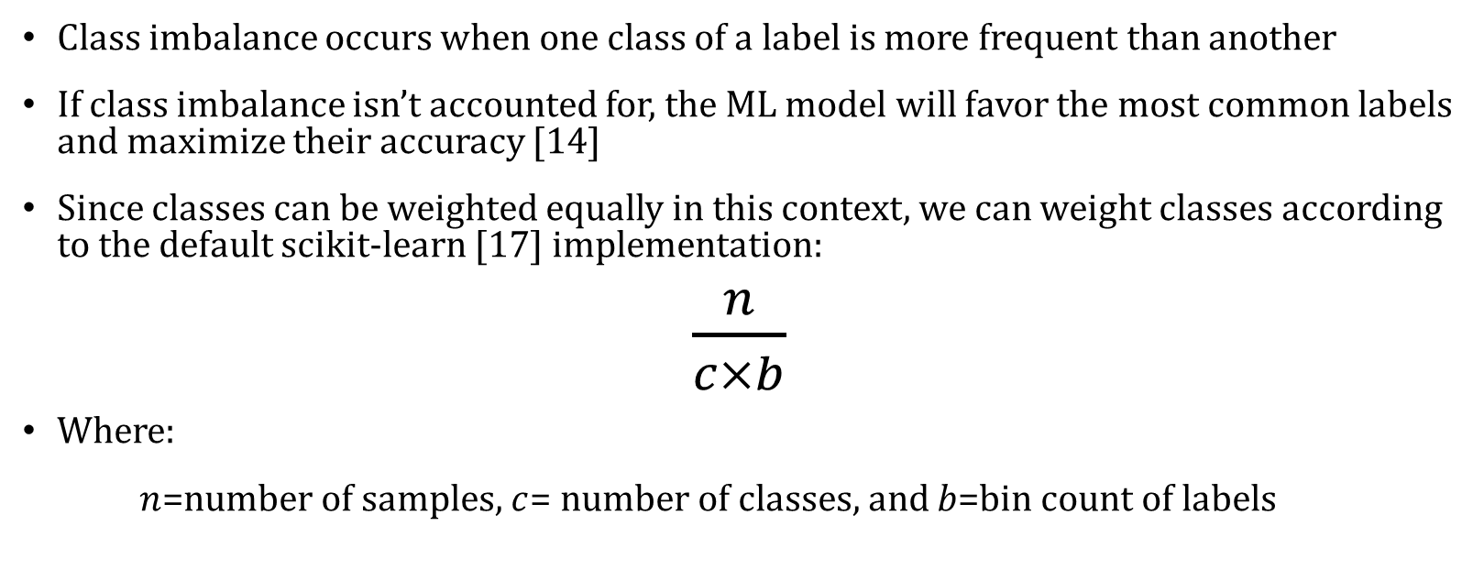
Class Imbalance
Class imbalance occurs when one class of a label is more frequent than another
If class imbalance isn’t accounted for, the ML model will favor the most common labels and maximize their accuracy [14]
Since classes can be weighted equally in this context, we can weight classes according to the default scikit-learn [17] implementation:
$\frac{n}{c×b}$
Where:
$n$=number of samples, $c$= number of classes, and $b$=bin count of labels
(1)

Slide 21
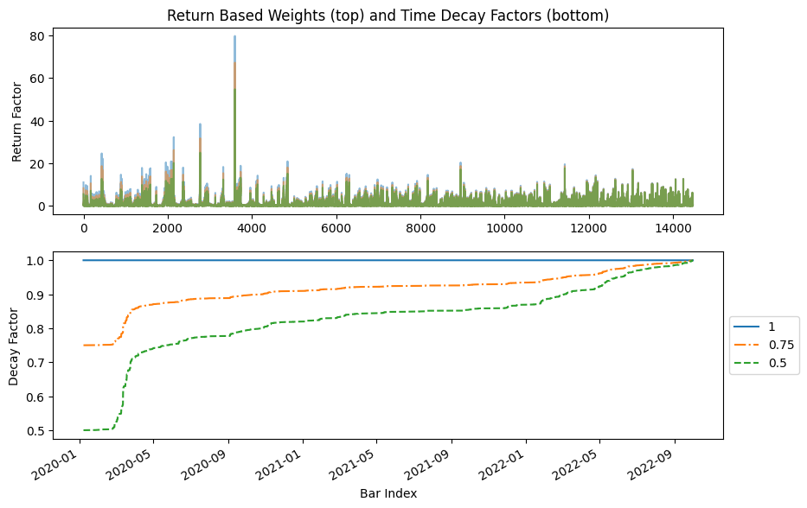
Sample Weights
In a general ML context, sample weighting is “an effective approach for tackling data biases such as imbalanced and corrupted labels” [20]
When labeling financial data, overlap is common as one label could be predicted from data used to predict a future label.
A label is said to be unique if its prediction window does not contain data used to generate another label
Sample weights weigh the importance of a label by a function of its uniqueness [14]
In the context of finance, we also want to take into account the time of a label and the return associated to it
Sample weighting by return [14]:
labels with high average returns should be given more importance than labels with smaller return, as these labels are more significant
Implementing a time decay factor [14]:
The factors the drive the performance of a market generally change over time, and something that may have affected the performance of a market 2 years ago may not be relevant today
To reflect this in our model, we can introduce a decay factor that assigns more importance to recent datapoints
This factor can be linear or exponential
Figure 5: Sample weights by return (top) and time decay factors (bottom)
Notes:
If we tried to combat overlap by only labeling when the prediction horizon passes the previous label, the minimum allowed unique data for each label would be restricted to the largest feature aggregation window.
For example, if monthly volatility was used as a feature, only one label could be produced per month.
This is not very realistic in finance, so overlap should be allowed but corrected for with sample weights.

Slide 22
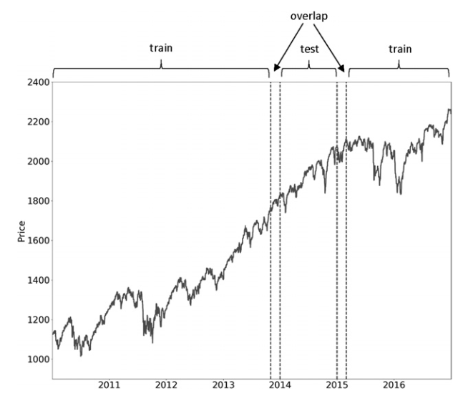
Cross Validation: Purge and Embargo
In ML, Cross-Validation (CV) is a method to evaluate the generalized performance of a model [5]
One of the most common CV methods is K-fold CV, where [5]:
Data is partitioned into K equal folds
The model is evaluated on each fold
Performance is evaluated by the average accuracy over each fold
CV assumes that samples are Independent and Identically Distributed (I.I.D), which is not the case for financial data
Label overlap also causes training sets to contain labels that use data from a previous testing set, leaking information between sets
This data leakage will artificially enhance the performance of the model and contribute to overfitting [6]
This problem can be combatted by [6]:
Purging: Removes labels from the training set that overlap with labels in the testing set
Embargo: Remove a small portion of data after a testing set for cases where purging cannot prevent all leakage
This method is called Purged K-Fold CV
Figure 6: Train and test set overlap, found in [14]

Slide 23
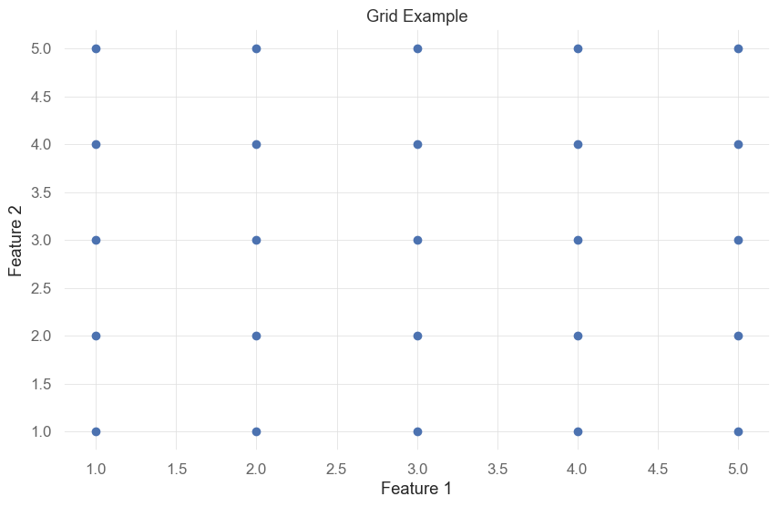
Hyper Parameter Tuning
Another purpose of Cross-Validation is hyper-parameter tuning
Hyper-parameter tuning is the process of selecting parameters that provide the best generalization performance [13]
Grid Search is commonly used, which exhaustively searches for the best parameters
We can use the previously discussed Purged K-Fold CV method to implement a grid search model that tunes parameters
Figure 7: Grid search example, where each axis represents a feature or parameter, and value combinations are represented by points on the plot

Slide 24
Feature Importance
A common mistake in finance is to repeatedly backtest on the same dataset used for creating a strategy until good results are obtained
This is a prime example of overfitting, and “Academic journals are filled with such pseudodiscoveries, and even large hedge funds constantly fall into this trap” [14]
Feature importance should be used instead of backtests to research the validity of a strategy
Feature Importance Methods [6]:
Mean Decrease Impurity (MDI): Specific to tree-based classifiers, where at each node in a tree, the feature splits the subset it receives in a way that decreases impurity. The decrease is then averaged across all trees for each feature.
Mean Decrease Accuracy (MDA): Fits a classifier and finds its out of sample performance, then permutes each feature and measures the out of sample performance for each permutation. The importance of a feature is then given by the loss of performance caused by its permutation. MDA has the benefit that it can work with any classifier but is slow since the classifier is constantly refit.
Single Feature Importance (SFI): Computes the out of sample importance for each feature in isolation. SFI is useful for viewing the importance of a single feature, which can sometimes be skewed by multicollinearity (correlated features) when using other feature importance methods

Slide 25
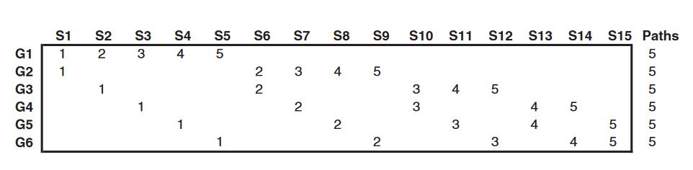
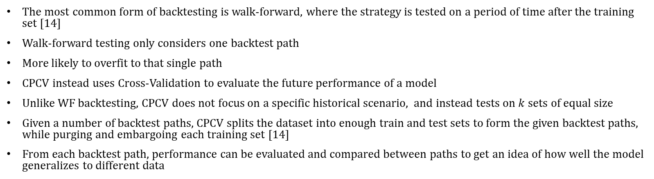
Combinatorial Purged K-Fold Cross Valiation (CPCV) as a Backtesting Tool
The most common form of backtesting is walk-forward, where the strategy is tested on a period of time after the training set [14]
Walk-forward testing only considers one backtest path
More likely to overfit to that single path
CPCV instead uses Cross-Validation to evaluate the future performance of a model
Unlike WF backtesting, CPCV does not focus on a specific historical scenario, and instead tests on $k$ sets of equal size
Given a number of backtest paths, CPCV splits the dataset into enough train and test sets to form the given backtest paths, while purging and embargoing each training set [14]
From each backtest path, performance can be evaluated and compared between paths to get an idea of how well the model generalizes to different data
Figure 9: Backtest paths generated by CSCV with 6 groups and a k of 2. Sourced from [14]

Slide 26
Future Improvements and Research Directions
Testing on simulated data
Implementing portfolio optimization methods
Basic parameter optimization
Asset universes and pairs trading

Slide 27
References
[1] Ashley, R. A., & Patterson, D. M. (1986). A Nonparametric, Distribution-Free Test for Serial Independence in Stock Returns. The Journal of Financial and Quantitative Analysis, 21(2), 221–227. https://doi.org/10.2307/2330739
[2] Bailey, D. H., Borwein, J., Lopez de Prado, M., & Zhu, Q. J. (2014). Pseudo-Mathematics and Financial Charlatanism: The Effects of Backtest Overfitting on Out-of-Sample Performance (SSRN Scholarly Paper 2308659). https://doi.org/10.2139/ssrn.2308659
[3] Black, F., & Scholes, M. (1973). The Pricing of Options and Corporate Liabilities. Journal of Political Economy, 81(3), 637–654.
[4] Easley, D., Lopez de Prado, M., & O’Hara, M. (2012). Flow Toxicity and Liquidity in a High Frequency World (SSRN Scholarly Paper 1695596). https://doi.org/10.2139/ssrn.1695596
[5] Fama, E. F. (1970). Efficient Capital Markets: A Review of Theory and Empirical Work. The Journal of Finance, 25(2), 383–417. https://doi.org/10.2307/2325486
[6] Harvey, C. R. (2017). Presidential Address: The Scientific Outlook in Financial Economics (SSRN Scholarly Paper 2893930). https://doi.org/10.2139/ssrn.2893930
[7] James, G., Witten, D., Hastie, T., Tibshirani, R., & Taylor, J. (2023). An Introduction to Statistical Learning: With Applications in Python. Springer International Publishing.
[8] Lo, A. W., & MacKinlay, A. C. (1999). A Non-Random Walk down Wall Street. Princeton University Press. http://ebookcentral.proquest.com/lib/cwu/detail.action?docID=819621
[9] Lopez de Prado, M. (2018). The 10 Reasons Most Machine Learning Funds Fail (SSRN Scholarly Paper 3104816). https://doi.org/10.2139/ssrn.3104816
[10] Lopez de Prado, M., & Bailey, D. H. (2018). The False Strategy Theorem: A Financial Application of Experimental Mathematics (SSRN Scholarly Paper 3221798). https://papers.ssrn.com/abstract=3221798

Slide 28
References Cont.
[11] Mandelbrot, B., & Taylor, H. M. (1967). On the Distribution of Stock Price Differences. Operations Research, 15(6), 1057–1062. https://doi.org/10.1287/opre.15.6.1057
[12] Mota, P. P. (2012). Normality assumption for the log-return of the stock prices. Discussiones Mathematicae Probability and Statistics, 32(1–2), 47. https://doi.org/10.7151/dmps.1143
[13] Müller, A. C., & Guido, S. (2016). Introduction to Machine Learning with Python: A Guide for Data Scientists. O’Reilly Media, Inc.
[14] Prado, M. L. de. (2018). Advances in Financial Machine Learning. John Wiley & Sons.
[15] Quantitative Finance: Definition & History | CQF. (n.d.). Retrieved October 11, 2023, from https://www.cqf.com/blog/what-quantitative-finance-brief-history
[16] Quigley, L. (n.d.). Statistical Analysis of the Log Returns of Financial Assets.
[17] Sklearn.utils.class_weight.compute_class_weight. (n.d.). Scikit-Learn. Retrieved February 27, 2024, from https://scikit-learn/stable/modules/generated/sklearn.utils.class_weight.compute_class_weight.html
[18] Stefan, A. M., & Schönbrodt, F. D. (2023). Big little lies: A compendium and simulation of p-hacking strategies. Royal Society Open Science, 10(2), 220346. https://doi.org/10.1098/rsos.220346
[19] Wang, S., Luo, Y., & Alvarez, M.-A. (2014). Seven Sins of Quantitative Investing. Signal Processing.
[20] Zhang, Z., & Pfister, T. (2021). Learning Fast Sample Re-weighting Without Reward Data (arXiv:2109.03216). arXiv. http://arxiv.org/abs/2109.03216

Slide 29
Image References
[21] AQR Capital Management. (n.d.). Retrieved February 27, 2024, from https://www.aqr.com/
[22] Home: Jane Street. (n.d.). Retrieved February 27, 2024, from https://www.janestreet.com/
[23] Renaissance Technologies. (n.d.). Retrieved February 27, 2024, from https://www.rentec.com/Home.action?index=true
[24] Citadel—Identifying the Highest and Best Uses of Capital. (n.d.). Citadel. Retrieved February 27, 2024, from https://www.citadel.com/
[25] Bloomberg. (2020, June 25). Top 5 Bloomberg Terminal “Hacks” To Help Traders Navigate the Markets from Home. Traders Magazine. https://www.tradersmagazine.com/departments/commentary/top-5-bloomberg-terminal-hacks-to-help-traders-navigate-the-markets-from-home/
[26] Backtest example. (n.d.). Retrieved February 27, 2024, from https://datagrid.lbl.gov/backtest/index.php

