Slide 1
lasFE
Lognormal Fitting of Laser Aerosol Spectrometer data for Filtration-Efficiency Analysis
Matt Wright
Research Associate I

Slide 2
Laser Aerosol Spectrometer (LAS)
Optical spectrometer using intracavity laser to measure aerosol particulate size and number concentration [1]
User interface software has previously been approved for use by ICET’s Quality Assurance Group (QAG)
Test HEPA filters for radiological-waste treatment facilities
Data produced follows ICET internal procedures for measuring FE. This includes aerosol sampling upstream and downstream of the filter
GOAL: Analyze data to characterize filter’s ability to remove particulate from aerosol, i.e., Filtration Efficiency (FE)
GOAL: Minimize instrumental anomaly

Slide 3

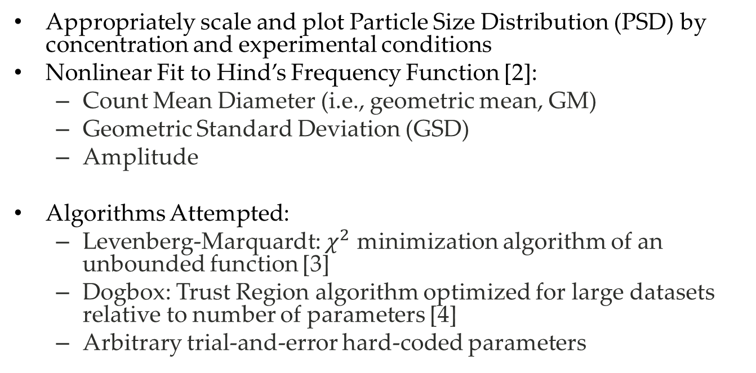
Computational Methods
Appropriately scale and plot Particle Size Distribution (PSD) by concentration and experimental conditions
Nonlinear Fit to Hind’s Frequency Function [2]:
Count Mean Diameter (i.e., geometric mean, GM)
Geometric Standard Deviation (GSD)
Amplitude
Algorithms Attempted:
Levenberg-Marquardt: $χ^{2}$ minimization algorithm of an unbounded function [3]
Dogbox: Trust Region algorithm optimized for large datasets relative to number of parameters [4]
Arbitrary trial-and-error hard-coded parameters

Slide 4
Fit Procedure
2-parameter fit for GM and GSD using scipy.optimize.curve_fit() [5]
Curve-area analysis to determine scaling
Trapezoidal Integration used to determine area under PSD and fit [6]
Fit scaled by area ratio such that PSD and fit functions have equivalent area
Both iterative methods fail to converge upon reasonable parameters. Going forward, considering 3-parameter fit to include scaling without curve-area analysis

Slide 5
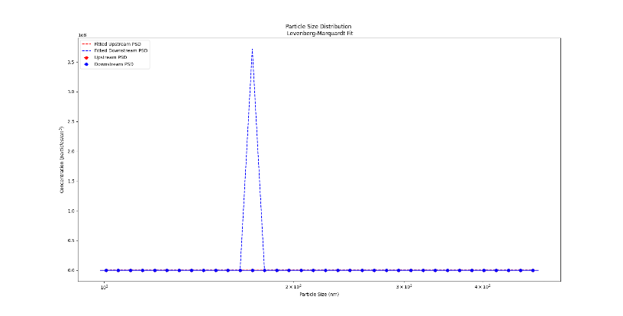
Levenberg-Marquardt (downstream dominant)

Slide 6
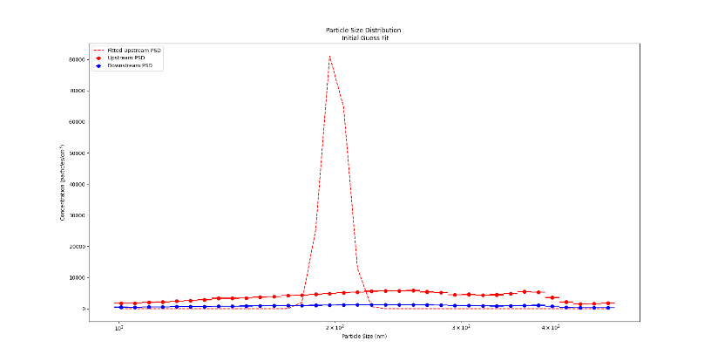
Levenberg-Marquardt (downstream removed)

Slide 7
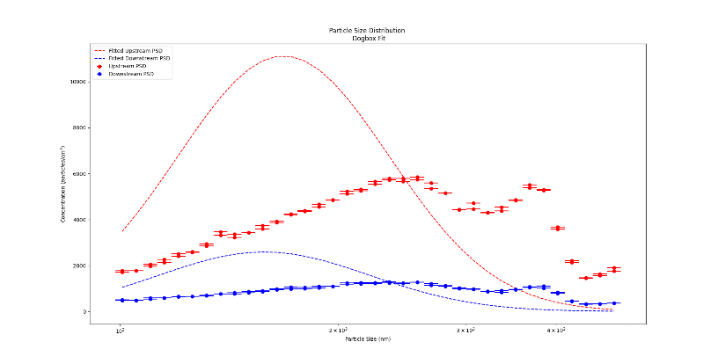
Dogbox

Slide 8
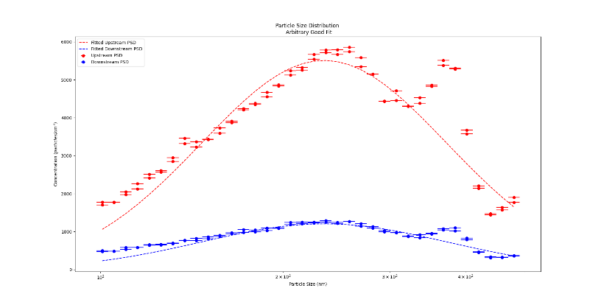
Good Fit

Slide 9
Software Quality Assurance (SQA)
My inescapable Kafkaesque nightmare
Automated Calculation Application Packages (ACAP) – Excel data-reduction spreadsheets approved by QAG
Limited iterative capabilities restricts complex analysis
Blackbox GUI hides internal operations reducing operator control. May ultimately result in conditions adverse to quality
ICET-QA-036 Rev. 3, Software Control [7]

Slide 10
SQA Activities Performed
Software Grade Level Determination (approved): A
Graded approach ensures all levels of analysis are commensurate with safety, the DOE’s mission, or other relevant factors [8]
Risk and Safety Assessment: Software failure may pose safety risks
Software Quality Assurance Plan (SQAP, in review)
Outlines project-specific SQA practices and documentation
Software Requirements and Specifications (SRS, in preparation)
Outlines functional and non-functional requirements and acceptance criteria
Test Plan and Execution (planned)
Ensure acceptance criteria outlined in SRS is met

Slide 11
Bibliography
TSI, “Laser Aerosol Spectrometer 3340A,”https://tsi.com/products/particle-sizers/supermicron-capable-particle-sizer-spectrometers/laser-aerosol-spectrometer-(las)-3340a/.
W. C. Hinds, Aerosol Technology, 2nd ed. (Wiley Inter-Science, 1999)
M. Lourakis, A Brief Description of the Levenberg-Marquardt Algorithm Implemented by Levmar 4 (2005)
K. Vogklis and I. Lagaris, “A rectangular trust-region approach for unconstrained and box-constrained optimization problems,” (2019) pp. 562–565.
Scipy Manual, optimize.curve_fit(), https://docs.scipy.org/doc/scipy/reference/generated/scipy. optimize.curve_fit.html#scipy.optimize.c
M. Newman, Computational Physics (2013)
ICET-QA-036 Rev. 3, Software Control
DOE O 414.1D Quality Assurance

