Slide 1
lasFE
Lognormal Fitting of Laser Aerosol Spectrometer data for Filtration-Efficiency Analysis
Matt Wright
Research Associate I

Slide 2
Laser Aerosol Spectrometer (LAS)
Optical spectrometer using intracavity laser to measure aerosol particulate size and number concentration
User interface software has previously been approved for use by ICET’s Quality Assurance Group (QAG)
Test HEPA filters for radiological-waste treatment facilities
Data produced follows ICET internal procedures for measuring FE. This includes aerosol sampling upstream and downstream of the filter
GOAL: Analyze data to characterize filter’s ability to remove particulate from aerosol, i.e., Filtration Efficiency (FE)
GOAL: Minimize instrumental anomaly

Slide 3

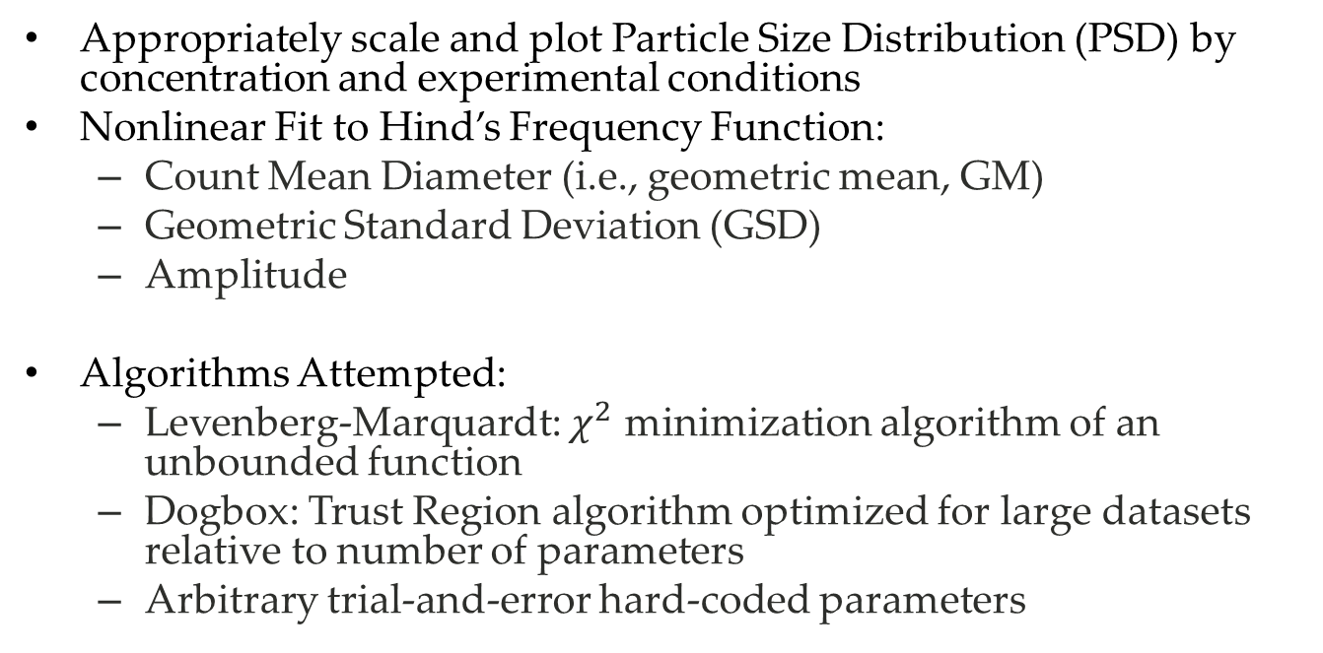
Computational Methods
Appropriately scale and plot Particle Size Distribution (PSD) by concentration and experimental conditions
Nonlinear Fit to Hind’s Frequency Function:
Count Mean Diameter (i.e., geometric mean, GM)
Geometric Standard Deviation (GSD)
Amplitude
Algorithms Attempted:
Levenberg-Marquardt: $χ^{2}$ minimization algorithm of an unbounded function
Dogbox: Trust Region algorithm optimized for large datasets relative to number of parameters
Arbitrary trial-and-error hard-coded parameters

Slide 4
Fit Procedure
2-parameter fit for GM and GSD using scipy.optimize.curve_fit()
Curve-area analysis to determine scaling
Trapezoidal Integration used to determine area under PSD and fit
Fit scaled by area ratio such that PSD and fit functions have equivalent area
Both iterative methods fail to converge upon reasonable parameters. Going forward, considering 3-parameter fit to include scaling without curve-area analysis

Slide 5
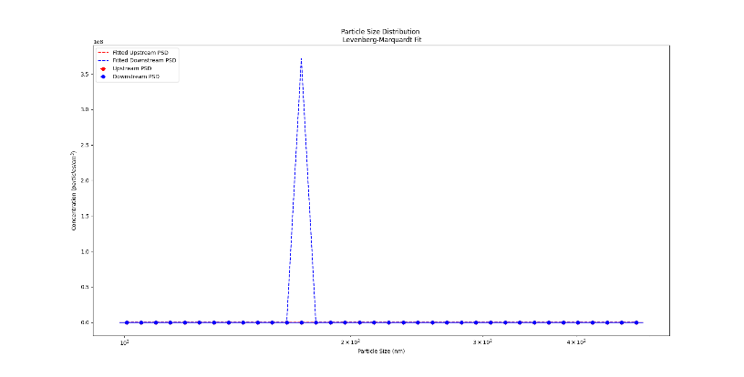
Levenberg-Marquardt (downstream dominant)

Slide 6
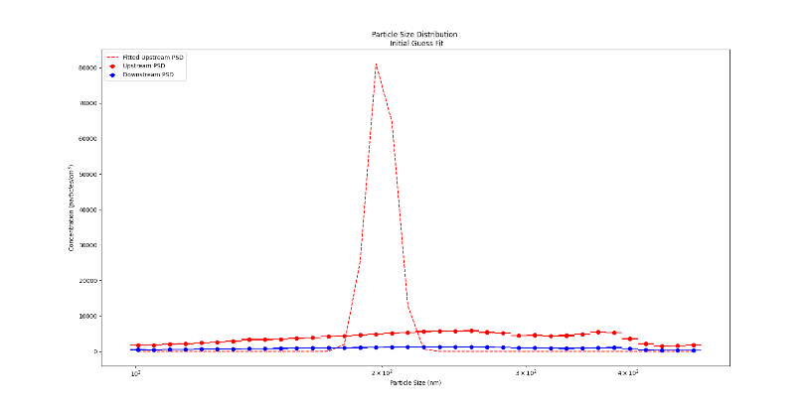
Levenberg-Marquardt (downstream removed)

Slide 7
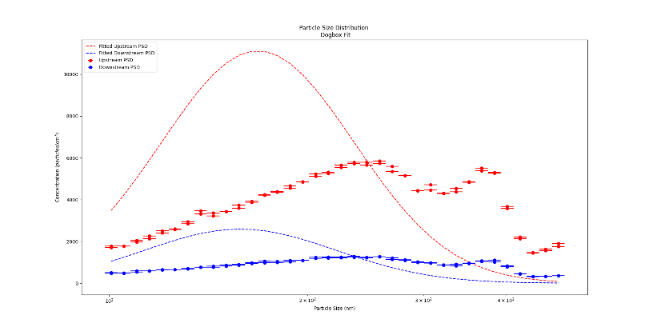
Dogbox

Slide 8
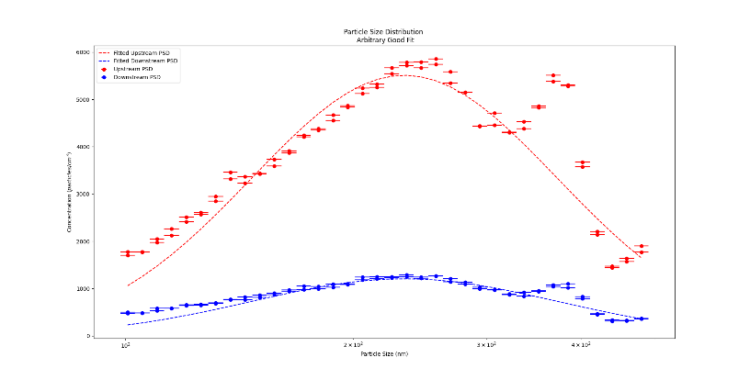
Good Fit

Slide 9
Software Quality Assurance (SQA)
My inescapable Kafkaesque nightmare
Automated Calculation Application Packages (ACAP) – Excel data-reduction spreadsheets approved by QAG
Limited iterative capabilities restricts complex analysis
Blackbox GUI hides internal operations reducing operator control. May ultimately result in conditions adverse to quality
ICET-QA-036 Rev. 3, Software Control

Slide 10
SQA Activities Performed
Software Grade Level Determination (approved): A
Graded approach ensures all levels of analysis are commensurate with safety, the DOE’s mission, or other relevant factors
Risk and Safety Assessment: Software failure may pose safety risks
Software Quality Assurance Plan (SQAP, in review)
Outlines project-specific SQA practices and documentation
Software Requirements and Specifications (SRS, in preparation)
Outlines functional and non-functional requirements and acceptance criteria
Test Plan and Execution (planned)
Ensure acceptance criteria outlined in SRS is met

