Slide 1
NFL Running Back Dataset
Matt Boyd
DS 210
Summer 2019

Slide 2

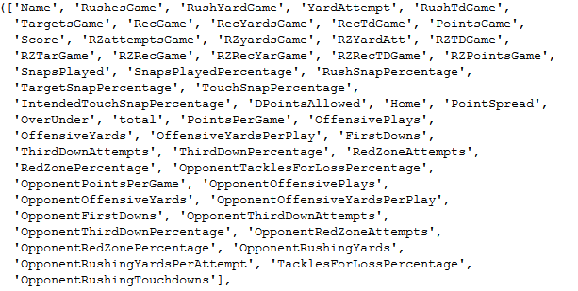
Dataset Creation
Weeks 1-16 2018 RB data
Player and opponent rushing
Player and opponent receiving
Touchdowns
Vegas odds
RedZone
Third down stats

Slide 3
Possible Questions
Classifying into 5 groups for week 17 based on week 1-16
A combination of high rushing yards/tds per game with a high opponent rushing yards/tds a game should result in being in the highest class
How accurately can I predict week 17 performance based on past performance
Which technique would be best?

Slide 4
PointsGame
Removed 91 weekly performance that contained a zero
This shows that the player did not participate in the game.
df['PointsGame'].value_counts()
df[df.PointsGame > 0]
Mean: df['PointsGame'].mean() 9.08
Median: df['PointsGame'].median() 7.4
Mode: df['PointsGame'].mode() 2.1

Slide 5
RushYardsGame
Performance based stat so no number is out of the range
Removed all Zeros
Mean: 33.03
Median:29
Mode: 1 2.5 and 3
Would Remove Bottom 25% of players because there performances aren’t useful

Slide 6
OppenentRushingYards
Real Data on how each team performed throughout season no reason to remove anything
Mean: 100.96
Median: 101.69
Mode:126.7
Mean and Median being so close makes since because it’s a team-based stat.

Slide 7
Supervised Learning Regression
Supervised Learning- Predict the value of one of the variable based on other variables when the new data is presented to us
Regression- Predicting the value of a numerical attribute based on past data.
FantasyPoints(wk17)
RushYardsGame, RushTdGame, OpponentRushingYards, OpponentRushingTocuhdowns
Linear Regression model to predict wk 17 performance based on prior performance

Slide 8
Supervised Learning Classification
Classification– Predicting the value of a categorical variable based on past data
ScorerTier
RushYardsGame, RushTdGame, OpponentRushingYards, OpponentRushingTouchdowns
Classify the Players into 5 groups based on these 4 stats

Slide 9
Unsupervised Learning Association
Unsupervised Learning- Looking for patterns or groups within the data
Association- Finding items that seem to be associated with each other
PointSpread(Vegas Odds)
How does Point spread correlate with RB production
This is valid because being a large favorite usually correlates to a large amount of touches when the favored team is trying to run the clock down

Slide 10
Unsupervised Learning Cluster
Cluster- Finding groups such that items in each group are more like each other than objects in the other groups
Opponent Rushing, Receiving and Touchdowns a game
Does a certain balance of the above features corelate to a high fantasy score

