Slide 1
NFL DraftKings Projections
Matt Boyd
DS 270

Slide 2
What is DFS
Daily Fantasy sports have become very popular recently passing up the standard season long league format. Each week players are given a salary then its your job to fill out a roster while staying below the salary cap. A typical DFS tournament has a entry fee of $1-$20 per lineup with the top 30% of lineups getting a payout.

Slide 3
Why make your own projections?
The majority of players use the same few websites for low variance/quality projections. When competing in large tournaments its crucial that your lineups are unique so they don’t get lost in the crowd of the 100k+ lineups. One of the best ways to do this is by making your own projections.

Slide 4
Dataset creation
Data for this project was pulled from fantasydata.com
Models for QB, RB, WR and TE where created
Each used Weekly/Yearly individual stats, Vegas odds, team offense and defense
Individual weekly data was collected from 2015-2018 season
2018 Data
  526x68 for QB’s
  980x53 for RB’s
  928x71 for WR’s
  494x71 for TE’s
2015-2018 Data
1927x68 for QB’s
6180x53 for RB’s
6660x71 for WR’s
3221x71 for TE’s

Slide 5
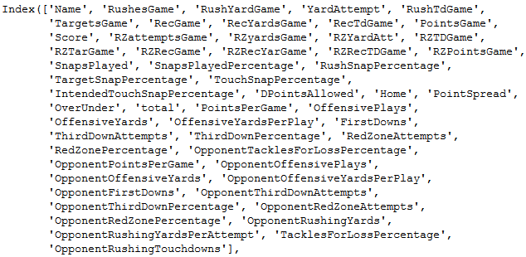
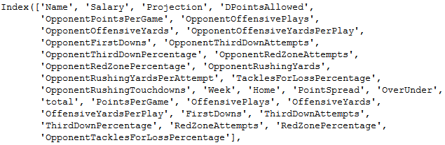


Running Back Data
Salaries + Opp Defense + Vegas odds
Individual Game Stats
Snaps
RedZone

Slide 6
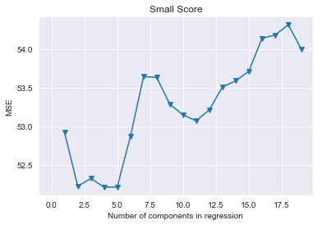
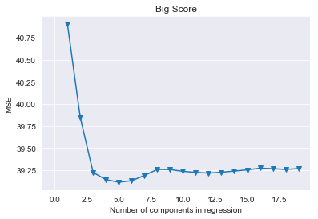
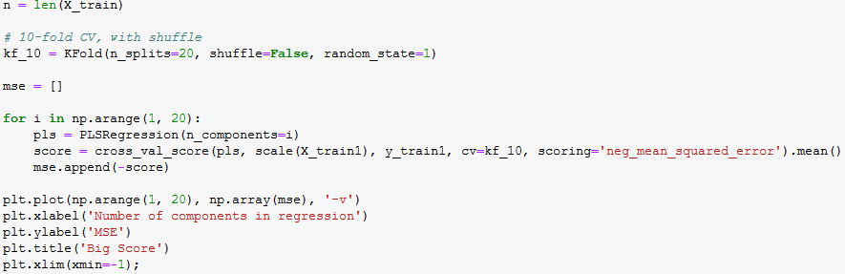
980 vs 6180 rows
The 2015-2018 outperforms the 2018 data alone.
Lowest MSE for both is 5 components

Slide 7
Linear Regression vs Random Forest vs PPG
2018 vs Big Data

Slide 8
Results
Point Per Game has a smaller MSE than Random Forest and Regression for every 2018 dataset.
The big dataset outperforms the 2018 dataset every time.
RB the least volatile position has the lowest MSE for every algorithm.
QB the most volatile position has better much better results from RF than regression
5 components in regression seem to be the best for every position

Slide 9
Future Work
Spend more time on the Datasets
Use of other Algorithm for predicting scores(NN and KNN)
Algorithms to predict Ownership percent
Algorithms to find best stacking and correlation methods
  How many players from same team + opposing team is best

