Slide 1
Sproutfolio
Group 18
Your leafy contact companion!

Slide 2
Meet the Team!

Slide 3
Team Members
Joshua Bell
Matthew Daley
Edrienne Gregana
Evan Naderi
Evan Tieu
API
API / Project Manager
Front-end
Front-end
Database
Notes:
Each member talks about their contribution (very short)

Slide 4
A closer look…

Slide 5









Technology Used
Database — Digital Ocean, MySQL
Team Dynamics — GitHub, Discord
API — Postman, SwaggerHub
DNS — Google Domains
Development – Visual Studio Code
Languages – HTML, CSS, JavaScript

Slide 6
Project Reflections
Things that went well…
Database finished quickly
Relatively fast communication
People knew their designated tasks
Things that didn’t go too well…
Schedules not aligning
Gantt chart completed retroactively
Accidentally deleted entire server (once)

Slide 7
Diagrams

Slide 8
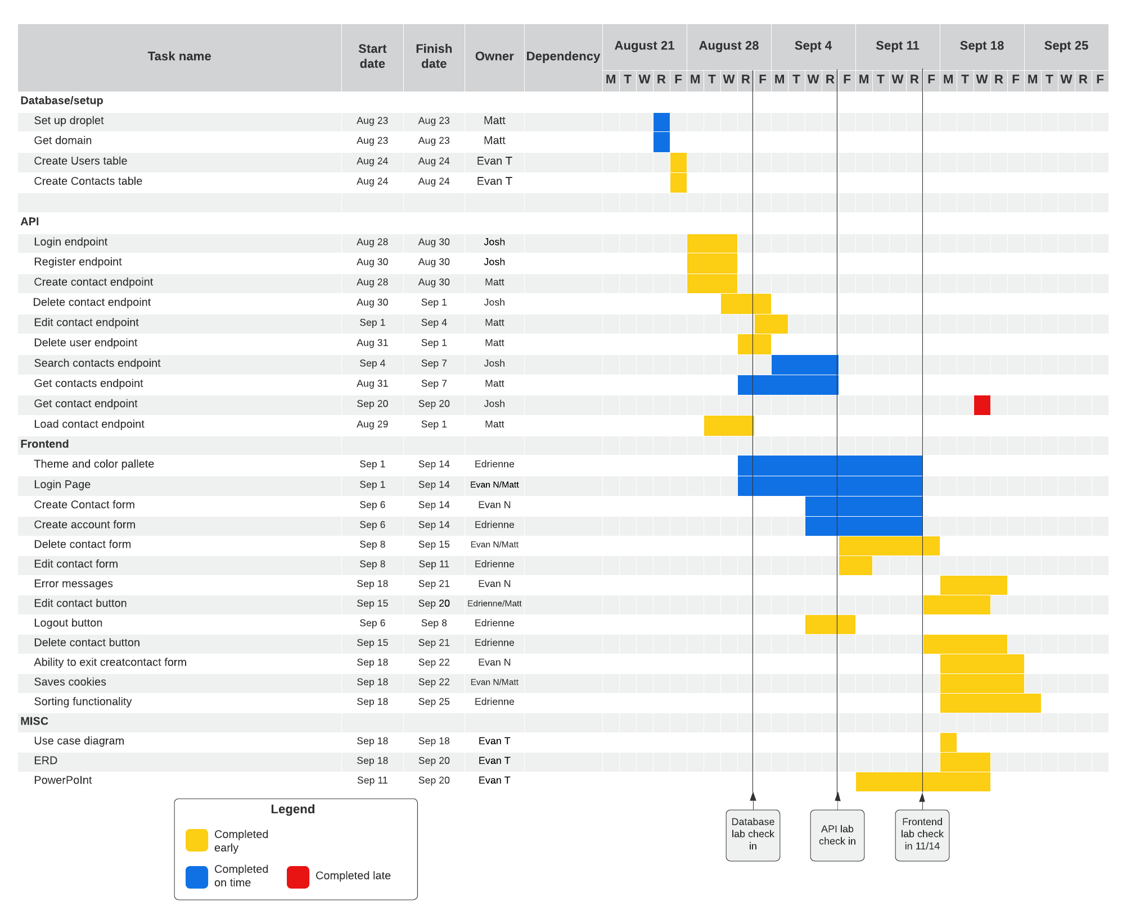
Notes:
Gantt chart

Slide 9
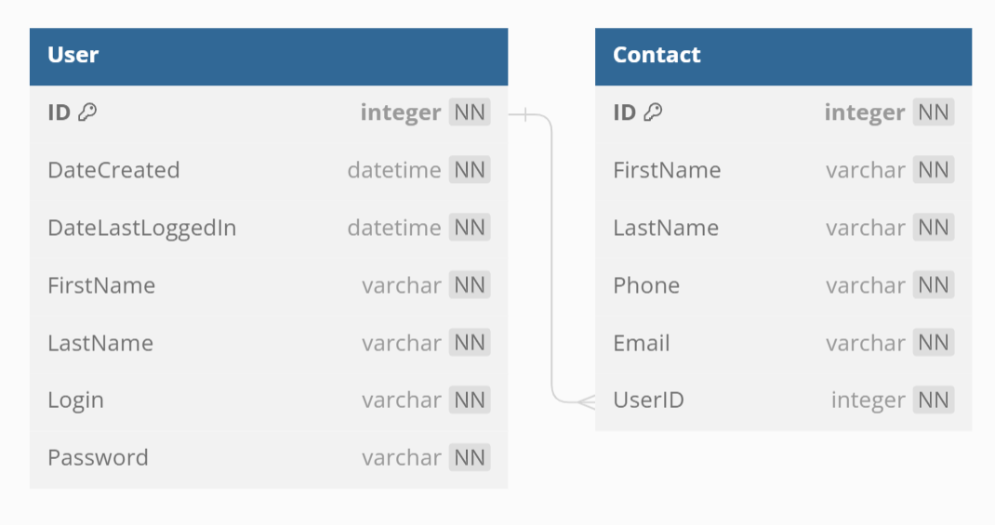
Notes:
Use case – two entities (user and contact), attributes, all no null, primary key and foreign key

Slide 10
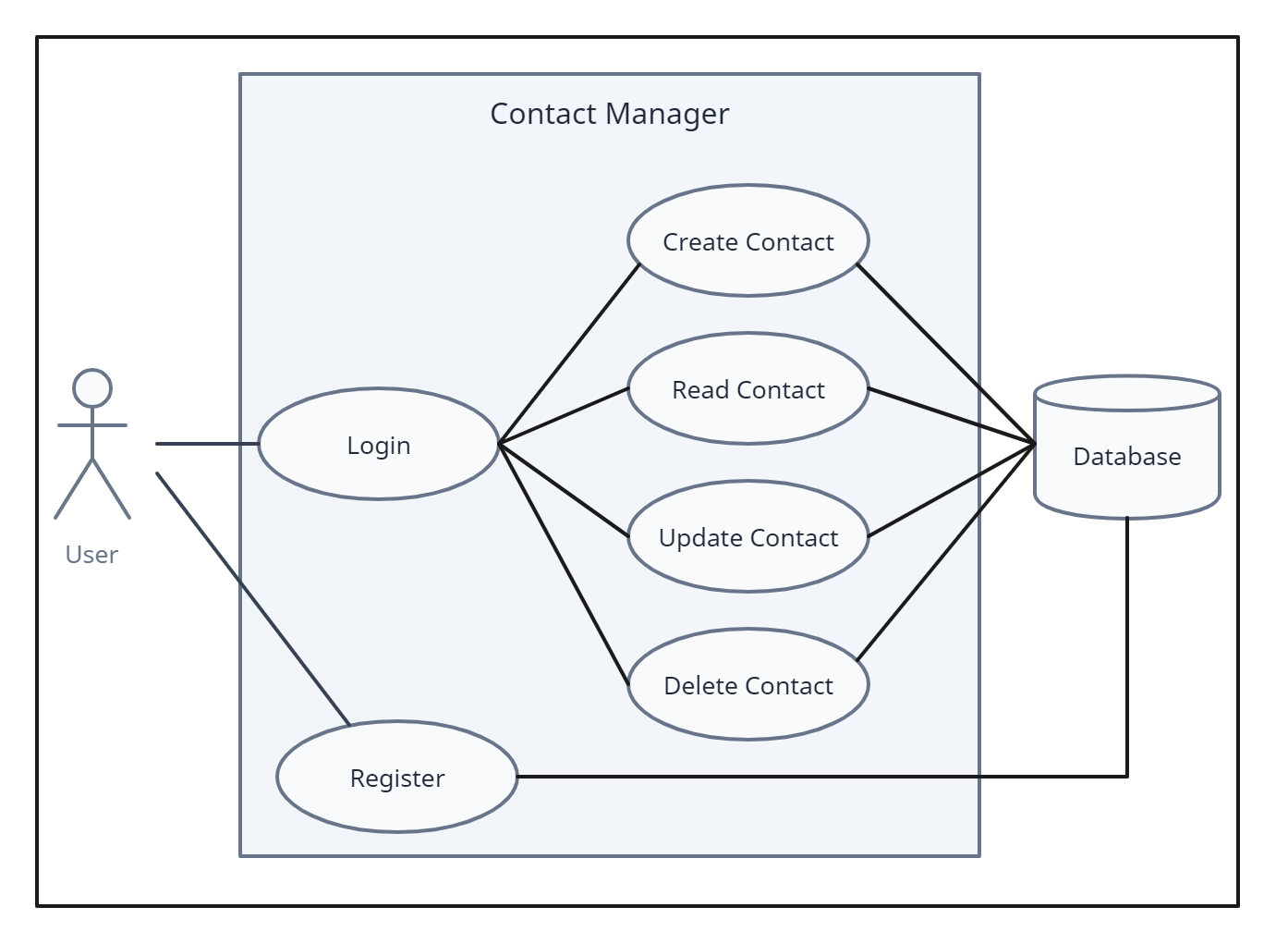
Notes:
Use case

Slide 11
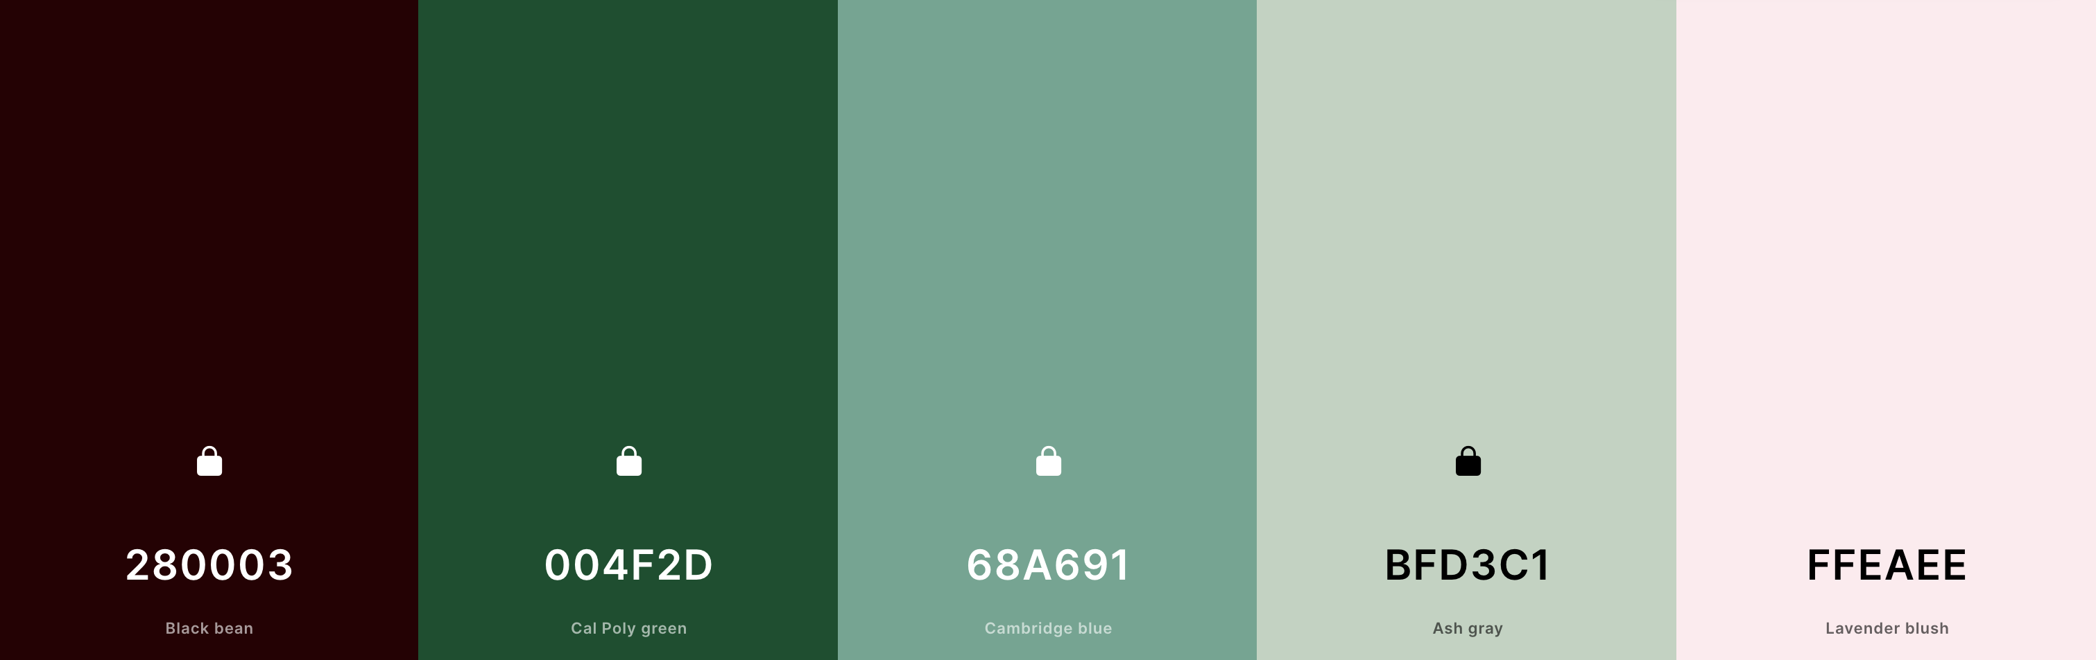
Notes:
Use case

Slide 12
Demonstrations

Slide 13
API Demonstration
SwaggerHub

Slide 14
Website Demonstration
http://poosd-project.com

Slide 15
Questions?

