Slide 1
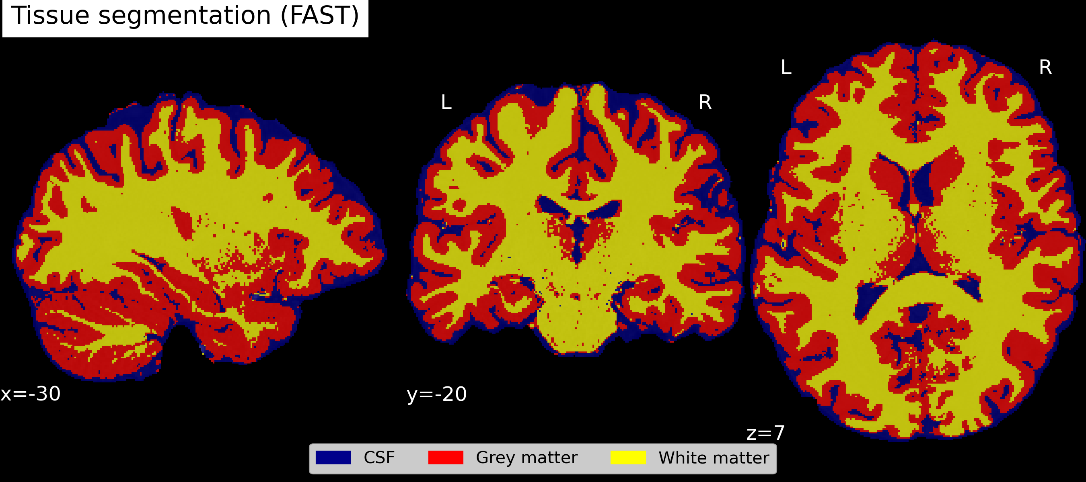
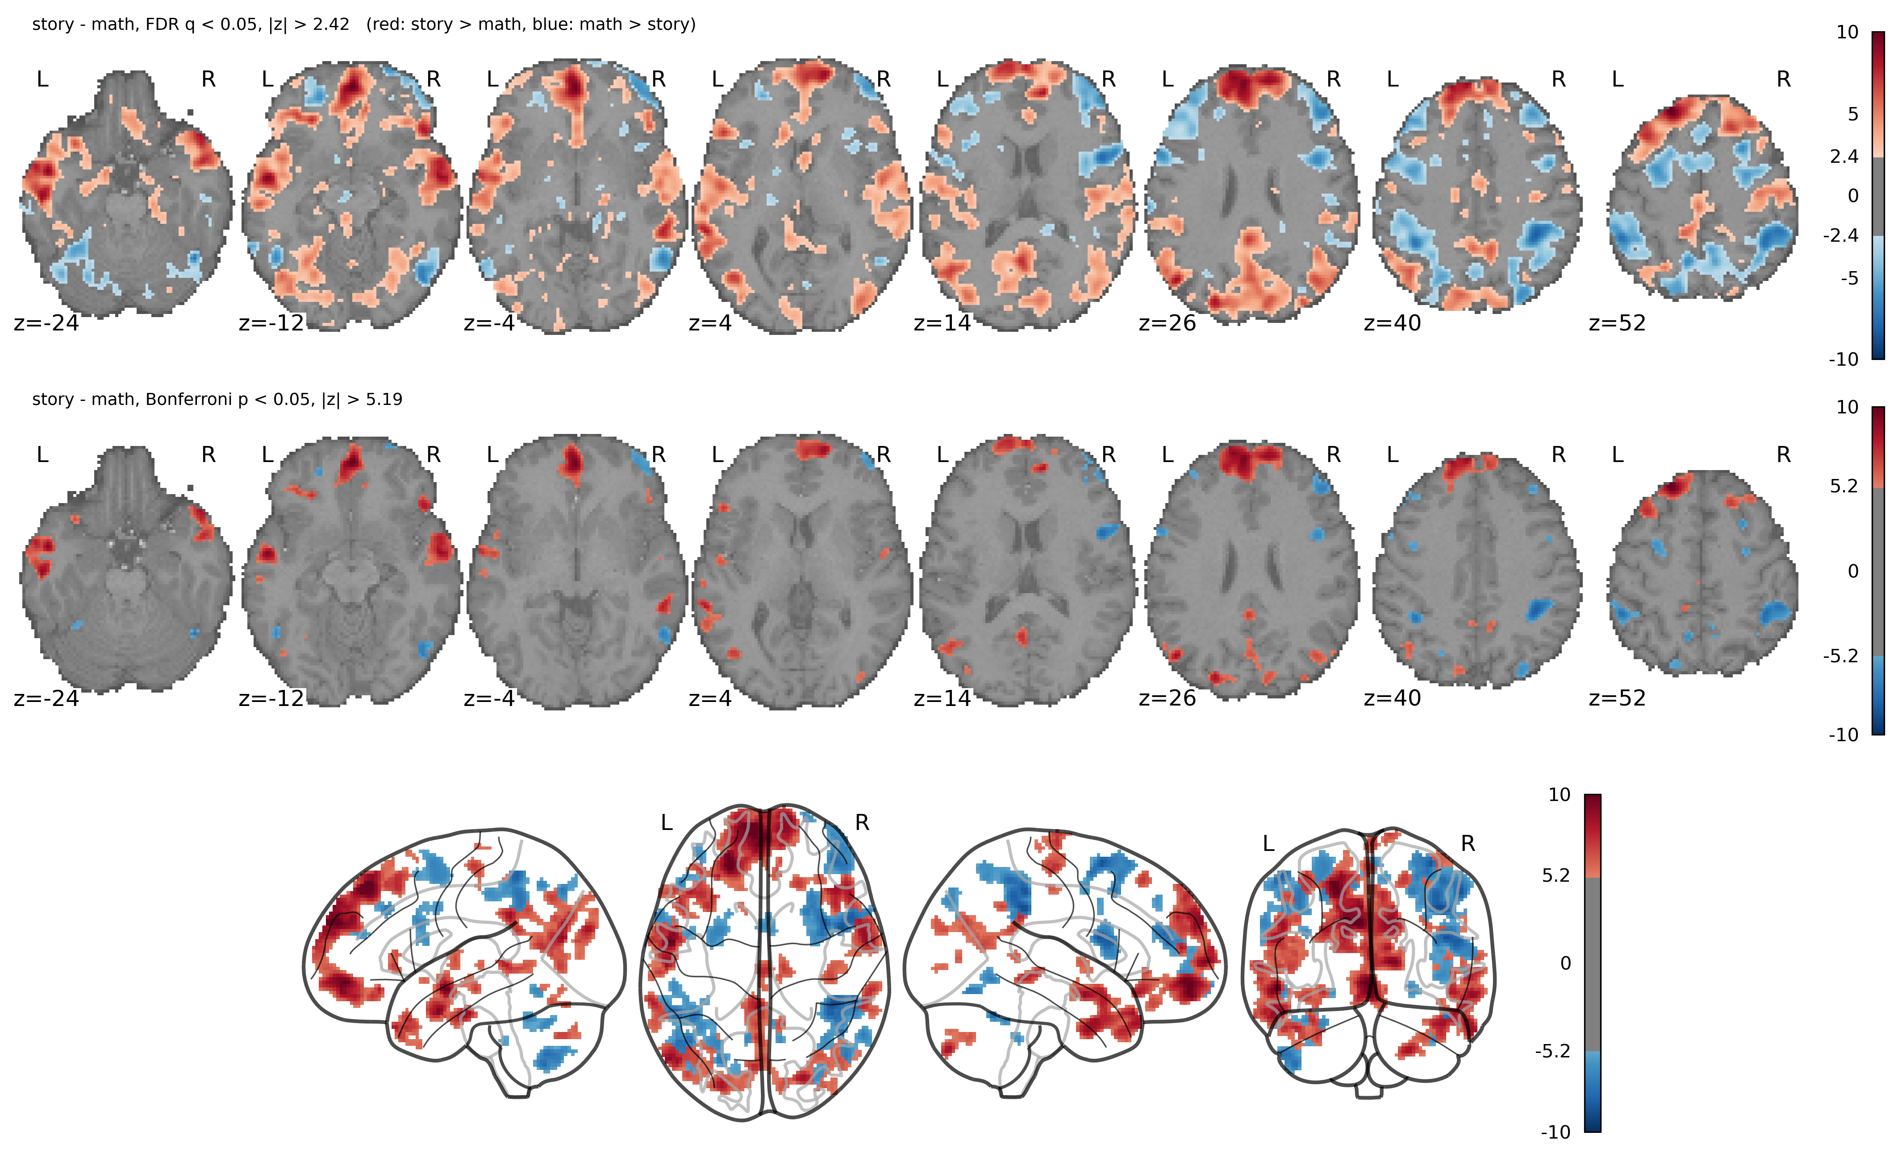

NSSP Miniproject 1
Group T
Marbach Valentin,
Schaffhauser Kilian,
Martignoni Matteo
November 2026

Slide 2
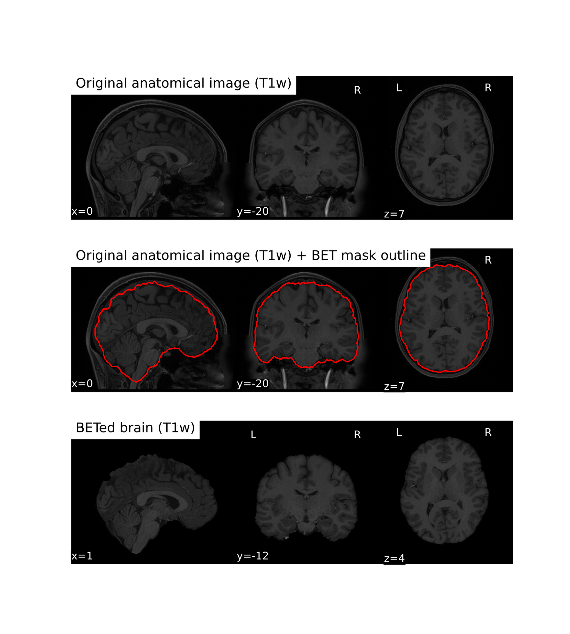
Structural preprocessing – Brain extraction

Slide 3
Structural preprocessing – Tissue Segmentation

Slide 4
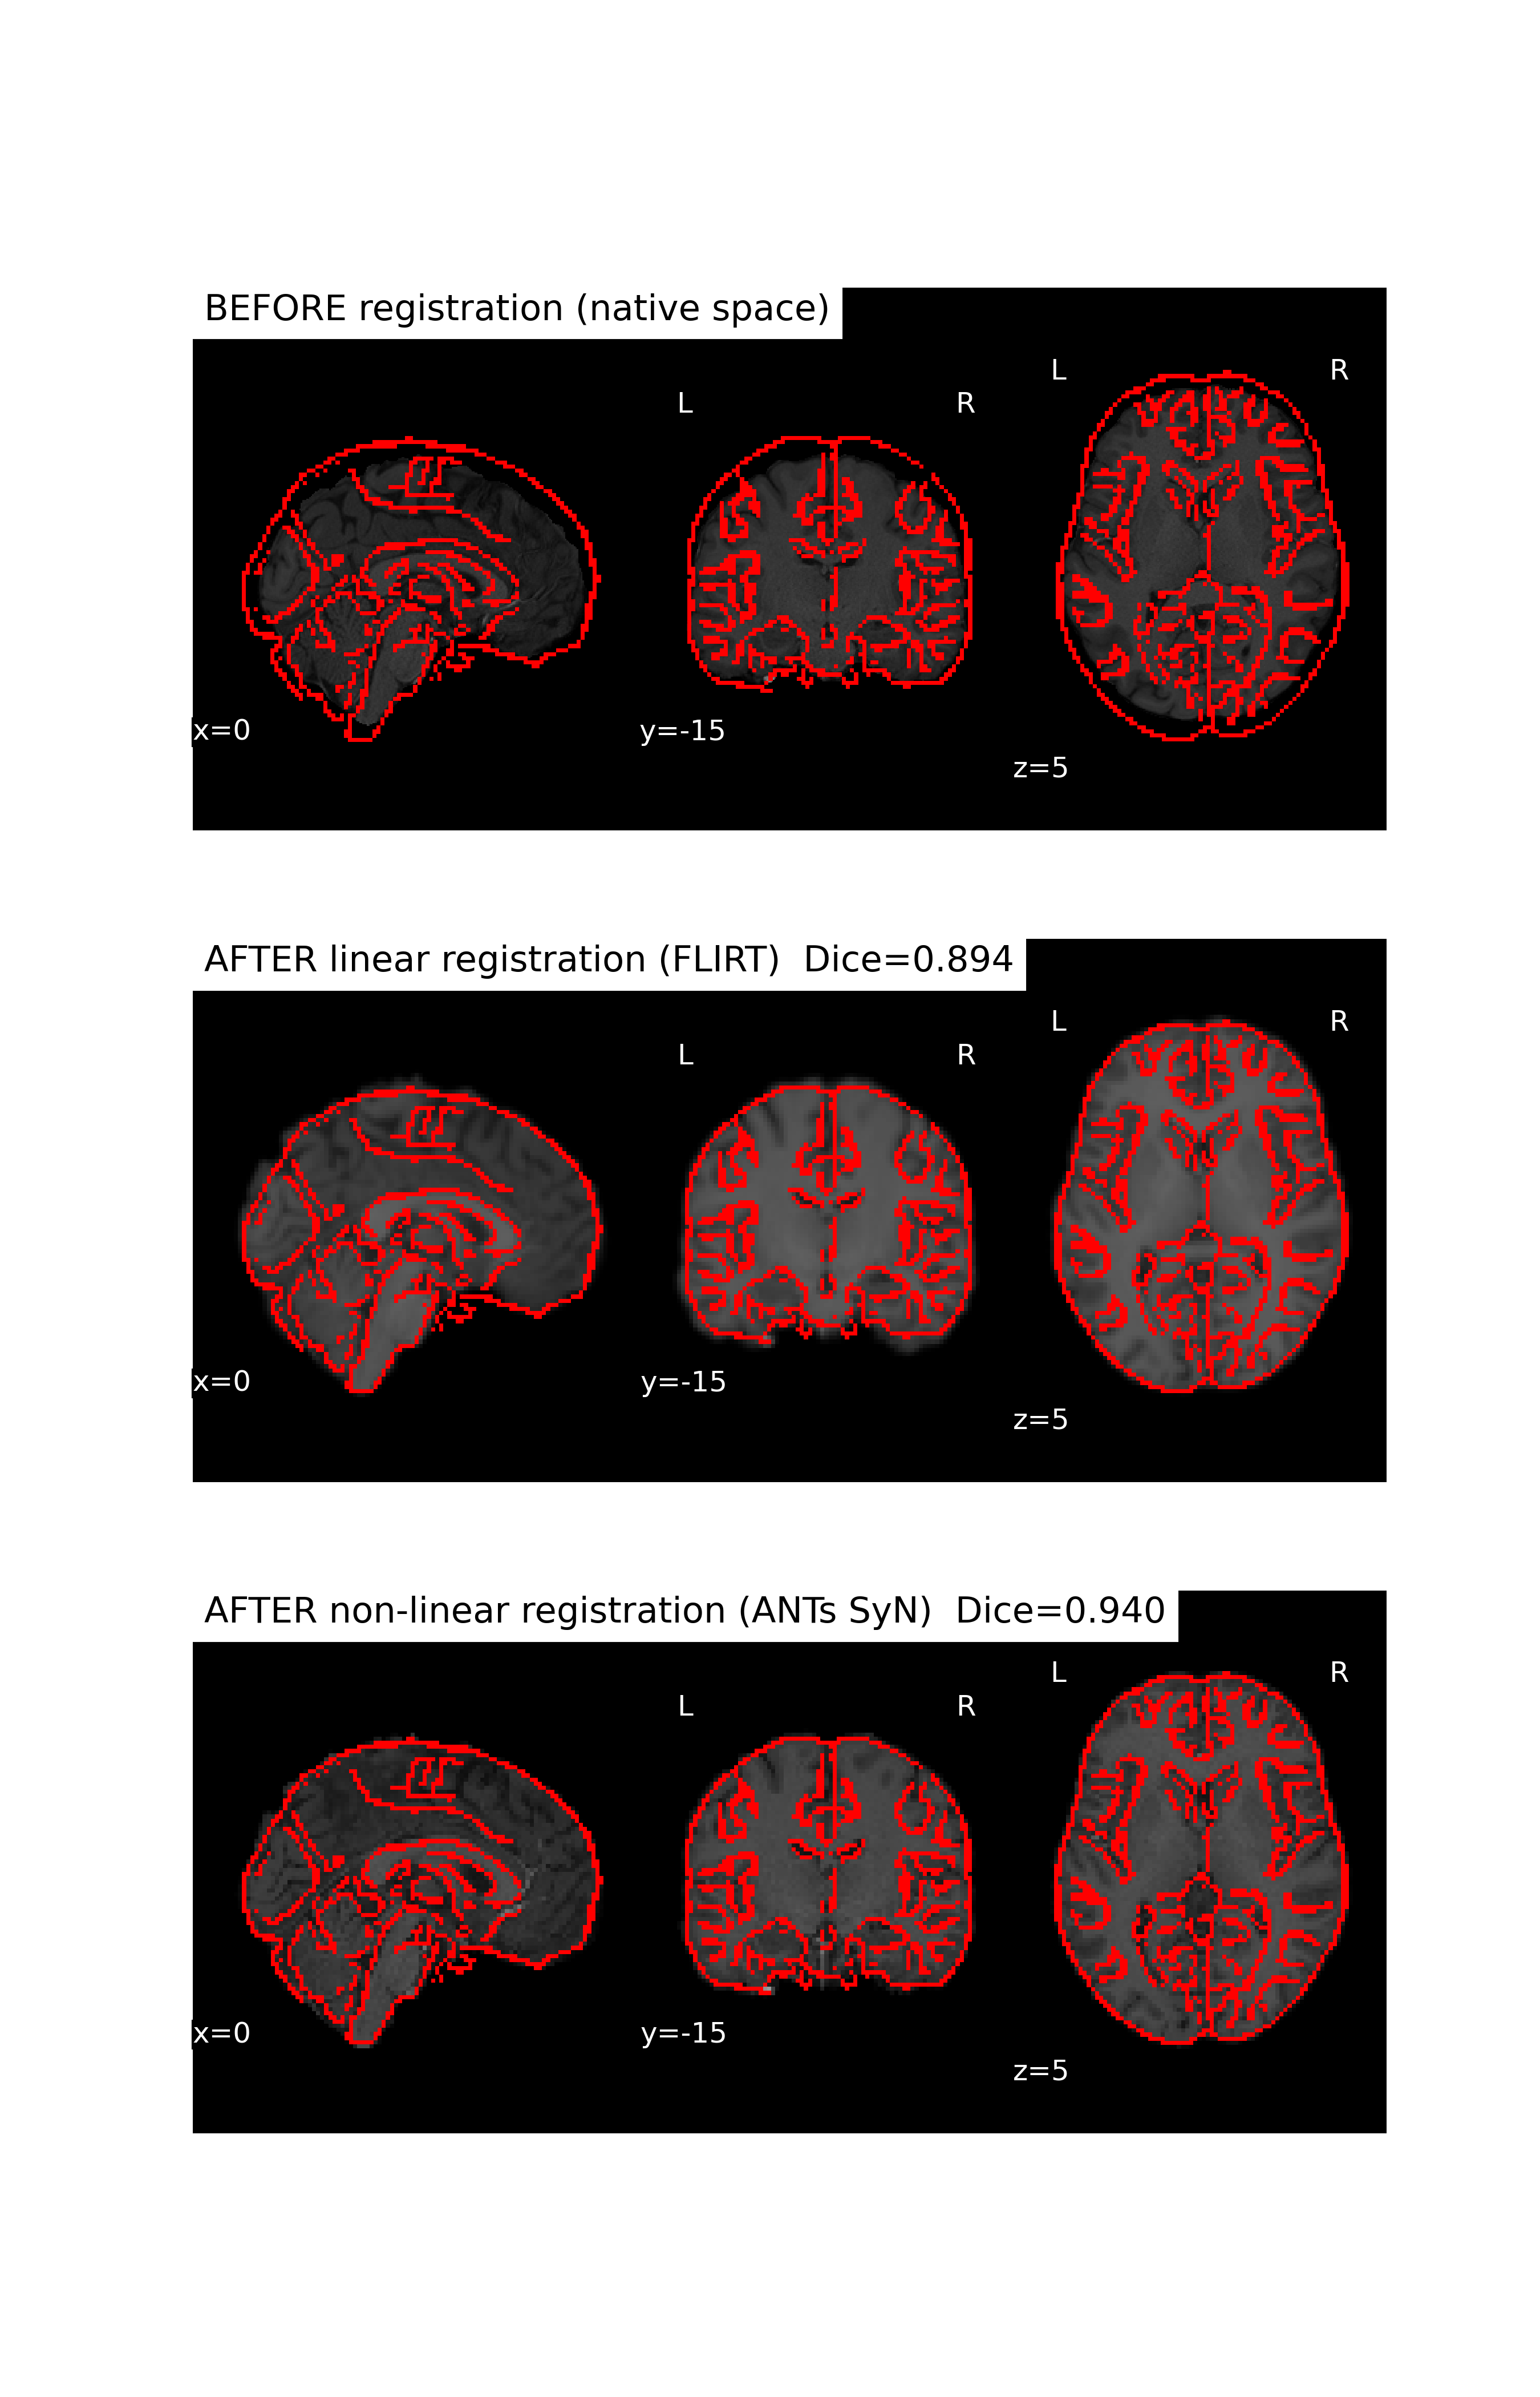
Structural preprocessing – Registration to MNI space

Slide 5
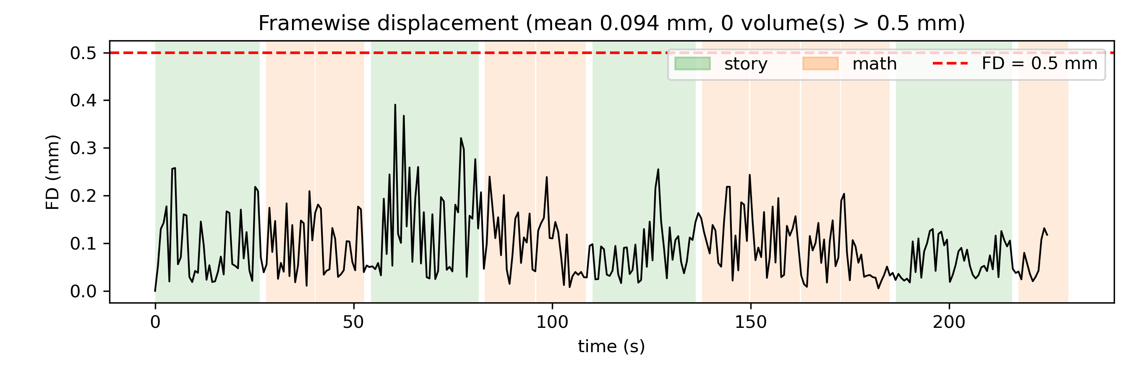
Functional preprocessing – Motion correction

Slide 6
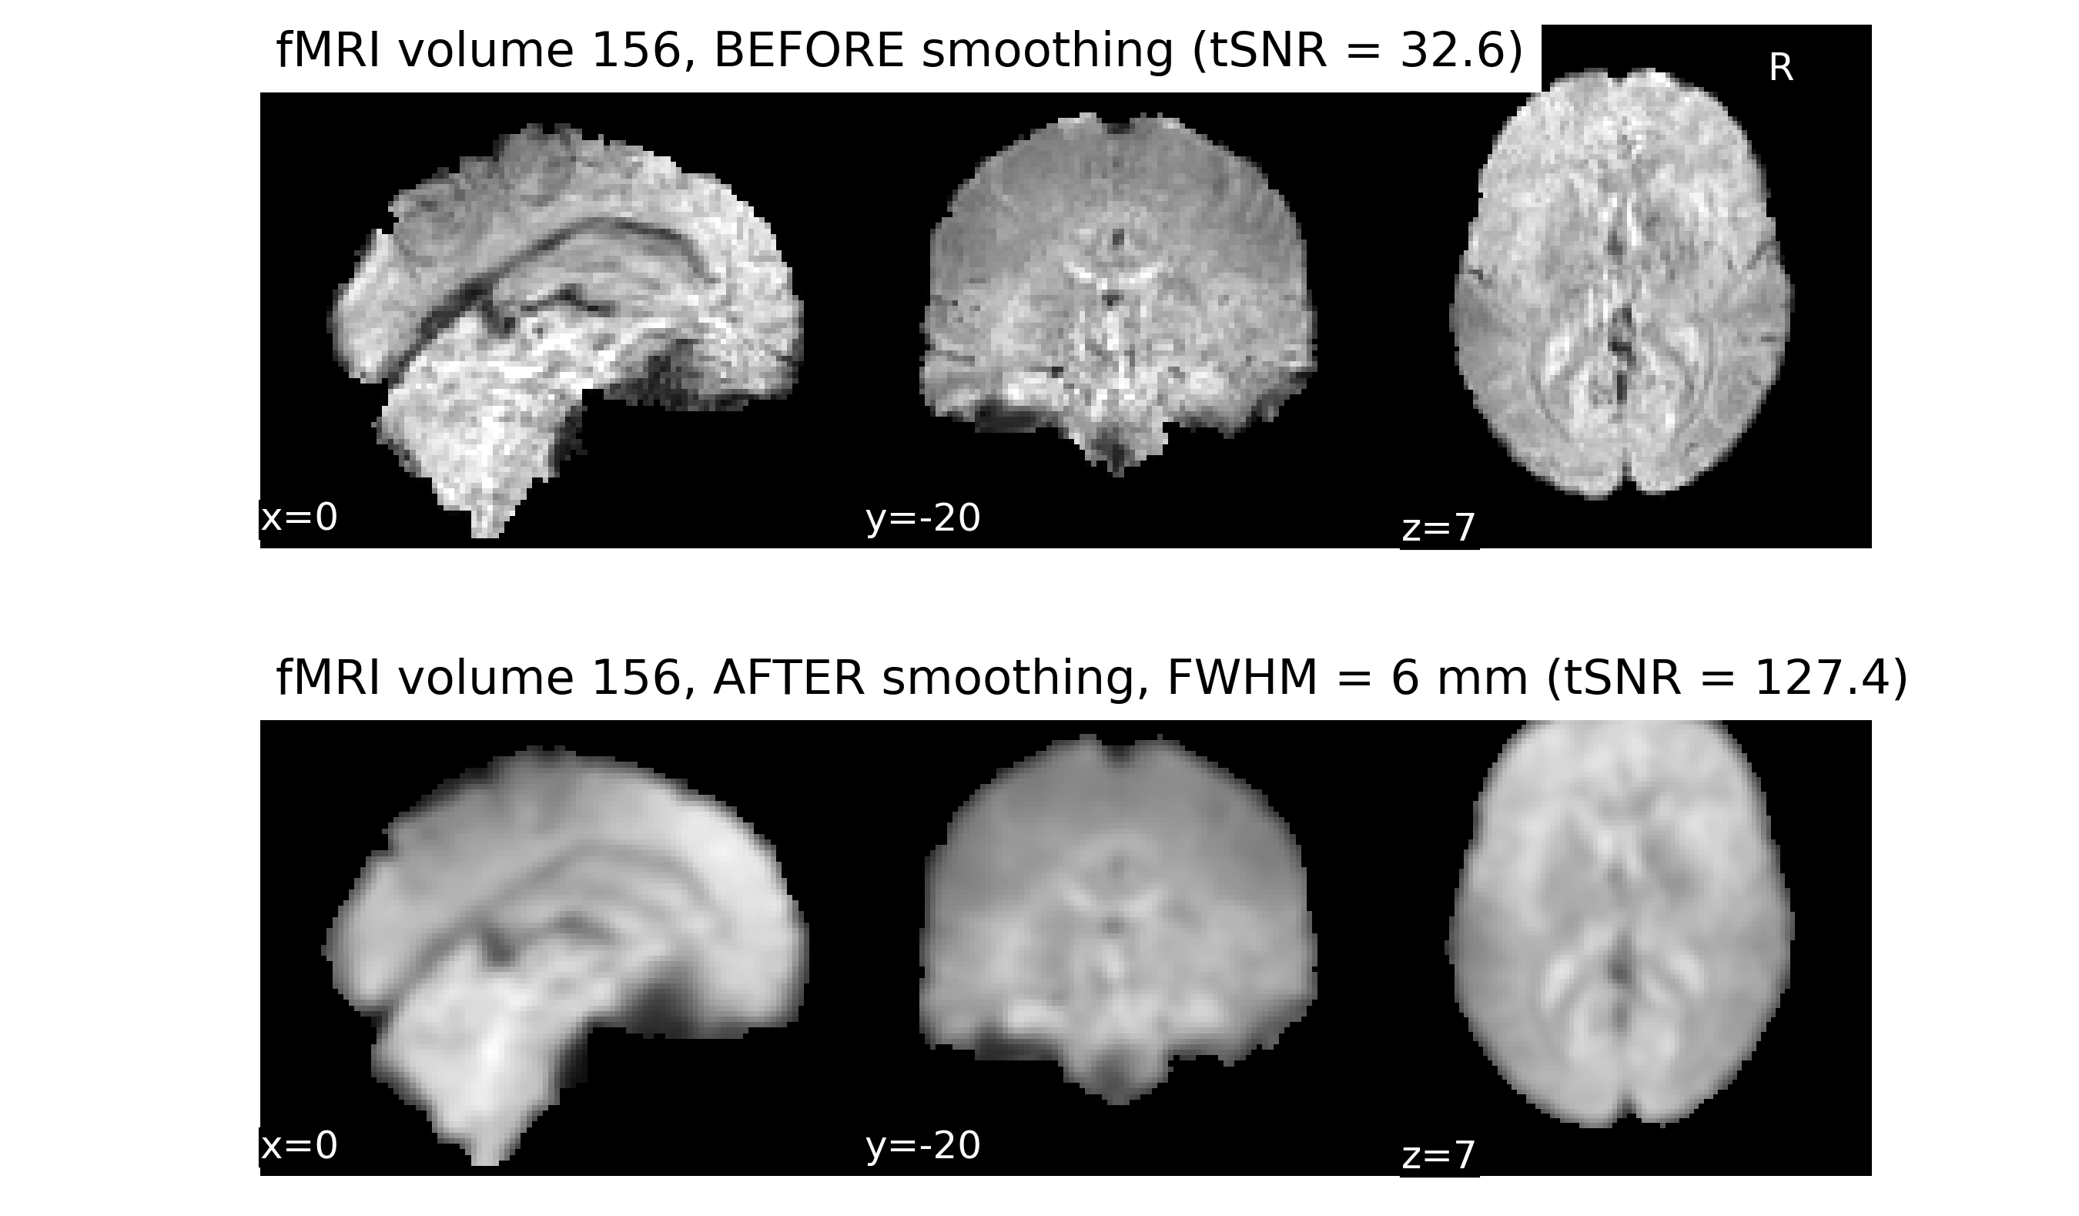
Functional preprocessing – Gaussian smoothing

Slide 7
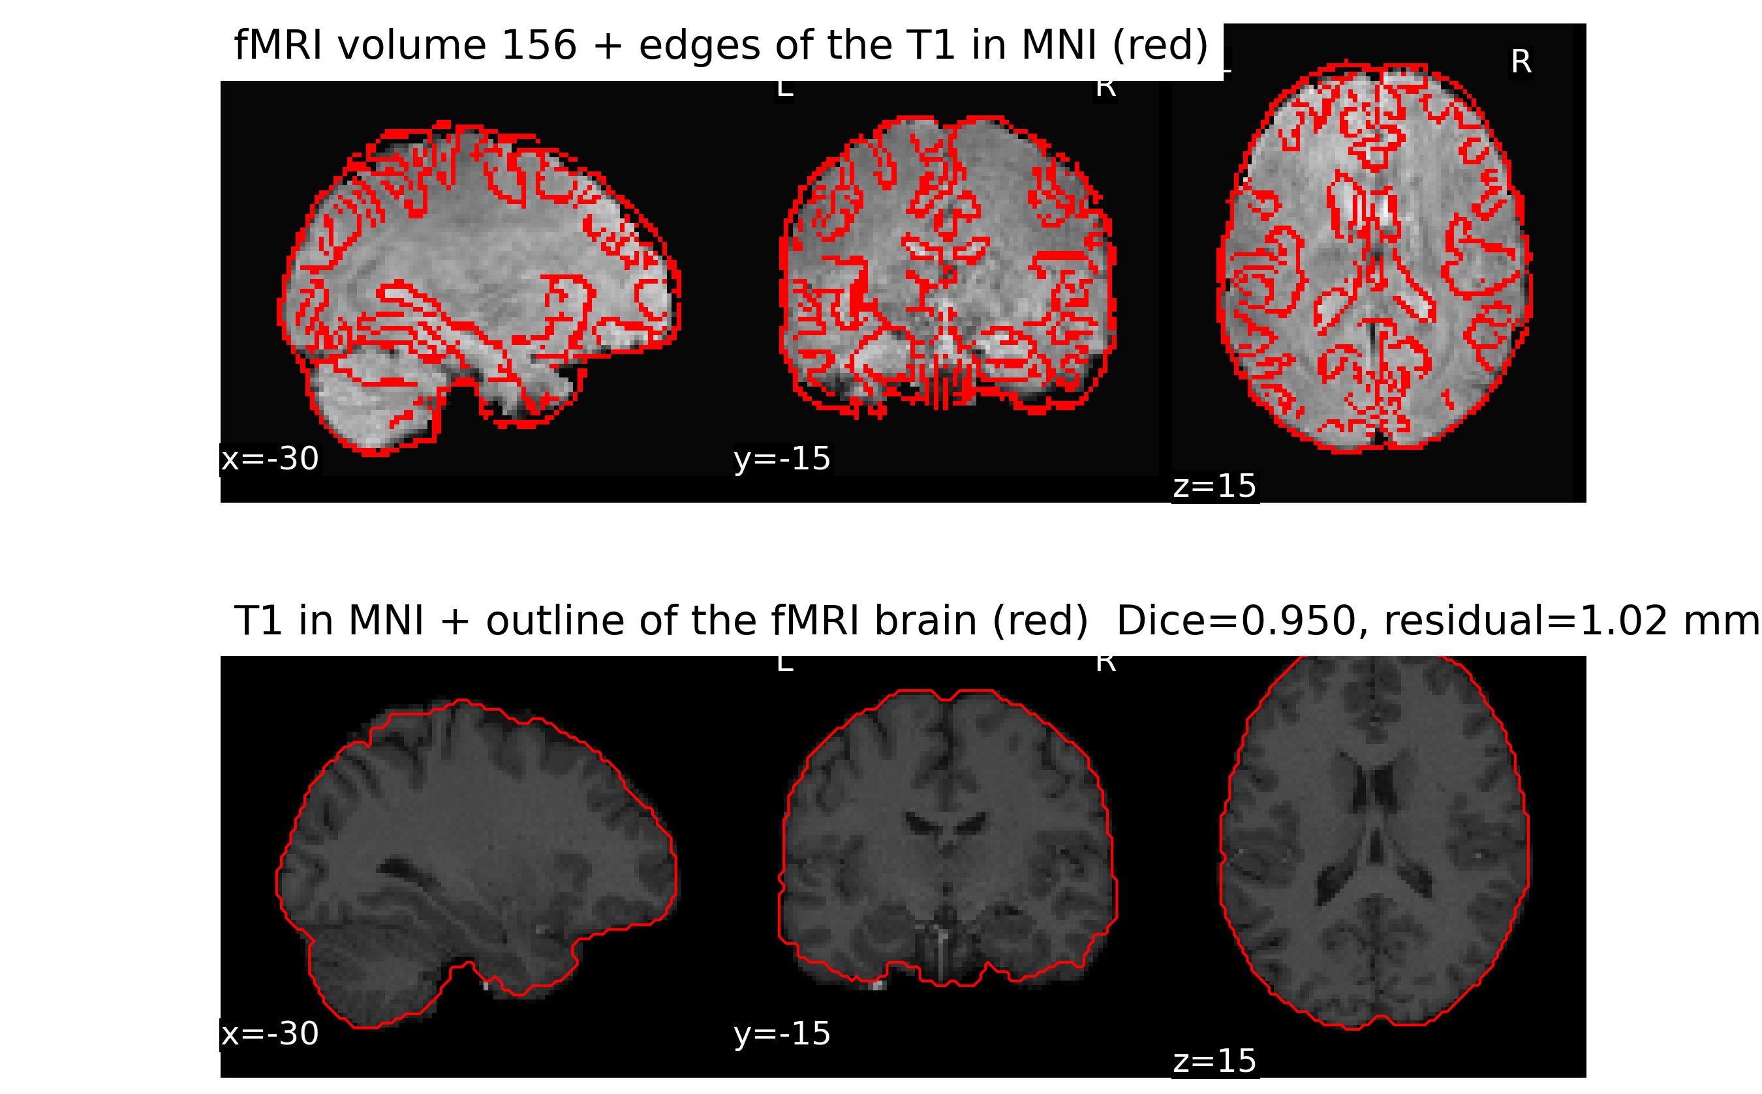
Anatomical – Functional overlay
Already in standard MNI space no need to coregister fMRI to T1 and normalize to MNI

Slide 8
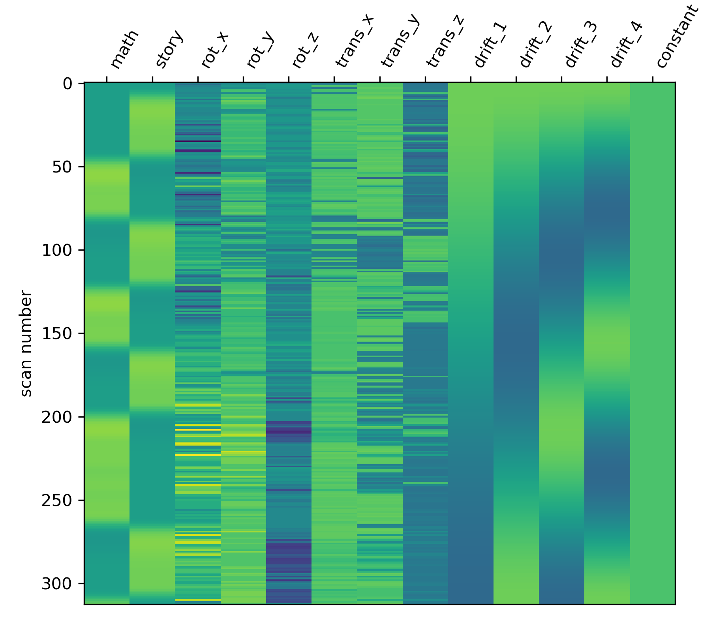
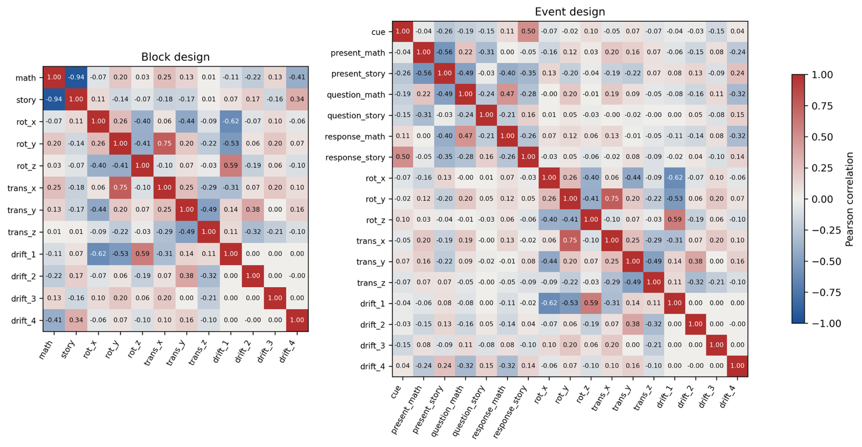
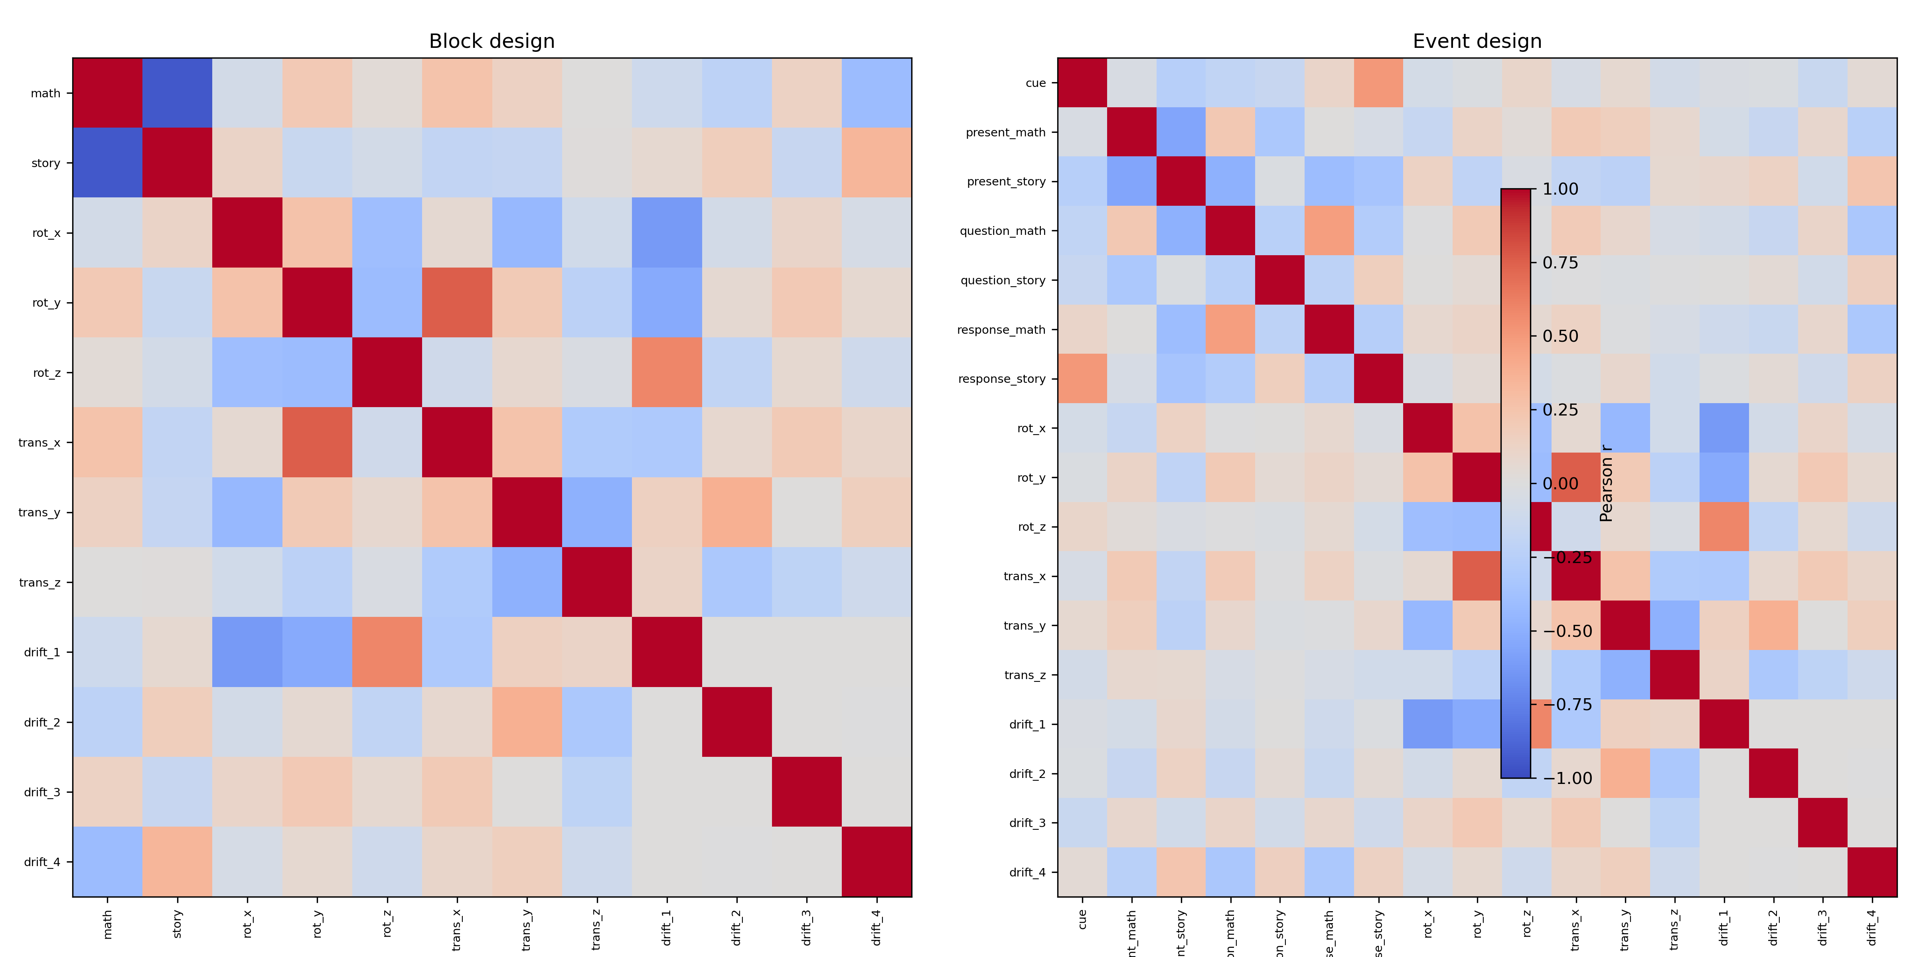
GLM – design matrix
Correlation matrix between regressors

Slide 9
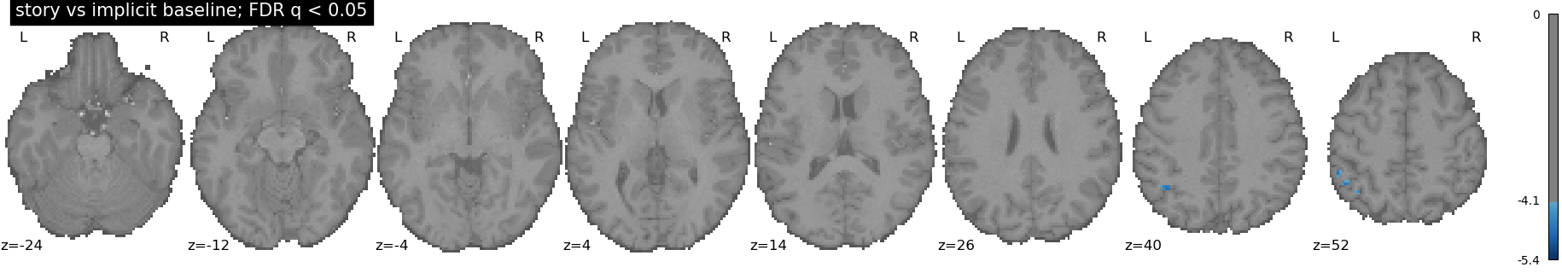
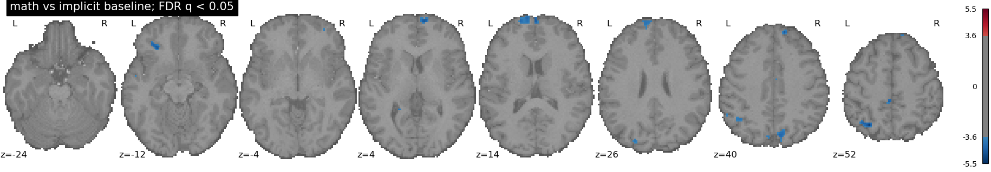
GLM – Regressor maps
Story map vs baseline
Math map vs baseline

Slide 10
GLM – story vs math contrast
Contrast vector: c = [−1, +1, 0, 0, 0, 0, 0, 0, 0, 0, 0, 0, 0]
story > math – FDR-adjusted (q < 0.05)
story > math – Bonferroni-adjusted (p < 0.05)

Slide 11
GLM - networks
Story > Math: Semantic / Default mode network
Math > Story: Fronto-parietal numerical processing, attention and working memory
Semantic language processing: Expected regions not present (e.g. ventral ATL) -> Contrast removes shared attributes + single run/single subject

Slide 12
Theoretical questions – Part 1
1) Contrast design
  a) Either story or math: F-test with with contrast matrix [1 0 0 …; 0 1 0 …] -> at least one β≠0.
  b) Question vs answer: Extend GLM with separate question and answer regressors (story-question, story-answer, math-question, math-answer). Contrast: [1 −1 1 −1 0 0 …].
  c) Task processing vs preparation: Add regressor for preparation period. Task−preparation contrast [1 −1].
2) Importance of story regressor: F-test of full vs reduced model (w/o story). If significant: story adds explanatory power to model.
3) Second run: H0: the story−math averaged over both runs = zero (c·β = 0 with c = [−1 +1 0 0 …]).
H1: story-math ≠ 0
Method: Concatenation of runs into single GLM, with separate nuisance regressors or separate GLMs and variance-adjusted contrasts.

Slide 13
Contributions

