Slide 1
Guava
May. 14th , 2018

Slide 2

What is Guava
Basic utilities.
Collections.
Caches.
Strings

Slide 3
What is Guava?
The Guava project contains several of Google's core libraries that we rely on in our Java-based projects: collections, caching, primitives support, concurrency libraries, common annotations, string processing, I/O, and so forth. Each of these tools really do get used every day by Googlers, in production services.

Slide 4
Basic utilities
Option
Many of the cases where programmers use null is to indicate some sort of absence: perhaps where there might have been a value, there is none, or one could not be found. For example, Map.get returns null when no value is found for a key.
Optional<T> is a way of replacing a nullable T reference with a non-null value. An Optional may either contain a non-null T reference (in which case we say the reference is "present"), or it may contain nothing (in which case we say the reference is "absent"). It is never said to "contain null."

Slide 5
Basic utilities
Option
创建Optional实例（以下都是静态方法）：
Optional.of(T) | 创建指定引用的Optional实例，若引用为null则快速失败
Optional.absent() | 创建引用缺失的Optional实例
Optional.fromNullable(T) | 创建指定引用的Optional实例，若引用为null则表示缺失

Slide 6
Basic utilities
Option
用Optional实例查询引用（以下都是非静态方法）：
boolean isPresent() | 如果Optional包含非null的引用（引用存在），返回true
T get() | 返回Optional所包含的引用，若引用缺失，则抛出java.lang.IllegalStateException
T or(T) | 返回Optional所包含的引用，若引用缺失，返回指定的值
T orNull() | 返回Optional所包含的引用，若引用缺失，返回null
Set<T> asSet() | 返回Optional所包含引用的单例不可变集，如果引用存在，返回一个只有单一元素的集合，如果引用缺失，返回一个空集合。

Slide 7
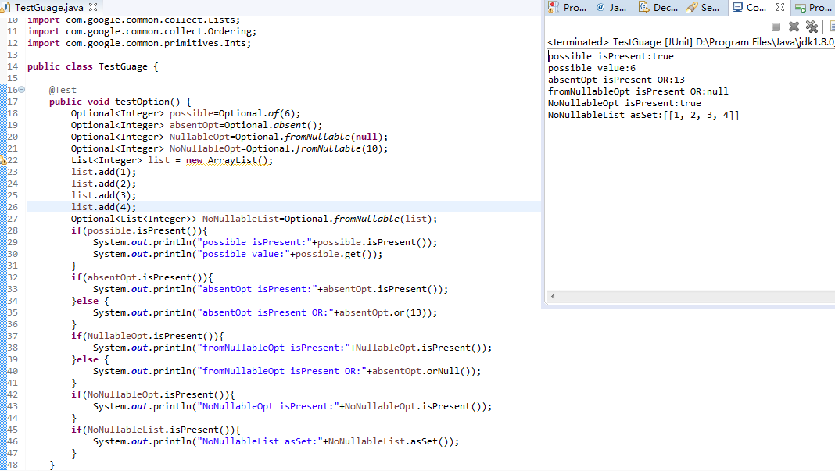
Basic utilities
Option

Slide 8
Q & A

