Slide 1
12-UNIX
Inter-Process Communication (IPC)
Pipe
Chapter 43-44

Slide 2
Overview of IPC in Linux (Chapter 43)
communication
data transfer
shared memory
signal
standard signal
realtime signal
synchronization
semaphore
file lock
mutex (threads)
condition variable (threads)
Based on chart
LPI page 878.

Slide 3
Communication expanded
data transfer
byte stream
pipe
FIFO
stream socket
pseudoterminal
message
System V message queue
POSIX message queue
datagram socket
shared memory
System V shared memory
POSIX shared memory
memory mapping
anonymous mapping
mapped file

Slide 4
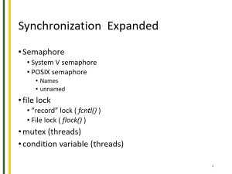

Synchronization Expanded
Semaphore
System V semaphore
POSIX semaphore
Names
unnamed
file lock
“record” lock ( fcntl() )
File lock ( flock() )
mutex (threads)
condition variable (threads)

Slide 5
We know:
What is a process?
How a process is created?
How a process can replace its image by running a new program ?
Parent Process waits for a Child Process.
Next:
How do we pass useful information between processes?
How do we synchronize processes?

Slide 6
Idea of Pipe
cmd1 | cmd2
pipe
standard
input
standard
output
Pipe connects a data flow
from one process to another

Slide 7
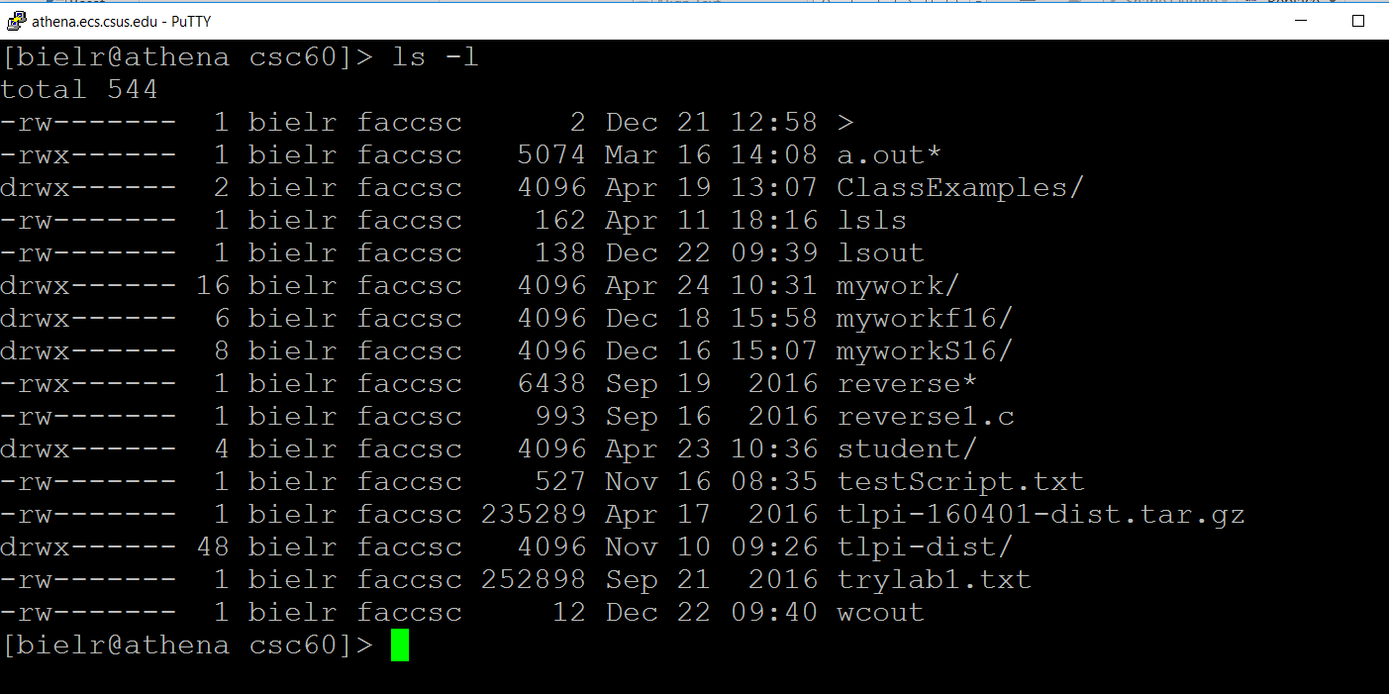
Pipelines: ls –l | sort –k5 –n The starting simple ls
Note: -k5 means sorting column 5; -n means sorting by numerical value

Slide 8
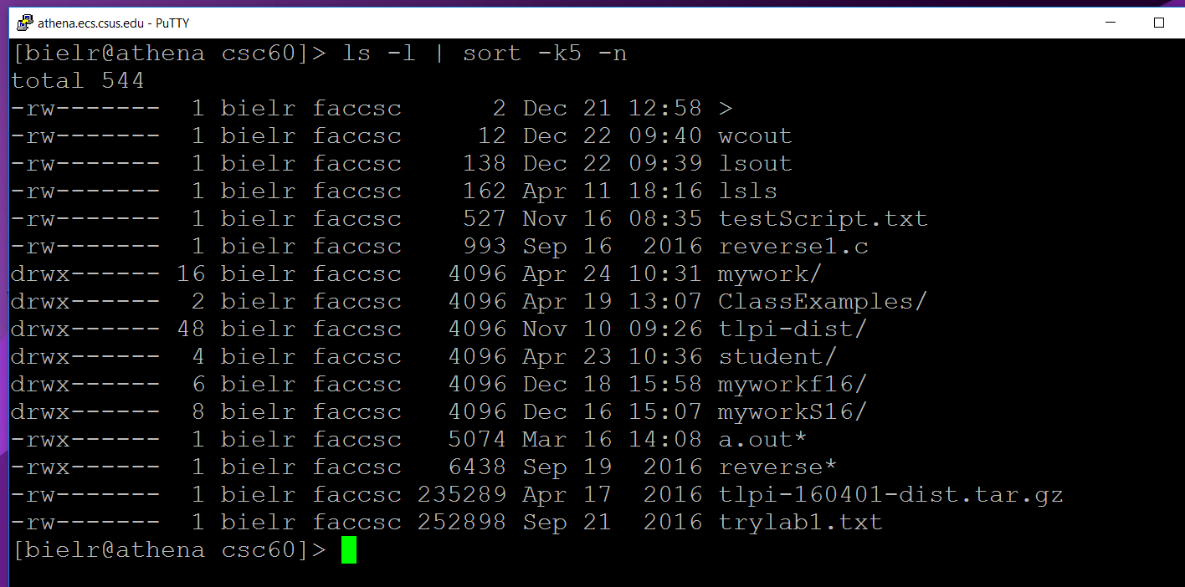
Pipelines: ls –l | sort –k5 –n The result of the sort
Note: -k5 means sorting column 5; -n means sorting by numerical value

Slide 9
Process Pipes (Formally)
A pipe is a mechanism for interprocess communication; data written to the pipe by one process can be read by another process.
The data is handled in a first-in, first-out (FIFO) order.
The pipe has no name, so it can only be used by the process that created it and by descendants that inherit the file descriptors on fork( ).

Slide 10
Process Pipes
A pipe has to be open at both ends simultaneously.
If you read from a pipe file that doesn't have any processes writing to it (perhaps because they have all closed the file, or exited), the read returns end-of-file (EOF).
Using normal blocking (BLOCK) reads however, the read will block if the pipe is empty.
Writing to a pipe that doesn't have a reading process
is treated as an error (ERROR) condition; it generates a SIGPIPE signal, and fails with error code EPIPE if the signal is handled or blocked.

Slide 11
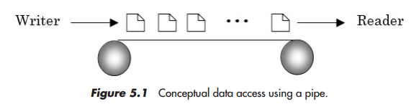
Process Pipes
Pipes do not allow file positioning (i.e. lseek). Both reading and writing operations happen sequentially; reading from the beginning of the file and writing at the end. System keeps track of last read/write location.
A common use of pipes is to send data to or receive
data from a program being run as a sub-process.

Slide 12
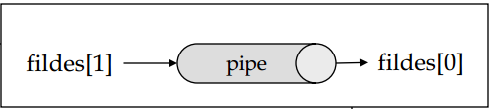
The Pipes system call (2)
The pipe call is a system call (man 2 pipe)
#include <unistd.h>
int pipe(int fildes[2]);
returns
0 if successful
-1 if the call fails
The pipe call fills in two file descriptors
fildes[0] is the file descriptor for reading from the pipe
fildes[1] is the file descriptor for writing to the pipe
It is easy to remember which comes first if you remember that 0 is standard in and 1 is standard out.
You read from fildes[0] (think STDIN==0)
You write to fildes[1] (think STDOUT=1)

Slide 13
The Pipe - Declaration
The following code fragment creates an un-named pipe:
then pass them to the
pipe command. Declare the file
descriptors
int fd[2];
if (pipe(fd) == -1)
perror(“Failed to create pipe…”);

Slide 14
Using Pipe
In typical use, a process creates a pipe just before it
forks one or more child processes.
The pipe is then used for communication either
between the parent or child processes,
or between two sibling processes.

Slide 15
Pipe Example
#include <unistd.h>
#include <stdio.h>
#include <string.h>
#define MAX_LENGTH 100
int main(int argc, char ** argv) {
int fildes[2];
char result[] = "";
pipe(fildes);
if (fork())
write(fildes[1], "I am writing into the pipe", MAX_LENGTH);
else {
read(fildes[0], result, MAX_LENGTH);
printf("I read <<%s>> from the pipe.\n", result);
}
}
Output: I read <<I am writing into the pipe>> from the pipe.
Notes:
/csc60/ClassExamples/pipeFork
/csc60/ClassExamples/pipeFork2 which lets me change the sentence.

Slide 16
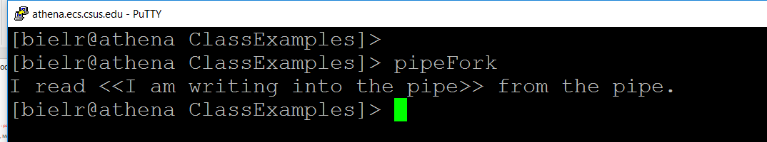
Demo # 1: set follow-fork-mode OUTPUT

Slide 17
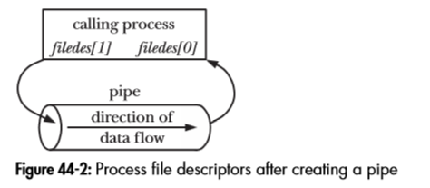
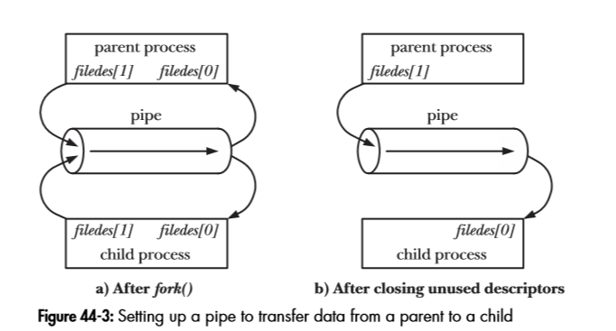
Pipe and Fork (LPI – Page 893)

Slide 18
Some good reasons for closing unused file descriptors (See LPI - page 894-895)
The reading process closes write descriptor in order that it can see “end-of-file” status (if not, instead it sees “block waiting” for data – due to kernel’s indication that there some write descriptor is still opened)
If the writing process does not close read descriptor, even after the read process closes the read descriptor, it can still write to the pipe’s until it is full. Once the pipe is full, it will block the write process indefinitely.
Free resources to be used by other processes.

Slide 19
Race Condition (formally)
An unanticipated execution ordering of concurrent flows that results in undesired behavior is called a race condition—a software defect and frequent source of vulnerabilities.

Slide 20
Race Condition - Example
char c;
pid_t pid;
int fd = open(filename, O_RDWR);
if (fd == -1) {
/* Handle error */
}
read(fd, &c, 1);
printf("root process:%c\n",c);
pid = fork();
if (pid == -1) {
/* Handle error */
}
if (pid == 0) { /*child*/
read(fd, &c, 1);
printf("child:%c\n",c);
}
else { /*parent*/
read(fd, &c, 1);
printf("parent:%c\n",c);
}
Filename = “text.txt”
(Contents = “abc”)
Possible Output:
(1)
root process: a
parent: b
child: c
Or
(2)
root process: a
child: b
parent: c

Slide 21
#include <stdio.h>
#include <stdlib.h>
#include <unistd.h>
#include <sys/stat.h>
#include <fcntl.h>
int main (void){
char c;
pid_t pid;
int fd = open("text.txt", O_RDWR);
if (fd == -1) {
perror("Error on open");
}
read(fd, &c, 1);
printf("root process:%c\n",c);
pid = fork();
if (pid == -1) {
perror("Error on Fork");
}
if (pid == 0) { /*child*/
read(fd, &c, 1);
printf("child:%c\n",c);
}
else { /*parent*/
read(fd, &c, 1);
printf("parent:%c\n",c);
}
return(EXIT_SUCCESS);
}
[bielr@athena ClassExamples]> race
root process:a
parent:b
child:c
Code that really works
Notes:
csc60/ClassExamples/race

Slide 22
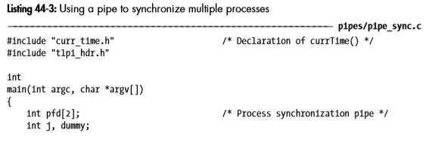
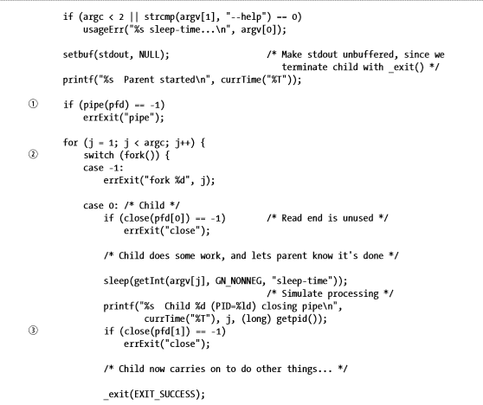
Using pipe as a method for synchronization (1 of 2)
Enlarged version following
Notes:
csc60/ClassExamples/pipe_sync

Slide 23

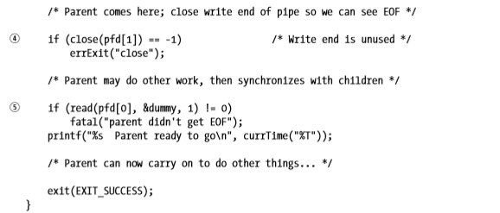
Using pipe as a method for synchronization (2 of 2)

Slide 24
Using pipe as a method for synchronization (1 of 4)
/* LPI page 897, Listing 44-3 */
#include "curr_time.h"
#include "tlpi_hdr.h"
int main(int agrc, char *argv[ ]) }
int pfd[2]; /* Process synchronization pipe */
int j, dummy;
if (argc < 2 || strcmp(argv[1] == "--help") == 0)
usageErr("%s sleep-time...\n", argv[0]);
setbuf(stdout, NULL); /* Make stdout unbuffered, since we
terminate child with _exit() */
printf("%s Parent started\n", currTimec));
if (pipe(pfd) == -1) /* build the pipe before creating child process */
errExit("pipe"); /* errExit is a textbook function, not a system function */
Notes:
Csc60/ClassExamples/pipe_sync

Slide 25
Using pipe as a method for synchronization (2 of 4)
for (j = 1; j < argc; j++) {
switch (fork() ) { /* Create the child process */
case -1:
errExit("fork &d", j);
case 0:
if (close(pfd[0] ) == -1 /* Read end is unused */
errExit("close"); /* errExit is a textbook function, not a system function */
/* Child does some work, and lets parent know it is done */
sleep(getInt(argv[j], GN_NONNEG, "sleep-time")); /* Simulate processing */
printf(“%s Child %d (PID=$ld) closing pipe \n",
currTime("%T"), j, (long) getpid());
Notes:
Csc60/ClassExamples/pipe_sync

Slide 26
Using pipe as a method for synchronization (3 of 4)
if (close(pfd[1]) == -1) /* Each child inherits a fd for the write end of pipe and closes this fd once it has completed its action */
errExit("close"); /* errExit is a textbook function, not a system function */
/* Child now carries on to do other things... */
_exit(EXIT_SUCCESS);
default: /* parent loops to create next child */
break;
} /* end of the switch */
} /* end of the for loop */
Notes:
Csc60/ClassExamples/pipe_sync

Slide 27
Using pipe as a method for synchronization (4/4)
/* Parent comes here; close write end of pipe so we can see EOF */
/* Note that closing the unused write end of the pipe in the parent is
essential to the correct operation of this technique; otherwise, the
parent would block forever when trying to read from the pipe. */
if (close(pfd[1]) == -1) /* Write end is unused */
errExit("close");
/* Parent may do other work, then synchronizes with children */
/* After all the children have closed their file descriptors for the write end
of the pipe, the parent's read() from the pipe will complete, returning
end-of-file (0). */
if (read(pfd[0], &dummy, 1) != 0)
fatal("parent didn't get EOF");
printf("%s Parent ready to go\n", currTime("%T"));
/* Parent can now carry onto do other things... */
exit(EXIT_SUCCESS);
}
Notes:
Csc60/ClassExamples/pipe_sync

Slide 28
Important Notes:
Communications buffers such as pipes can be empty
if all of the information previously written has been read. The empty buffer is not an end-of-file condition.
Rather, it reflects the asynchronous nature of inter-process communication.
A read call will normally block, waiting for data to become available.
However, a read on a pipe that has the other end closed for writing will not block, but will return a zero. This allows the reading process to detect the pipe equivalent to an end-of-file condition and react accordingly.

Slide 29
exit Function
exit()
The exit() function causes normal process termination and the value of status & 0377 is returned to the parent.
All open stdio(3) streams are flushed and closed. (C standard library - from man 3 exit)
(informally)
clean shutdown, flush streams, close files, etc

Slide 30
_exit Function
_exit()
The function _exit() terminates the calling process "immediately".
Any open file descriptors belonging to the process are closed; any children of the process are inherited by process 1, init, and the process’s parent is sent a SIGCHLD signal.
(System call - from man 2 _exit)
(informally) drop out, files are closed but streams are not flushed

Slide 31
exit vs. _exit Functions
The two functions terminate normally short of return:
Note:
Child and parent could have buffers with a copy of the unflushed data.
If both call exit(), the pending stdio buffers to be flushed twice.
Thus, child should call _exit() instead.

Slide 32
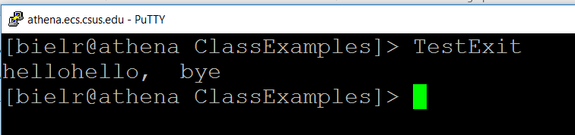

Example 1
#include <stdio.h>
#include <stdlib.h>
#include <unistd.h>
int main () {
int status;
printf("hello");
pid_t pid = fork();
if (pid == 0) {
sleep (2);
exit(0);
} else {
wait(&status);
printf(“, bye\n");
}
exit(0);
}
What is going on here? Why there are
two hellos displayed ?
Notes:
csc60/ClassExamples/TestExit use capital letters.

Slide 33
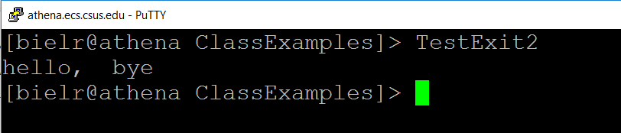
Example 2
#include <stdio.h>
#include <stdlib.h>
#include <unistd.h>
int main () {
int status;
printf("hello");
pid_t pid = fork();
if (pid == 0) {
sleep (2);
_exit(0);
} else {
wait(&status);
printf(“, bye\n");
}
exit(0);
}
Make more sense!
Notes:
csc60/ClassExamples/TestExit2

Slide 34
Pipelines …

Slide 35
Getting the idea (1 of 2)
Redirect standard output of the ls command to the file myfile.txt
What do these commands do?
$ ls –l > myfile.txt
$ sort –k5 –n < myfile.txt
Sort is a filter. It normally takes
input from stdin and outputs to stdout.
In this case we redirected its standard
input to come from myfile.txt

Slide 36
Getting the ideas (2 of 2)
We can achieve the same effect by using a pipe.
This eliminates the intermediate file myfile.txt
ls –l | sort –k5 –n

Slide 37
Pipelines: ls –l | sort –k5 –n The starting simple ls
Note: -k5 means sorting column 5; -n means sorting by numerical value

Slide 38
Pipelines: ls –l | sort –k5 –n The result of the sort
Note: -k5 means sorting column 5; -n means sorting by numerical value

Slide 39
Using pipe
We can achieve the same effect by using a pipe.
This eliminates the intermediate file myfile.txt
ls –l | sort –k5 –n
sort file descriptor table
0 | pipe read
1 | standard out
2 | standard err
1
sort
2
0
pipe
ls file descriptor table
1
0 | standard in
1 | pipe write
2 | standard err
ls
0
2

Slide 40
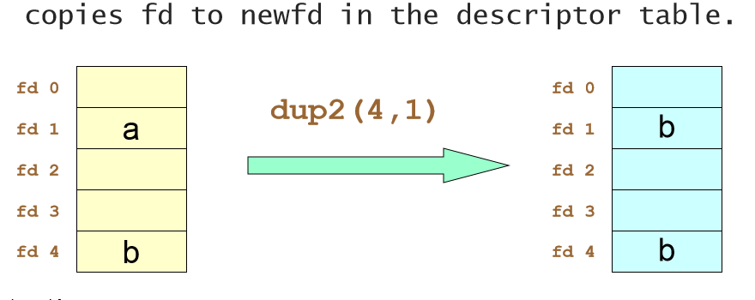
Recall - dup2
#include <unistd.h>
int dup2(int fd1, int fd2);
Duplicates this file descriptor on fd2.
If the file on fd2 is open,
it is closed first and
then the duplicate is made.

Slide 41
In a program … Beginning
int main ( )
{
pid_t childpid;
int fd[2];
if ((pipe(fd) == -1) ||
((childpid = fork( )) == -1))
{
perror("Failed to set up pipeline...");
return (1);
}
}
0
1
parent
2
parent file descriptor table
0 | standard in
1 | standard out
2 | standard err

Slide 42
In a program … with pipe execution
int main ( )
{
pid_t childpid;
int fd[2];
if ((pipe(fd) == -1) ||
((childpid = fork( )) == -1))
{
perror("Failed to set up pipeline...");
return (1);
}
}
0
1
0
parent
2
3
4
pipe
fd[0]
fd[1]
parent file descriptor table
0 | standard in
1 | standard out
2 | standard err
3 | pipe read | fd[0]
4 | pipe write | fd[1]

Slide 43

In a program … with fork execution
int main ( )
{
pid_t childpid;
int fd[2];
if ((pipe(fd) == -1) ||
((childpid = fork( )) == -1))
{
perror("Failed to set up pipeline...");
return (1);
}
0
1
parent
2
3
4
fd[0]
fd[1]
pipe
3
4
child
0
2
1
child file descriptor table
0 | standard in
1 | standard out
2 | standard err
3 | pipe read | fd[0]
4 | pipe write | fd[1]
0 | standard in
1 | standard out
2 | standard err
3 | pipe read | fd[0]
4 | pipe write | fd[1]

Slide 44
Child calls dup2
if (childpid == 0)
{
if (dup2(fd[1], STDOUT_FILENO) == -1)
perror ("Failed to redirect stdout of ls");
else if ((close(fd[0]) == -1) || (close(fd[1]) == -1))
perror ("Failed to close extra file descriptors");
else
{
execl("/bin/ls","ls", "-l", NULL);
perror("Failed to exec ls ...");
}
return (1);
}
Standard out is first closed, then
file descriptor fd[1] is duplicated
on the file descriptor for stdout.
0
1
sort
2
child file descriptor table
after dup2 call
3
4
0 | standard in
1 | pipe write
2 | standard err
3 | pipe read | fd[0]
4 | pipe write | fd[1]
fd[1]
fd[0]
pipe
3
4
ls
0
2
1

Slide 45
Child closes file descriptors
if (childpid == 0)
{
if (dup2(fd[1], STDOUT_FILENO) == -1)
perror ("Failed to redirect stdout of ls");
else if ((close(fd[0]) == -1) || (close(fd[1]) == -1))
perror ("Failed to close extra file descriptors");
else
{
execl("/bin/ls","ls", "-l", NULL);
perror("Failed to exec ls ...");
}
return (1);
}
0
1
child file descriptor table
after dup2 and close(s) calls
sort
2
3
fd[1]
4
0 | standard in
1 | pipe write
2 | standard err
fd[0]
pipe
1
ls
0
2

Slide 46
Parent calls dup2
if(dup2(fd[0], STDIN_FILENO) == -1) /* Parent executes sort */
perror("Failed to redirect stdin of sort...");
else if ((close(fd[0] == -1) || close(fd[1]) == -1))
perror("Failed to close extra file descriptors");
else
{
execl("/usr/bin/sort", "sort", "-k5", "-n", NULL);
perror("Failed to exec sort");
}
return 1;
}
1
parent file descriptor table
after dup2 call
sort
2
0
0 | pipe read
1 | standard out
2 | standard err
3 | pipe read | fd[0]
4 | pipe write | fd[1]
3
4
pipe
fd[0]
fd[1]
ls
0
2
1

Slide 47
Parent closes file descriptors
if(dup2(fd[0], STDIN_FILENO) == -1)
perror("Failed to redirect stdin of sort...");
else if ((close(fd[0] == -1) || close(fd[1]) == -1))
perror("Failed to close extra file descriptors");
else
{
execl("/usr/bin/sort", "sort", "-k5", "-n", NULL);
perror("Failed to exec sort");
}
return 1;
}
1
sort
2
0
parent file descriptor table
After dup2 & close(s) calls
pipe
fd[0]
fd[1]
0 | standard in
1 | pipe write
2 | standard err
ls
0
2
1

Slide 48
Child executes ls
if (childpid == 0)
{
if (dup2(fd[1], STDOUT_FILENO) == -1)
perror ("Failed to redirect stdout of ls");
else if ((close(fd[0]) == -1) || (close(fd[1]) == -1))
perror ("Failed to close extra file descriptors");
else
{
execl("/bin/ls","ls", "-l", NULL);
perror("Failed to exec ls ...");
}
return (1);
}
child file descriptor table
After dup2 & close(s) calls
0
1
0 | standard in
1 | pipe write
2 | standard err
sort
2
3
pipe
fd[1]
fd[0]
1
ls writes to stdout
ls
0
2

Slide 49
Parent executes sort
if(dup2(fd[0], STDIN_FILENO) == -1)
perror("Failed to redirect stdin of sort...");
else if ((close(fd[0] == -1) || close(fd[1]) == -1))
perror("Failed to close extra file descriptors");
else
{
execl("/usr/bin/sort", "sort", "-k5", "-n", NULL);
perror("Failed to exec sort");
}
return 1;
}
parent file descriptor table
after dup2 & close(s) calls
1
sort
2
sort reads
from stdin
0 | pipe read
1 | standard out
2 | standard err
0
pipe
fd[0]
fd[1]
ls
0
2
1

Slide 50
Finally: At the end – we have
ls –l | sort –k5 –n
sort file descriptor table
1
0 | pipe read
1 | standard out
2 | standard err
sort
2
0
pipe
1
ls file descriptor table
ls
0 | standard in
1 | pipe write
2 | standard err
0
2

Slide 51
GDB debugger with fork (1 of 2)
GDB Commands using with fork | Description
(gdb) set follow-fork-mode ( child or parent) Example: To follow the fork, type: follow-fork-child | Set debugger response to a program call of fork. follow-fork-mode can be: parent - the original process is debugged after a fork child - the new process is debugged after a fork The unfollowed process will continue to run. By default, the debugger will follow the parent process.
(gdb) set detach-on-fork ( on or off ) | Specifies whether GDB should debug both parent and child process after a call to fork() - Default is on: The child process (or parent process, depending on the value of follow-fork-mode) will be detached and allowed to run independently. This is the default.

Slide 52
GDB debugger with fork (2 of 2)
GDB Commands using with fork | Description
(gdb) catch fork | Catch calls to fork.
(gdb) info inferiors | Display IDs of currently known inferiors.
(gdb) inferior N | Use this command to switch between inferiors. The new inferior ID must be currently known (See above command).

Slide 53
Demo # 2: set detach-on-fork off (Process Synchronization)
Enlarged version following

Slide 54
(1 of 3): set detach-on-fork off (Process Synchronization)
#include <sys/wait.h>
#include “tlpi_hdr.h”
#define BUF_SIZE 10
int main (int argc, char *argv[ ]) {
int pfd[2]; /* Pipe file descriptors */
char buf[BUF_SIZE];
ssize_t numRead;
if (argc != 2 || strcmp(argv[1], "--help") == 0)
usageErr("%s string\n". argv[0]);
if (pipe(pfd) == -1) /* Create the pipe */
errExit("pipe");
switch (fork()) { /* Call fork to create child */
…continued….
Notes:
Csc60/ClassExamples/pipe_sync 4 2 6

Slide 55
(2 of 3): set detach-on-fork off (Process Synchronization)
switch (fork()) { /* Call fork to create child */
case -1:
errExit("fork");
case 0: /* Child -reads from pipe */
if(close(pfd[1]) == -1) /* Write end is unused */
errExit("close - child");
for (;;){ /* Read data from pipe, echo on stdout */
numRead = read(pfd[0], buf, BUF_SIZE); /* read the data */
if (numRead == -1)
errExit("read");
if (numRead == 0)
break; /* encounters End-of-file */
if (write(STDOUT_FILENO, BUF, numRead) != numRead) fatal("child - partial/failed write");
} /* end of for loop */

Slide 56
(3 of 3): set detach-on-fork off (Process Synchronization)
write(STDOUT_FILENO, "\n", 1); /* exit loop */
if (close(pdf[0] == -1)
errExit("close"); /*closed fd on read end of pipe*/
_exit(EXIT_SUCCESS); /* terminate */
default: /* Parent - writes to pipe */
if (close(pdf[0]) == -1) /* Read end is unused */
errExit("close - parent");
if (write(pdf[1], argv[1], strlen(argv[1])) != strlen(argv[1]))
fatal("parent - partial/failed write");
if (close(pdf[1]) == -1) /* Child will see EOF */
errExit("close");
wait(NULL); /* Wait for child to finish */
exit(EXIT_SUCCESS);
} /* end of switch */
}

Slide 57
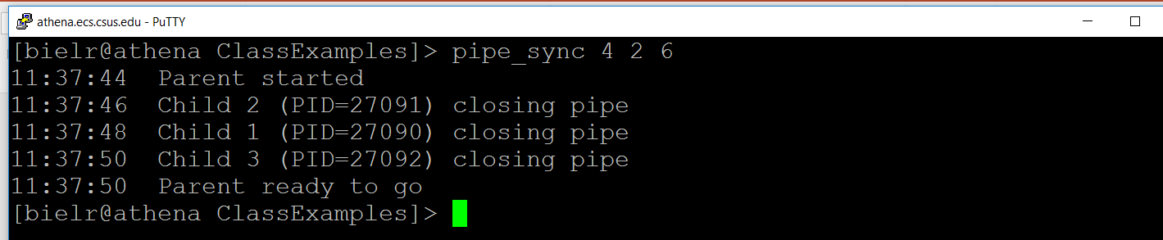
Program pipe_sync Output
Notes:
Execute: pipe_sync 4 2 6

Slide 58
12-UNIX
Inter-Process Communication - Pipe
The End

