Slide 1
CSc 174
Database Management Systems
1. Introduction to Database Management Systems
Ying Jin
Computer Science Department
California state University, Sacramento

Slide 2
Database Management Systems
Database
  A database is a collection of related data
Database management System (DBMS)
  A database management system is a collection of programs that enables users to create and maintain a database

Slide 3
Database Users
Database Administrators (DBA)
  Manage database and related software.
  e.g. Monitor use of resource, authorized access to the database, and system performance
Database Designers
  Design the structure to represent and store data
  Identify the data to be stored
End Users
  Causal end user: use sophisticated database query language
  Naïve user: menu-driven interface
  Sophisticated end users: familiar with DMBS to implement their applications.

Slide 4
Data Models
Data Model: A collection of concepts to describe the structure of a database.
High-level / conceptual model
  Entity-Relationship model
Representational /implementation model
  Relational data model
  Object data model
  Network model
  Hierarchical model
Low-level / physical data model
  How data is stored in the computer

Slide 5
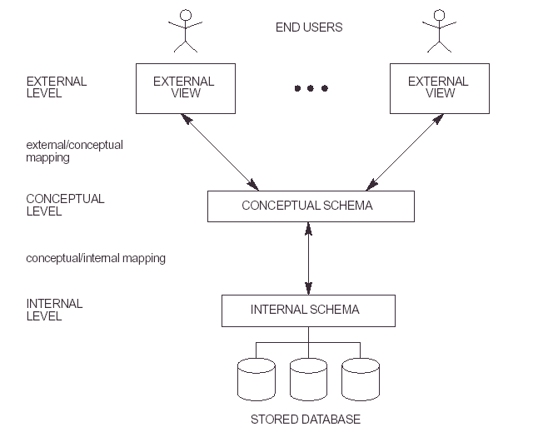
DBMS Architecture and Data Independency

Slide 6
Database Languages
Data Definition Language (DDL)
  Use to specify database schema
Data Manipulation Language (DML)
  Manipulate and access data (e.g. Insert, retrieve, delete, update)
Query Language
  Part of DML to specify how to retrieve data from the database
Comprehensive Integrated language
  e.g. SQL

Slide 7
Three-Tier client/Server Architecture for Web Application
Client
  GUI, Web interface
Application Server
  Application programs, web pages
  Store procedures and constraints to access data from Database Server
  Check client’s credentials
  Process and filter data
Database Server
  Database Management System

Slide 8
Classification of DBMS (1)
Data Model
  Relational, object-oriented, hierarchical, network model
Number of Users
  Single-user (one user at a time)
  Multiuser system
General purpose vs. special purpose
  Online transaction processing (OLTP) for a large number of concurrent transaction

Slide 9
Classification of DBMS (2)
Number of Sites
  Centralized (data is stored at a single computer site)
  Distributed (DDBMS)
    Homogeneous DDBMS (same DBMS at multiple sites)
    Heterogeneous DBMS
    Federated DBMS or multidatabase system (DBMSs are loosely coupled and have a degree of local autonomy).

Slide 10
These slides are based on the textbook:
R. Elmasri and S. Navathe,
“Fundamentals of Database Systems,”
Addison Wesley, 7th edition.

