Slide 1
CSc 174
Database Management Systems
3 Data Modeling Using Enhanced Entity-Relationship Model
Ying Jin
Computer Science Department
California state University, Sacramento

Slide 2
Why EER?
More accurate to describe applications
  Engineering design and manufacturing (CAD/CAM)
  Telecommunications
  Complex software systems
  Geographic Information Systems (GIS)

Slide 3
The Enhanced Entity-Relationship (EER) Model
The EER model extends ER model with advanced features
  An entity is defined as a class
  A specific occurrence of an entity is an instance of the class
  Superclass/subclass – Specialization and Generalization
  Union of class - Categories

Slide 4
Specialization & Generalization
Specialization
  The process of defining a set of subclass of an entity type.
  Emphasis the difference between objects
Generalization
  The opposite of specialization
  Suppress the differences among several entity types and generalize them into a single superclass.

Slide 5
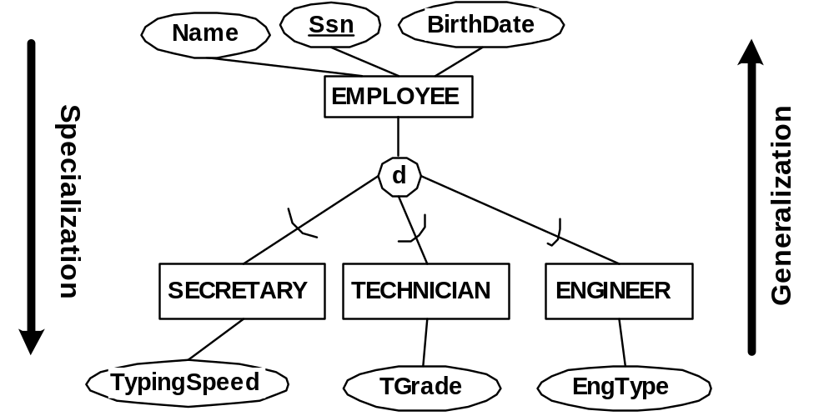

Slide 6
Superclass/Subclass
An instance of a subclass is an instance of the superclass.
A subclass inherits all the attributes from the superclass

Slide 7
Constraints on Specialization & Generalization
Attribute-defined vs. user-defined specialization
Disjoint vs. overlap constraint
Completeness constraint
  Total
  Partial

Slide 8
Attribute-defined vs. user-defined specialization
Attribute-defined specialization
  all subclasses in a specialization have their membership condition on the same attribute of the superclass
  Figure next page
User-defined specialization
  We do not have a condition for determining membership in a subclass.
  Figure

Slide 9
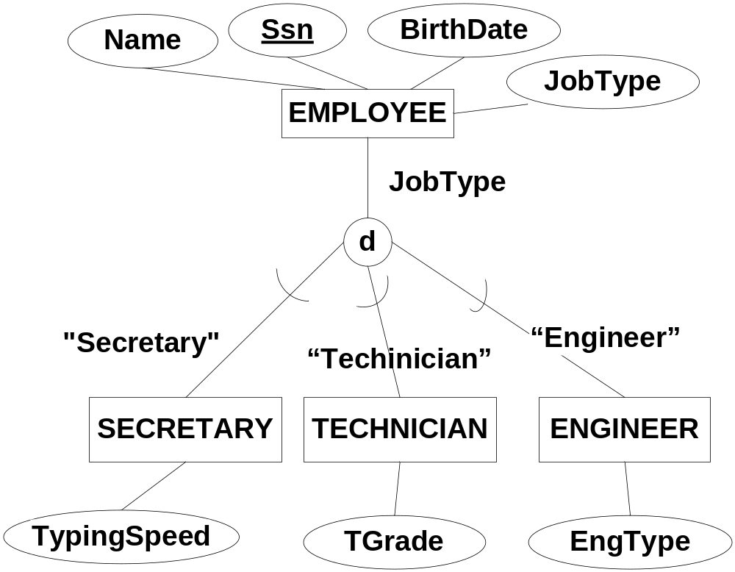
Attribute-defined Specialization

Slide 10
Disjoint constraint
An entity is a member of at most one of the subclasses of the specialization
Attribute define → disjoint

Slide 11
Overlap constraint
An entity can be a member of more than one subclass of the specialization

Slide 12
Total specialization
Any entity in the superclass must be a member of at least one subclass in the specialization.

Slide 13
Partial Specialization
An entity in the superclass may not be a member of any of the subclasses.

Slide 14
Specialization Hierarchy vs. Lattice
Specialization hierarchy
  Each a subclass has only one parent
Specialization Lattice
  A subclass can have more than one parent (this subclass is then called a shared subclass)
  Multiple inheritance
  An instance of a shared subclass is an instance of all of its superclasses.

Slide 15
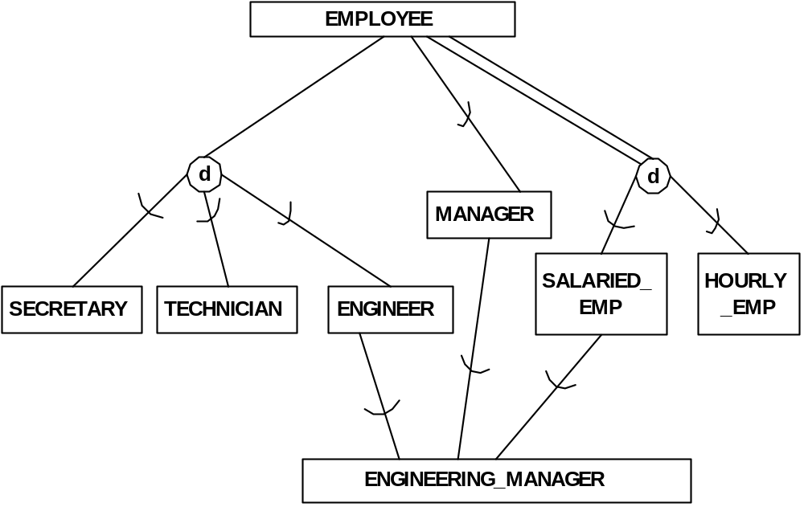
Multiple Inheritance

Slide 16
Category
A category represents a union of its superclasses.
An instance of a category subclass must be an instance of at least one superclass, but is NOT necessarily a member of all superclasses.

Slide 17
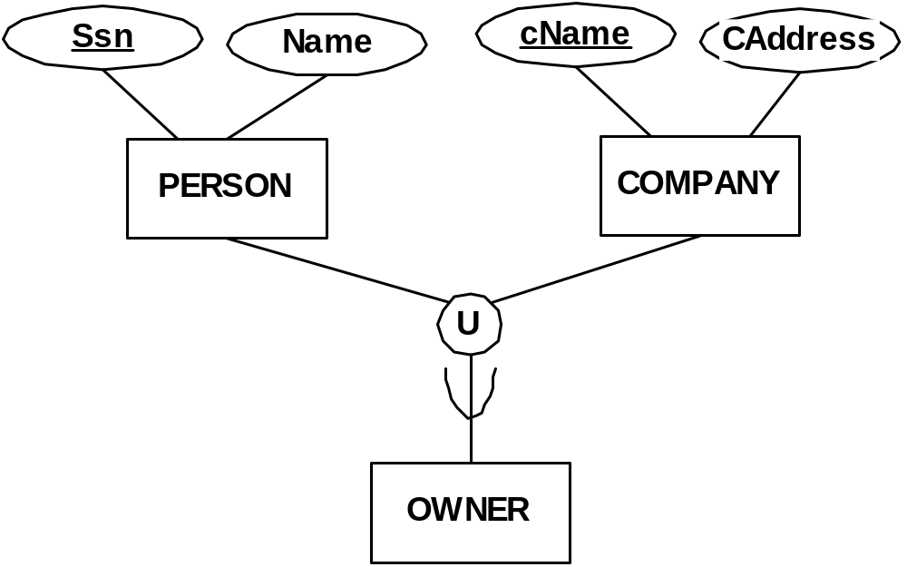
Category

Slide 18
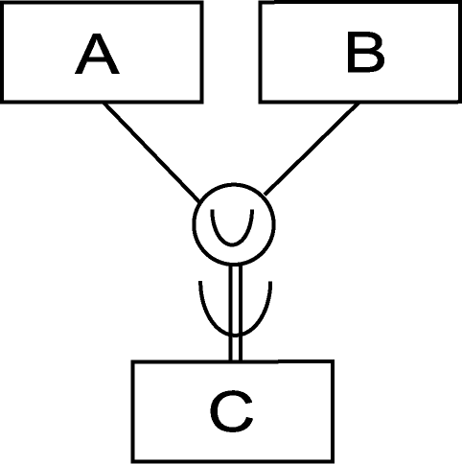
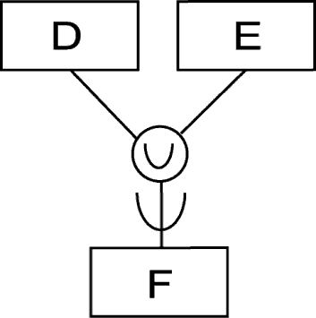
Total vs. Partial Categorization
Total Categorization
Each instance of a superclass must be an instance of the category
Partial Categorization
An instance of a superclass is not required to be an instance of the category

Slide 19
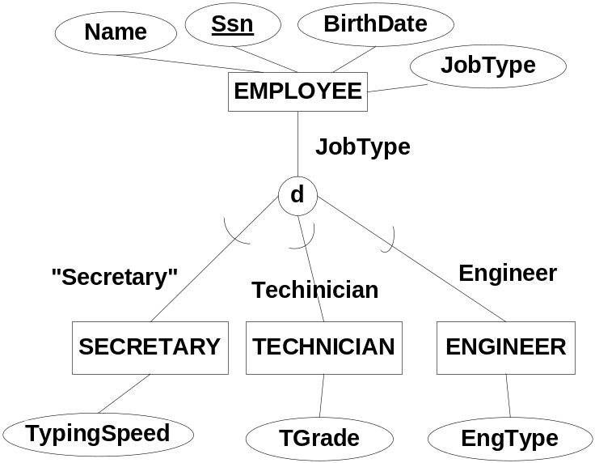
Specialization vs. Categorization
Total
  A total category may be represented alternatively as a total specialization
Partial:
  Every engineer is an employee. Some companies are not owner.
  Partial generalization implies that there are other types of employees, such as sales man.
  Partial categorization implies that only person and company can be an owner , but not other types of entity can be an owner.

Slide 20
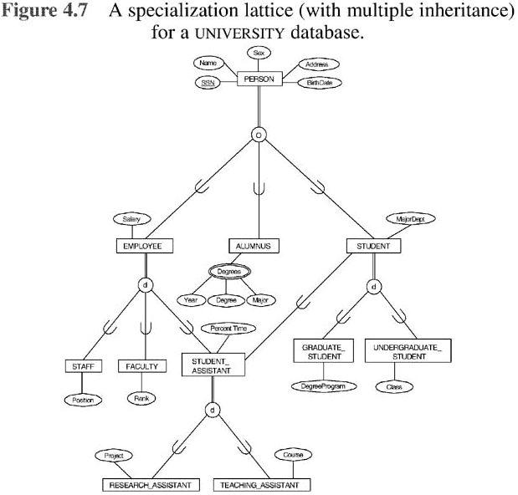
University Database Schema

Slide 21
These slides are based on the textbook:
R. Elmasri and S. Navathe, "Fundamentals of database systems, " Addison Wesley, 7th edition

