Slide 1
CSc 174
Database Management Systems
4. EER to Relational Mapping
Ying Jin
Computer Science Department
California state University, Sacramento

Slide 2
EER to Relational Mapping
ERR is a conceptual model
Map conceptual model to representational /implementation model

Slide 3
(Strong) Entity
Create a relation for the entity
Include all the simple attribute and simple component attributes of a composite attribute
fName
SSN
employee
name
mInit
salary
lName

Slide 4
Weak Entity
The primary key of an weak entity is the combination of the primary key of the owner(s) and the partial key of the weak entity.
dependent
dependents_of
employee
N
1
name
birthDate
SSN
salary

Slide 5
1:1 Relationship
Chose one entity to include the primary key of the other entity as foreign key.
Include simple attributes of the relation
It is better to choose an entity type with total participation.
1
1
employee
manages
department
SSN
mgrStartDate
dName
dNumber

Slide 6
1:N Relationship
SSN
salary
The entity at N side includes the primary key of the entity at 1 side as foreign key.
The entity at N side includes simple attributes of the relation
Employee
N
Works_For
1
Department
dName
dNumber

Slide 7
1:N Recursive Relationship
The entity includes the primary key of itself as foreign key to represent the recursion
SSN
Employee
salary
supervisor
supervisee
1
N
Supervisions

Slide 8
M:N Relationship
SSN
salary
Create a new relation for the relationship
Include the primary keys of the two entities as foreign keys.
The combination of two foreign keys as the primary key of the new relation.
Employee
M
Works_On
Hours
N
Project
pName
pNumber

Slide 9
Multivalued Attributes
Create a new relation R for a multivalued attribute A (of entity E).
R includes an attribute corresponding to A and the primary key of E as the foreign key.
The combination of A and this foreign key as the primary key of R.
Department
dNumber
locations
dName

Slide 10
Class Hierarchy
Options for mapping class hierarchy
  Create a table for each class (both superclass and subclass).
  Create a table for each subclass only
  Flattening the hierarchy: create one table to present the class hierarchy, using type field to indicate superclass and subclass hierarchy.

Slide 11
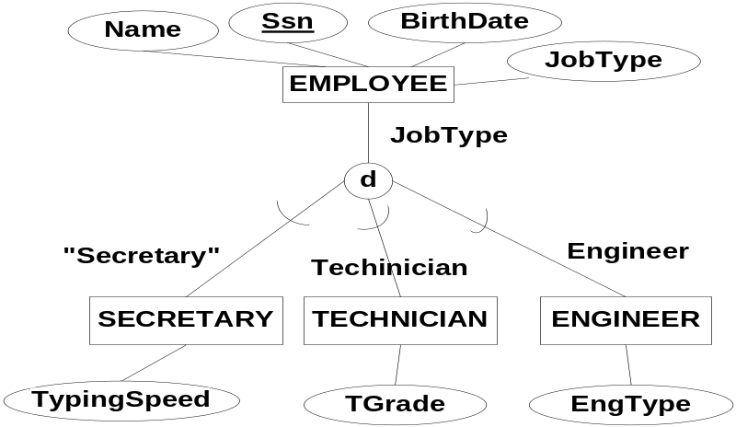
Class Hierarchy
- 1. Create a table for each class
This option works for any specialization (total or partial, disjoint or overlapping)
Create a table for each class
Create a view for each subclass

Slide 12
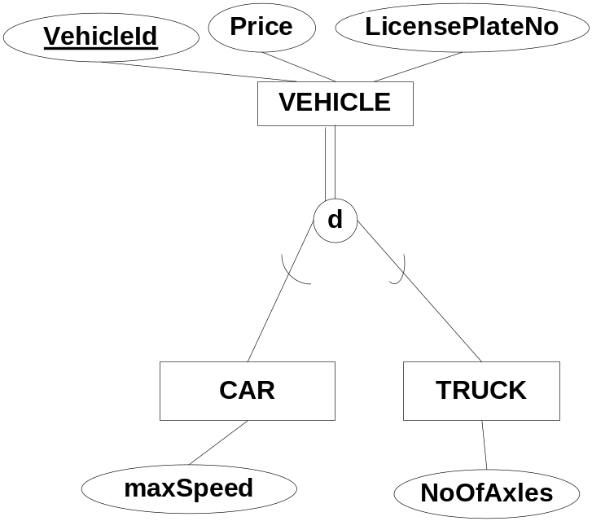
Class Hierarchy
- 2. Create a table for each subclass only
This option only works for total and disjoint specialization
Create a table for each subclass
Create a view for the superclass

Slide 13
Class Hierarchy
- 3. Flattening the Hierarchy
Create a single table for both the superclass and subclasses
  Including all the attributes of the superclass and subclasses
  Use type field to distinguish subclasses
  If a tuple does not belong to a subclass, then the corresponding specific attributes of that subclass will have null values.
Create a view for each superclass and subclass
This option works for any specialization (total or partial, disjoint or overlapping)
Not recommended if there are many specific attributes for the subclasses.

Slide 14
3.Flattening the Hierarchy
- Different cases
3a) Attribute defined specialization
3b)Use single type attribute
3c) Use multiple type attributes

Slide 15
Category
Specify a surrogate key.
Create a relation for the category class with the surrogate key
Each superclass relation includes the surrogate key as a foreign key referencing the category class
No associate views

Slide 16
Category
- Special Case
A category whose superclasses have the same key, there is no need for a surrogate key.
Example

