Slide 1
CSc 174
Database Management Systems
5. SQL (Review)
Ying Jin
Computer Science Department
California state University, Sacramento

Slide 2
CREATE TABLE
  CREATE TABLE DEPT
  ( DNAME VARCHAR(10) NOT NULL,
  DNUMBER INTEGER NOT NULL CHECK (DNUMBER>0 AND DNUMBER <21),
  MGRSSN CHAR(9),
  MGRSTARTDATE CHAR(9),
  PRIMARY KEY (DNUMBER),
  UNIQUE (DNAME),
  FOREIGN KEY (MGRSSN) REFERENCES EMP );

Slide 3
DROP TABLE
Remove a relation (base table) and its definition
The relation can no longer be used in queries, updates, or any other commands
Example:
DROP TABLE DEPENDENT;

Slide 4
ALTER TABLE
Example:
ALTER TABLE EMPLOYEE ADD JOB VARCHAR(12);
How to enter value for the new attribute ?

Slide 5
Retrieval Queries in SQL (cont.)
  SELECT <attribute list>
  FROM <table list>
  WHERE <condition>

Slide 6
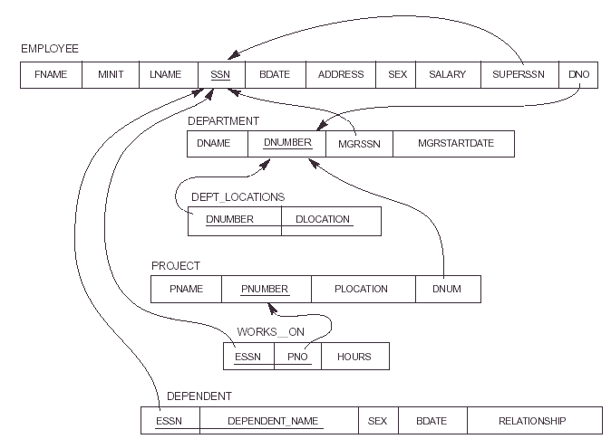
Relational Database Schema

Slide 7
Simple SQL Queries
Query 1: Retrieve the name and address of all employees who work for the 'Research' department.
SQL query?

Slide 8
Simple SQL Queries (cont.)
Query 2: For every project located in 'Stafford', list the project number, the controlling department number, and the department manager's last name, and birthdate.
Q2:
  SELECT PNUMBER, DNUM, LNAME, BDATE
  FROM ?
  WHERE?

Slide 9
Qualify attribute name
Use the same name for two (or more) attributes as long as the attributes are in different relations
Qualify the attribute name with the relation name by prefixing the relation name to the attribute name
Example:
EMPLOYEE.LNAME, DEPARTMENT.DNAME

Slide 10
ALIASES
Query 8: For each employee, retrieve the employee's name, and the name of his or her immediate supervisor.
Q8: SELECT E.FNAME, E.LNAME, S.FNAME, S.LNAME
FROM EMPLOYEE E S
WHERE E.SUPERSSN=S.SSN
We can think of E and S as two different copies of EMPLOYEE
  E represents employees in role of supervisees
  S represents employees in role of supervisors

Slide 11
ALIASES (cont.)
  Aliasing can also be used in any SQL query for convenience
  Can also use the AS keyword to specify aliases
  Q8: SELECT E.FNAME, E.LNAME, S.FNAME, S.LNAME
  FROM EMPLOYEE AS E, EMPLOYEE AS S
  WHERE E.SUPERSSN=S.SSN

Slide 12
USE OF DISTINCT
Q11: SELECT SALARY
FROM EMPLOYEE
Q11A: SELECT DISTINCT SALARY
FROM EMPLOYEE
Which query will return a set ?

Slide 13
NESTING OF QUERIES
Query 1: Retrieve the name and address of all employees who work for the 'Research' department.
Q1: SELECT FNAME, LNAME, ADDRESS
FROM EMPLOYEE
WHERE DNO IN
(SELECT DNUMBER
FROM DEPARTMENT
WHERE DNAME='Research' );

Slide 14
THE EXISTS FUNCTION
Check whether the result of a correlated nested query is empty

Slide 15
THE EXISTS FUNCTION (cont.)
Query 12: Retrieve the name of each employee who has a dependent with the same first name as the employee.
Q12B: SELECT FNAME, LNAME
FROM EMPLOYEE
WHERE EXISTS
(SELECT *
FROM DEPENDENT
WHERE SSN=ESSN AND FNAME=DEPENDENT_NAME)

Slide 16
AGGREGATE FUNCTIONS
Include COUNT, SUM, MAX, MIN, and AVG
Query 16: Find the maximum salary, the minimum salary, and the average salary among employees who work for the 'Research' department.

Slide 17
THE GROUP BY, HAVING-CLAUSE
Retrieve the values of these functions for only those groups that satisfy certain conditions
The HAVING-clause
  Specify a selection condition on groups (rather than on individual tuples)

Slide 18
THE GROUP BY, HAVING-CLAUSE (Cont.)
Query 22: For each department which has more than two employees, retrieve the department number, the number of employees in the department, and their average salary.

Slide 19
ARITHMETIC OPERATIONS
+, -, *, /
Query 27: Show the effect of giving all employees who work on the 'ProductX' project a 10% raise.
Are the salary different after execute the query?

Slide 20
ORDER BY
The ORDER BY clause is used to sort the tuples in a query result based on the values of some attribute(s)
Query 28: Retrieve a list of employees and the projects each works in, ordered by the employee's department, and within each department ordered alphabetically by employee last name.
Q28:
SELECT DNAME, LNAME, FNAME, PNAME
FROM DEPARTMENT, EMPLOYEE, WORKS_ON, PROJECT
WHERE DNUMBER=DNO AND SSN=ESSN AND
PNO=PNUMBER
ORDER BY DNAME, LNAME

Slide 21
Summary of SQL Queries
A query in SQL can consist of up to six clauses, but only the first two, SELECT and FROM, are mandatory. The clauses are specified in the following order:
SELECT <attribute list>
FROM <table list>
[WHERE <condition>]
[GROUP BY <grouping attribute(s)>]
[HAVING <group condition>]
[ORDER BY <attribute list>]

Slide 22
Specifying Updates in SQL
There are three SQL commands to modify the database; INSERT, DELETE, and UPDATE

Slide 23
INSERT
Example1:
INSERT INTO EMPLOYEE
VALUES ('Richard','K','Marini', '653298653',
'30-DEC-52', '98 Oak Forest,Katy,TX', 'M',
37000,'987654321', 4 )

Slide 24
DELETE
U4A: DELETE FROM EMPLOYEE
WHERE LNAME='Brown’
U4D: DELETE FROM EMPLOYEE

Slide 25
UPDATE
Example: Change the location and controlling department number of project number 10 to 'Bellaire' and 5, respectively.
U5: UPDATE PROJECT
SET PLOCATION = 'Bellaire', DNUM = 5
WHERE PNUMBER=10

Slide 26
UPDATE (cont.)
Example: Give all employees in the 'Research' department a 10% raise in salary.
U6: UPDATE EMPLOYEE
SET SALARY = SALARY *1.1
WHERE DNO IN (SELECT DNUMBER
FROM DEPARTMENT
WHERE DNAME='Research')

Slide 27
These slides are based on the textbook:
R. Elmaseri and S. Navathe, Fundamentals of Database System, 7th Edition, Addison-Wesley.

