Slide 1
CSc 174
Database Management Systems
10. Relational Database Design Algorithms
Ying Jin
Computer Science Department
California state University, Sacramento

Slide 2
1. Properties of Relational Decompositions

Slide 3
Properties
Attribute preservation
Dependency preservation property
Lossless join property

Slide 4
Universal Relation
Universal Relation Schema:
  a relation schema R={A₁, A_{2,} …, A_{n}} that includes all the attributes of the database.
Universal relation assumption
every attribute name is unique
Decomposition:
decompose R into D = {R₁,R₂, …, R_{m}}, by using the functional dependencies.

Slide 5
Attribute Preservation
Attribute preservation
Each attribute in R will appear in at least one relation schema R_{i} in the decomposition, so that no attributes are “lost”.

Slide 6
Dependency Preservation Property
-Informally
Informally:
Each function dependency X  Y specified in F, either
(1) appeared directly in one of the relation schemas Ri in the decomposition D, or
(2) could be inferred from the dependencies that appear in some Ri.
What is F⁺ (Closure of F)?

Slide 7
Project of F on R - Definition
Definition:
Given a set of dependencies F on R,
the projection of F on R_{i}, denoted by π_{Ri}(F), where R_{i} ⊆ R, is the set of dependencies X  Y in F⁺ such that the attributes in X υ Y are all contained in R_{i}.
all their left- and right-hand-side attributes are in R_{i}.

Slide 8
Dependency Preservation Property
Dependency Preservation Property definition:
a decomposition D = {R₁, R₂, ..., R_{m}} of R is dependency-preserving with respect to F if the union of the projections of F on each R_{i} in D is equivalent to F; that is, (
(π_{R1}(F)) υ . . . υ (π_{Rm}(F)))⁺ = F⁺
Claim 1: It is always possible to find a dependency-preserving decomposition D with respect to F such that each relation R_{i} in D is in 3nf.

Slide 9
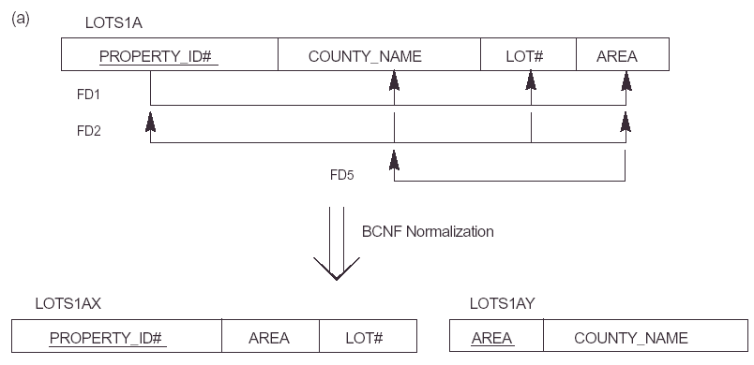
Not Dependency-Preservation Example
Which fd is lost?

Slide 10
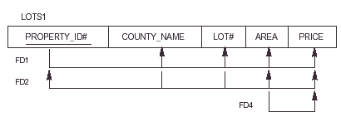
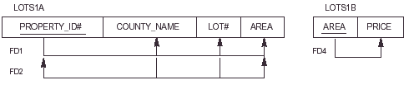
Dependency-Preservation Example

Slide 11
Lossless (Non-additive) Join Property
No addition of spurious tuples.
Definition
Lossless join property: a decomposition D = {R₁, R₂, ..., R_{m}} of R has the lossless (nonadditive) join property with respect to the set of dependencies F on R if, for every relation state r of R that satisfies F, the following holds, where * is the natural join of all the relations in D:
* (π_{R1}(r), ..., π_{Rm}(r)) = r
Note: lossless refers to loss of information, not to loss of tuples.

Slide 12
Algorithm for Lossless (Non-additive) Join Property of a Decomposition
Testing for Lossless Join Property
Input: A universal relation R, a decomposition D = {R₁, R₂, ..., R_{m}} of R, and a set F of functional dependencies.
Create an initial matrix S with one row i for each relation R_{i} in D, and one column j for each attribute A_{j} in R.
Set S(i,j):=b_{ij} for all matrix entries. (each b_{ij} is a distinct symbol associated with indices (i,j) ).
For each row i representing relation schema R_{i}
{for each column j representing attribute A_{j}
{if (relation R_{i} includes attribute A_{j}) then set S(i,j):= a_{j};};};
(each a_{j} is a distinct symbol associated with index (j) )

Slide 13
Algorithm for Lossless (Non-additive) Join Property of a Decomposition (Cont.)
Repeat the following loop until a complete loop execution results in no changes to S
{for each functional dependency X Y in F
{for all rows in S which have the same symbols in the columns corresponding to attributes in X
{make the symbols in each column that correspond to an attribute in Y be the same in all these rows as follows: if any of the rows has an “a” symbol for the column, set the other rows to that same “a” symbol in the column; If no “a” symbol exists for the attribute in any of the row, choose one of the “b” symbols that apperas in one of the rows for the attribute and set the other rows to that same “b” symbol in the column };};};
If a row is made up entirely of “a” symbols, then the decomposition has the lossless join property; otherwise it does not.

Slide 14
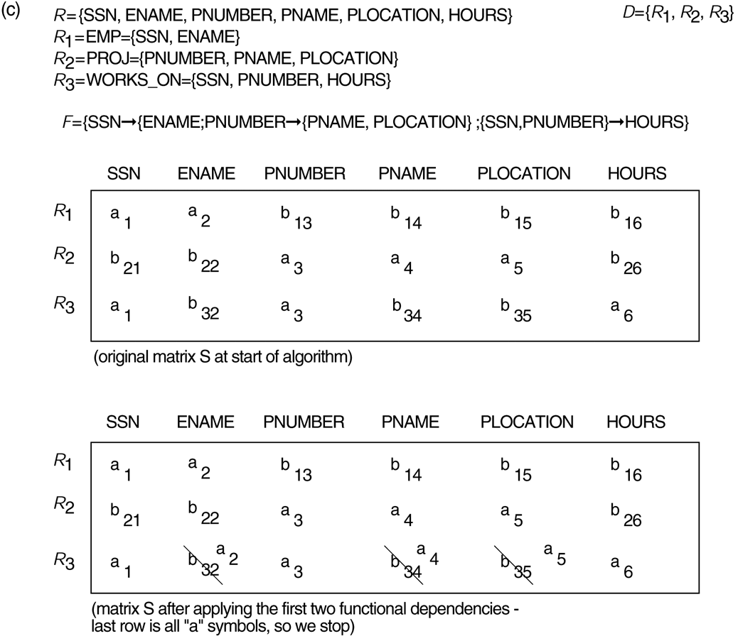



Lossless (nonadditive) join test for n-ary decompositions – Example
Decomposition of EMP_PROJ into EMP, PROJECT, and WORKS_ON satisfies test.

Slide 15
Binary Decomposition
Binary Decomposition: decomposition of a relation R into two relations.
PROPERTY LJ1 (lossless join test for binary decompositions): A decomposition D = {R₁, R₂} of R has the lossless join property with respect to a set of functional dependencies F on R if and only if either
  The f.d. ((R₁ ∩ R₂)  (R₁- R₂)) is in F⁺, or
  The f.d. ((R₁ ∩ R₂)  (R₂ - R₁)) is in F⁺.

Slide 16
Successive Lossless Join Decomposition
Claim 2 (Preservation of non-additivity in successive decompositions):
If a decomposition D = {R₁, R₂, ..., R_{m}} of R has the lossless (non-additive) join property with respect to a set of functional dependencies F on R, and if a decomposition D_{i} = {Q₁, Q₂, ..., Q_{k}} of R_{i} has the lossless (non-additive) join property with respect to the projection of F on R_{i}, then the decomposition D₂ = {R₁, R₂, ..., R_{i-1}, Q₁, Q₂, ..., Q_{k}, R_{i+1}, ..., R_{m}} of R has the non-additive join property with respect to F.

Slide 17
2. Algorithms for Relational Database Schema Design

Slide 18
Relational Synthesis into 3NF with Dependency Preservation (Relational Synthesis Algorithm)
Does not guarantee the lossless join property
Input: A universal relation R and a set of functional dependencies F on the attributes of R.
Find a minimal cover G for F (use Algorithm 10.2);
For each left-hand-side X of a functional dependency that appears in G, create a relation schema in D with attributes {X υ {A₁} υ {A₂} ... υ {A_{k}}}, where X  A₁, X  A₂, ..., X  A_{k} are the only dependencies in G with X as left-hand-side (X is the key of this relation) ;
Place any remaining attributes (that have not been placed in any relation) in a single relation schema to ensure the attribute preservation property.

Slide 19
Relational Decomposition into BCNF with Lossless (non-additive) join property
No guarantee of dependency preservation
Input: A universal relation R and a set of functional dependencies F on the attributes of R.
Set D := {R};
While (there is a relation schema Q in D that is not in BCNF) do {
choose a relation schema Q in D that is not in BCNF;
find a functional dependency X  Y in Q that violates BCNF;
replace Q in D by two relation schemas (Q - Y) and (X υY);
};

Slide 20
Relational Synthesis into 3NF with Dependency Preservation and Lossless (Non-Additive) Join Property
Input: A universal relation R and a set of functional dependencies F on the attributes of R.
Find a minimal cover G for F (Use Algorithm 10.2).
For each left-hand-side X of a functional dependency that appears in G, create a relation schema in D with attributes {X υ {A₁} υ {A₂} ... υ {A_{k}}}, where X  A₁, X  A₂, ..., X –>A_{k} are the only dependencies in G with X as left-hand-side (X is the key of this relation).
If none of the relation schemas in D contains a key of R, then create one more relation schema in D that contains attributes that form a key of R. (Use Algorithm 11.4a to find the key of R).
Eliminate redundant relations from the resulting set of relations in the relational database schema. A relation R is considered redundant if R is a project of another relation S in the schema.

Slide 21
Algorithm: Finding a Key K for R Given a set F of Functional Dependencies
Input: A universal relation R and a set of functional dependencies F on the attributes of R.
Set K := R.
For each attribute A in K {
compute (K - A)⁺ with respect to F;
If (K - A)⁺ contains all the attributes in R,
then set K := K - {A}; }

Slide 22
Discussion of Normalization Algorithms
Problems:
The database designer must first specify all the relevant functional dependencies among the database attributes.
It is not always possible to find a decomposition into relation schemas that preserves dependencies and allows each relation schema in the decomposition to be in BCNF (instead of 3NF as in Algorithm 11.4).
Many different designs arise corresponding to the same set of functional dependencies, depending on the order in which such dependencies are considered.
Some design may be superior, or undesirable.

Slide 23
Algorithms for Relational Database Schema Design
Input
Output
Properties/Purpose
Remarks
A decomposition D of R and a set F of functional dependencies
Boolean result: yes or no for lossless join property
Testing for lostless join decomposition
Set of functional dependencies F
A set of relations in 3NF
Dependency preservation
No guarantee of satisfying lossless join property
Set of functional dependencies F
A set of relations in BCNF
Lossless join decomposition
No guarantee of dependency preservation
Set of functional dependencies F
A set of relations in 3NF
Lossless join and dependency preserving decomposition
May not achieve BCNF
Relation schema R with a set of functional dependencies F
Key K of R
To find a key K
(which is a subset of R)
The entire relation R is always a default superkey

Slide 24
These slides are based on the textbook:
R. Elmasri and S. Navathe, Fundamentals of Database System, 7th Edition, Addison-Wesley.

