Slide 1
CSc 174
Database Management Systems
12. Introduction to Transaction Processing Concepts and Theory
Ying Jin
Computer Science Department
California state University, Sacramento

Slide 2
Transaction
Operations to access a database
  read –retrieval
  write - insert or update
  Delete
Transaction
  A logical unit of database processing that includes one or more access operations

Slide 3
Simple Model of a Database
For purposes of discussing transactions
A database
  collection of named data items
Granularity of data
  a field, a record , or a whole disk block
Basic operations are read and write
  read_item(X)
  write_item(X)

Slide 4
Read
read_item(X):
Reads a database item named X into a program variable. To simplify our notation
we assume that the program variable (in main memory) is also named X.
read_item(X) command includes the following steps:
Find the address of the disk block that contains item X.
Copy that disk block into a buffer in main memory (if that disk block is not already in some main memory buffer).
Copy item X from the buffer to the program variable named X.

Slide 5
Write
write_item(X)
Writes the value of program variable X into the database item named X.

Slide 6
Write (Cont.)
write_item(X) command includes the following steps:
Find the address of the disk block that contains item X.
Copy that disk block into a buffer in main memory (if that disk block is not already in some main memory buffer).
Copy item X from the program variable named X into its correct location in the buffer.
Store the updated block from the buffer back to disk (either immediately or later).

Slide 7

Examples

Slide 8
More about a transaction
A transaction is an atomic unit of work that is either completed in its entirety or not done at all.
Balance Transfer Example

Slide 9
Properties of Transactions
ACID properties:
Atomicity: A transaction is an atomic unit of processing; it is either performed in its entirety or not performed at all.
Consistency preservation: A correct execution of the transaction must take the database from one consistent state to another.
  A consistent state of the database satisfies the constraints specified in the schema as well as any other constraints that should hold on the database.

Slide 10
Properties of Transactions (Cont.)
ACID properties (cont.):
Isolation: A transaction should appear as if it is being executed in isolation from other transactions. That is, the execution of a transaction should not be interfered with by any other transactions executing concurrently.
Durability or permanency: Once a transaction changes the database and the changes are committed, these changes must never be lost because of subsequent failure.

Slide 11
Information of a Transaction
Important information of a transaction
  begin_transaction: This marks the beginning of transaction execution.
  read or write: These specify read or write operations on the database items that are executed as part of a transaction.
  end_transaction: All the read and write transaction operations have ended

Slide 12
Information of a Transaction (Cont.)
commit_transaction: This signals a successful end of the transaction so that any changes (updates) executed by the transaction can be safely load to the database
Rollback (or abort): This signals that the transaction has ended unsuccessfully, so that any changes or effects that the transaction may have applied to the database must be undone.

Slide 13
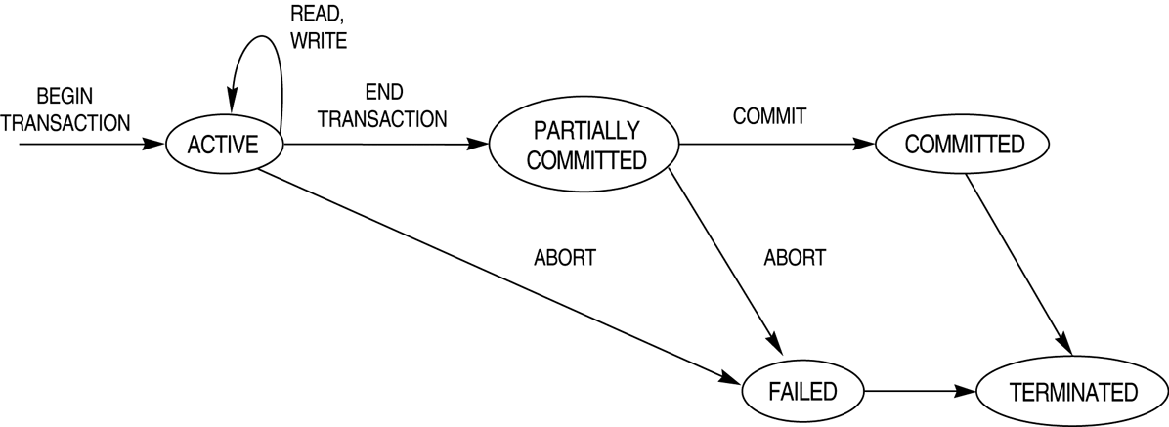
States for transaction execution

Slide 14
Failure
Can a transaction fail?
Failure modes

Slide 15
Failure Modes
Erroneous Data Entry
  E.g. Mistypes one digit of a phone number.
Media Failures
  E.g. head crashes
Catastrophic Failure
  Media completely destroyed.
  E.g. fire

Slide 16
Failure Modes (Cont.)
System Failures
  E.g. power loss, software errors
  Data in memory lost
  State of transaction lost
Failure -> recovery needed!

Slide 17
The system Log
Keeps track of all transaction operations that affect the values of database items.
Use log to recovery from transaction failures.
The log is kept on disk, so it is not affected by any type of failure except for disk or catastrophic failure.
The log is periodically backed up to archival storage (tape) to guard against such catastrophic failures.

Slide 18
Types of Log record
[start_transaction,T]: Records that transaction T has started execution.
[write_item,T,X,old_value,new_value]: Records that transaction T has changed the value of database item X from old_value to new_value.
[read_item,T,X]: Records that transaction T has read the value of database item X.
[commit,T]: Records that transaction T has completed successfully, and affirms that its effect can be committed (recorded permanently) to the database.
[abort,T]: Records that transaction T has been aborted.

Slide 19
Force writing a log
Before a transaction reaches its commit point, any portion of the log that has not been written to the disk yet must now be written to the disk.
How to use log for recovery?
  - Lecture 12.

Slide 20
These slides are based on the textbook:
R. Elmasri and S. Navathe, Fundamentals of Database System, 7th Edition, Addison-Wesley.

