Slide 1
CSc 174
Database Management Systems
13. Concurrency Control
Ying Jin
Computer Science Department
California state University, Sacramento

Slide 2
Concurrency Control
Transactions can execute concurrently.
Problems when allow concurrent execution without control
  The Lost Update Problem.
    This occurs when
      two transactions that access the same database items and
      have their operations interleaved in a way that makes the value of some database item incorrect.

Slide 3
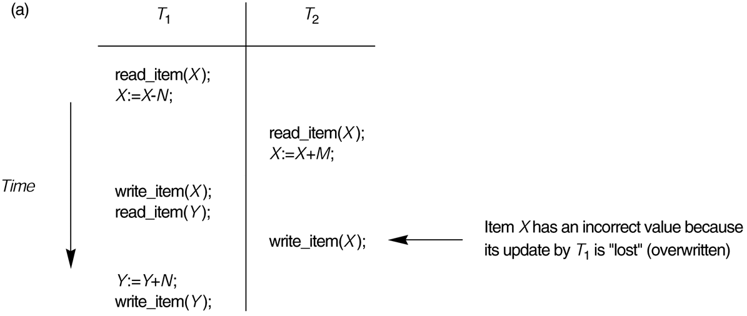
The Lost Update Problem - Example

Slide 4
Dirty Read problem
The Temporary Update (or Dirty Read) Problem.
This occurs when
  one transaction updates a database item
  and then the transaction fails for some reason.
  The updated item is accessed by another transaction before it is changed back to its original value.

Slide 5
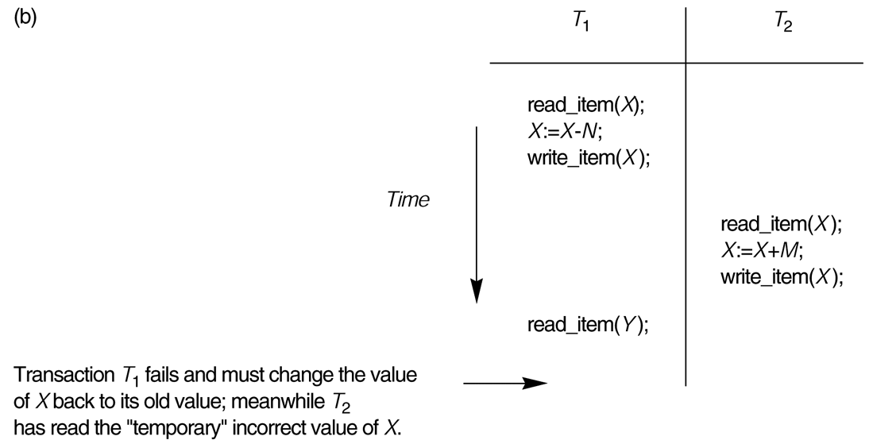
Dirty Read problem - Example

Slide 6
Solve problems
Problems occurs without control.
Concurrency Control
  Concepts: schedule, serializable
  Concurrency control technique

Slide 7
Transaction Schedule
A schedule (or history) S of n transactions T1, T2, ..., Tn
It is an ordering of the operations of the transactions subject to the constraint that:
  for each transaction Ti that participates in S
  the operations of Ti in S must appear in the same order in which they occur in Ti.
Note, however, that operations from other transactions Tj can be interleaved with the operations of Ti in S.

Slide 8
Conflict operations
Two operations in a schedule conflict if they satisfy all three of the following conditions:
  (1)They belong to different transactions
  (2)They access the same item X
  (3) At least one of the operations is a write_item(X)

Slide 9
Equivalent schedule
Result equivalent: Two schedules are called result equivalent if they produce the same final state of the database.
  Two different schedules may accidentally produce the same final state.
Conflict equivalent: Two schedules are said to be conflict equivalent if the order of any two conflicting operations is the same in both schedules.

Slide 10
Serial Schedule
A schedule S is serial if,
  for every transaction T participating in the schedule,
  all the operations of T are executed consecutively in the schedule.
  (Without interleaving - Only one transaction active at once)
Otherwise, the schedule is called nonserial schedule.

Slide 11
Serializable Schedule
Conflict serializable: A schedule S is said to be conflict serializable if it is conflict equivalent to some serial schedule S’.
We call it “serializable” in the rest of this CSC 174 class.
Being serializable is not the same as being serial

Slide 12
Property of Serializable schedule
Why study Serializablity?
Being serializable implies that the schedule is a correct schedule.
  It will leave the database in a consistent state.
  The interleaving is appropriate and will result in a state as if the transactions were serially executed, yet will achieve efficiency due to concurrent execution.

Slide 13
Testing for conflict serializability
Algorithm 17.1:
Looks at only read_Item (X) and write_Item (X) operations
Constructs a precedence graph (serialization graph) - a graph with directed edges
An edge is created from T_{i} to T_{j} if one of the operations in T_{i} appears before a conflicting operation in T_{j} (RW,WR,WW)
The schedule is serializable if and only if the precedence graph has no cycles.
Example 1

Slide 14
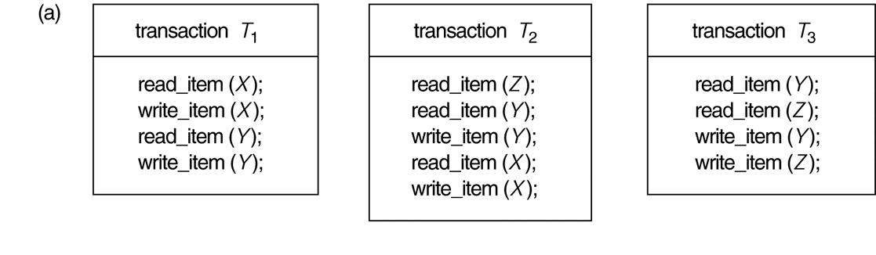
Example 2

Slide 15
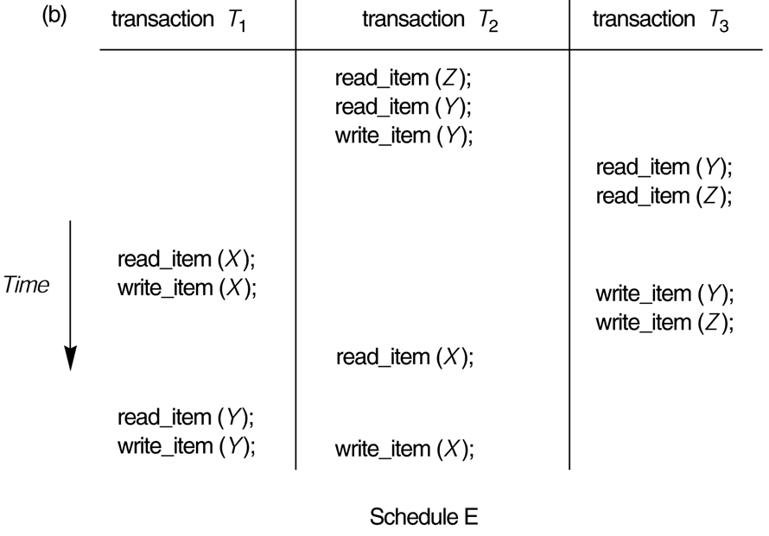
Example 2 (cont.)

Slide 16
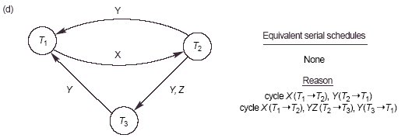
Example 2 (Cont.)

Slide 17
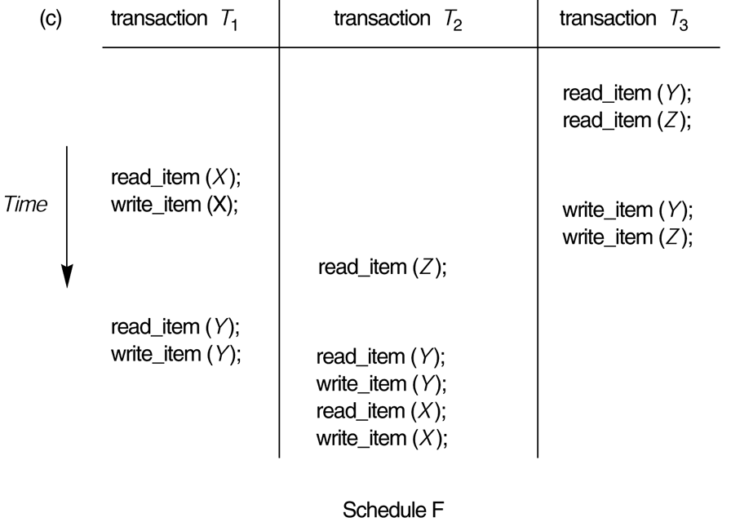
Exercise

Slide 18
Use of Serializability
In practice
  Interleaving of operations from concurrent transactions is typically determined by the operating system scheduler
  It’s difficult to determine beforehand how the operations in a schedule will be interleaved.
If transactions are executed at will and then resulting schedule is tested for serializability,
→ cancel the effect of non-serializable schedule. → impractical

Slide 19
Practical Approach
Come up with methods (protocols) to ensure serializability.
Current approach used in most DBMSs:
Concurrency Control Techniques
  Two-Phase locking
  Timestamp Ordering

Slide 20
Lock
Locking is an operation which secures
permission to Read or
permission to Write a data item for a transaction.
Binary Locks:
Lock (X). Data item X is locked in behalf of the requesting transaction.
Unlock (X). Data item X is made available to all other transactions.

Slide 21
Rules for Binary locking
Every transaction T must obey the following rules:
  T must issue the operation lock(x) before any read(x) or write(x) operations are performed in T.
  T must issue the operation unlock(x) after all read(x) and write(x) operations are completed in T.
  T will not issue lock(x) operation if it already holds the lock on item x
  T will not issue an unlock(x) operation unless it already holds the lock on item X.
At most one transaction can hold the lock on a particular item.

Slide 22
Shared/Exclusive locks
The above binary locking is too restrictive.
We should allow several transactions to access the same item X if they all access x for reading purpose
Three locking operations: read_lock(x), write_lock(x), and unlock(x).
  Shared lock: read_lock (X). More than one transaction can apply share lock on X for reading its value.
  Exclusive lock: write_lock(x). Only a single transaction exclusively holds the lock on the item.

Slide 23
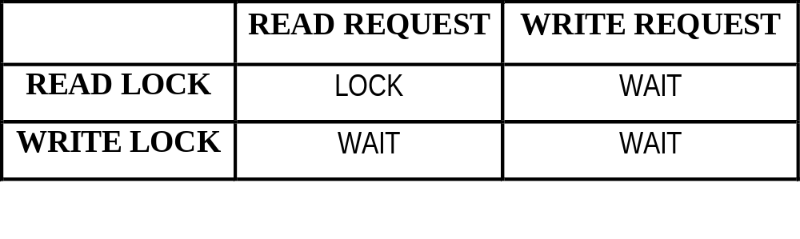
Lock Compatibility
T is requesting a lock.
Lock: The lock manager issue a lock to T.
Wait: T has to wait until the lock is issued by the lock manager.

Slide 24
Well-formed transactions
Database requires that all transactions should be well-formed.
A transaction is well-formed if:
  It must lock the data item in an appropriate mode before it reads or writes to it. (read: read_lock, write: write_lock)
  If the data item is already locked by another transaction in an incompatible mode, then T must wait until all incompatible locks held by other transactions have been released.
  It must not try to unlock a free data item.

Slide 25
Locking Example
T1 T2 Result
read_lock (Y); read_lock (X); Initial values: X=20; Y=30
read_item (Y); read_item (X); Result of serial execution
unlock (Y); unlock (X); T1 followed by T2
write_lock (X); Write_lock (Y); X=50, Y=80.
read_item (X); read_item (Y); Result of serial execution
X:=X+Y; Y:=X+Y; T2 followed by T1
write_item (X); write_item (Y); X=70, Y=50
unlock (X); unlock (Y);

Slide 26
Locking Example (Cont)
T1 T2 Result
read_lock (Y); X=50; Y=50
read_item (Y); Well-formed. Serializable?
unlock (Y); Lock guarantee Serializable?
read_lock (X); Need more rules/ protocols.
read_item (X);
unlock (X);
write_lock (Y);
read_item (Y);
Y:=X+Y;
write_item (Y);
unlock (Y);
write_lock (X);
read_item (X);
X:=X+Y;
write_item (X);
unlock (X);

Slide 27
Two-Phase Locking Protocol (2PL)
A transaction is said to follow the two-phase locking protocol if all locking operations (read_lock, write_lock) precede the first unlock operation.
Transaction can be divided into two phases
  Growing (first) phase: new locks on items can be acquired but none can be released
  Shrinking(second) phase: existing locks can be released but no new locks can be acquired.

Slide 28
2PL (Cont.)
If every transaction in a schedule follows the two-phase locking protocol, the schedule is guaranteed to be serializable.

Slide 29
Example 1 of 2PL
T’1
read_lock (Y);
read_item (Y);
write_lock (X);
unlock (Y);
read_item (X);
X:=X+Y;
write_item (X);
unlock (X);

Slide 30
Example 2 of 2PL
T’2
read_lock (X);
read_item (X);
Write_lock (Y);
unlock (X);
read_item (Y);
Y:=X+Y;
write_item (Y);
unlock (Y);
Example 3: Interleaving of T3 and T4.

Slide 31
Deadlock
Deadlock occurs when each transaction T in a set of two or more transactions is waiting for some item that is locked by some other transaction T’ in the set.

Slide 32
Deadlock Example
T’1 T’2
read_lock (Y); T1 and T2 did follow two-phase
read_item (Y); policy, but they are deadlock
read_lock (X);
read_item (X);
write_lock (X);
(waits for X) write_lock (Y);
(waits for Y)
Deadlock (T’1 and T’2)

Slide 33
Deadlock Prevention
Use deadlock prevention protocol to prevent deadlock.
  Conservative two-phase locking:
    Requires a transaction to lock all the items it accesses before the transaction begins execution.
    If any of the items cannot be obtained, none of the items are locked.
    Then the transaction will try again at a later time.
  Not practical

Slide 34
Deadlock Detection
DBMS checks if a state of deadlock actually exists.
More practical approach
Wait-for graph
  One node for each transaction that is currently executing
  Whenever Ti is waiting to lock an item X that is currently locked by a transaction Tj, a directed edge (Ti -> Tj) is created in the wait-for graph

Slide 35
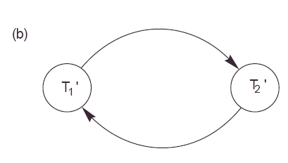
Wait-for graph example
T1’ and T2’ of Page 33

Slide 36
Deadlock Detection (Cont.)
Deadlock if an only if the wait-for graph has cycle
DBMS needs to select a time to check for a deadlock.

Slide 37
Deadlock Detection (Cont.)
When a deadlock occurs, DBMS will choose some transaction causing the deadlock to abort.
Victim Selection algorithm:
  Avoid selecting transactions that have been running for a long time and that have performed many update.
  Select transactions that have not made many changes

Slide 38
Starvation
Starvation occurs when a transaction cannot proceed for an indefinite period of time while other transactions in the system continue normally.
This may occur if the waiting/aborting scheme for locked items is unfair.
  Fair waiting scheme: first-come-first-served
  Allow priority: Priority increasing during waiting.

Slide 39
Timeout
Simple approach to deal with deadlock
If a transaction waits for a period longer than a system-defined timeout period, the system assumes that the transaction may be deadlocked and aborts it – regardless of whether a deadlock actually exists or not.
Practical because of is low overhead and simplicity.

Slide 40
These slides are based on the textbook:
R. Elmasri and S. Navathe, Fundamentals of Database System, 7th Edition, Addison-Wesley.

