Slide 1
CSc 174
Database Management Systems
16. NoSQL
Ying Jin
Computer Science Department
California state University, Sacramento

Slide 2
No SQL Characteristics
Not requiring a schema
Any constraints on the data have to be programmed in the application programs
Less powerful query languages
  Typically a set of functions and operations as programming APIl
  Do not provide join

Slide 3
Categories of NoSQL systems
Document-based
Key-value store
Column-based or wide column
Graph-based

Slide 4
Categories (1)
Document-based
  Store data in the form of documents
  MongoDB
  CouchDB

Slide 5
Categories (2)
Key-value store
  Every value(data itme) must be associated with a unique key
  Retrieving the value by supplying the key must be very fast.
  Amazon DynamoDB, Oracle NoSQL database,Redis, Apache Cassandra (also categorized as column-based)

Slide 6
Categories (3)
Column-based or wide column
  Partition a table by column into column families
  Google BigTable
  Apache Hbase
  Apache Cassandra
Graph-based
  Neo4j, GraphBase

Slide 7
MongoDB

Slide 8
MongoDB
Document-based NoSQL
Documents are stored in BSON (Binary JSON: Binary JavaScript Object Notation)
Individual documents are stored in a collection

Slide 9
Collection
db.createCollection(“Project”, {capped:true, size: 1310720, max:500})
db.crateCollection(“Worker”, {capped:true, size: 5242880, max:2000}))
Each document in a collection has a unique ObjectId, _id
  Can be specified by users
  If not specified by users, it is system-generated

Slide 10
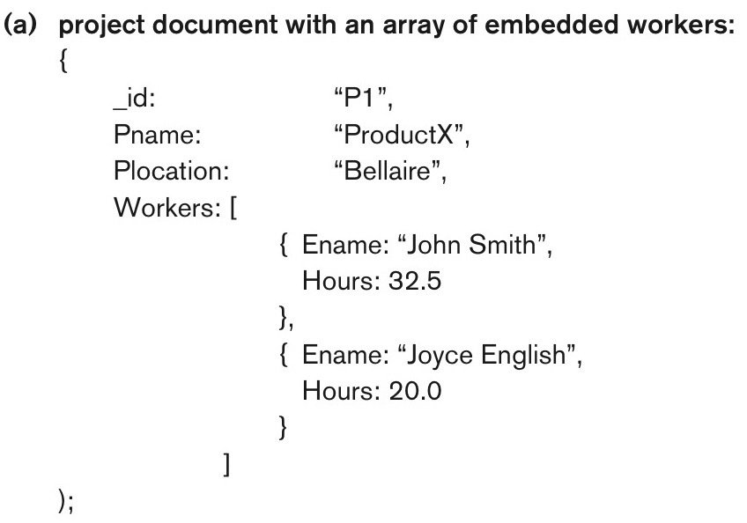

Slide 11
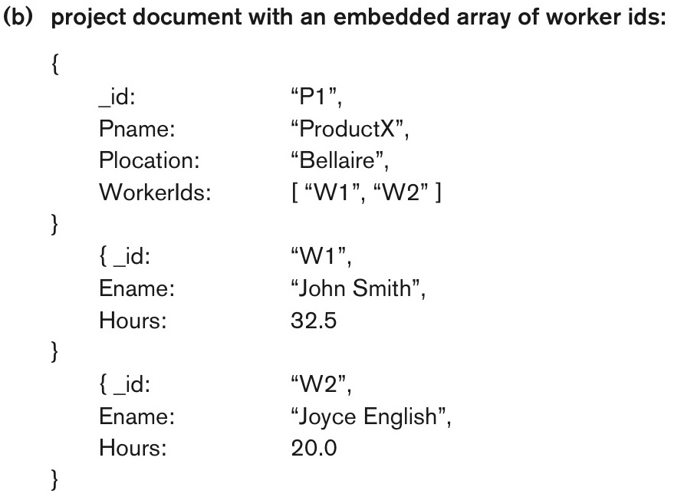

Slide 12
CRUD Operations
db.<collection_name>.insert(<document(s)>)
db.<collection_name>.remove(<condition>)
Db.<collection_name>.find(<condition>)
Db.<collection_name>.update(<condition>)

Slide 13
Neo4j

Slide 14
Data Model
Node
  Lable: nodes with the same label are grouped into a collection
Relationship
  Directed: with a start node and end node

Slide 15
Query Language -Cypher
Create nodes
Create relationships
query

Slide 16
Query
MATCH
WITH
WHERE
RETURN
ORDER BY
LIMIT

Slide 17
Query Example
A)Retrieve projects and hours per weeks that the employee with Empid=2 works on.
B)Retrieve all employees and the projects they work on, sorted by Ename, but only returns the first 10 answers.
C) Retrieve the employees who work on more than two projects, as well as the number of projects each employee works on.

Slide 18
These slides are based on the textbook:
R. Elmasri and S. Navathe, Fundamentals of Database System, 7th Edition, Addison-Wesley.

