Slide 1
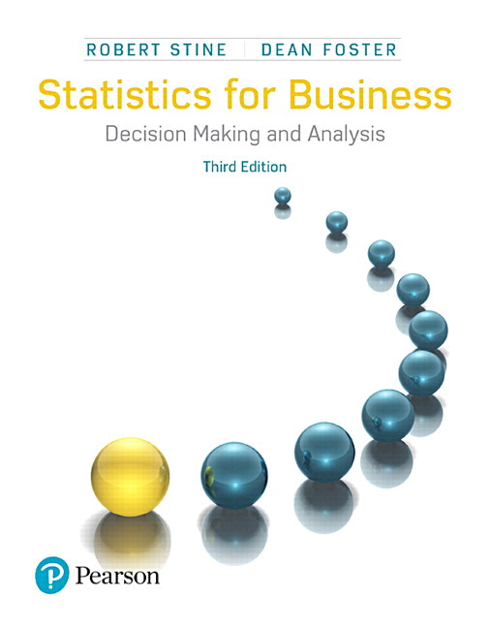
Chapter 19
Linear Patterns

Slide 2
19.1 Fitting a Line to Data
What is the relationship between the price
and weight of diamonds?
Use regression analysis to find an equation that summarizes the linear association between price and weight
The intercept and slope of the line estimate the fixed and variable costs in pricing diamonds

Slide 3
19.1 Fitting a Line to Data
Consider Two Questions about Diamonds:
What’s the average price of diamonds that weigh 0.4 carat?
How much more do diamonds that weigh 0.5 carat cost?

Slide 4
19.1 Fitting a Line to Data
Equation of a Line
Using a sample of diamonds of various weights, regression analysis produces an equation that relates weight to price.
Let y denote the response variable (price) and let x denote the explanatory (or predictor) variable (weight).

Slide 5
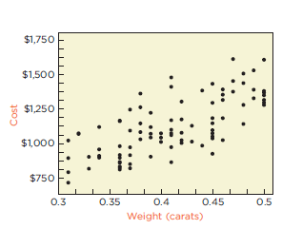
19.1 Fitting a Line to Data
Scatterplot of Cost vs. Weight
Linear association is evident (r = 0.71).

Slide 6


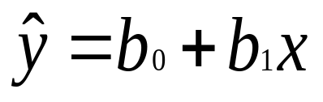
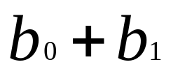
19.1 Fitting a Line to Data
Equation of a Line
Identify the line fit to the data by an intercept
and a slope .
The equation of the line is
Estimated Cost = Weight.

Slide 7
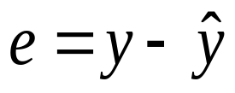
19.1 Fitting a Line to Data
Least Squares
Residual: vertical deviation of a point from the line ( ).
The best fitting line collectively makes the squares of residuals as small as possible
(the choice of b₀ and b₁ minimizes the sum of the squared residuals).

Slide 8
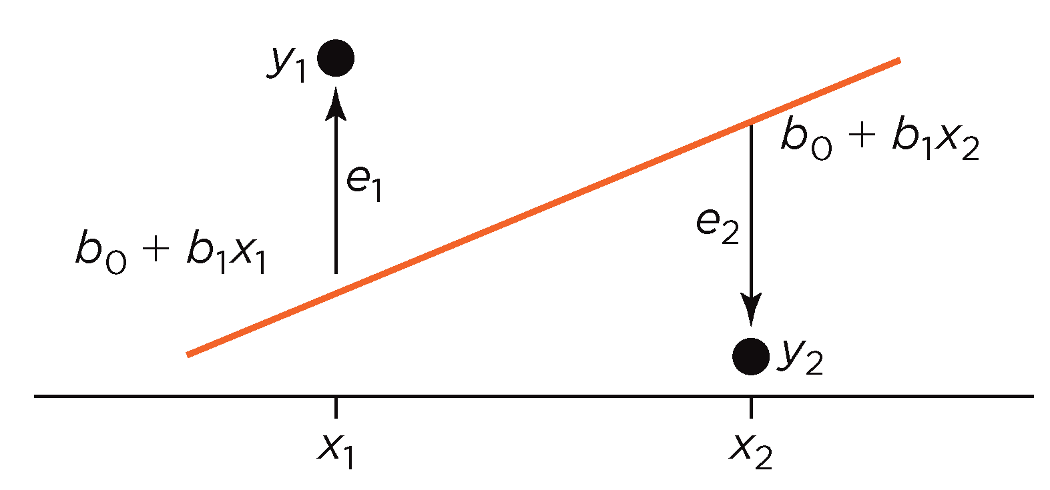
19.1 Fitting a Line to Data
Residuals – Vertical Deviation (+ or -)

Slide 9
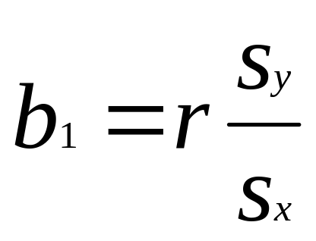
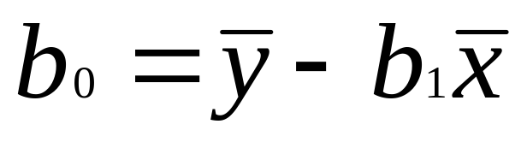
19.1 Fitting a Line to Data
Least Squares Regression

Slide 10
19.2 Interpreting the Fitted Line
Diamond Example
The least squares regression equation for relating diamond prices to weight is
Estimated Cost = 15 + 2,697 Weight

Slide 11
19.2 Interpreting the Fitted Line
Diamond Example
The average price of a diamond that weighs 0.4 carat is
Estimated Price = 15 + 2,697(0.4) = $1,093.80
A diamond that weighs 0.5 carat costs about $270 more, on average.

Slide 12
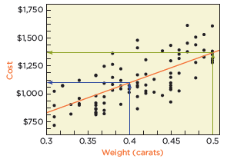
19.2 Interpreting the Fitted Line
Diamond Example

Slide 13
19.2 Interpreting the Fitted Line
Interpreting the Intercept
The intercept is the portion of y that is present for all values of x (i.e., fixed cost, $15, per diamond).
The intercept estimates the average response when x = 0 (where the line crosses the y axis).

Slide 14
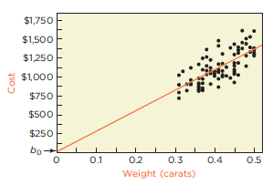
19.2 Interpreting the Fitted Line
Interpreting the Intercept
Unless the range of x values includes zero, b₀ will
be an extrapolation.

Slide 15
19.2 Interpreting the Fitted Line
Interpreting the Slope
The slope estimates the marginal cost used to find the variable cost (i.e., marginal cost is $2,697 per carat).
While tempting, it is not correct to describe the slope as the change in y caused by changing x.

Slide 16
4M Example 19.1:
ESTIMATING CONSUMPTION
Motivation
A utility company that sells natural gas in the
Philadelphia area needs to estimate how
much is used in homes in which their meters
cannot be read.

Slide 17
4M Example 19.1:
ESTIMATING CONSUMPTION
Method
Use regression analysis to find the equation
that relates y (amount of gas consumed
measured in CCF) to x (the average number
of degrees below 65º during the billing
period). The utility company has 4 years of
data (n = 48 months) for one home.

Slide 18
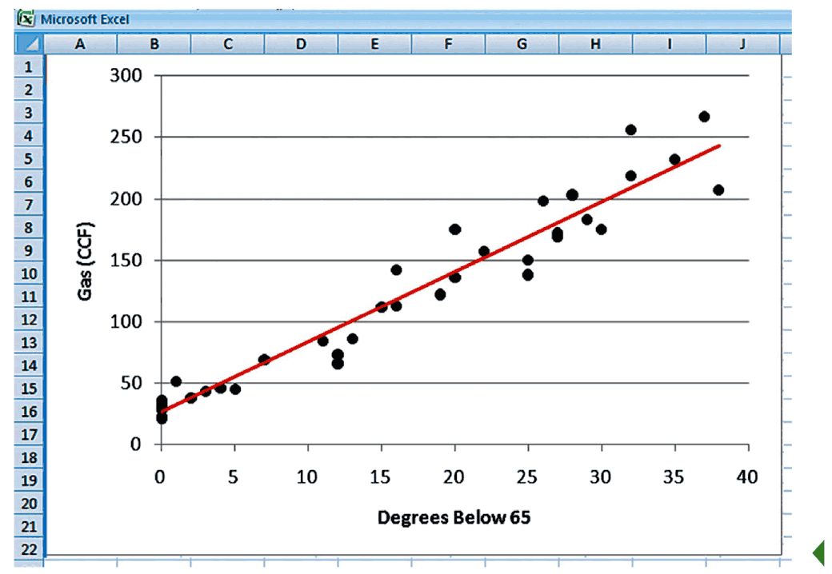
4M Example 19.1:
ESTIMATING CONSUMPTION
Mechanics
Linear association is evident.

Slide 19

4M Example 19.1:
ESTIMATING CONSUMPTION
Mechanics
The fitted least squares regression line is
Estimated Gas = 26.7 + 5.7 Degrees Below 65

Slide 20
4M Example 19.1:
ESTIMATING CONSUMPTION
Message
During the summer, the home uses about
26.7 CCF of gas during the billing period. As
the weather gets colder, the estimated
average amount of gas consumed rises by
5.7 CCF for each additional degree below
65º.

Slide 21
19.3 Properties of Residuals
Residuals
Show variation that remains in the data after accounting for the linear relationship defined by the fitted line.
Should be plotted against x to check for patterns.

Slide 22
19.3 Properties of Residuals
Residual Plots
If the least squares line captures the association between x and y, then a plot of residuals versus x should stretch out horizontally with consistent vertical scatter.
Can use the visual test for association to check for the absence of a pattern.

Slide 23
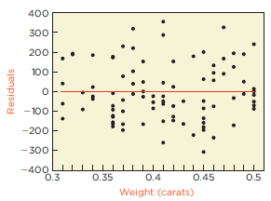
19.3 Properties of Residuals
Residual Plot for Diamond Example
There is no clear pattern. The fitted line captures
the pattern that relates weight to price.

Slide 24
19.3 Properties of Residuals
Standard Deviation of Residuals (s_{e})
Measures how much the residuals vary around the fitted line.
Also known as standard error of the regression or the root mean squared error (RMSE).
For the diamond example, s_{e} = $145.

Slide 25
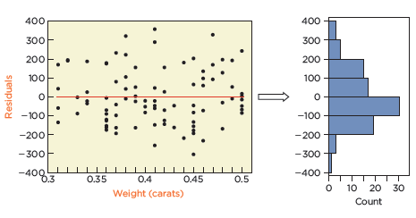
19.3 Properties of Residuals
Standard Deviation of Residuals
Since the residuals are approximately normal, the
empirical rule implies that about 95% of the prices
are within $290 of the regression.

Slide 26
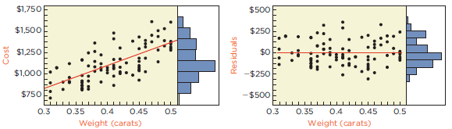
19.4 Explaining Variation
Residuals Vary Less than Original Costs

Slide 27
19.4 Explaining Variation
R-squared (r²)
Is the square of the correlation between x and y.
Is the fraction of the variation accounted for by the least squares regression line.
For the diamond example, r² ≈ 0.5 (i.e., the fitted line explains about 50% of the variation in price).

Slide 28
19.4 Explaining Variation
Summarizing the Fit of Line
Always report both r² and s_{e} so others can judge how well the regression equation describes the data.

Slide 29
19.5 Conditions for Simple Regression
Checklist
No obvious lurking variable: need to think about whether other explanatory variables might better explain the linear association between x and y.
Linear: use scatterplot to see if pattern resembles a straight line.
Random residual variation: use the residual plot to make sure no pattern exists.

Slide 30
4M Example 19.2: LEASE COSTS
Motivation
How can a dealer anticipate the effect of age
on the value of a used car? The dealer
estimates that $4,000 is enough to cover the
depreciation per year.

Slide 31
4M Example 19.2: LEASE COSTS
Method
Use regression analysis to find the equation
that relates y (resale value in dollars) to x
(age of the car in years). The car dealer has
data on the prices and age of 183 used
BMWs in the 3-series from Web sites
advertising certified used BMWs in 2011.

Slide 32
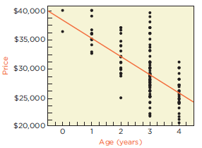
4M Example 19.2: LEASE COSTS
Mechanics
Linear association is evident. Mileage of the
car may be a potential lurking variable.

Slide 33
4M Example 19.2: LEASE COSTS
Mechanics
The fitted least squares regression line is
Estimated Price = 38,680.42 – 3,262.92 Age
r² = 0.41 and s_{e} = $3,527

Slide 34
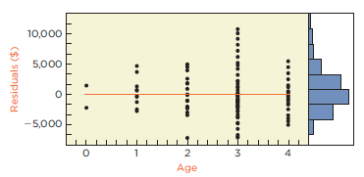
4M Example 19.2: LEASE COSTS
Mechanics
There is more variation among residuals for cars
that are 3 years old compared to other ages. Keep this in
mind going forward.

Slide 35
4M Example 19.2: LEASE COSTS
Message
The results indicate that used BMWs in the 3-
series decline in resale value by $3,300 per
year. The current lease price of $4,000 per
year appears profitable. However, the fitted
line leaves more than half of the variation
unexplained. And leases longer than 4 years
would require extrapolation.

Slide 36
Best Practices
Always look at the scatterplot.
Know the substantive context of the model.
Describe the intercept and slope using units of the data.
Limit predictions to the range of observed conditions.

Slide 37
Pitfalls
Do not assume that changing x causes changes in y.
Do not forget lurking variables.
Don’t trust summaries like r² without looking at plots.

