Slide 1
DATA MINING LECTURE 6
Linear Regression
Logistic Regression
Neutral Networks
A Little Bit of Deep Learning
CSC177
Dr. Victor Chen

Slide 2
Regression Problem
The problem of predicting continuous values is called regression problem
General approach: find a continuous function that models the continuous points.

Slide 3
Linear Regression with one input
A simple regression has the coefficient β and the constant α. The equation is then:
y = α + β * x
where α is y-intercept and β is slope

Slide 4
Linear Regression with more than one input
Multiple Linear Regression
A multiple regression is in the following form:
y = α + β₁ * X₁ + β₂ * X₂ + … + β_{k} * X_{k}
where k is the number of variables, or parameters.

Slide 5
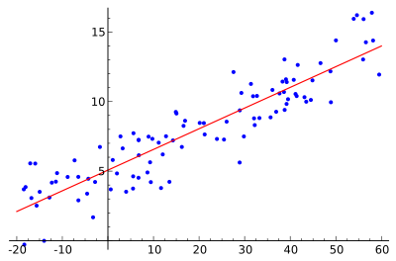
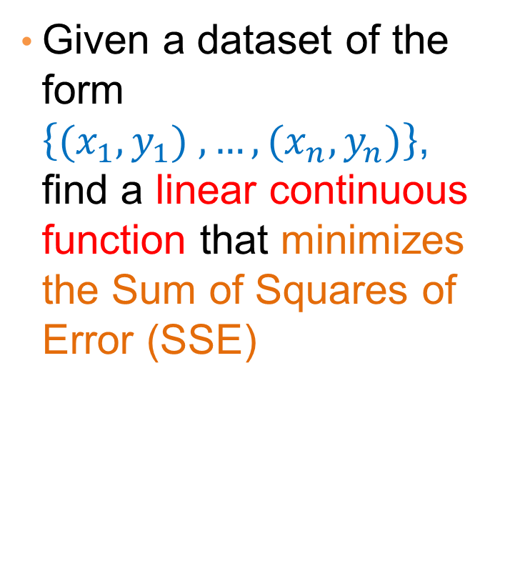
Linear regression for 2D data
Given a dataset of the form $\left\{{(x}_{1},y_{1}) ,…,{(x}_{n},y_{n})\right\}$, find a linear continuous function that minimizes the Sum of Squares of Error (SSE)

Slide 6
Linear Regression
y’ = b0 + b1X
є
Dependent variable (y)
b1 = slope
= ∆y/ ∆x
b0 (y intercept)
Independent variable (x)

Slide 7
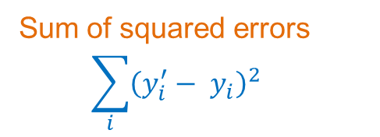
Sum of Squares of Error (SSE)
Regression
Sum of squared errors
$$\sum_{i}{{\left(y_{i}^{′}− y_{i}\right)}^{2}}$$
Dependent variable
Independent variable (x)
Sum of Squares of Error (SSE) is the sum of all the squared errors.

Slide 8
Sum of Squares of Regression (SSR)
Data mean
Dependent variable
Independent variable (x)
Sum of Squares of Regression (SSR) is the sum of the squared differences between each prediction and the mean of data.

Slide 9
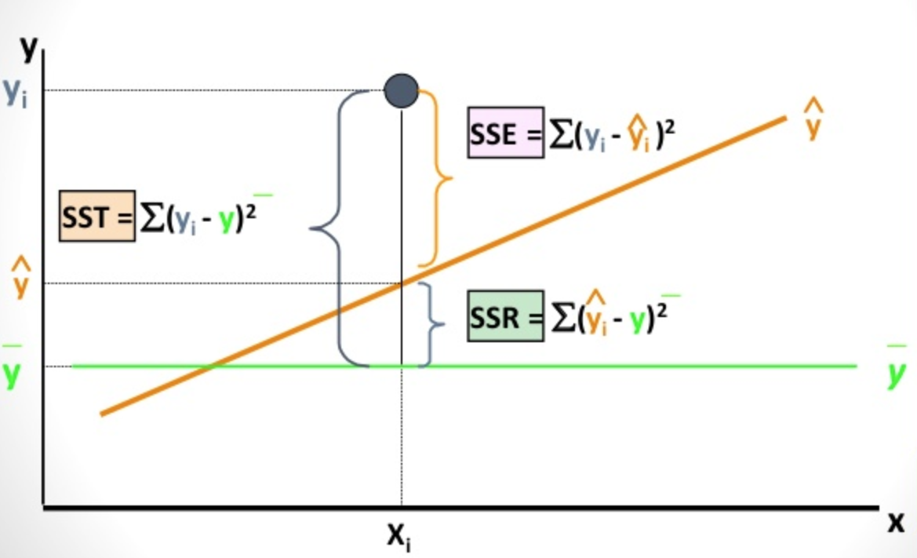
Sum of Squares of Total (SST)
SST = SSE + SSR

Slide 10
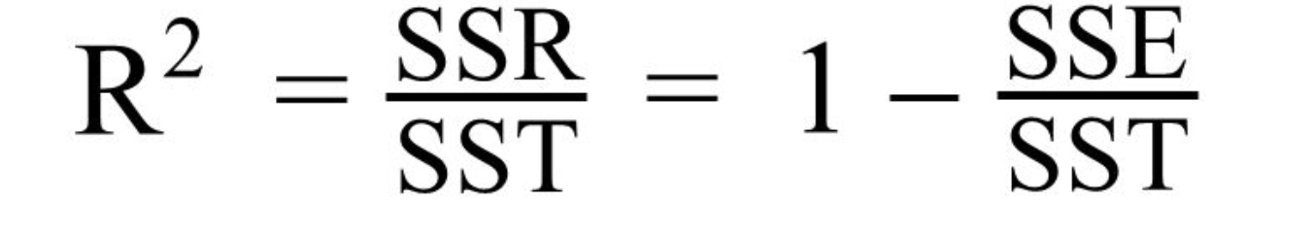
R-Squared score
The Coefficient of Determination
R-Squared score can be used as a single summary number to measure the quality of linear regression model
The value of R² can range between 0 and 1.
The higher R^{2,} the more accurate the regression model is.

Slide 11
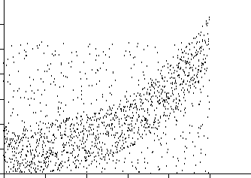
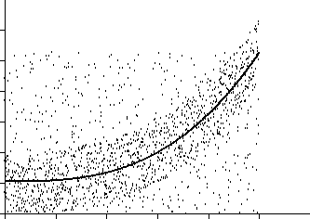
Nonlinear functions can also be fit as regressions
Nonlinear Regression
Any nonlinear continuous functions can also be fit as regressions, including power, Logarithmic, Exponential, and Logistic.

