Slide 1

Is it wrong to pick up a rfid project for csc 196p
Matthew Mendoza for CSC 196P: Cloud and Mobile Pragmatics

Slide 2
EPIC Fail: Watch What Happened When I Tried Playing with RFID!
Matthew Mendoza for CSC 196P: Cloud and Mobile Pragmatics

Slide 3
I Spent 24 Hours with RFID: Here's What I Discovered!
Matthew Mendoza for CSC 196P: Cloud and Mobile Pragmatics

Slide 4
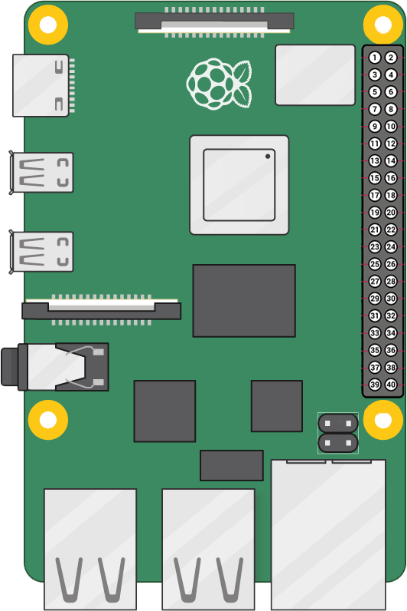
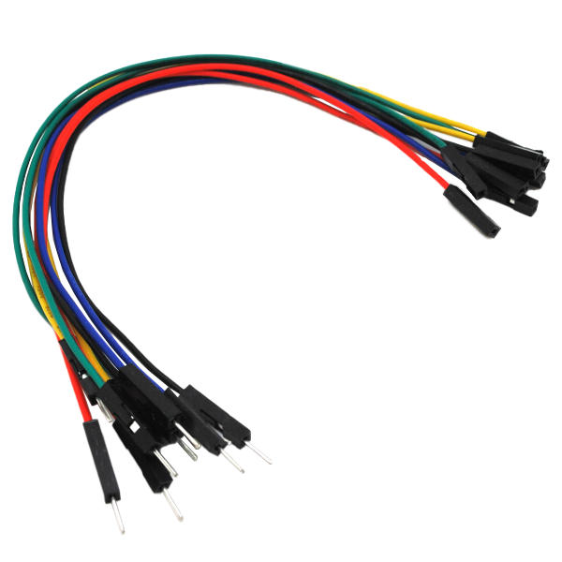
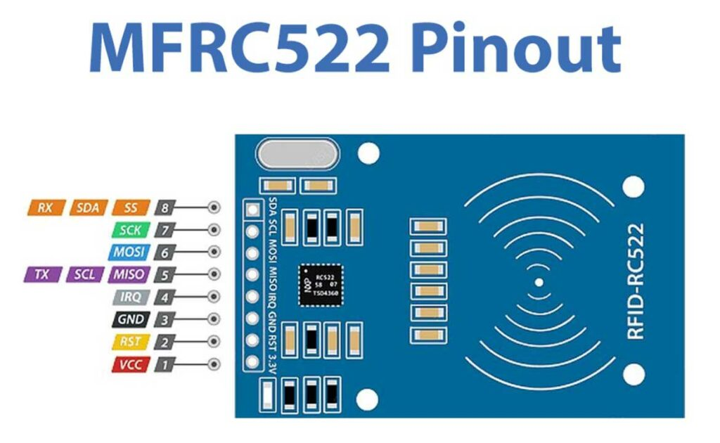
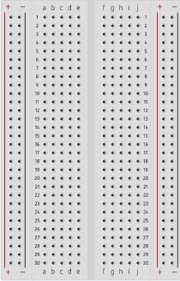

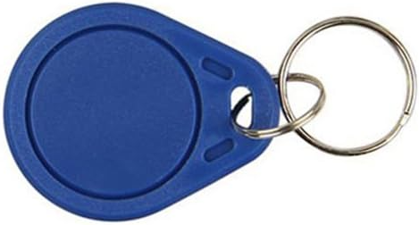
Hardware Components
Male-Female Jumper Wires
RFID Card Tag
Key Fob Tag
Mifare RC522
Module RFID Reader
Raspberry Pi 4 Model B
Breadboard

Slide 5
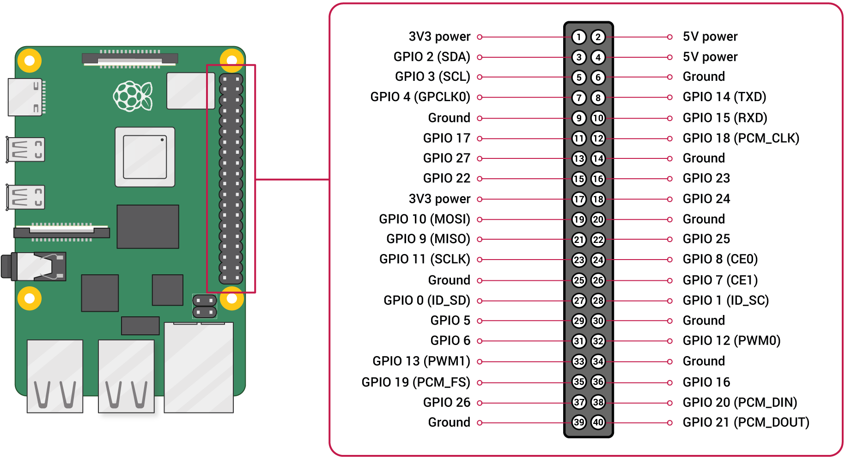
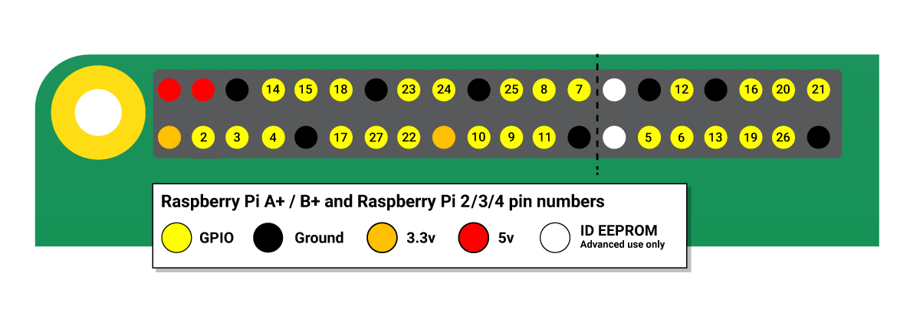
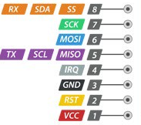
pinouts
Raspberry Pi 4 Model B
Mifare RC522Module RFID Reader

Slide 6



Wiring
RC522 Module (Left to Right) |  | Raspberry Pi
PIN 1: Voltage Common Collector (VCC) | Red | PIN 1: 3.3v
PIN 2: Reset (RST) | Gray | PIN 22: GPIO #25
PIN 3: Ground (GND) | Black | PIN 6: Ground (GND)
PIN 4: Interrupt Request (IRQ) |  | Not connected
PIN 5: Master In Slave Out (MISO) | Blue | PIN 21: GPIO #9 (MISO)
PIN 6: Master Out Slave In (MOSI) | GOLD | PIN 19: GPIO #10 (MOSI)
PIN 7: Serial Clock (SCK) | Orange | PIN 23: GPIO #11 (SCLK)
PIN 8: Serial Data Line (SDA) | Green | PIN 24: GPIO #8 (CE0)
Notes:
RC522 Module PIN 1: Voltage at the Common Collector (VCC) - Used to Power the module, typically 3.3V is used
PIN 2: RST - Reset pin – used to reset or power down the module
PIN 3: Ground - Connected to Ground of system
PIN 5: MISO - used for SPI communication, acts as SCL for I2c and Tx for UART.
PIN 6: MOSI - Master out slave in pin for SPI communication
PIN 7: SCK - Serial Clock pin – used to provide clock source
PIN 8: SDA - Acts as Serial input (SS) for SPI communication, SDA for IIC and Rx during UART

Slide 7
Thank you

Slide 8
Backup Slides

Slide 9
Wiring
RC522 Module (Left to Right) |  | Raspberry Pi
PIN 1: Voltage Common Collector (VCC) | Red | PIN 1: 3.3v
PIN 2: Reset (RST) | Gray | PIN 22: GPIO #25
PIN 3: Ground (GND) | Black | PIN 6: Ground (GND)
PIN 4: Interrupt Request (IRQ) |  | Not connected
PIN 5: Master In Slave Out (MISO) | Blue | PIN 21: GPIO #9 (MISO)
PIN 6: Master Out Slave In (MOSI) | GOLD | PIN 19: GPIO #10 (MOSI)
PIN 7: Serial Clock (SCK) | Orange | PIN 23: GPIO #11 (SCLK)
PIN 8: Serial Data Line (SDA) | Green | PIN 24: GPIO #8 (CE0)
Notes:
RC522 Module PIN 1: Voltage at the Common Collector (VCC) - Used to Power the module, typically 3.3V is used
PIN 2: RST - Reset pin – used to reset or power down the module
PIN 3: Ground - Connected to Ground of system
PIN 5: MISO - used for SPI communication, acts as SCL for I2c and Tx for UART.
PIN 6: MOSI - Master out slave in pin for SPI communication
PIN 7: SCK - Serial Clock pin – used to provide clock source
PIN 8: SDA - Acts as Serial input (SS) for SPI communication, SDA for IIC and Rx during UART

