Slide 1
Mid-term Review
Mid-term will occur in class on 10/20/2021.
One page note( front and back) is permitted.
Closed book
Total time is 75 minutes
Questions includes:
  10 short-answer questions
  10 True/False questions
  10 Multiple-choice questions
  3 Long-answer questions
1

Slide 2
Midterm Review
What’s Internet, protocol?
Network Edge
  Access networks, physical media
Network Core
  Packet-switching: Store and forward; end-end delay; queuing and loss;
  Circuit switching: TDM vs FDM; Example.

Slide 3
Midterm Review
Packet delay
  Four sources of packet delay;
Packet loss
Throughput
Protocol layer
  Internet protocol stack
Encapsulation

Slide 4
Midterm Review
Network security
  DoS
  Packet sniffing
  IP spoofing
Chapter 2
Application models
  Client-server
  peer-to-peer (P2P)
Socket

Slide 5
Midterm Review
Transport protocols
  TCP
  UDP
Web and HTTP
  HTTP protocol
  Persistence and non-persistence HTTP
  RTT
  HTTP response time
  HTTP response message (see example)
  Cookies
  Web caches
  Conditional GET

Slide 6
Midterm Review
Electronic mail
  Three major components
  SMTP
  Mail access protocols (IMAP, HTTP)
  SMTP vs HTTP

Slide 7
Midterm Review
DNS
  Definition
  Services
  Different Tiers of servers
  DNS resolution example
  DNS records (resource records (RR))
P2P
  Example about file distribution using CS vs P2P
  BitTorrent

Slide 8
Midterm Review
Video Streaming
  DASH: server and client
  Content distribution networks
Socket programing
  UDP and TCP
  Application example

Slide 9
MidtermReview
Chapter 3
Transport-layer services
Multiplexing and demultiplexing
UDP
Internet checksum
Rdt1.0 to 3.0
Pipelined protocols
  Go-Back N
  Selective repeat

Slide 10
Midterm Review
  Part1: 10 Short-answer questions (carefully, briefly and clearly. )
  What is the main reason that packet loss may occur in computer network?

Slide 11
Midterm Review
  Part 2: 10 True/False questions
  Packet switching is dedicated, while circuit switching is not.

Slide 12
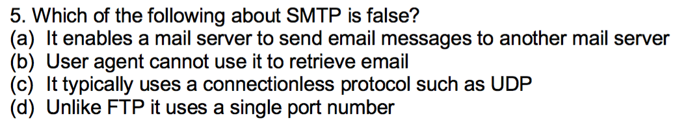
Midterm Review
  Part 3: 10 Multiple-choice questions (Single answer)

Slide 13
Midterm Review
  Part 4: Long-answer questions
  In the process of developing a reliable data transfer (rdt) protocol, we may face several issues and have several intermediate versions of this protocol to solve them, such as rdt 1.0, rdt 2.0, rdt 2.1, rdt 2.2, rdt 3.0. Although these versions are not in practical use, their methods become very useful for generating the de-factor protocol, i.e. TCP. In the following questions, please help summarize what methods we can borrow from these early versions.

Slide 14
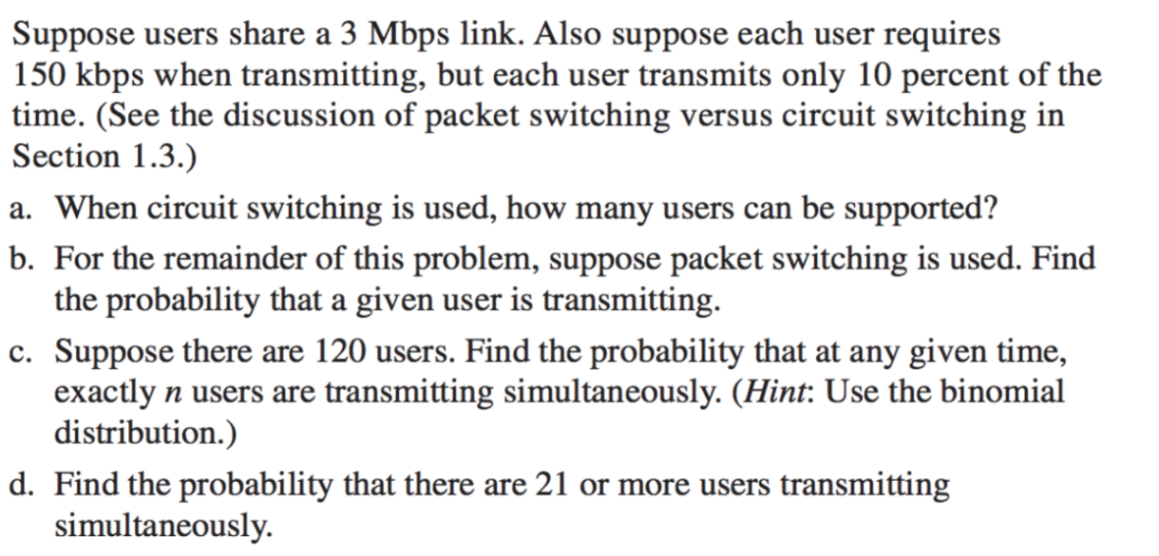
Midterm Review
  Part 4: Long-answer questions

Slide 15
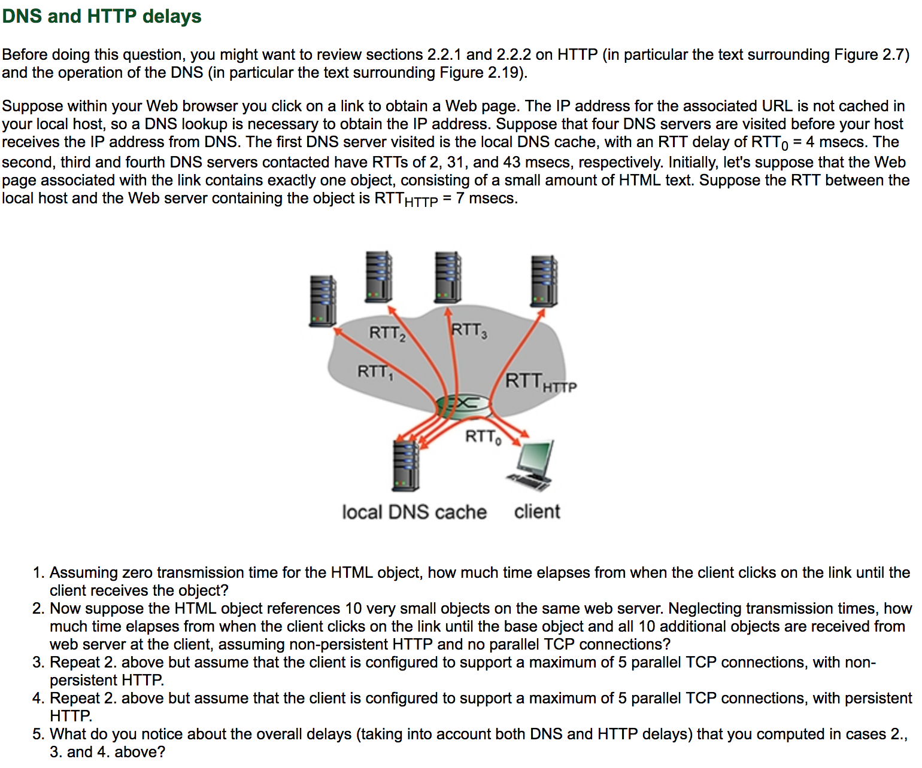
Application Layer
2-<number>

