Slide 1
Computer Science
ENGL 109W Project #2
Matthew Mendoza

Slide 2
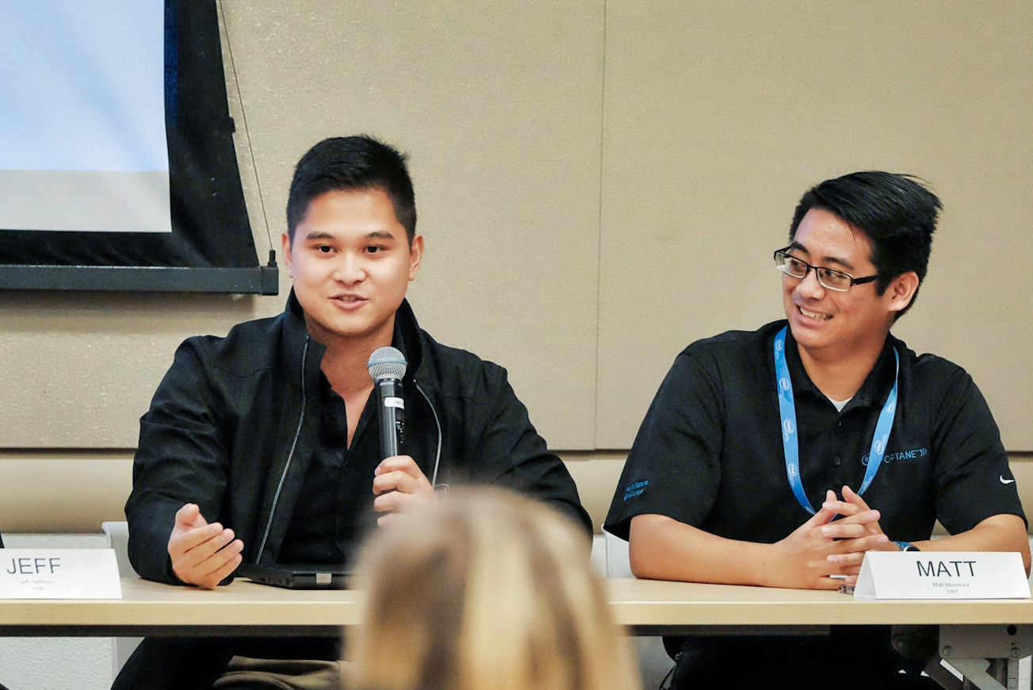
WHY I CHOSE COMPUTER SCIENCE
I love tinkering with things and learning new concepts or develop new insight.
From changing out the batteries of the TV remote early on and to building computers
Computer Science, especially code, allows me to tinker with anything that has the capacity to compute (take input, process, and produce an output)

Slide 3
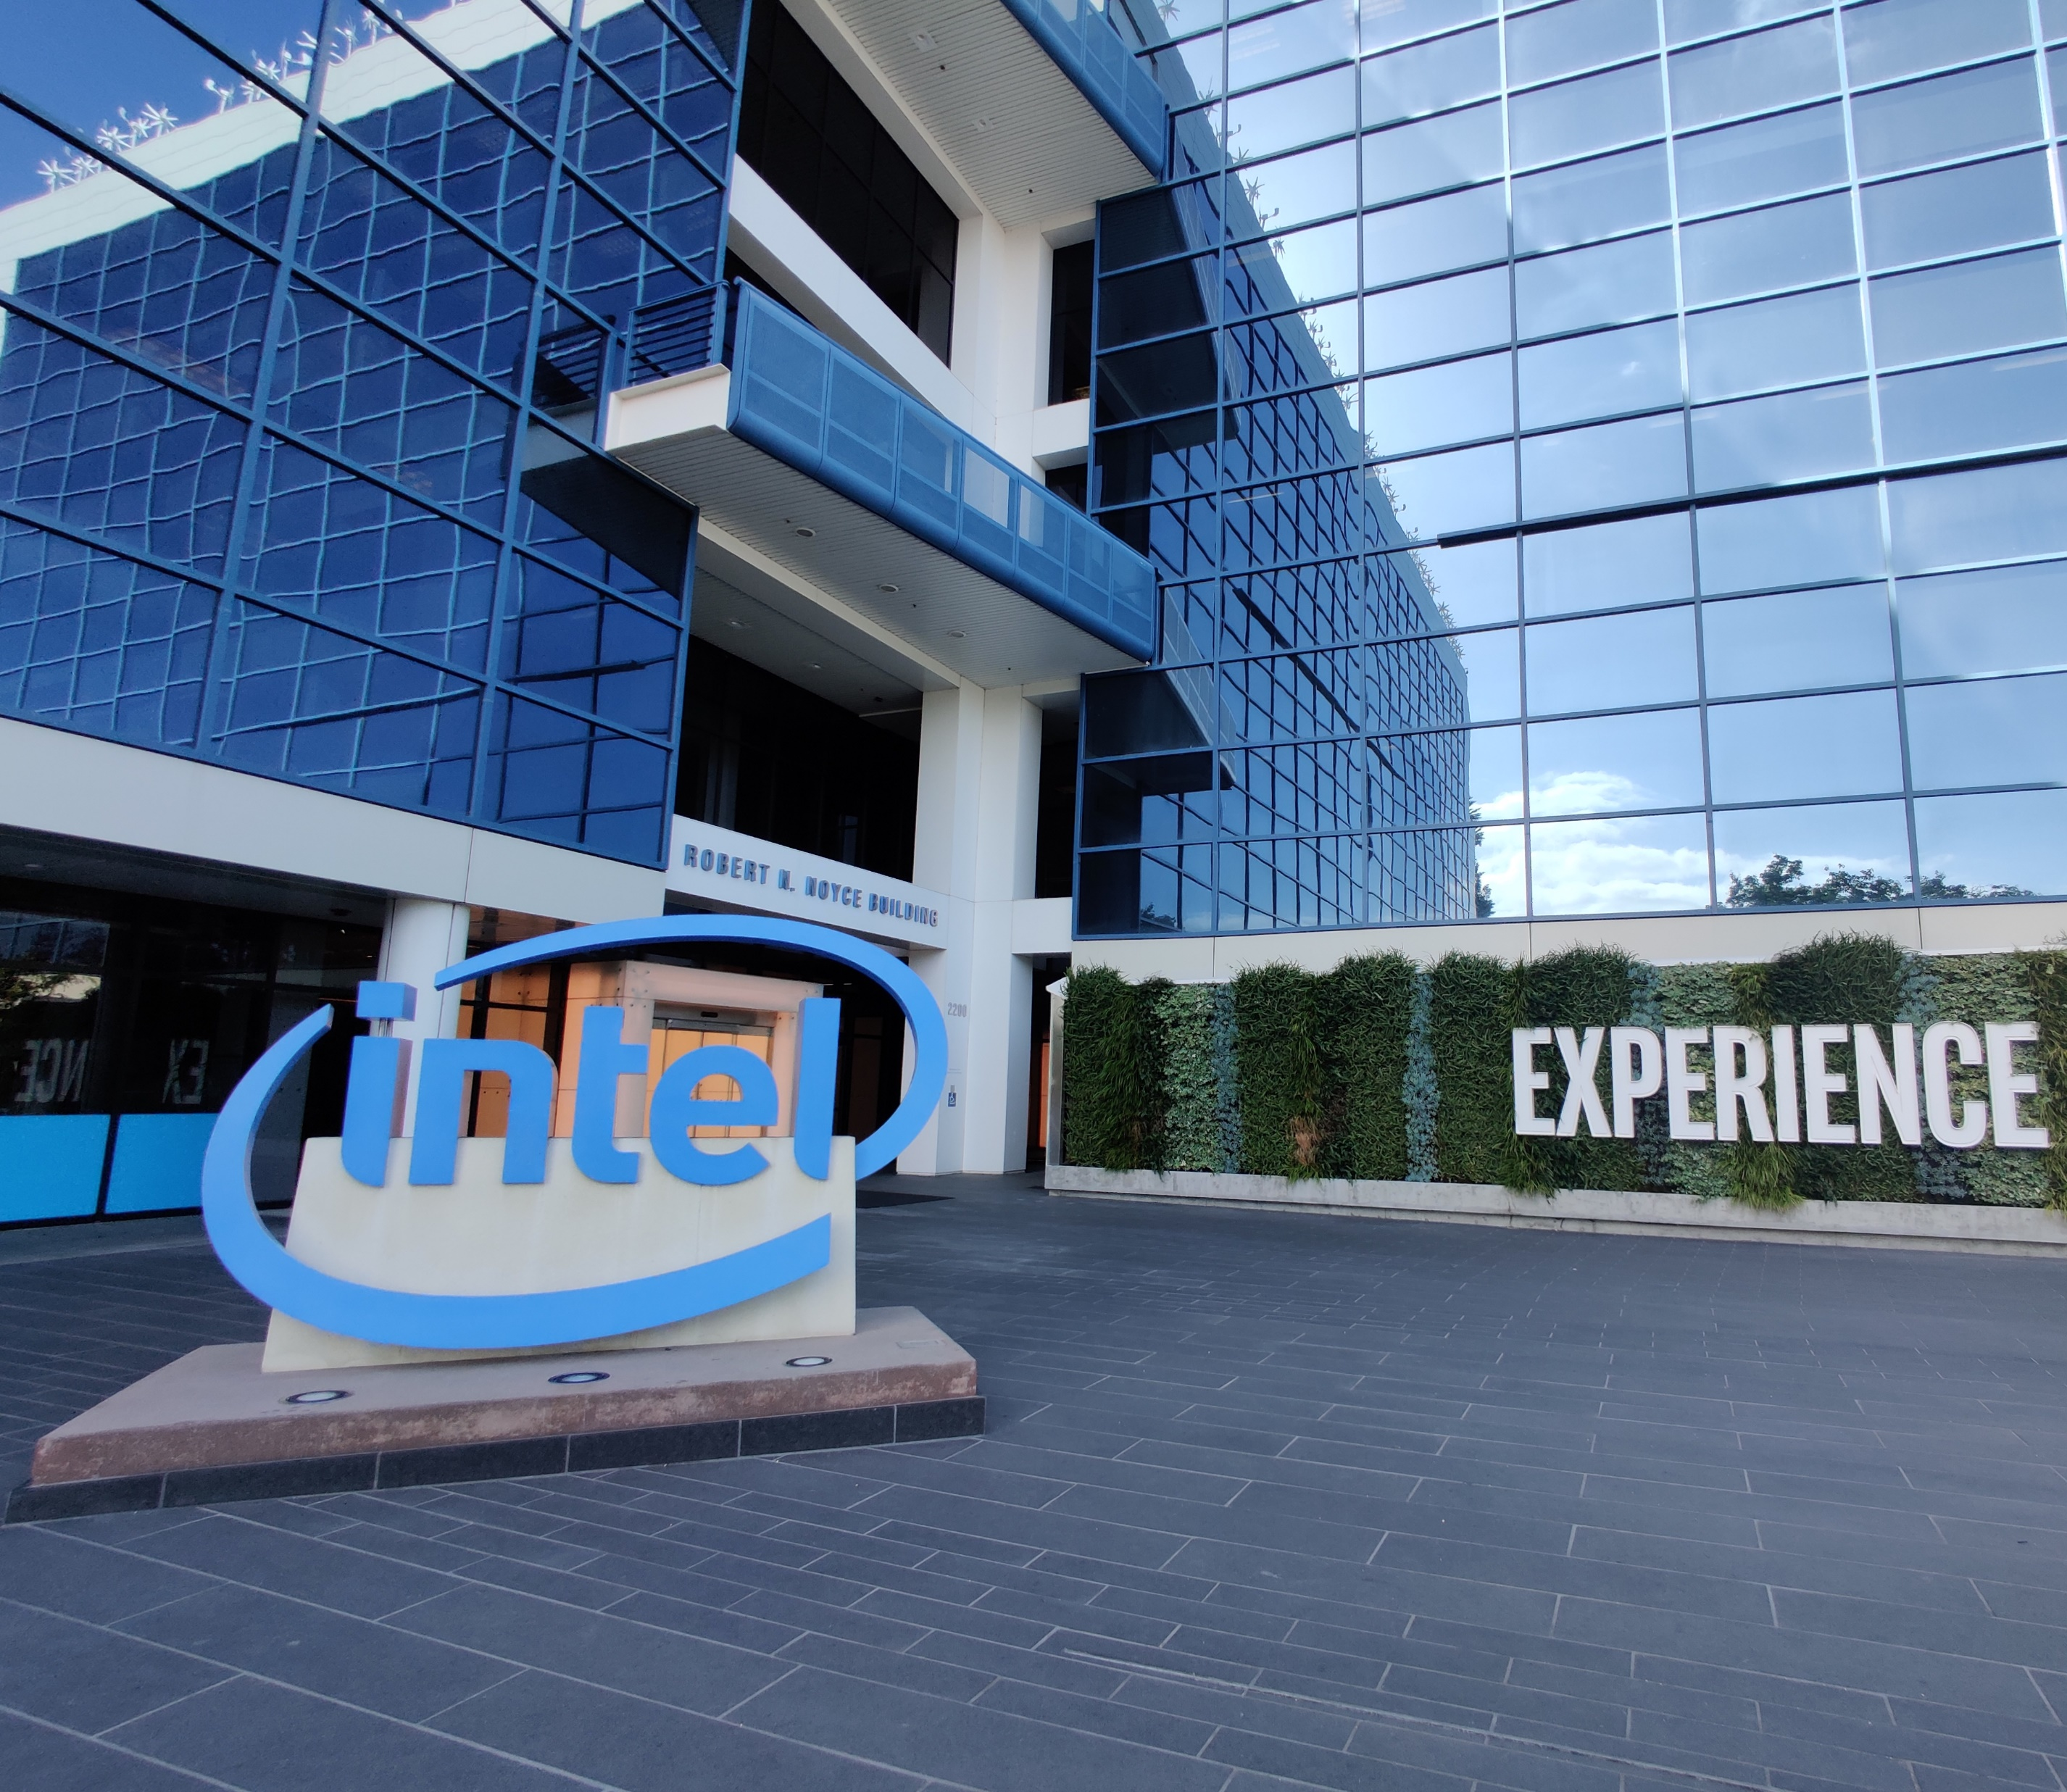
Original Thoughts
Computer Science is not all about coding, it’s a means to an end, but is the focus and study of computation (inputs, processing, and outputs)
Computer Science students are taught and encouraged to practice methodical, structured, thinking by way of Stepwise Refrainment: taking a task and break it down into smaller, trivial, subtasks.
Many computer science students may feel that schools fail them in teaching the latest technologies, but in a fast-moving industry schools can’t teach the state-of-the-art for most times they are unproven, are often proprietary, and/or lack of individuals how can teach the topic.
As a result, schools teaches the fundamentals most technologies are built from

Slide 4
Research Questions
What do non-computer science students need to know about the computer science discourse community?

Slide 5
Interview
The interviewee: Tyler Smart
10+ years of experience
Holds a Doctorate in Physics
Professional Software Developer
Interview held in person
Highlight: a wonderful coworker and mentor
Documents
Java Project for CSC 133
Technical Document: Open Compute Project Foundation (OCP)

Slide 6
Interview Questions
What types of reading/writing/research do students need to do in Computer Science for academic assignments?
What special form/format/style/vocabulary should I use? Why?
What types of writing do professionals often do on the job in computer science?
How do professionals communicate most often with each other in computer science?
How do professionals communicate most often with clients in computer science?
How do professionals in computer science research important information needed for the job?
What types of documents or publications do professionals in computer science read on the job? Why?
What is the most important type of document professionals in computer science need to know how to write/produce?

Slide 7
Interview Questions
What types of reading/writing/research do students need to do in Computer Science for academic assignments?
Unless you’re going into graduate school with a particular focus in a field of Computer Science there isn’t much “research” to have. The industry moves fast and depending on where you want to take, you’re career it’s hard to say any specific types of reading, writing, and/or research one would need to do.
What special form/format/style/vocabulary should I use? Why?
What types of writing do professionals often do on the job in computer science?
How do professionals communicate most often with each other in computer science?

