Slide 1

Exam 1 Question REDO
Matthew Mendoza
Exam 01 – February 29th, 2024

Slide 2
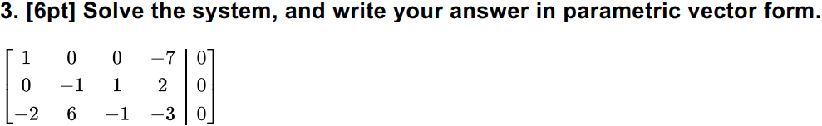
Question 3

Slide 3

How did it go?

Slide 4
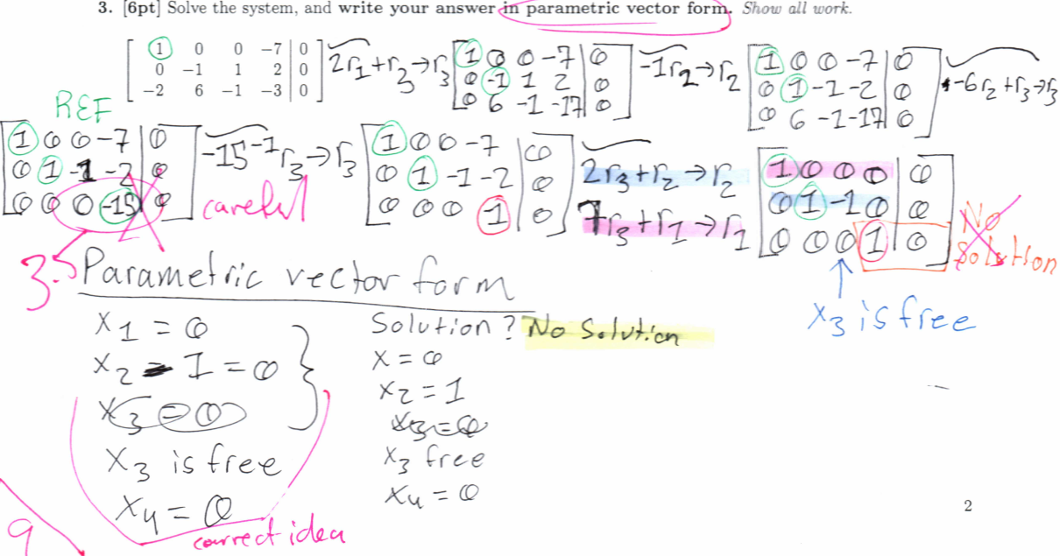
Didn’t go so well…

Slide 5

My error?
Basic algebra

Slide 6

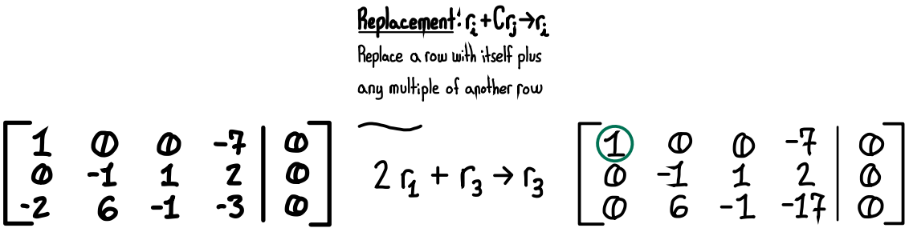
Step 1
Original
Redo

Slide 7
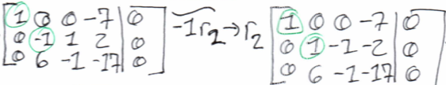
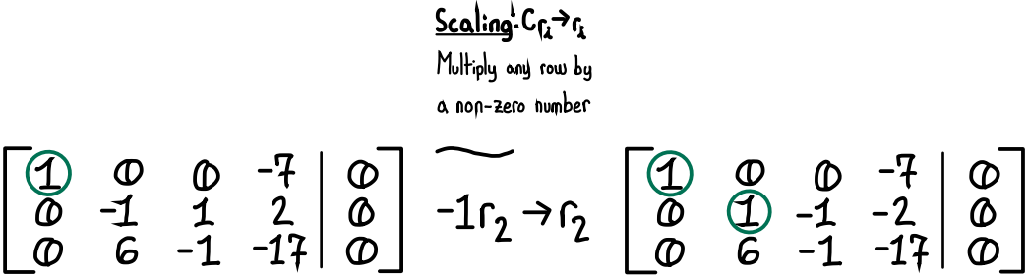
Step 2
Original
Redo

Slide 8
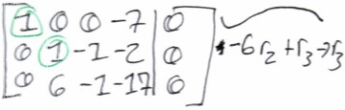
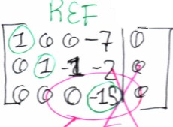
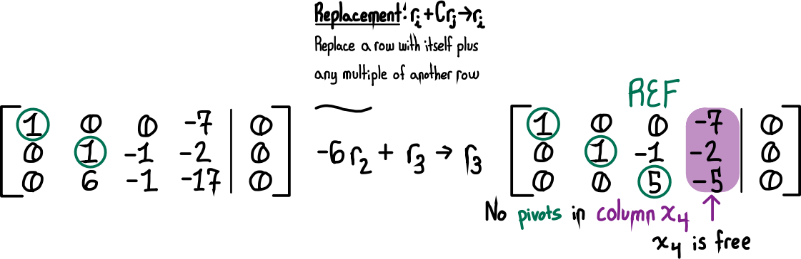

Step 3
Original – Algebra mistake
Redo – $r_{33}$: $−6\left(−1\right)+\left(−1\right)=5$

Slide 9
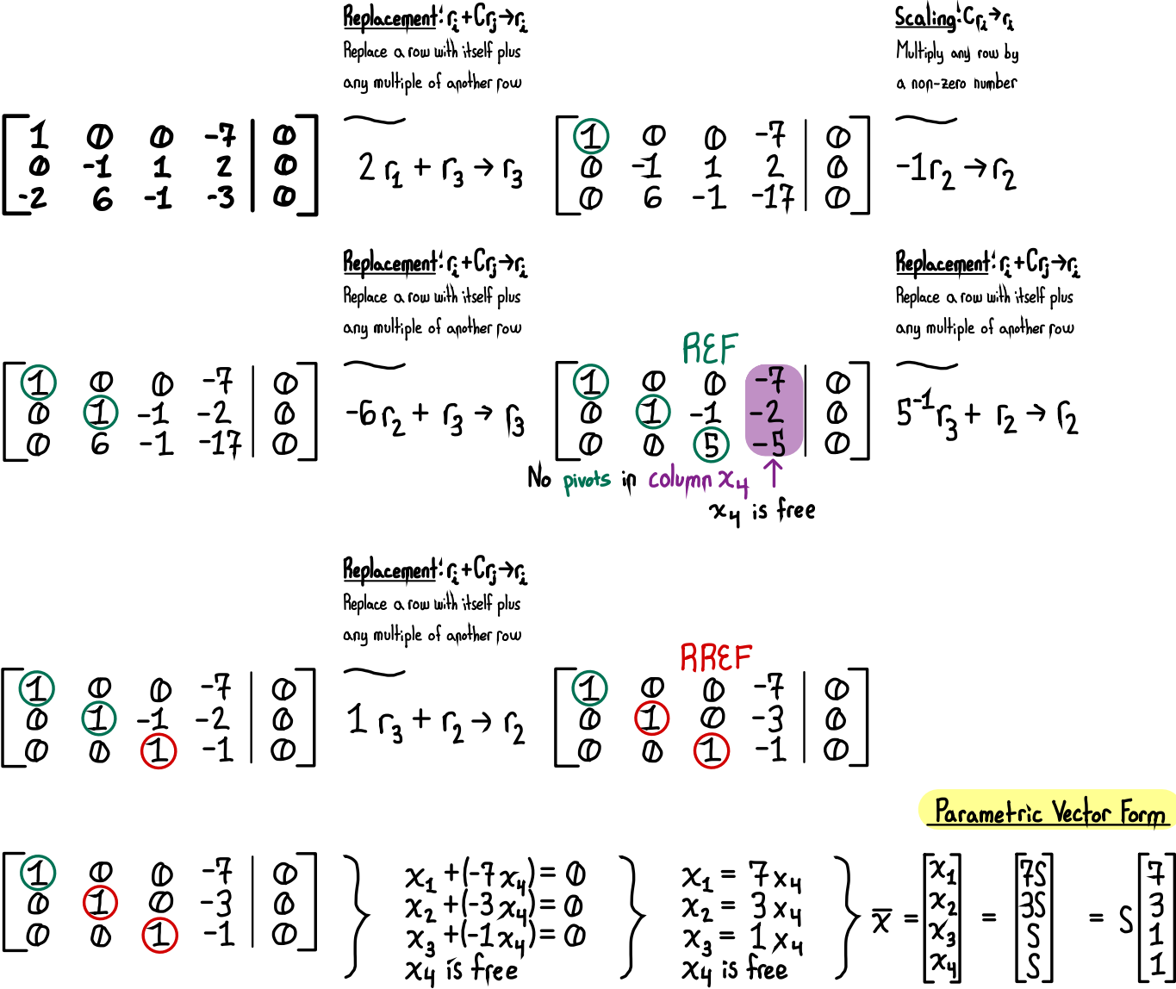
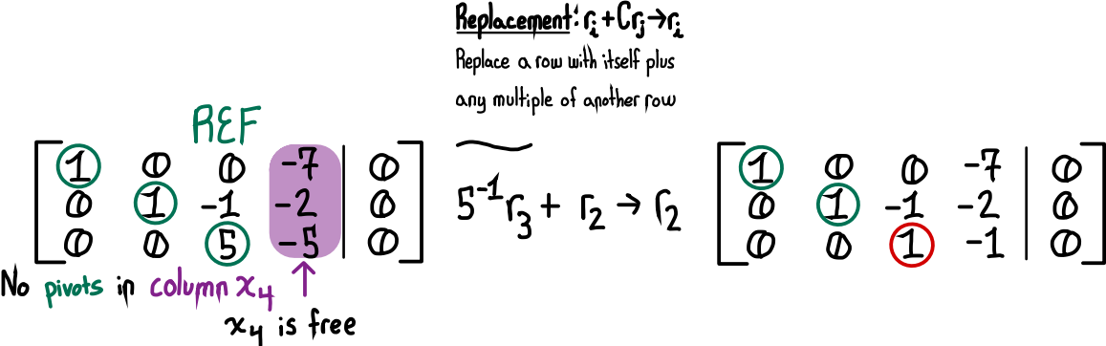
Step 4 - REDO

Slide 10
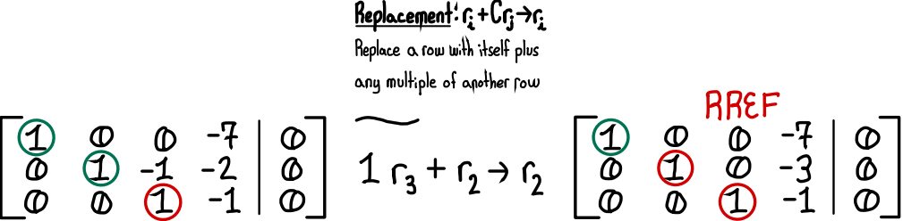
Step 4 - REDO

Slide 11
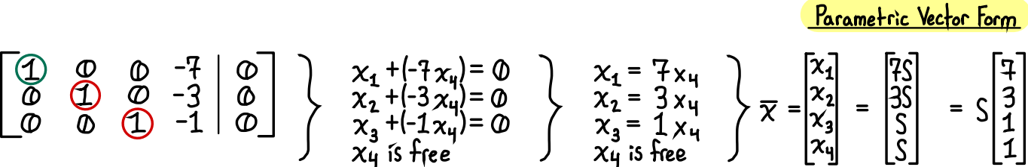
Step 5 - REDO

Slide 12

ALL TOGETHER

