Slide 1
Final Project Proposal: 8 Ball Pool
Class: ICS3U1
By: Matthew, Daniel and Elgin
Last Updated: January 11, 2016
Date Started: December 16, 2015
Date Delivered: To be determined

Slide 2
Customer Requirements
Our clients are the teacher and the students in our class.
- A cue that is controlled by the mouse.
- The orientation (or direction) of the cue will be determined by the location of the mouse.
- When the left button on the mouse is clicked and dragged, the cue will move backwards. When the left mouse button is released, the cue will collide with the cue ball and transfer speed and direction values to the ball depending on how far the cue was pulled back as well as it’s orientation.
- Once the cue ball is moving, it will collide with other balls in it’s direct line and will in turn transfer the appropriate speed and direction values to the other balls depending on the impact location and prior speed of the cue ball. These rules will apply to any subsequent collision between any other balls on the pool table.
- if any ball falls into a pocket or is “pocketed”, then the ball will be removed from the playing surface and the appropriate score/game scenario will be recorded.
- The game will operate in accordance to the 8 ball pool format. After the initial break by one player, the first ball pocketed will determine which player is assigned to solid or striped balls. If a player pockets the black ball (“8 ball”) is pocketed at any time, the other will win the game. The first player to pocket all balls of the type they are assigned to, and then pocket the 8 ball last will win the game.

Slide 3
Project Timeline
 | Requirements | Design | Implementation | Testing | Deployment
Proposed | Dec 15-18 | Jan 4-8 | Jan 9-16 | Jan 17-19 | Jan 20-33
Completed | Dec 18-Jan 4 | Jan 4-11 | To be determined | To be determined | To be determined

Slide 4
Design Proposal
The game will consist of a cue that the players will control with their mouse, and use varying direction and amount of force in order to move a cue ball which will strike other balls in order to pocket them. The end goal is to pocket all of the balls assigned to the player, with the final ball being the black, or cue ball.
The physics and game play elements (such as dragging the cue and the physics of the ball movements) will be original.
In addition the menu and other graphical elements will all be original work
The program will use libraries such as “math” or “sin”
Resources:
https://www.pygame.org/docs (used as a reference to make sure function parameters and return values are in the correct positions.
http://www.purplemath.com/modules/distform.htm (distance formula)
http://stackoverflow.com/questions/10473930/how-do-i-find-the-angle-between-2-points-in-pygame (Find the angle between two given points)

Slide 5
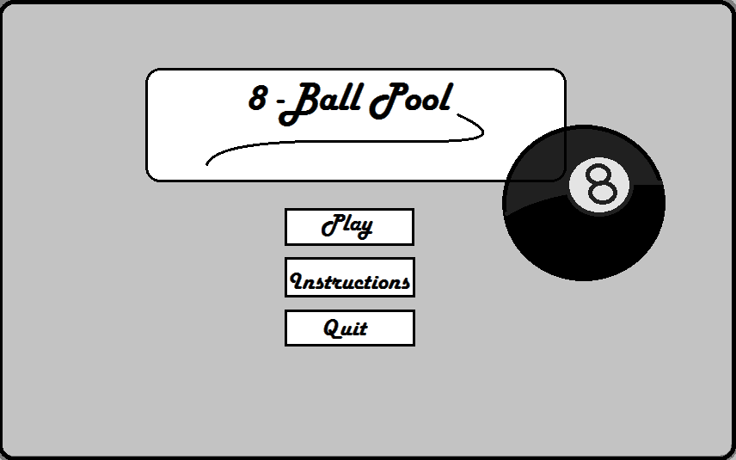
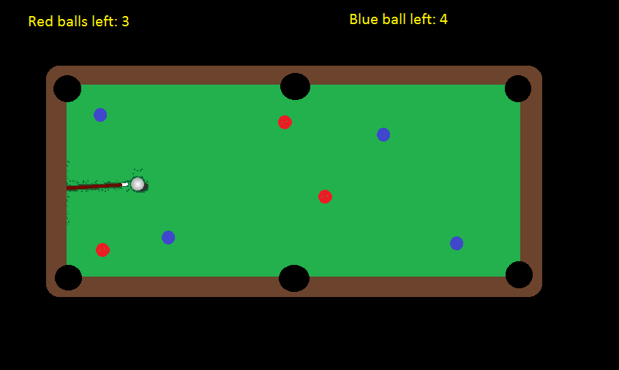
Design Proposal – Mockups
Main menu
Gameplay

Slide 6
Design Proposal – IPO Chart
Input | Process | Output
Menu Users Choices; Choice A – Start Playing Choice B – How To Play Choice C – Quit Game | Start Menu If Choice A: Play 1v1 by taking turns using the mouse If Choice B: A guide on how to play If Choice C: Quits Game | Position of each ball on the table Position and speed of the cue based on user input Direction and speed of each ball based on the initial strike by the cue, as well as any subsequent collisions with other objects on the playing surface. The current number of ball pocketed (score) and number of balls left to pocket per player

Slide 7
Design Proposal – Stepwise Refinement
move_cue()
Move_balls()
8 Ball Pool
main_menu()
display_score( )

Slide 8
Design Proposal - Flowcharts
Start
Menu ( )
Move ( )
move_cue ( )
move_balls ( )
Display ( )
display_score()
Stop

Slide 9
Menu ( )
Print (“Welcome to 8 Ball Pool”)
Print (“Play”)
Print (“Instructions”)
Print (“Quit Game”)
Display ( )
If Choice == (“Start Game”)
If Choice == (“Tutorial”)
pygame.quit ( )
Stop
Move ( )
Print (“All the instructions”)

Slide 10
menu()
Print menu()
Get_user_choice()

Slide 11
move_cue()
Draw_pool_table()
Get_cue_position()
Draw_cue()

Slide 12
move_balls()
Get_ball_positions()
Draw_pool_table()
Get_ball_speed_and_direction()
Determine_if_ball_pocketed()
Draw_balls()

Slide 13
display_score()
determine_score()
draw_score()

Slide 14
Design Proposal - UML Diagrams
Ball
Int Speed Int Direction String Colour
move_ball()
Pocket()
Int location()
check_for_ball_contactl()

Slide 15
Resource Allocations
Task | Responsibility | Description
Daniel | IPO Chart Flowcharts Proposal pygame | Created an IPO Chart to use for making the flowchart Constructed a variety of flowcharts to use for creating the pygame Created Project Timeline Created graphics for the pygame (such as pool table, balls, etc.) Helped with integrating ideas into the game
Matthew | Flowcharts UML Diagrams Proposal pygame | Helped with making flowcharts Created the required UML Diagrams Created design proposal Created Mockups Created Customer Requirements Created a lot of the pygame
Elgin | Step Wise Graphics Pygame Flowcharts | Created stepwise refinement Created the Menu to the pygame Helped with design proposal Helped with flowcharts Created ideas to be used Helped with logic Created graphics for the game

