Slide 1
Introduction to Java
Università di Modena e Reggio Emilia
Prof. Nicola Bicocchi (nicola.bicocchi@unimore.it)

Slide 2
Java Timeline
1991: SUN develops a programming language for cable TV set-top boxes
1996: Java 1
1996: Netscape supports Java. Popularity grows
1998: Java 2 (libraries)
2005: Java 5 (major enhancements)
2014: Java 8
https://en.wikipedia.org/wiki/Java_version_history

Slide 3
Java Features
Platform independence (portability)
Write once, run everywhere
Translated to intermediate language (bytecode)
Run time loading and linking
Automatic garbage collection
Robust language, i.e. less error prone
Strong type model and no pointers
Exceptions as a pervasive mechanism
Shares many syntax elements w/ C++
Learning curve is less steep for C/C++ Programmers
Pure OO language

Slide 4
Java Programs
Application
It’s a common program, similar to C/C++
Runs through the Java interpreter (Java) of the installed Java Virtual Machine (JVM)
Servlet (web server)
Java program that extends the capabilities of a Web server
Java counterpart to other dynamic Web content technologies such as PHP and ASP.NET
Applet (deprecated)
Java code dynamically downloaded
Execution is limited by “sandbox”

Slide 5
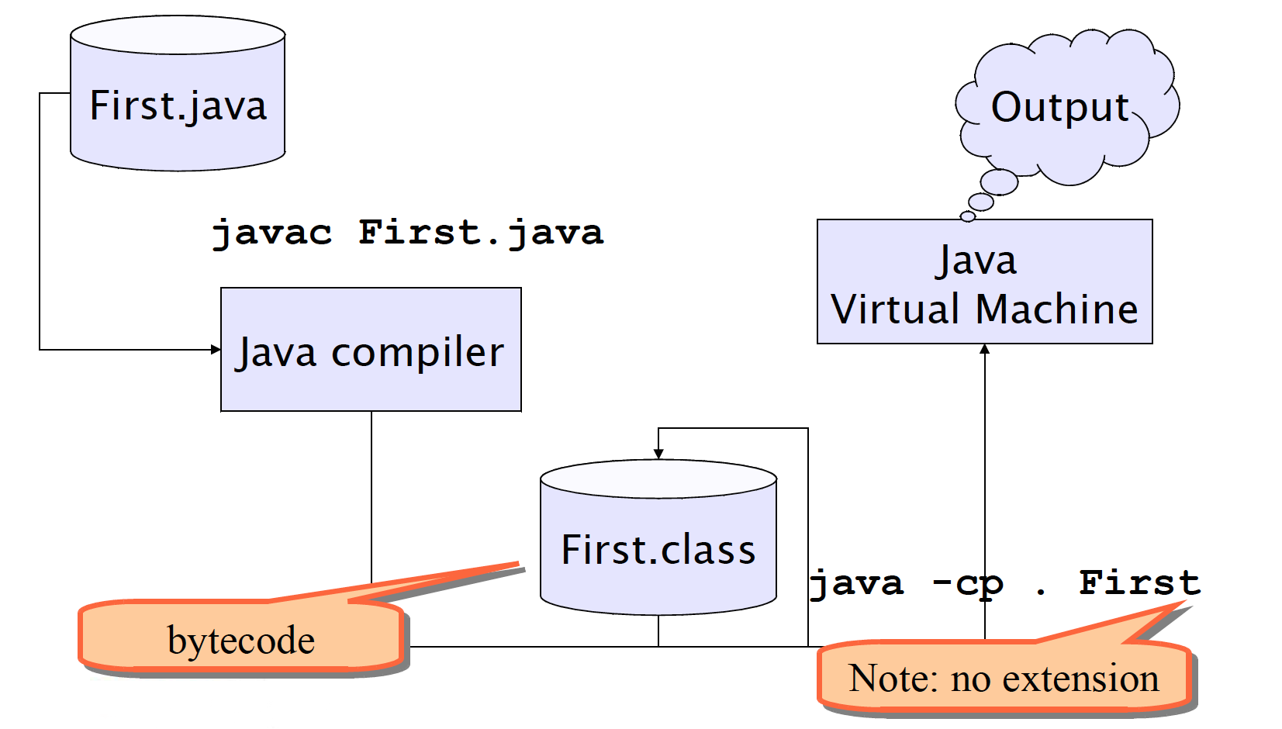
Building and running

Slide 6
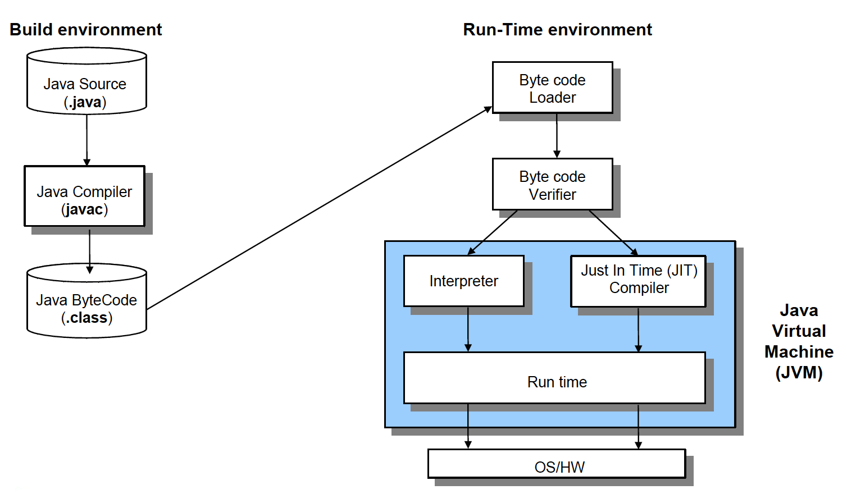
Building and running

Slide 7
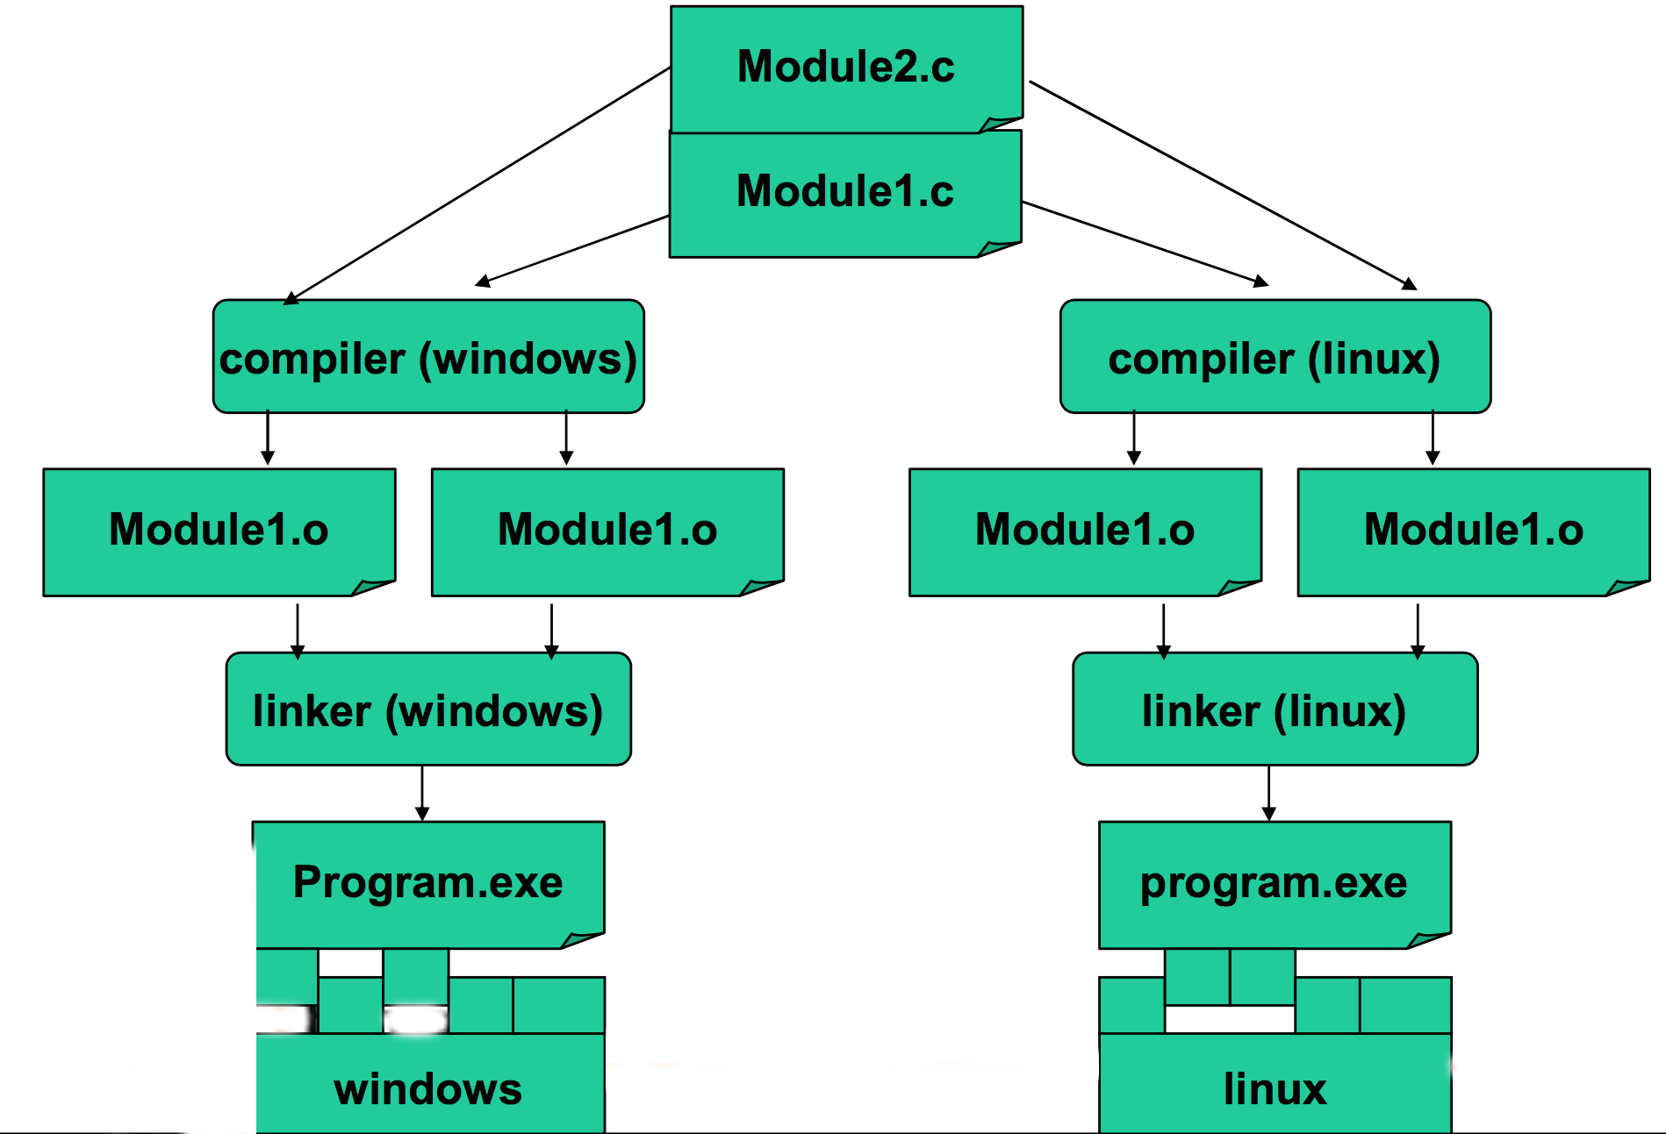
C (Compiled)

Slide 8
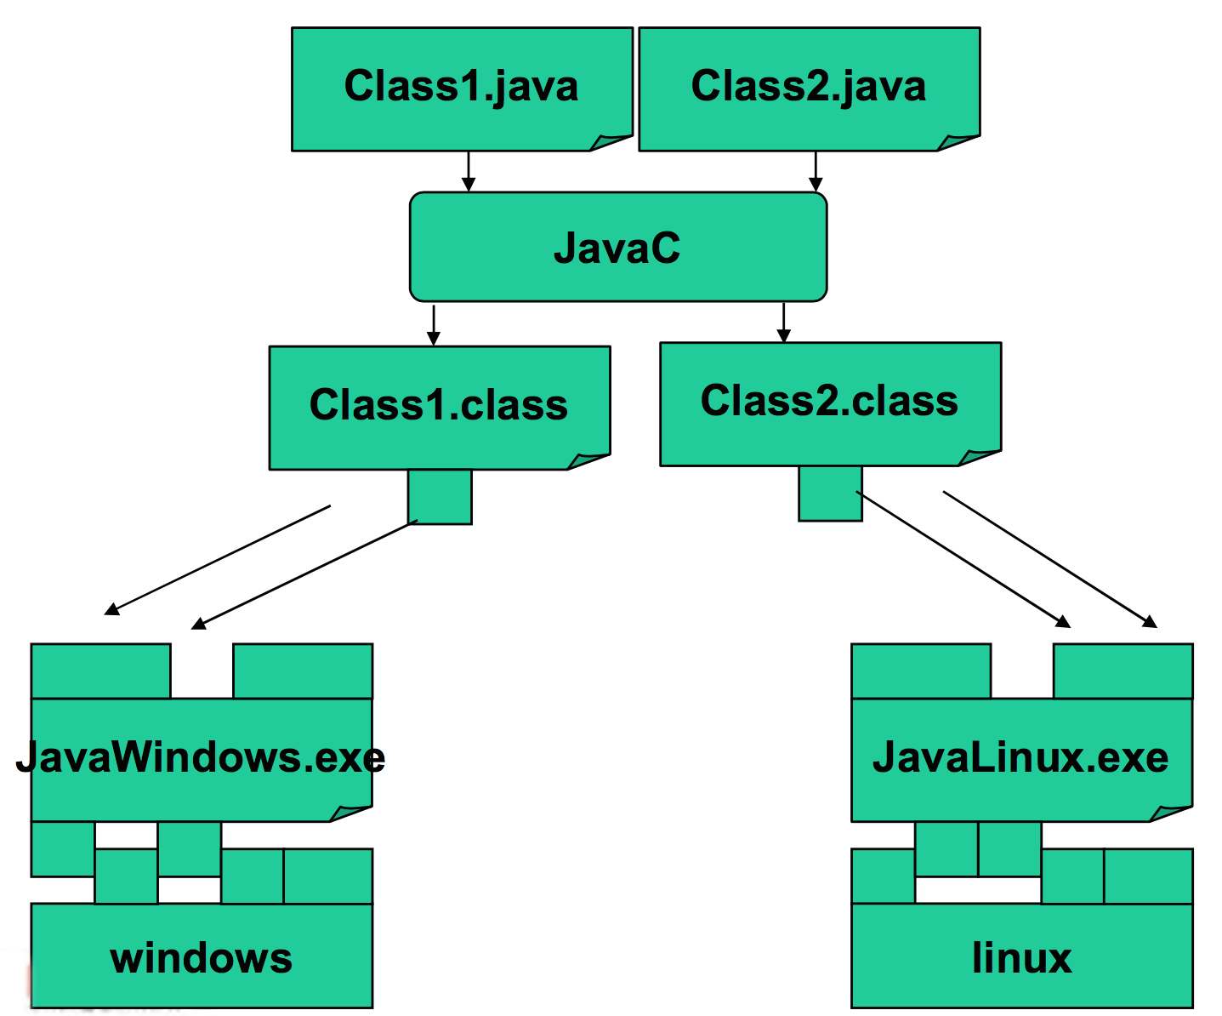
Java (Interpreted)

Slide 9
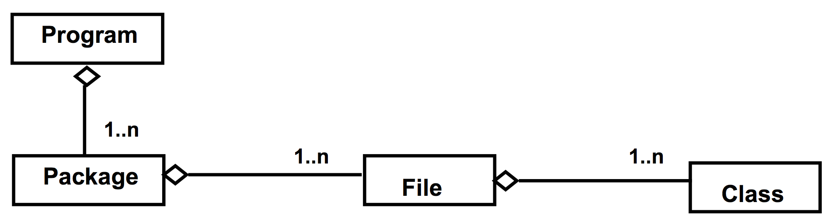
Program, files and classes
A program is made of one or more packages, containing one or more files
A file contains one public class and, optionally, multiple private classes. The file name must be equal to the public class name.

Slide 10
public static void main(String[] args)
In Java there are no functions, but only methods within classes
The execution of a Java program starts from a special method:
public static void main(String[] args) {
…
}

Slide 11
Basic concepts

Slide 12
Comments
C-style comments (multi-lines)
/* this comment is so long
that it needs two lines */
Comments on a single line
// comment on one line

Slide 13
Code blocks and Scope
Java code blocks are the same as in C language
Each block is enclosed by braces { } and starts a new scope for the variables
Variables can be declared both at the beginning and in the middle of block code
for (int i=0; i<10; i++){
int x = 12; ... int y;
...
}

Slide 14
Control statements
Same as C
if-else
switch-case
while
do-while
for
break
continue

Slide 15
Passing Parameters
Parameters are always passed by value
...they can be primitive types or object references
Note well: only the object reference is copied not the value of the object

Slide 16
Passing Parameters
public class Parameters {
public static void main(String[] args) {
Point p1 = new Point(0, 0);
Point p2 = new Point(10, 10);
System.out.println(p1);
System.out.println(p2);
swap(p1, p2);
System.out.println(p1);
System.out.println(p2);
}
public static void swap(Point p1, Point p2) {
Point tmp = p1;
p1 = p2;
p2 = tmp;
}
}
main() stack
heap
swap() stack
p1
(0, 0)
p1
p2
(10, 10)
p2

Slide 17
Passing Parameters
public class Parameters {
public static void main(String[] args) {
Point p1 = new Point(0, 0);
Point p2 = new Point(10, 10);
System.out.println(p1);
System.out.println(p2);
move(p1, p2);
System.out.println(p1);
System.out.println(p2);
}
public static void move(Point p1, Point p2) {
p1.move(20, 20);
p2.move(30, 30);
}
}
main()
move()
p1
(0, 0)
p1
p2
(10, 10)
p2

Slide 18
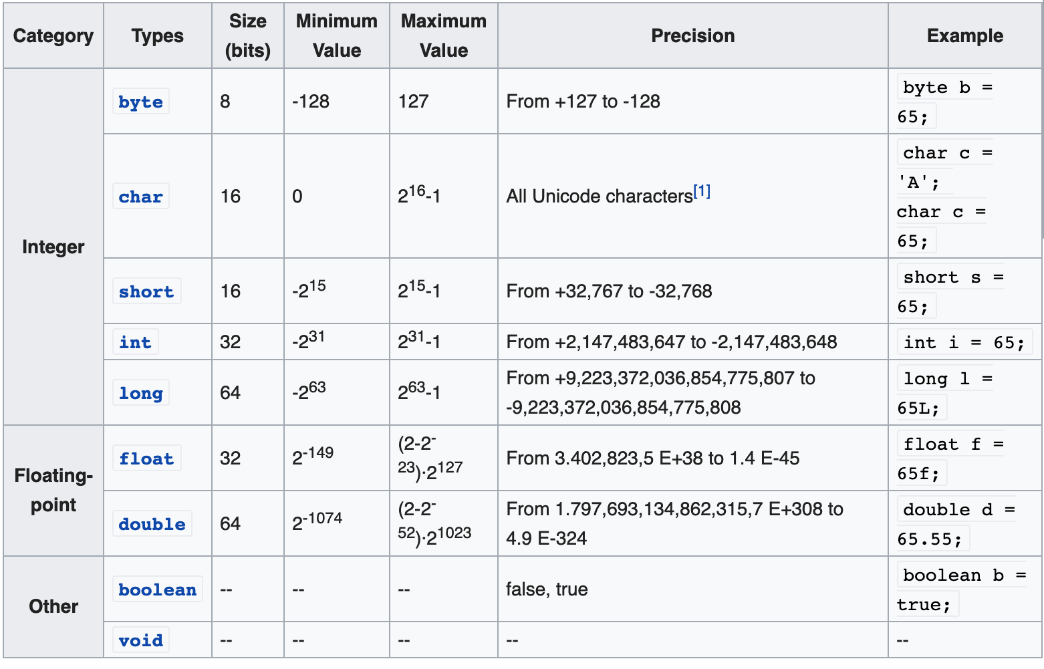
Primitive types

Slide 19
Constants
The final modifier
final float PI = 3.1415;
PI = 16.0; // ERROR, no changes allowed
Use uppercases (coding conventions)

Slide 20
Operators (integer and floating-point)
Operators follow C syntax:
arithmetical + - * / %
Relational == != > < >= <=
bitwise & | ^ ! >> <<
Logical && || ! ^
Assignment = += -= *= /= %= &= |= ^=
Increment ++ --
Chars can be treated as integers (e.g. switch)
Logical operators work ONLY on booleans. int is NOT considered a boolean value like in C

Slide 21
Switch with chars
public class Test {
public static void main(String args[]) {
char grade = ‘A';
switch(grade) {
case 'A' :
System.out.println("Excellent!");
break;
case 'B' :
case 'C' :
System.out.println("Well done");
break;
case 'D' :
System.out.println("You passed");
case 'F' :
System.out.println("Better try again");
break;
default :
System.out.println("Invalid grade");
}
System.out.println("Your grade is " + grade);
}
}

Slide 22
Coding Conventions
class ClassName {
final double PI = 3.14;
private int attributeName;
public void methodName {
int var;
if (var == 0) {
/* this is a comment*/
}
}
}
In Eclipse: CTRL+A, CTRL-I (Auto Indent)

Slide 23
Strings

Slide 24
String
No primitive type to represent string
C
char s[] = “literal”
Equivalence between string and char arrays
Java
char[] != String
java.lang.String (see Java API)

Slide 25
String
Strings are immutable. the JVM can optimize the amount of memory allocated for them by storing only one copy of each literal String in the pool. This process is called interning.
When we create a String variable and assign a value to it, the JVM searches the pool for a String of equal value. If found, the Java compiler will simply return a reference to its memory address, without allocating additional memory.
If not found, it’ll be added to the pool (interned) and its reference will be returned.
String first = "Baeldung";
String second = "Baeldung";
System.out.println(first == second); // True

Slide 26
String
Let’s create two different objects using new and check that they have different references:
String first = new String("Baeldung");
String second = new String("Baeldung");
String third = "Baeldung";
System.out.println(first == second); // False
System.out.println(first == third); // False

Slide 27
String
String: an object storing a sequence of text characters.
Creating a string:
String name = "text";
String name = expression;
Examples:
String name = "Marty Stepp";
int x = 3;
int y = 5;
String point = "(" + x + ", " + y + ")";

Slide 28
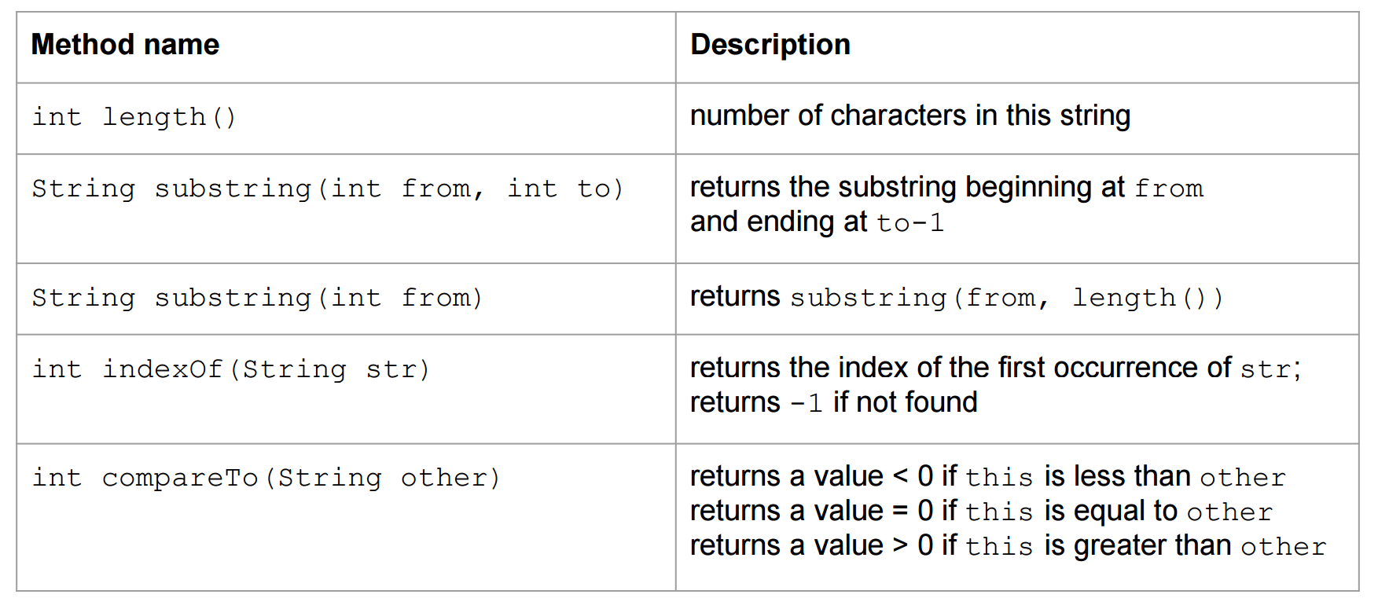
String

Slide 29
The equals method
Objects (not only Strings) are compared using a method named equals.
String s1,s2;
if (s1 == s2) {
System.out.println(”s1 and s2 point to the same String object");
}
if (s1.equals(s2)) {
System.out.println("The strings are equal!");
}

Slide 30
Operator +
It is used to concatenate 2 strings
“This string” + “is made by two strings”
Works also with other types (automatically converted to string)
System.out.println(”pi = ” + 3.14); System.out.println(”x = ” + x);

Slide 31
StringBuffer
Fast way for concatenating Strings.
A thread-safe, mutable sequence of characters. A string buffer is like a String, but can be modified. At any point in time it contains some particular sequence of characters, but the length and content of the sequence can be changed through certain method calls. (insert(), append(), delete(), reverse(), toString(),…)

Slide 32
StringBuffer
// string concatenation using +
String str = new String (“GNU is not ”);
str += “Unix”;
// string concatenation using stringbuffer
// each concatenation does not create a new String object
StringBuffer str = new StringBuffer ("Stanford ");
str.append("Lost!!");

Slide 33
Array

Slide 34
Array
An array is an ordered sequence of variables of the same type which are accessed through an index
Can contain both primitive types or object references (no actual objects!)
Array size must be defined at creation time (cannot change afterwards)

Slide 35
Array declaration
An array reference can be declared with one of these equivalent syntaxes
int[] v, int v[]
Point[] v, Point v[]
An array is an Object, must be created using new, and it is stored in the heap (as all objects)
Array declaration (e.g., int[] v) allocates memory space for a reference, whose default value is null

Slide 36
Array creation
Using the new operator
int[] v = new int[256];
Using static initialization, filling the array with values
int[] v = {2,3,5,7,11,13}

Slide 37
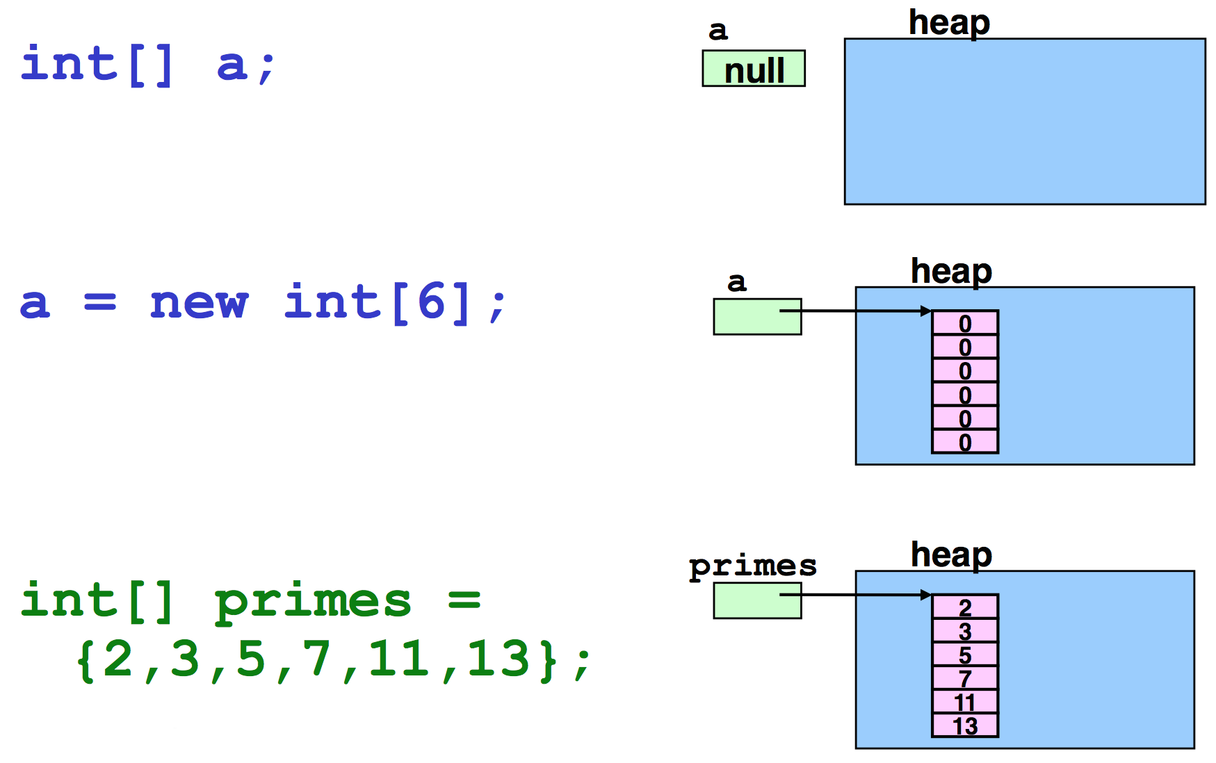
Example – Primitive types

Slide 38
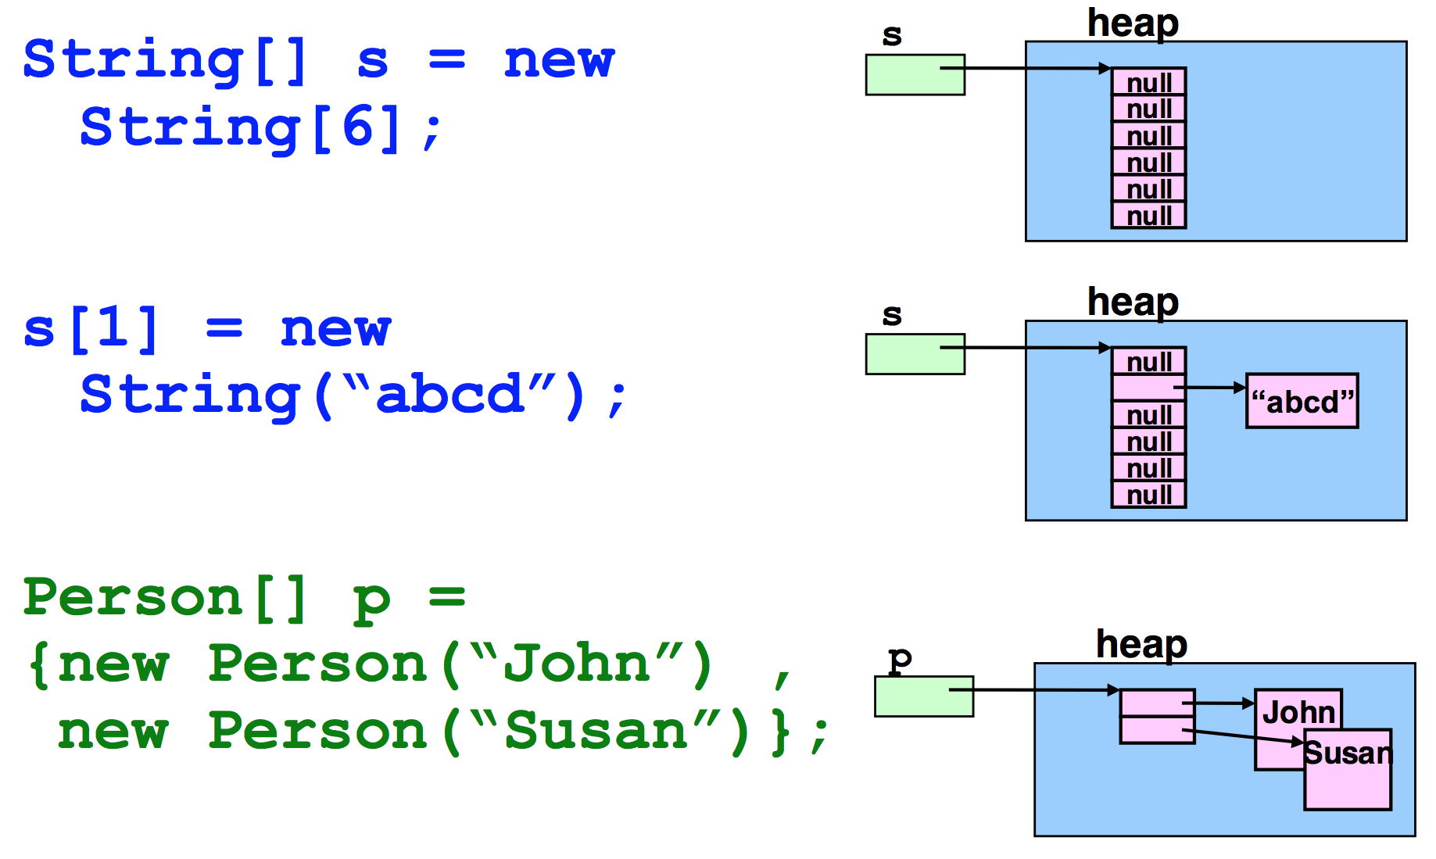
Example – Object reference

Slide 39
Operations on arrays
Elements are selected with brackets [ ] (C-like) but Java makes bounds checking
int[] v = new int[16]
System.out.println(v[20])
ArrayIndexOutOfBoundsException (runtime!)
Array length (size of the array, not number of contained elements) is given by the attribute length
for (int i=0; i < v.length; i++) v[i] = i;

Slide 40
Operations on arrays
An array reference is not a pointer to the first element of the array
It is a reference to the array object
Arithmetic on pointers does not exist in Java

Slide 41
Operations on arrays
New loop construct: for( Type var : set_expression )
set_expression can be either
an array
a class implementing Iterable (see Java Collection Framework)
The compiler can automatically loop with correct indexes
less error prone

Slide 42
For each
String[] args;
/* implicit index */
for(String arg: args){
System.out.println(arg);
//...
}
/* explicit index */
for(int i = 0; i < args.length; i++){
System.out.println(args[i]); //...
}

Slide 43
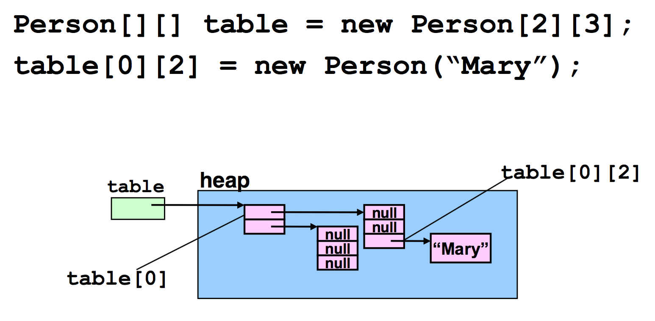
Multidimensional array
Implemented as array of arrays

Slide 44
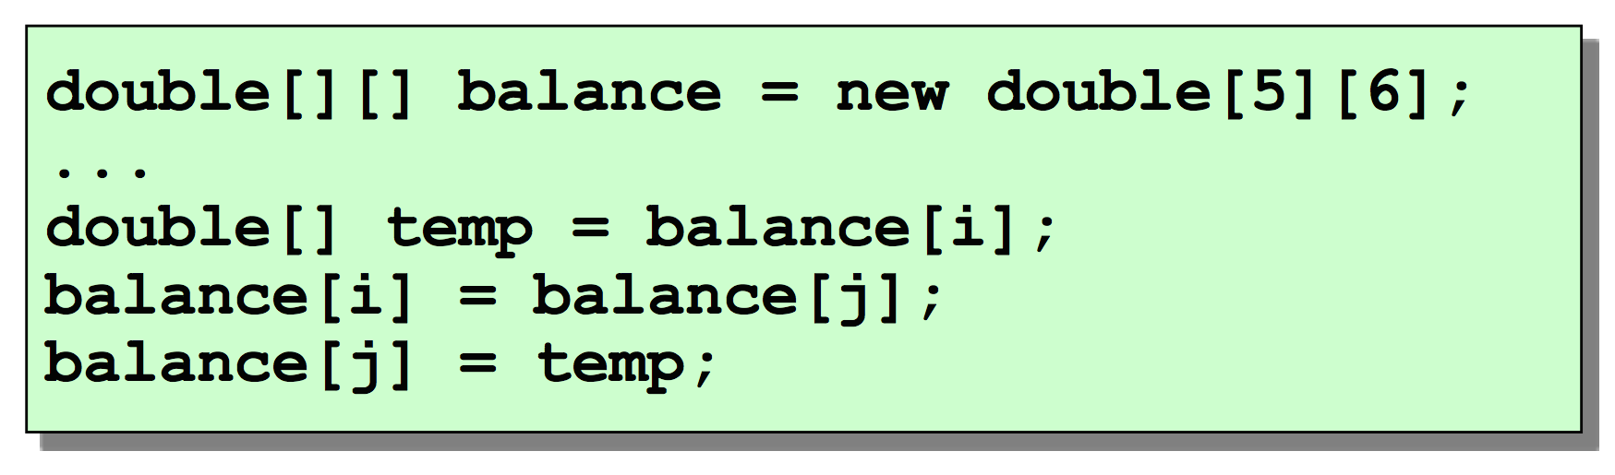
Rows and columns
As rows are not stored in adjacent positions in memory they can be easily exchanged

Slide 45
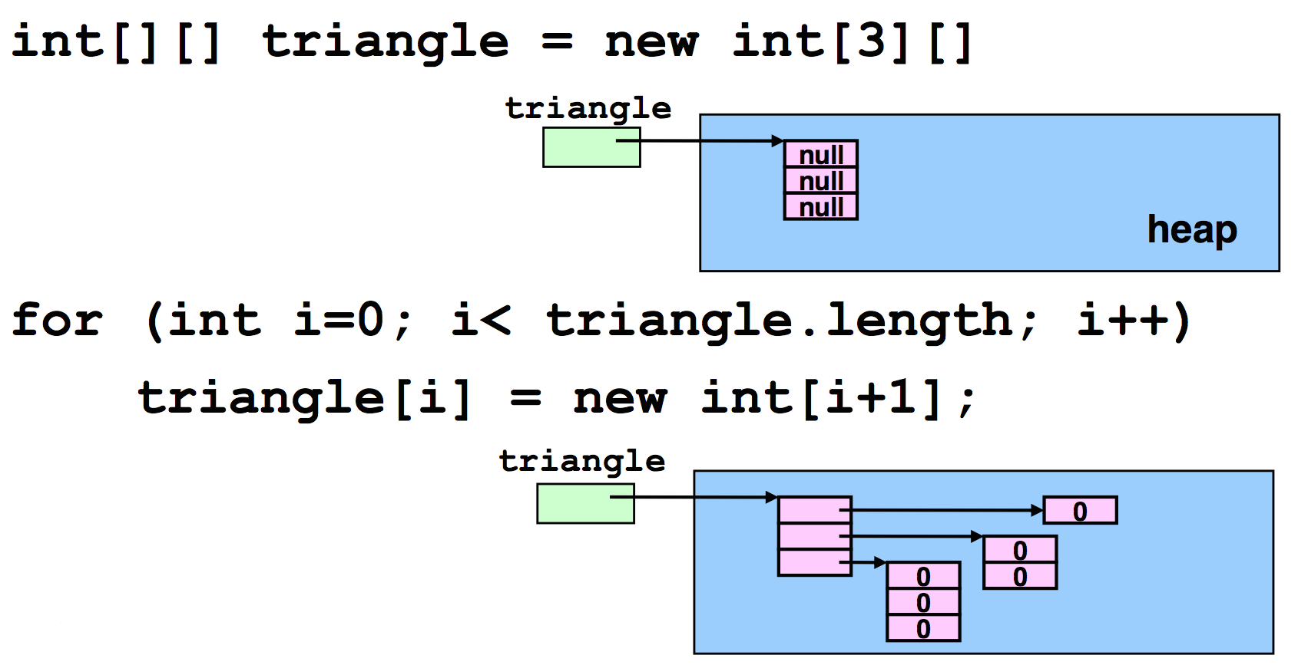
Rows with different length
􏰀A matrix (bidimensional array) is indeed an array of arrays

Slide 46
Classes

Slide 47
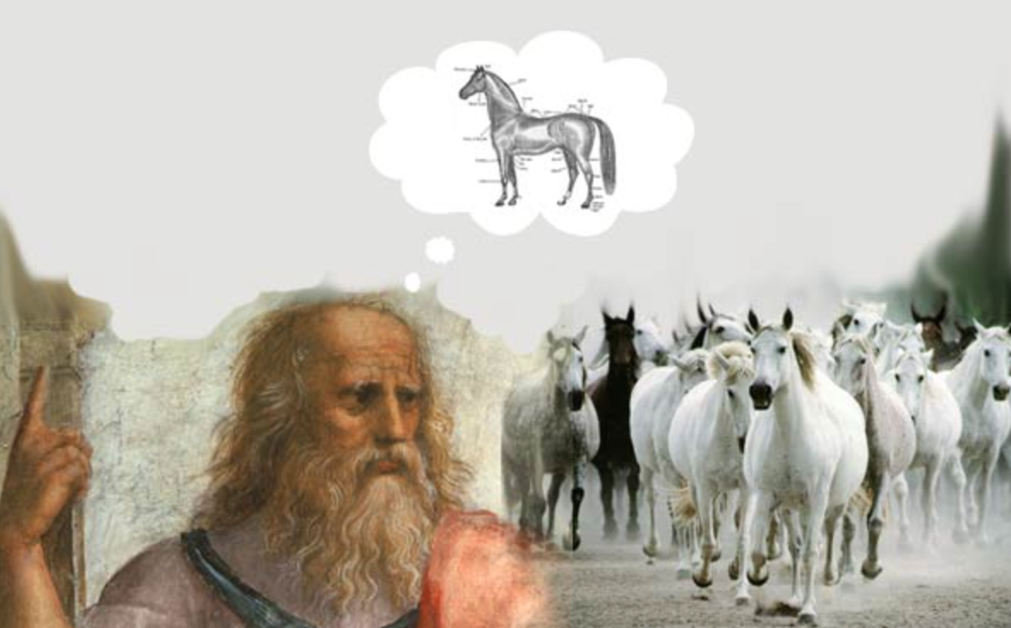
Class
Descriptor of a class of objects (Platonic idea)

Slide 48
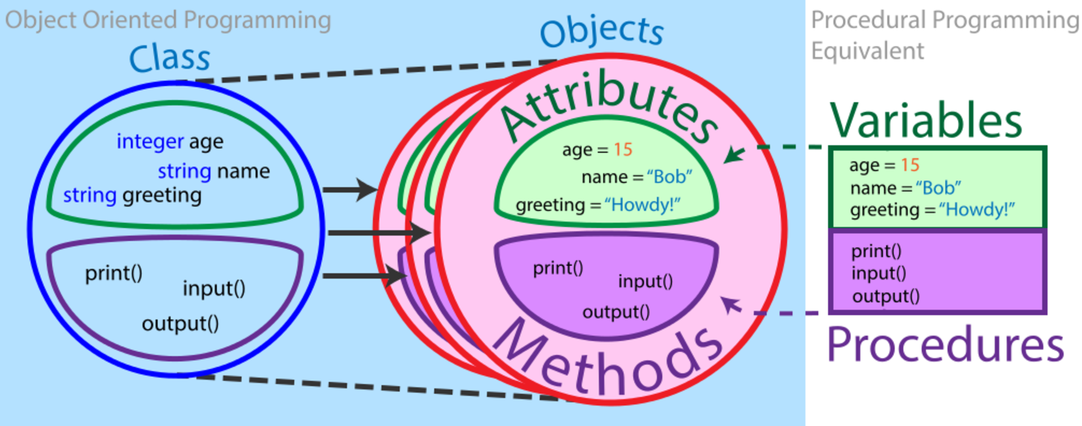
Class

Slide 49
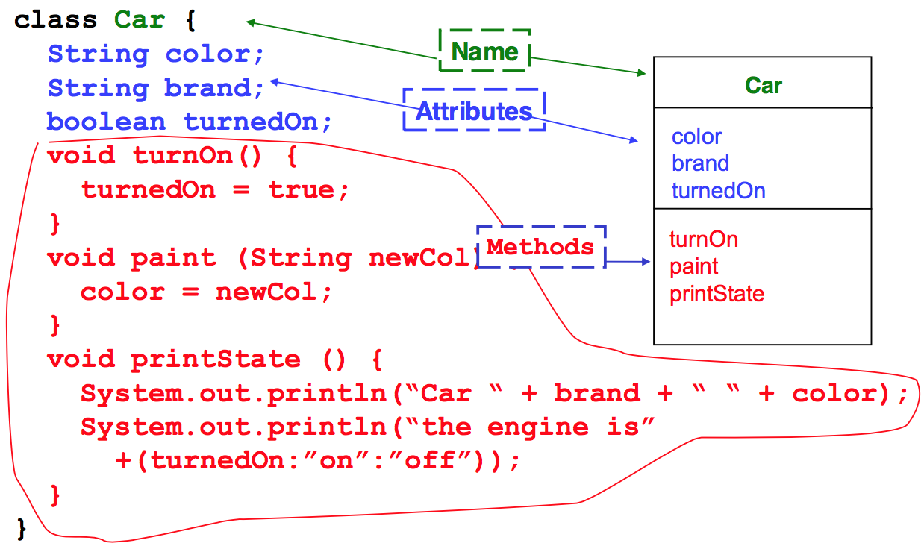
Definition

Slide 50
Information hiding
public class Car {
public String color;
public void paint(String newColor) {
color = newColor;
}
}
public class App {
public static void main(String[] args) {
Car c = new Car();
c.color = “red”; /* Works but unsafe! */
}
}

Slide 51
Information hiding
public class Car {
private String color;
private void paint(String newColor) {
color = newColor;
}
}
public class App {
public static void main(String[] args) {
Car c = new Car();
c.color = “red”; /* Compiler error*/
c.paint(“red”); /* OK, Safe! */
}
}

Slide 52
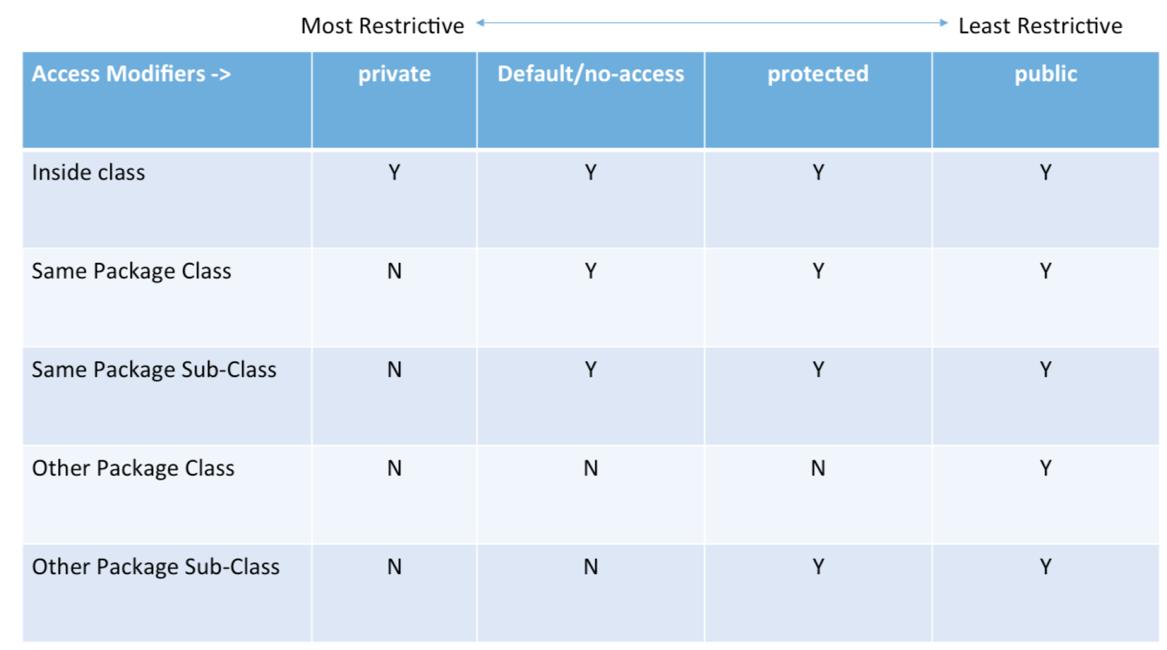
Visibility

Slide 53
Method Overloading
􏰀Method may have parameters
In a Class there may be different methods with the same name but different signatures
􏰀A signature is made by:
Method name
Ordered list of parameters types
􏰀The method whose parameters types list matches, is then executed

Slide 54
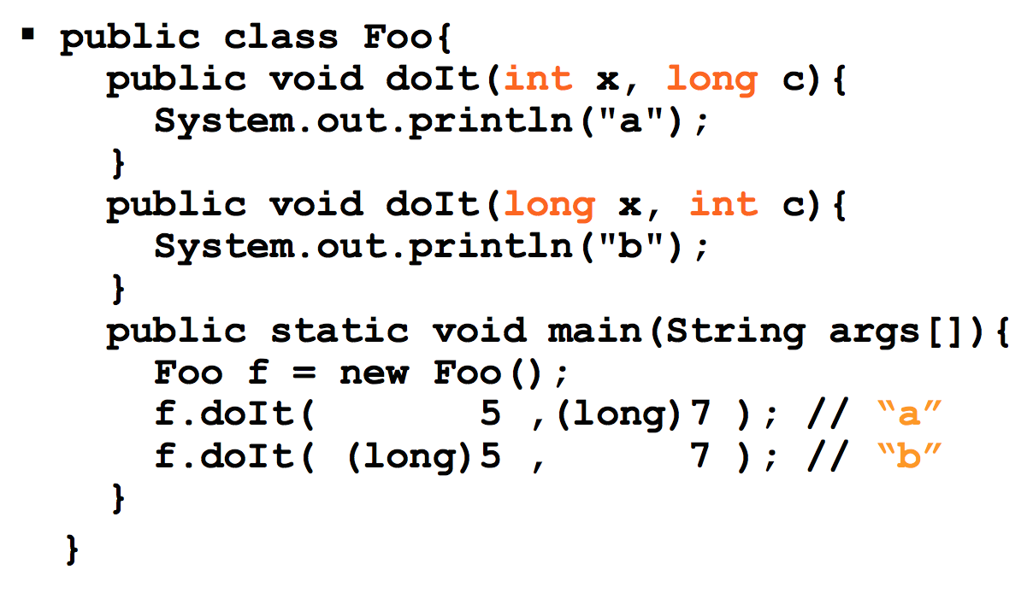
Method Overloading

Slide 55
Objects
􏰀An object is identified by:
Its class, which defines its structure in terms of attributes and methods
Its state (attributes values)
An internal unique identifier
try: System.out.println(new int[16]);
􏰀Zero, one or more reference can point to the same object

Slide 56
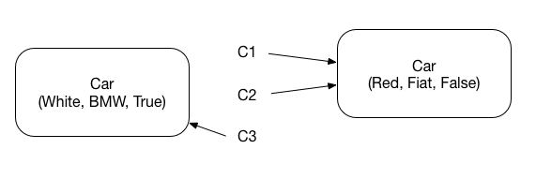
Objects creation
􏰀Creation of an object is made with the keyword new
􏰀It returns a reference to the piece of memory containing the created object
Car c1 = new Car(Red, Fiat, False);
Car c2 = c1;
Car c3 = new Car(White, BMW, True)

Slide 57
The keyword new
􏰀Creates a new instance of the specific Class, and allocates the necessary memory in the heap
􏰀Calls the constructor method of the object (a method without return type and with the same name of the Class)
􏰀Returns a reference to the new object created
􏰀Constructors can have parameters
String s = new String();
String s = new String(“ABC”);

Slide 58
Constructors
􏰀Constructor method contains operations we want to execute on each object as soon as it is created (make sure attributes are always initialized!)
􏰀Overloading of constructors is often used
􏰀If a Constructor is not declared, a default one (with no parameters) is defined. If a constructor with parameters is defined, the default one is disabled!

Slide 59
Constructors
public class Car {
private String color;
public void paint(String newColor) {
color = newColor;
}
/* this is a constructor */
public Car(String c) {
color = c;
}
public static void main(String[] args) {
Car c = new Car(“red”);
}
}

Slide 60
The keyword this
􏰀It can be useful in methods to distinguish object attributes from local variables (this represents a reference to the current object)
class Car{
String color;
...
public Car(String color) {
this.color = color;
}
}
Methods accessing attributes or methods of the same object do not need using object reference (this implied)

Slide 61
The keyword this
􏰀It is worth noting that, for reducing the number of errors in code, using the same name for method parameters and class attributes is a good pratice!
class Car{
String color;
...
public Car(String color) {
this.color = color;
}
public paint(String color) {
this.color = color;
}
}

Slide 62
Getters and Setters
􏰀Since attributes are usually kept private, methods for reading and writing them are frequently useful. These methods are called getters and setters.
class Car {
String color;
...
public String getColor() {
return color;
}
public void setColor(String color) {
this.color = color;
}
}

Slide 63
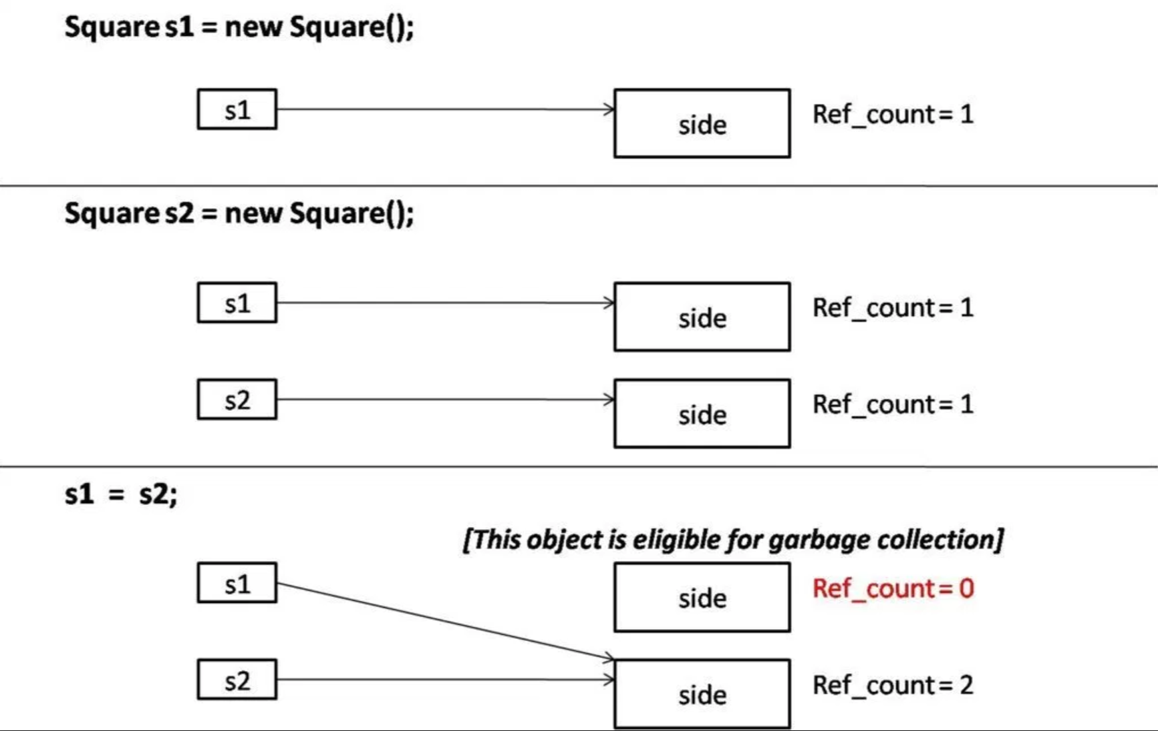
Objects Destruction
􏰀It is no longer a programmer concern, Java uses Garbage Collection (an automatic way for de-allocating unreferenced objects)

Slide 64
Combining dotted notations
􏰀Dotted notations can be combined
System.out.println(“Hello world!”);
System is a Class in package java.lang
Out is a (static) attribute of System referencing an object of type PrintStream (representing the standard output)
Println() is a method of PrintStream which prints a text line on the screen

Slide 65
Operations on references
Only the relational operators == and != are defined
Note well: the equality condition is evaluated on the values of the references and NOT on the values of the objects !
The relational operators tell you whether the references points to the same object in memory
􏰀Dotted notation is applicable to object references
􏰀There is NO pointer arithmetic

Slide 66
Package

Slide 67
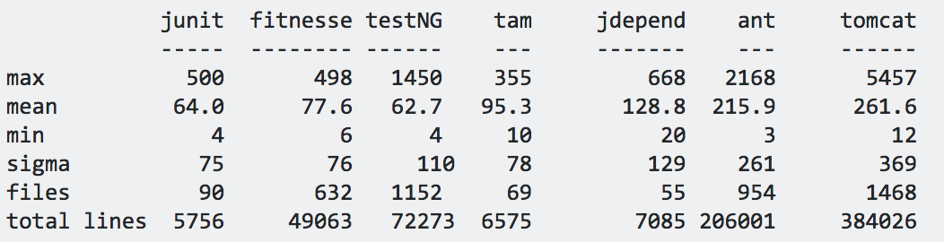
Motivation
􏰀Class is a better element of modularization than a procedure. But it is still little (100-200 lines on average)
􏰀For the sake of modularization, Java provides packages

Slide 68
Package
􏰀A package is a logic set of class definitions
􏰀These classes are all stored in the same directory
􏰀Each package defines a new scope (i.e., it puts additional bounds to visibility)
􏰀It’s then possible to use same class names in different packages without name conflicts

Slide 69
Package names
􏰀A package is identified by a name with a hierarchic structure (fully qualified name)
java.lang.String
java.util.Date
java.sql.Date
􏰀Conventions to create unique names (Internet name in reverse order)
it.unimo.myPackage

Slide 70
Package example
􏰀javax.swing
JWindow
JButton
JMenu
􏰀javax.swing.event (sub-package)
JComponent
JInternalFrame

Slide 71
Definition and usage
􏰀Definition: Package statement at the beginning of class file
package packageName;
􏰀Usage: Import statement at the beginning of class file
import packageName.className;
import java.awt.*;

Slide 72
Access to a class in a package
􏰀Referring to a method/class of a package
int i = myPackage.Console.readInt()
􏰀If two packages define a class with the same name, they cannot be both imported. If you need both classes you have to use one of them with its fully-qualified name:
import java.sql.Date; Date d1; // java.sql.Date java.util.Date d2 = new java.util.Date();

Slide 73
Package and scope
􏰀Scope rules also apply to packages
􏰀The interface of a package is the set of public classes contained in the package
􏰀Hints
Consider a package as an entity of modularization
Minimize the number of classes, attributes, methods visible outside the package

Slide 74
Static attributes and methods

Slide 75
Static attributes and methods
􏰀Represent properties (attributes) and behaviors (methods) which are common to all instances of an object
􏰀They exist even when no object has been instantiated!
􏰀They are defined with the static modifier
􏰀Access: ClassName.attributename|methodname

Slide 76
Static attributes and methods
Class Car {
static final int nWheels = 4;
/* … */
}
public static void main(String[] args) {
/* access to a static attribute */
int n = Car.nWheels;
…
/* access to a static method */
Double cos = Math.cos();
}

Slide 77
Wrapper Classes

Slide 78
Wrapper Classes
In an ideal OO world, there are only classes and objects
For the sake of efficiency, Java use primitive types (int, float, etc.)
Wrapper classes are object versions of the primitive types
They provide conversion operations among Strings, Objects, and primitive types

Slide 79
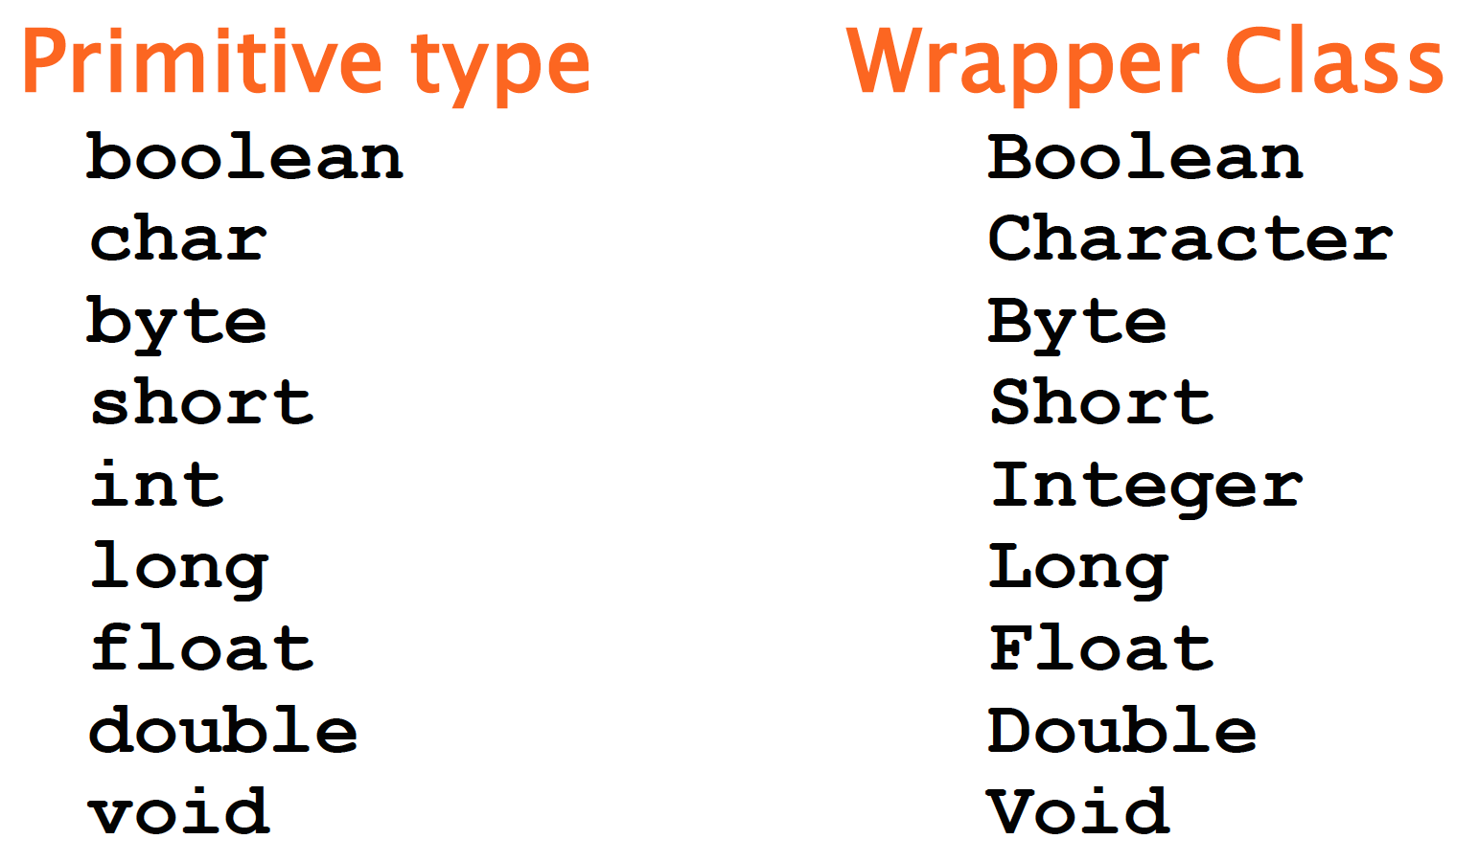
Wrapper Classes

Slide 80
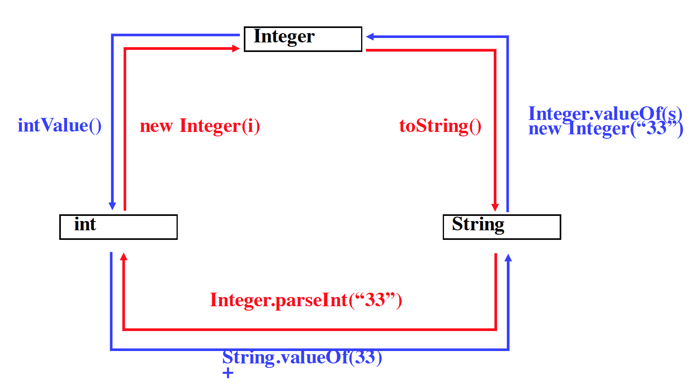
Conversions

Slide 81
Conversions, examples
Integer obj = new Integer(88);
String s = obj.toString();
int i = obj.intValue();
Int i = Integer.parseInt(“99”);
int k = (new Integer(99)).intValue();

Slide 82
Autoboxing
Auto boxing is the automatic conversion that the Java compiler makes between the primitive types and their corresponding object wrapper classes. For example, converting an int to an Integer, a double to a Double, and so on. If the conversion goes the other way, this is called Unboxing.
class AutoboxingExample {
public static void myMethod(Integer num){
System.out.println(num);
}
public static void main(String[] args) {
/* passed int (primitive type), it would be
* converted to Integer object at Runtime
*/
myMethod(2);
}
}

Slide 83
Unboxing
Auto boxing is the automatic conversion that the Java compiler makes between the primitive types and their corresponding object wrapper classes. For example, converting an int to an Integer, a double to a Double, and so on. If the conversion goes the other way, this is called Unboxing.
class UnboxingExample {
public static void myMethod(int num){
System.out.println(num);
}
public static void main(String[] args) {
Integer inum = new Integer(100);
/* passed Integer wrapper class object, it
* would be converted to int primitive type
* at Runtime */
myMethod(inum);
}
}

