Slide 1
Introduction to Object Oriented Programming
Università di Modena e Reggio Emilia
Prof. Nicola Bicocchi (nicola.bicocchi@unimore.it)

Slide 2
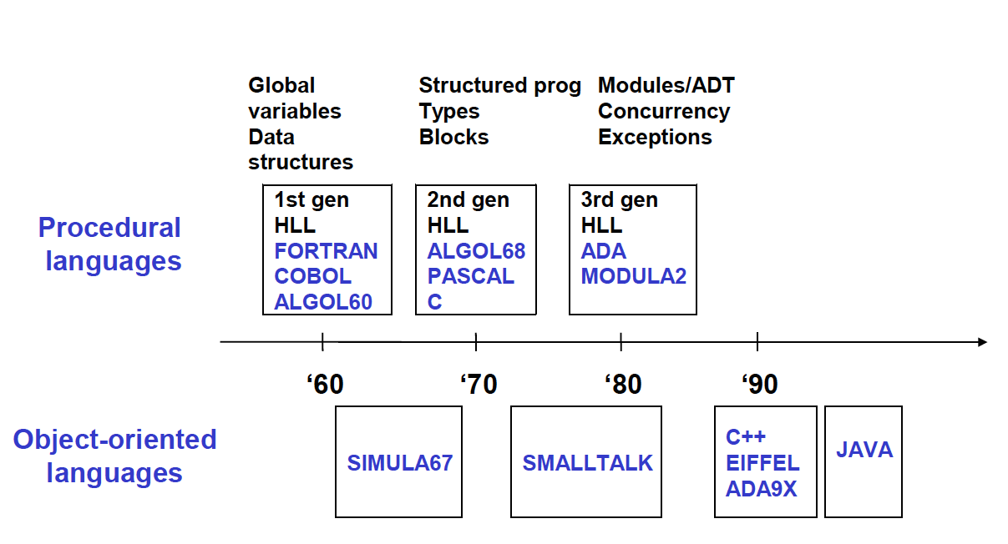
Languages Timeline

Slide 3
Why OOP?
Procedural programming (e.g., Pascal, C) are not suitable for building large software infrastructures
OOP addresses this issue and reduces development and maintenance costs for large and complex software projects

Slide 4
Limits of procedural programming
Reuse of code limited
Data and procedures (functions) are separate. This makes it complex to reuse existing code in other projects
Data protection limited
Unprotected data accessible from vast portions of the source code. After a certain stage, debug becomes a nightmare!
Unsuitable for large systems
Large scale projects require large scale working force (many teams). Unprotected data, separate from functions makes it hard to decompose the global effort

Slide 5
Software crisis (1970)
The causes of the software crisis were linked to the overall complexity of hardware and the software development process. The crisis manifested itself in several ways:
Projects running over-budget
Projects running over-time
Software was very inefficient
Software was of low quality
Software often did not meet requirements
Projects were unmanageable and code difficult to maintain
Software was never delivered

Slide 6
Software defects
The book "Code Complete" by Steve McConnell summarize error expectations as follows:
Industry Average: about 15 - 50 errors per 1000 lines of delivered code
Microsoft Applications: about 10 - 20 defects per 1000 lines of code during in-house testing, and 0.5 defect per 1000 lines of delivered code
The ‘cleanroom development’ technique developed by Harlan Mills achieve rates as low as 3 defects per 1000 lines of code during in-house testing and 0.1 defect per 1000 lines of delivered code
Notes:
The book "Code Complete" by Steve McConnell has a brief section about error expectations. He basically says that the range of possibilities can be as follows: (a) Industry Average: "about 15 - 50 errors per 1000 lines of delivered code." He further says this is usually representative of code that has some level of structured programming behind it, but probably includes a mix of coding techniques. (b) Microsoft Applications: "about 10 - 20 defects per 1000 lines of code during in-house testing, and 0.5 defect per KLOC (KLOC IS CALLED AS 1000 lines of code) in released product (Moore 1992)." He attributes this to a combination of code-reading techniques and independent testing (discussed further in another chapter of his book). (c) "Harlan Mills pioneered 'cleanroom development', a technique that has been able to achieve rates as low as 3 defects per 1000 lines of code during in-house testing and 0.1 defect per 1000 lines of code in released product (Cobb and Mills 1990). A few projects - for example, the space-shuttle software - have achieved a level of 0 defects in 500,000 lines of code using a system of format development methods, peer reviews, and statistical testing."

Slide 7
Some data…
Software | Lines of codes
Windows XP | 45M
Windows 10 | 55M
Debian 7.0 | 419M
Linux kernel 3.6 | 16M
Mac OS X 10.4 | 86M
OpenOffice | 1M
Gimp | 0.6M
* http://www.informationisbeautiful.net/visualizations/million-lines-of-code/

Slide 8
OOP Goal
Build software being:
Secure, re-usable, reconfigurable, flexible, documentable, extensible
Instead of focusing on algorithms, optimization and efficiency, OOP focus on programming techniques

Slide 9
Which direction?
The growing complexity of the reality we want to model requires approaches allowing:
During design, to consider software as a set of well-defined entities containing both data and functions and preventing other entities to access the same data

Slide 10
Procedural Programming
int vect[20];
void sort() { /* sort */ }
int search(int n){ /* search */ }
void init() { /* init */ }
// …
int i;
void main(){
init();
sort();
search(13);
}

Slide 11
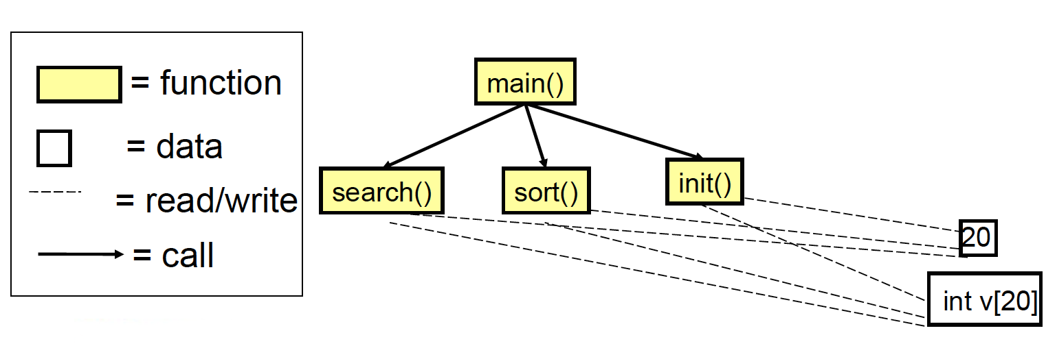
Modules and relationships

Slide 12
Issues
There is no syntactic relationship between:
Vectors ( int vect[20] )
Operations on vectors (search, sort, init)
There is no control over size:
for (i=0; i<=20; i++) { vect[i ]=0; };
Initialization
Actually performed?

Slide 13
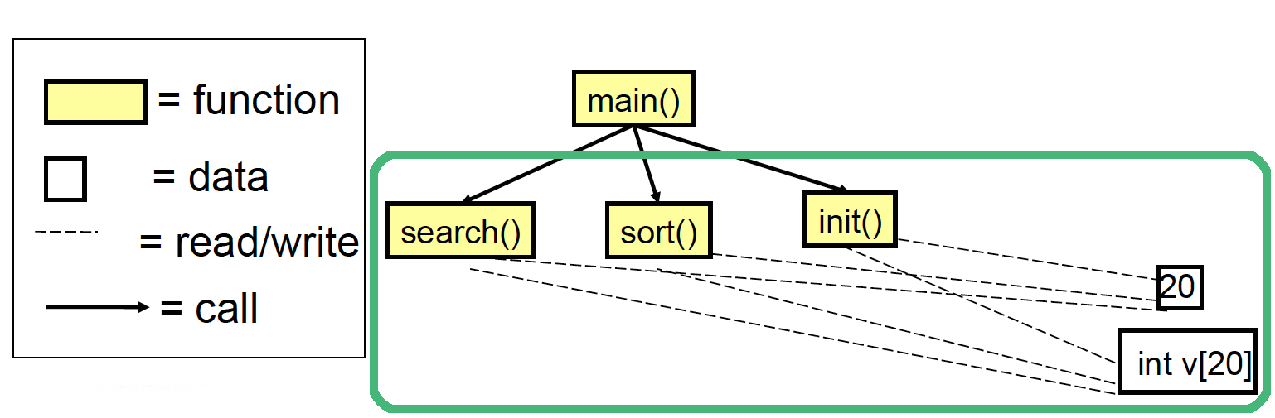
Issues
It’s not possible to consider a vector as a primitive and modular concept
Data and functions cannot be modularized properly

Slide 14
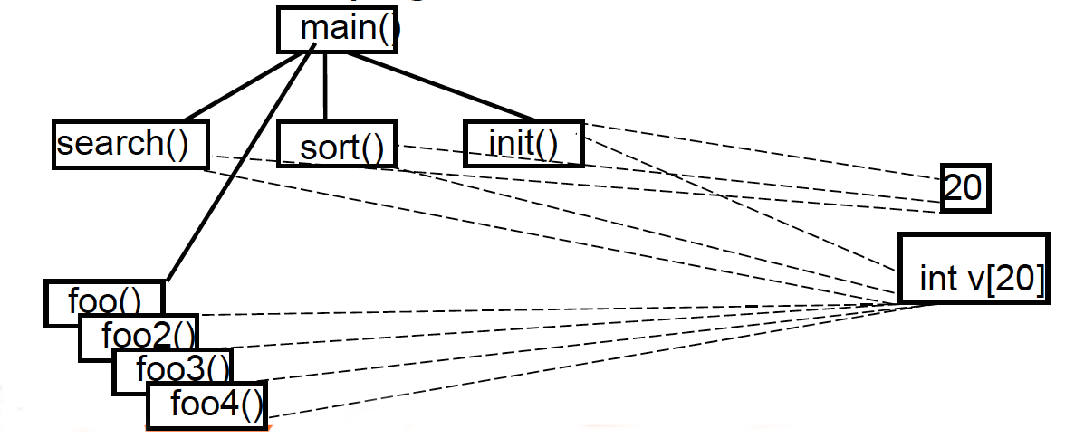
Issues, on the long run
External functions can read/write vector’s data, leading to a growing number of relationships
Source code becomes difficult to understand and maintain

Slide 15
What is OO?
Procedural Paradigm
Program defines data and then calls subprograms acting on data
OO Paradigm
Program creates objects encapsulating data and procedures operating on data
OO is only a new way of organizing code
Cannot do anything using OO that can’t be done using procedural paradigm

Slide 16
Why OO?
Programs are getting too large to be fully comprehensible by any person. There is need of a way of managing very large projects
Object Oriented paradigm allows:
programmers to use large blocks of code without knowing the whole picture
code reuse a real possibility
easier maintenance and evolution of code

Slide 17
Why OO?
Benefits only occur in larger programs
Programs < 30 lines, spaghetti is as understandable and faster to write than structured
Programs > 1K lines, spaghetti is incomprehensible, probably doesn’t work, not maintainable
Only programs > 1K lines benefit from OO really

Slide 18
An engineering approach
Given a system, with components and relationships among them, we have to:
Identify the components
Define component interfaces
Define how components interact each other through their interfaces
Minimize relationships among components

Slide 19
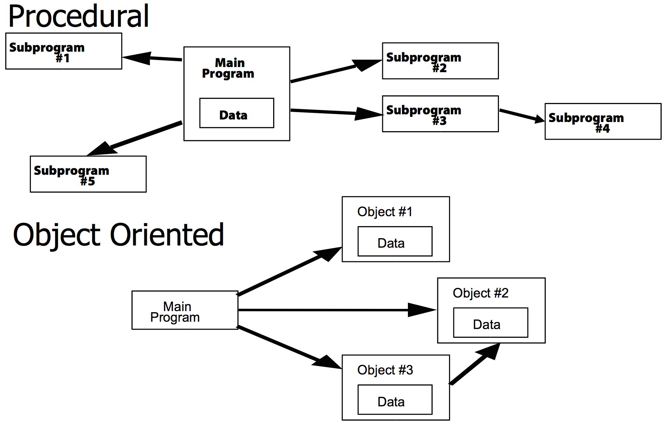
An engineering approach
Objects add an additional abstraction layer
More complex systems can be built

Slide 20
Object-Oriented approach
Defines a new component type such as Object (and class)
Data and functions on data are within the same module allowing the definition of more precise interfaces
Defines a new kind of relationship
Message passing
Read/write operations are limited to the object scope

Slide 21
Object-Oriented approach
class MyVector {
// internal data (attributes)
private int v[20];
// external interface (methods)
public MyVector() {
for(int i=0; i<20; i++) v[i]=0;
}
public sort(){ /*sort*/ }
public search(int c){ /*search*/ }
}

Slide 22
Object-Oriented approach
Use of the class MyVector:
MyVector v1 = new MyVector();
MyVector v2 = new MyVector();
v1.sort();
v1.search(22);
v1++; //Error: not an integer
v1.v[2] = 47; //Error: v[] is private

Slide 23
Class and object
Class (the description of object structure, i.e. type ):
Data (ATTRIBUTES or FIELDS)
Functions (METHODS or OPERATIONS)
Creation methods (CONSTRUCTORS)
Object (class instance)
Identity
State

Slide 24
Class and object
A class is like a type definition. No data is allocated until an object is created from the class
The creation of an object is called instantiation. The created object is often called an instance
No limit to the number of objects that can be created from a class
Each object is independent. Changing one object doesn't change the others

Slide 25
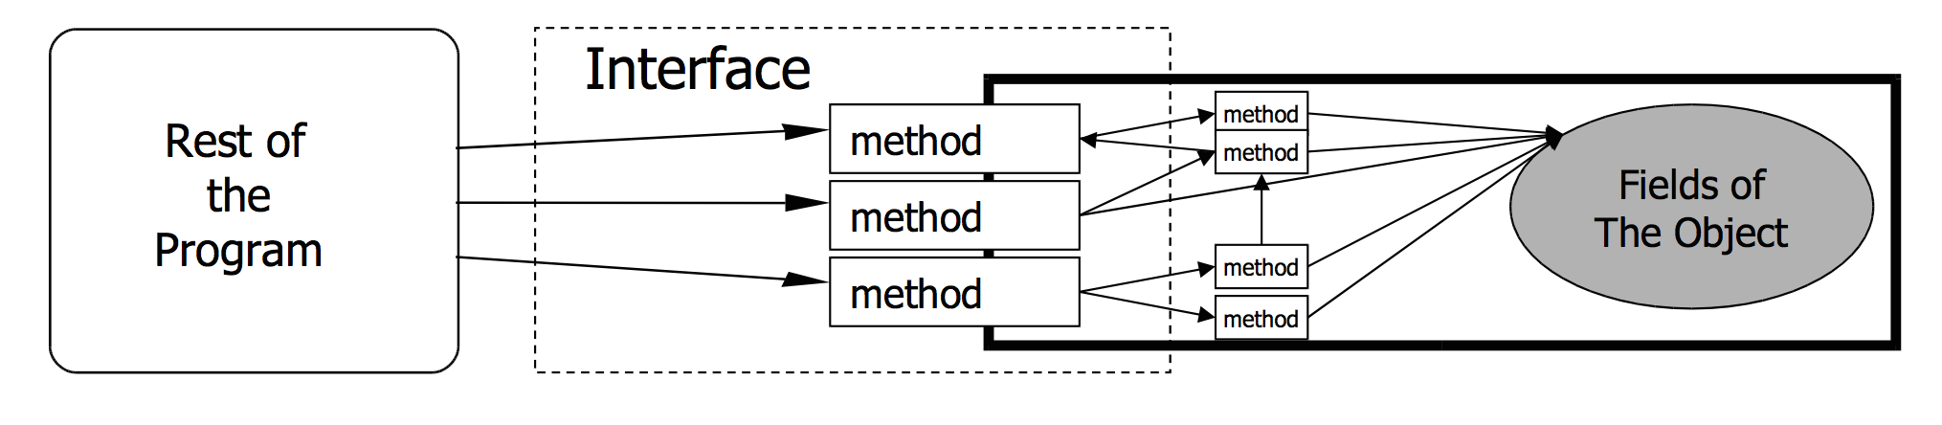
Class and interface
A class interface represents operations (methods) that other objects can call.
Methods are gateways to the internal state.

Slide 26
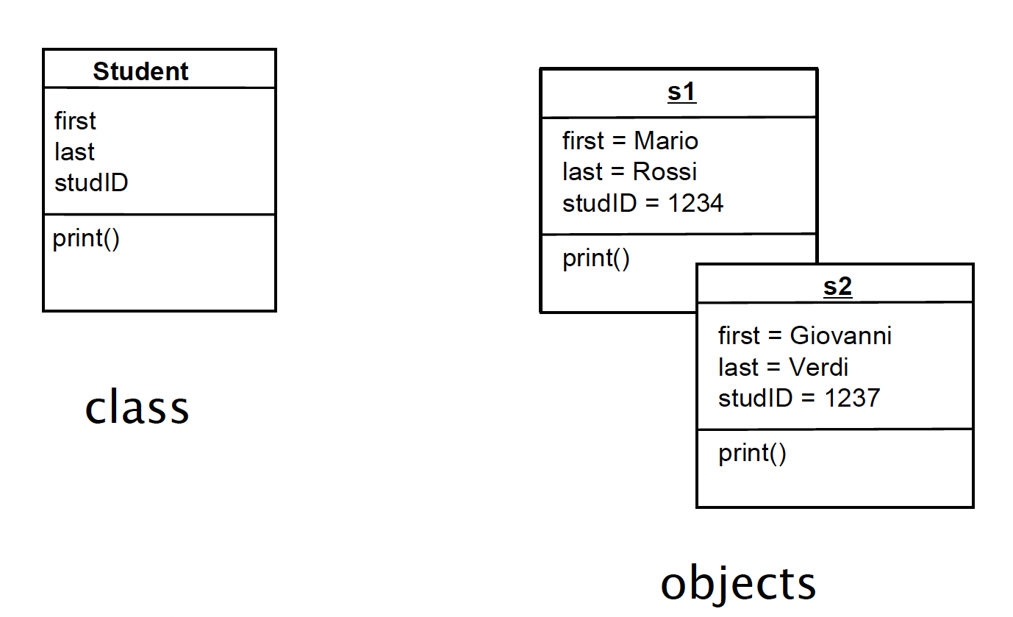
UML – Unified Modeling Language

Slide 27
Client-Server Model
Client
Knows the server
Uses a service
Server
Does not know clients a-priori
Offers services
OOP implies a paradigm shift:
Do not uses functions for processing data entities
Ask entities to deliver services

Slide 28
Client-Server Model
Procedural
OOP
operation(object, params)
For example:
insert(list, element)
object.operation(params)
For example:
list.insert(element)

Slide 29
OOP Key Features
Encapsulation
Inheritance
Polymorphism

Slide 30
Encapsulation
Each object “wraps” code and data
Each object handles its own data
Other objects can use the object’s interface to require services

Slide 31
Encapsulation
class MyVector {
// internal data (encapsulated data)
private int v[20];
// external interface (methods)
public MyVector() {
for(int i=0; i<20; i++) v[i]=0;
}
public sort(){ /*sort*/ }
public search(int c){ /*search*/ }
}

Slide 32
Inheritance
A class can derive from another class by extending it
The derived class inherits variables and methods of the base class. The child class adds its own variables and methods
Simplify the code reuse, build relations among classes

Slide 33
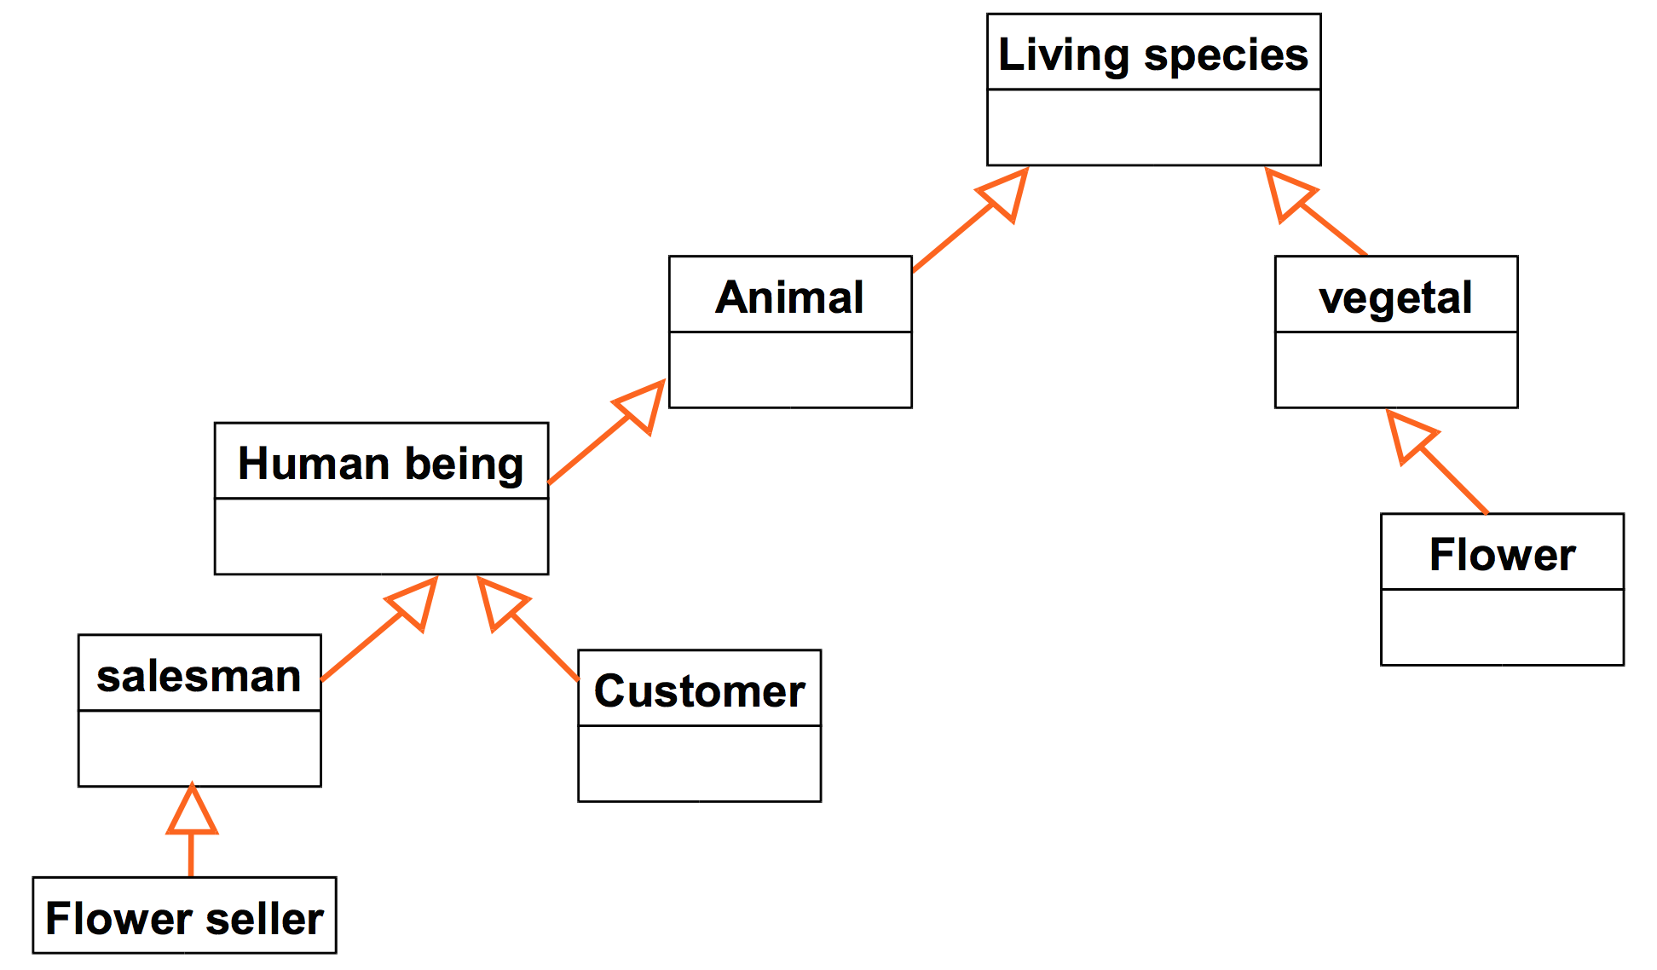
Inheritance

Slide 34
Inheritance
public class LivingSpecies {
private boolean isAlive;
}
public class Animal extends LivingSpecies {
. . .
}
public class HumanBeing extends Animal {
. . .
}

Slide 35
Polymorphism
Same requests for a method may lead to different behaviors depending on:
The actual object performing the operation (e.g., base class vs derived class)
Type of parameters passed as argument
Execution context

Slide 36
Example: Courses management
Management software for courses
As a first step, we must identify which real world entities should be modeled as classes:
Courses
Students
Exams
But also
Counters
Date
…

Slide 37
Define attribute and methods
Class Course
attributes: name, exams, enrolled students, global counter for passed examinations
methods: add student, get student, know how many exams a student succeed
Class Student
attributes: name, surname, registration number, enroll date, enroll year, list of attended courses, number of passed exams
methods: update passed exams and number of exams, set enroll year, know if student passed a specific exam
NOT ALLOWED: Change enroll date or number of passed exams, change name/surname
Class Exam
attributes: course name, passed/failed, attended date, grade
methods: set grade, read course name and obtained grade
NOT ALLOWED: change grade, change passed or fail state.
Class counter: as mentioned above

Slide 38
Create objects
At the execution time objects representing entities of the real world will be created:
One object Course for each course
One object Student for each student. The same object will be attribute of the object Course which belongs
One object Exam for each passed exam. The object will be attribute of the object student who succeed it

Slide 39
Runtime
Math
26
Stud. 453
Physics28
Computer Science
Count
exams
453
main
Count CS exams
Stud. 454
Math
21
Physics
Count exams
454
Physics24
Mathematics

Slide 40
Advantages of OOP
Simplify the process of building software in a cooperative manner:
Different people developing different classes (on the same project!)
Each developer can easily test the class behaviour by initializating the corresponding object and calling the related methods
Respect the contract: Define an interface (methods and properties) for each class

Slide 41
Advantages of OOP (2)
Simplify code management
Bugs on object data are easy to spot. Since data are not visible from the outside, errors mostly occurs in the object handling the data
Changes on a specific class do not impact other classes (unless the interface is not modified)

Slide 42
Advantages of OOP(3)
Support incremental design and development
Define new classes by extending the exsisting ones (e.g. new class student starting from an exsisting class people )
Chance of rapid prototyping
Testing object without caring of entirely define the class behaviour

Slide 43
OOP’s cost
Needs a Object Oriented way of thinking
Complex design (e.g., Which classes, How many?)
Expensive infrastractures for simple applications

