Slide 1
Java Exceptions
Università di Modena e Reggio Emilia
Prof. Nicola Bicocchi (nicola.bicocchi@unimore.it)

Slide 2
The world without exceptions
If errors happen while method is executing, we return a special value
Developers must remember value/meaning of special values for checking errors
List<Integer> list = new ArrayList<Integer>();
public int get(int i) {
if (list.size() <= i) {
return -1;
return list.get(i)
}

Slide 3
The world without exceptions
Alternatively, if a non locally remediable error happens within a method, we might be tempted to call System.exit(). Resulting code is not reusable!
List<Integer> list = new ArrayList<Integer>();
public int get(int i) {
if (list.size() <= i) {
System.exit(); // Never do this!!
return list.get(i)
}

Slide 4
Real-world problems
When we use return codes for handling errors
Code is messy to write and hard to read
Only the direct caller can intercept errors (no delegation to any upward method)
if (function() == ERROR_CODE) {
// handle error
} else
// proceed
}

Slide 5
An example, read a file into memory
Open the file
Determine file size
Allocate (the needed amount of) memory
Read the file into memory
Close the file
All operations can fail!

Slide 6
First approach
Short, readable BUT not reusable nor dependable
int loadFile() {
open the file;
determine file size;
allocate memory;
read the file into memory;
close the file;
return 0;
}

Slide 7
Second approach
open the file;
if(operationFailed) return -1;
determine file size;
if(operationFailed) return -2;
allocate memory;
if(operationFailed) {
close the file;
return -3;
}
read the file into memory;
if (operationFailed) {
close the file;
return -4;
}
close the file;
if (operationFailed) return -5;
Reusable, dependable BUT long and obscure
A lot of error-detection and error-handling code
To detect errors we must check the specification of library calls
Each library has its own standards

Slide 8
Third approach, using exceptions
try {
open the file;
determine file size;
allocate that much memory;
read the file into memory;
close the file;
} catch (fileOpenFailed) {
doSomething;
} catch(sizeDeterminationFailed) {
doSomething;
} catch (memoryAllocationFailed) {
doSomething;
} catch (readFailed) {
doSomething;
} catch (fileCloseFailed) {
doSomething;
}

Slide 9
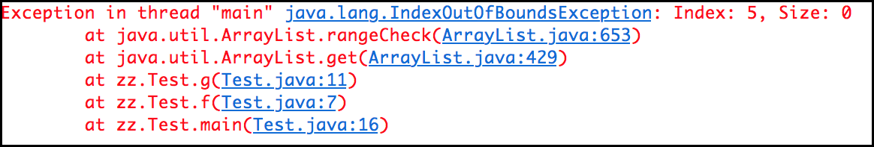
Basic Concepts (stack trace)
public class Test {
public void f(int i) {
g(i);
}
public void g(int i) {
new ArrayList().get(i);
}
public static void main(String[] args) {
new Test().f(5);
}
}

Slide 10
Basic Concepts
The code causing an error generates an exception
At some point, up in the hierarchy of method invocations, a method might catch and handle the exception
All methods can
Intercept the exception (no delegation)
Ignore the exception (complete delegation)
Intercept and generate a new exception (partial delegation)

Slide 11
Syntax
Java provides four keywords related with exceptions
Try
Contains code that may generate exceptions
Catch
Defines the error handler
Finally
Code block being executed regardless the catching phase
Throws
Mark a method as able to delegate exceptions
Throw
Generates a new exception
There is also a class for representing exceptions
Exception class (java.lang.Exception)

Slide 12
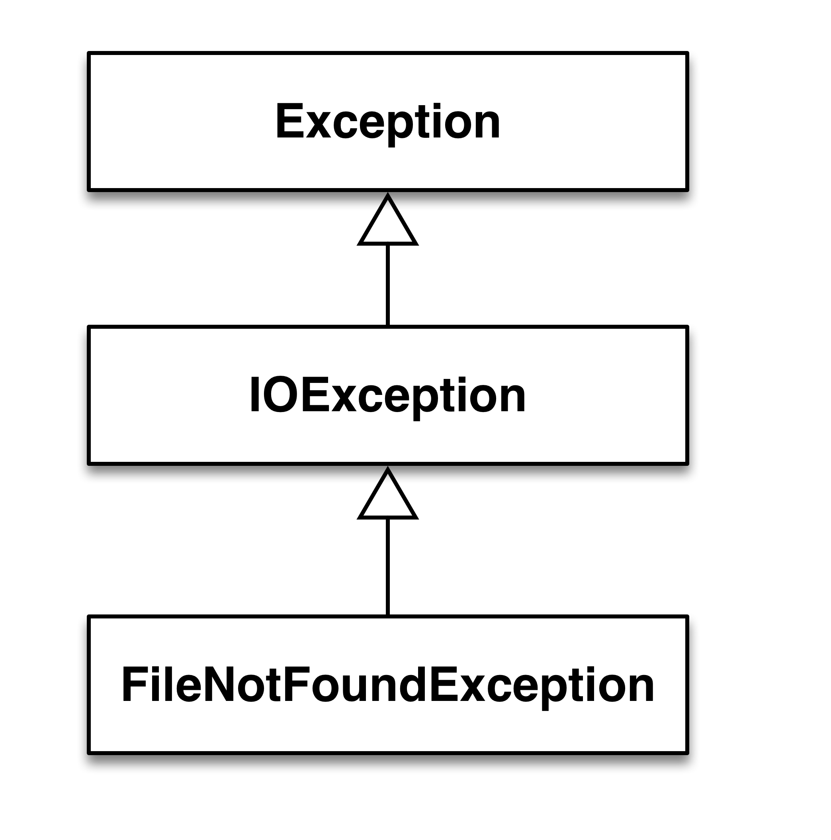
Interception (catch)
public static void main(String[] args) {
char[] v = new char[256];
try {
FileReader f = new FileReader("test.txt");
} catch (FileNotFoundException e) {
e.printStackTrace();
}
}

Slide 13
Interception (catch)
public static void main(String[] args) {
char[] v = new char[256];
try {
FileReader f = new FileReader("test.txt");
f.read(v);
f.close();
} catch (FileNotFoundException e) {
e.printStackTrace();
} catch (IOException e) {
e.printStackTrace();
}
}

Slide 14
Interception (catch)
public static void main(String[] args) {
char[] v = new char[256];
try {
FileReader f = new FileReader("test.txt");
f.read(v);
f.close();
} catch (IOException e) {
e.printStackTrace();
}
}

Slide 15
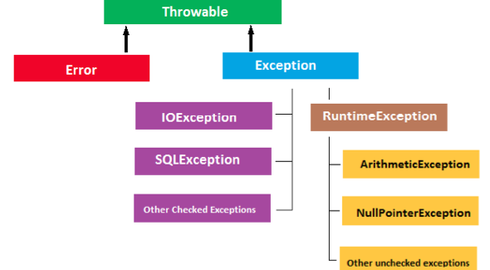
Matching Rules
Generality

Slide 16
Delegation (throws)
For enabling delegation, method interface must declare exception type(s) generated within its implementation (list with commas)
Exception can be either generated:
by the method directly
by other methods called within the method and not caught

Slide 17
Delegation (throws)
public static void main(String[] args)
throws IOException {
char[] v = new char[256];
FileReader f = new FileReader("test.txt");
f.read(v);
f.close();
}

Slide 18
Delegation (throws)
Class Dummy {
public void foo() throws IOException {
char[] v = new char[256];
FileReader f = new FileReader("test.txt");
f.read(v);
f.close();
}
}
Class App {
public static void main (String args[]) throws IOException {
new Dummy().foo();
}
}

Slide 19
Delegation (throws)
Class Dummy {
public void foo() throws IOException {
char[] v = new char[256];
FileReader f = new FileReader("test.txt");
f.read(v);
f.close();
}
}
Class App {
public static void main (String args[]) {
try {
new Dummy().foo();
} catch (IOException e) { // do something }
}
}

Slide 20
Generation (throw)
(Eventually) Declare an exception class
Mark the method generating the exception with throws
Throw upward a new exception object

Slide 21
Generation (throw)
public static void main(String[] args) {
Queue<String> q = new LinkedList<String>();
q.remove();
}
Exception in thread "main" java.util.NoSuchElementException
at java.util.LinkedList.removeFirst(LinkedList.java:270)
at java.util.LinkedList.remove(LinkedList.java:685)
at main(Test.java:13)

Slide 22
Generation (throw)
public class LinkedList implements List, Queue {
public Object removeFirst()
throws NoSuchElementException {
if (size() == 0) {
throw(new NoSuchElementException());
}
…
}
}

Slide 23
Generation (throw)
public class EmptyStackException extends Exception {}
public Object removeFirst()
throws EmptyStackException {
if (size() == 0) {
throw(new EmptyStackException());
}
…
}
}

Slide 24
Partial delegation (catch, throw)
Methods can intercept and exception, handle it eventually partially, and throw a new exception to be managed by their callers.
The thrown exception can be either of the same type or of a different type

Slide 25
Partial delegation (catch, throw)
public static void main(String[] args)
throws IOException {
char[] v = new char[256];
FileReader f;
try {
f = new FileReader("test.txt");
f.read(v);
f.close();
} catch (IOException e) {
// do something
throw (new IOException());
}
}

Slide 26
Partial delegation (catch, throw)
public class MyException extends Exception {}
public static void main(String[] args)
throws IOException {
char[] v = new char[256];
FileReader f;
try {
f = new FileReader("test.txt");
f.read(v);
f.close();
} catch (IOException e) {
// do something
throw (new MyException());
}
}

Slide 27
Nesting
Try/catch blocks can be nested (e.g., error handlers may generate new exceptions)
public static void main(String[] args) {
try {
FileReader f = new FileReader("test.txt");
} catch (FileNotFoundException e) {
try {
FileWriter w = new FileWriter("log.txt");
w.write("Error in opening test.txt");
} catch (IOException e1) {
e1.printStackTrace();
}
}
}

Slide 28
Custom Exception
It is possible to define new types of exceptions if the ones provided by the system are not enough…
Subclass Throwable or Exception
public class EmptyStack extends Exception {}

Slide 29
Exceptions and loops
For errors affecting a single iteration (or items of a collection!), the try-catch blocks is nested in the loop. In case of exception the execution goes to the catch block and then proceed with the next iteration.
while(true){
try{
// potential exceptions
} catch(Exception e){
// discard iteration
}
}

Slide 30
Exceptions and loops
For errors compromising the whole loop, the loop is nested within the try block. In case of exception the execution goes to the catch block, thus exiting the loop.
try{
while(true){
// potential exceptions
}
} catch(Exception e){
// discard whole loop
}

Slide 31
Finally
The JVM always executes the finally block regardless the outcome of try/catch. Usually it is used for cleaning things up (e.g., closing files, connections)
public static void main(String[] args) {
FileReader f;
try {
f = new FileReader("test.txt");
f.read(v);
f.close();
} catch (IOException e) {
// do something
} finally {
if (f != null) f.close();
}
}

Slide 32
Exceptions and Errors
Trowable
Error
Checked
Exception
RuntimeException
Uncheked
Unchecked

Slide 33
Errors
An Error is a subclass of Throwable referring to serious issues that a reasonable application should not try to catch. Most of errors are truly abnormal conditions.
LinkageError indicates that a class has some dependency on another class; however, the latter class has incompatibly changed after the compilation of the former class.
VirtualMachineError indicates that the Java Virtual Machine is broken or has run out of resources
Trowable
Error
Checked
Exception
RuntimeException
Uncheked
Unchecked

Slide 34
Checked and Unchecked Exceptions
Unchecked exceptions (Generated by JVM)
Their generation is not foreseen (can happen everywhere)
Need not to be managed with try/catch (not checked by the compiler). Examples are NullPointerException, ArrayIndexOutOfBound, …
Checked exceptions
Exceptions manages with try/catch and checked by the compiler
Generated using throw. Examples are IOException, SQLException, ClassNotFoundException, …
Trowable
Error
Checked
Exception
RuntimeException
Uncheked
Unchecked

Slide 35
Summarizing
Exceptions separate error handling from functional code
Functional code is more readable
Error code is centralized, rather than being scattered
Exceptions eventually, delegate error handling to higher levels
Callee might not know how to recover from an error
Caller of a method can handle error in a more appropriate way than the callee

Slide 36
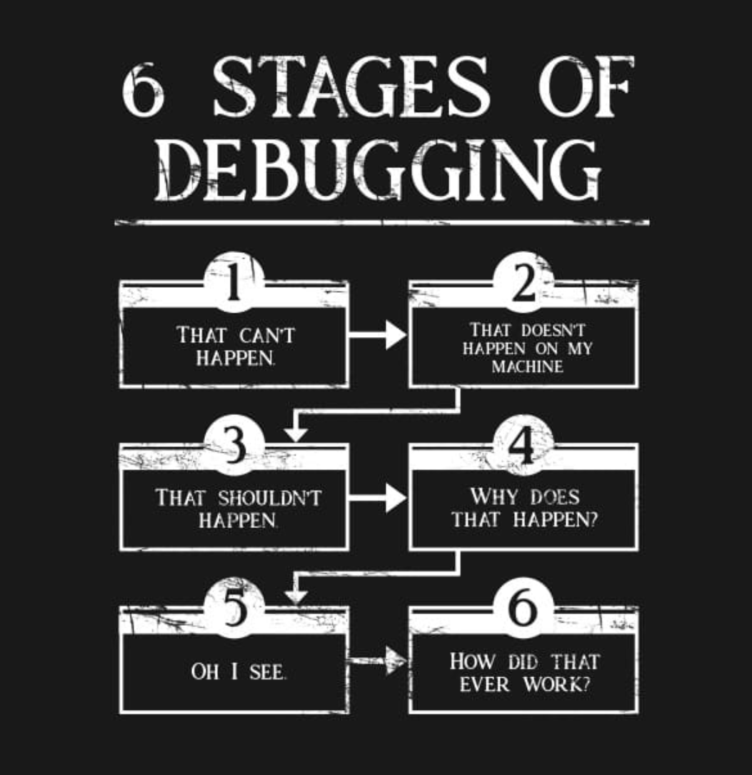
Summarizing

