Slide 1
Java I/O
Università di Modena e Reggio Emilia
Prof. Nicola Bicocchi (nicola.bicocchi@unimore.it)

Slide 2
Stream
All I/O operations rely on the abstraction of STREAM (“bytes flow”)
Random access unsupported (see java.io.RandomAccessFile)
I/O operations work in the same way with ALL kinds of streams. For example, a stream can be:
Standard input, output, error
A regular file
A data-flow from/to memory or a pipe, …
A network connection

Slide 3
Stream
Abstract classes Reader Writer
stream of chars (Unicode Chars 16 bit)
Characters
Abstract classes InputStream OutputStream
stream of bytes (8 bit)
Binary data (e.g., sounds, images)
package java.io
All related exceptions are subclasses of java.io.IOException

Slide 4
java.io.Reader
int read()
Reads a single character.
int read(char[] buffer)
Reads characters into a char array.
long skip(long n)
Skips characters.
void close()
Closes the stream.

Slide 5
java.io.InputStream
int read()
Reads a single byte (packed into an int).
int read(byte[] buffer)
Reads bytes into a char array.
long skip(long n)
Skips bytes.
void close()
Closes the stream.

Slide 6
java.io.Writer
void write(int c)
Writes a single character.
void write(char[] buffer)
Writes an array of characters.
void write(String str)
Writes a string.
void flush()
Flushes the stream.
void close()
Closes the stream, flushing it first.

Slide 7
java.io.OutputStream
void write(int b)
Writes a single byte.
void write(byte[] buffer)
Writes an array of bytes.
void flush()
Flushes the stream.
void close()
Closes the stream, flushing it first.

Slide 8
java.io.PrintStream
A PrintStream adds functionality to another output stream, namely the ability to print representations of various data values conveniently.
Adds methods like print(), println(), printf(), format() for string formatting
Unlike other output streams, a PrintStream never throws an IOException; instead, exceptional situations merely set an internal flag that can be tested via the checkError method.

Slide 9
System.in and System.out
System defines default input, output and error streams as
class System {
static InputStream in;
static PrintStream out;
static PrintStream err;
…
}

Slide 10
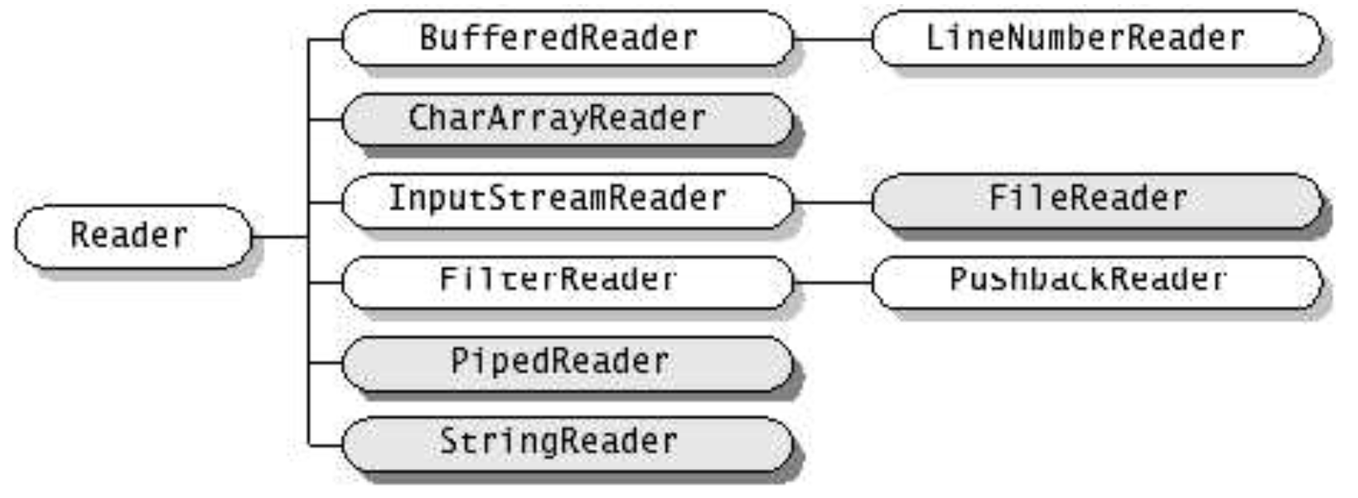
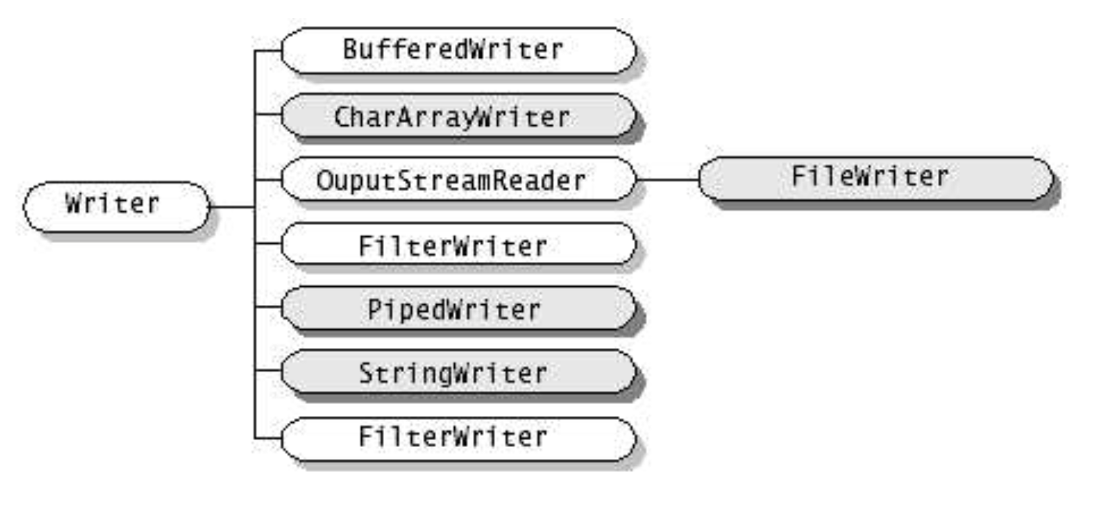
Reader and Writer

Slide 11
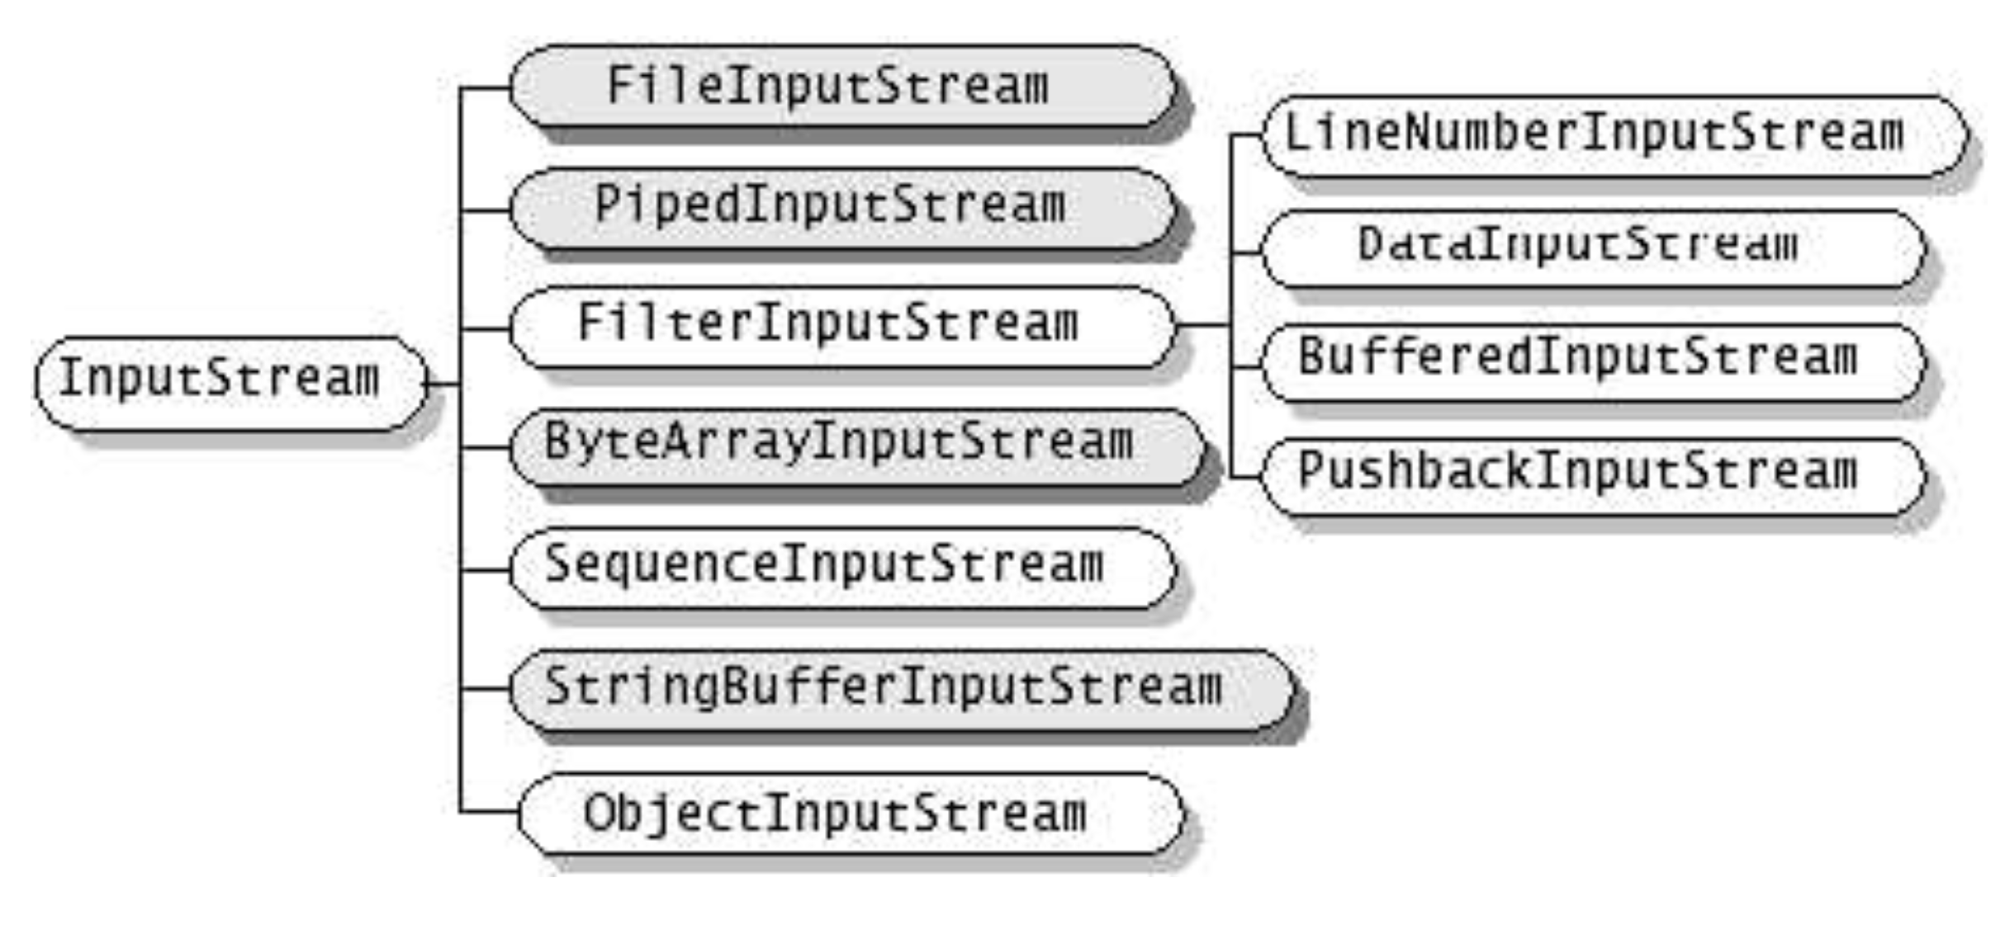
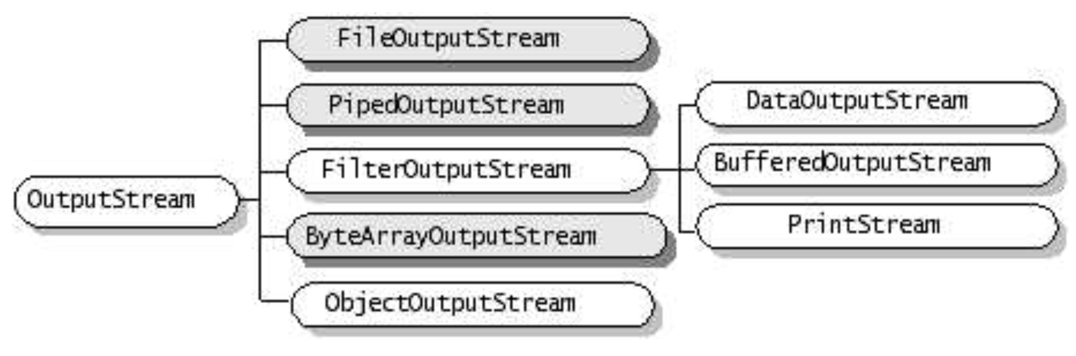
InputStream and OutputStream

Slide 12
Read/Write of files
FileReader
FileWriter
R/W char from file
FileInputStream
FileOutputStream
R/W byte from file
File
handles filename and pathname

Slide 13
Read/Write of pipes
PipedReader
PipedWriter
R/W chars from pipe
PipedInputStream
PipedOutputStream
R/W bytes from pipe

Slide 14
Read/Write in memory
CharArrayReader
CharArrayWriter
R/W chars from/to array in memory
StringReader
StringWriter
R/W chars from/to String
ByteArrayInputStream
ByteArrayOutputStream
R/W bytes from/to array in memory

Slide 15
Buffered Streams
Transparently add buffering functionality. The manual alternative is to use read(int[] buf) or read(char[] buf)
BufferedInputStream
BufferedOutputStream
BufferedReader
BufferedWriter
Examples:
BufferedInputStream(InputStream in)
BufferedReader(Reader in)

Slide 16
Interpreted Streams
Translates primitive types in standard format (UTF-8) on file
DataInputStream(InputStream i)
readByte(), readChar(), readDouble(), readFloat(), readInt(), readLong(), readShort()
DataOutputStream(OutputStream o)
writeByte(), writeChar(), writeDouble(), writeFloat(), writeInt(), writeLong(), writeShort()

Slide 17
java.io.File
An abstract representation of file and directory pathnames. Provides a conversion between File and String
methods:
exists(), isFile(), isDirectory(), isHidden(), length(), canRead(), canWrite(), canExecute(), getPath()…
File f = new File(“/etc/passd”).
Is this truly portable?

Slide 18
java.io.File
Platform dependent
File f = new File("tmp/abc.txt");
Platform independent
File f = new File(“tmp” + File.separator + "abc.txt");
See Java System Properties
See File static attributes

Slide 19
java.nio.file.Files
This class consists exclusively of static methods that operate on files, directories, or other types of files.
In most cases, the methods defined here will delegate to the associated file system provider to perform the file operations.

Slide 20
java.util.StringTokenizer
StringTokenizer
Works on String
set of delimiters (blank, “,”, \t, \n, \r, \f )
Blank is the default delimiter
Divides a String in tokens (separated by
delimiters), returning the token
hasMoreTokens(), nextToken()
Does not distinguish identifiers, numbers, comments, quoted strings

Slide 21
java.io.StreamTokenizer
StreamTokenizer
Works on Stream (Reader subclasses)
More sophisticated, recognizes identifiers, comments, quoted string, numbers
Use symbol table and flag
nextToken(), TT_EOF if at the end

Slide 22
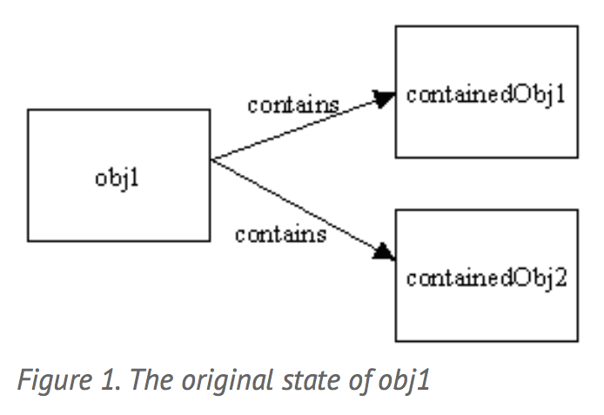
Deep and Shallow copies

Slide 23
Serialization
Read / write of an object imply:
read/write attributes (and optionally the type) of the object
Correctly separating different elements
When reading, create an object and set all attributes values
These operations (serialization) are automated by
ObjectInputStream
ObjectOutputStream

Slide 24
Serialization
Methods to read/write objects are:
void writeObject(Object)
Object readObject()
ONLY objects implementing interface Serializable can be serialized. Serializable is an empty interface. It is used to avoid serialization of objects, without the permission of the class developer

Slide 25
Serialization, deep copy
An ObjectOutputStream saves automatically all objects referred by its attributes
objects serialized are numbered in the stream
references are saved like ordering numbers in the stream
If I save 2 objects pointing to a third one, this is saved just once
Before saving an object, ObjectOutputStream checks if it has not been already saved
Otherwise it saves just the reference (as a number)

Slide 26
Serialization, type recovery
When reading, an object is created
... but which is its type?
Down casting to the exact type is useful only to send specific messages
A viable solution could be down casting to a common ancestor

Slide 27
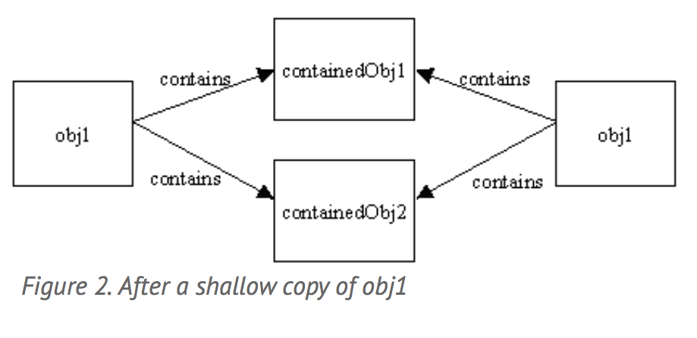
Deep and Shallow copies

Slide 28
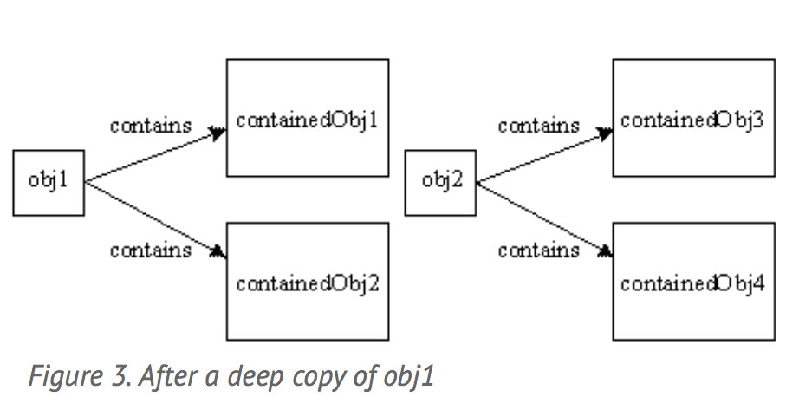
Deep and Shallow copies

