Slide 1
Introduction to Object Oriented Programming
Università di Modena e Reggio Emilia
Prof. Nicola Bicocchi (nicola.bicocchi@unimore.it)

Slide 2
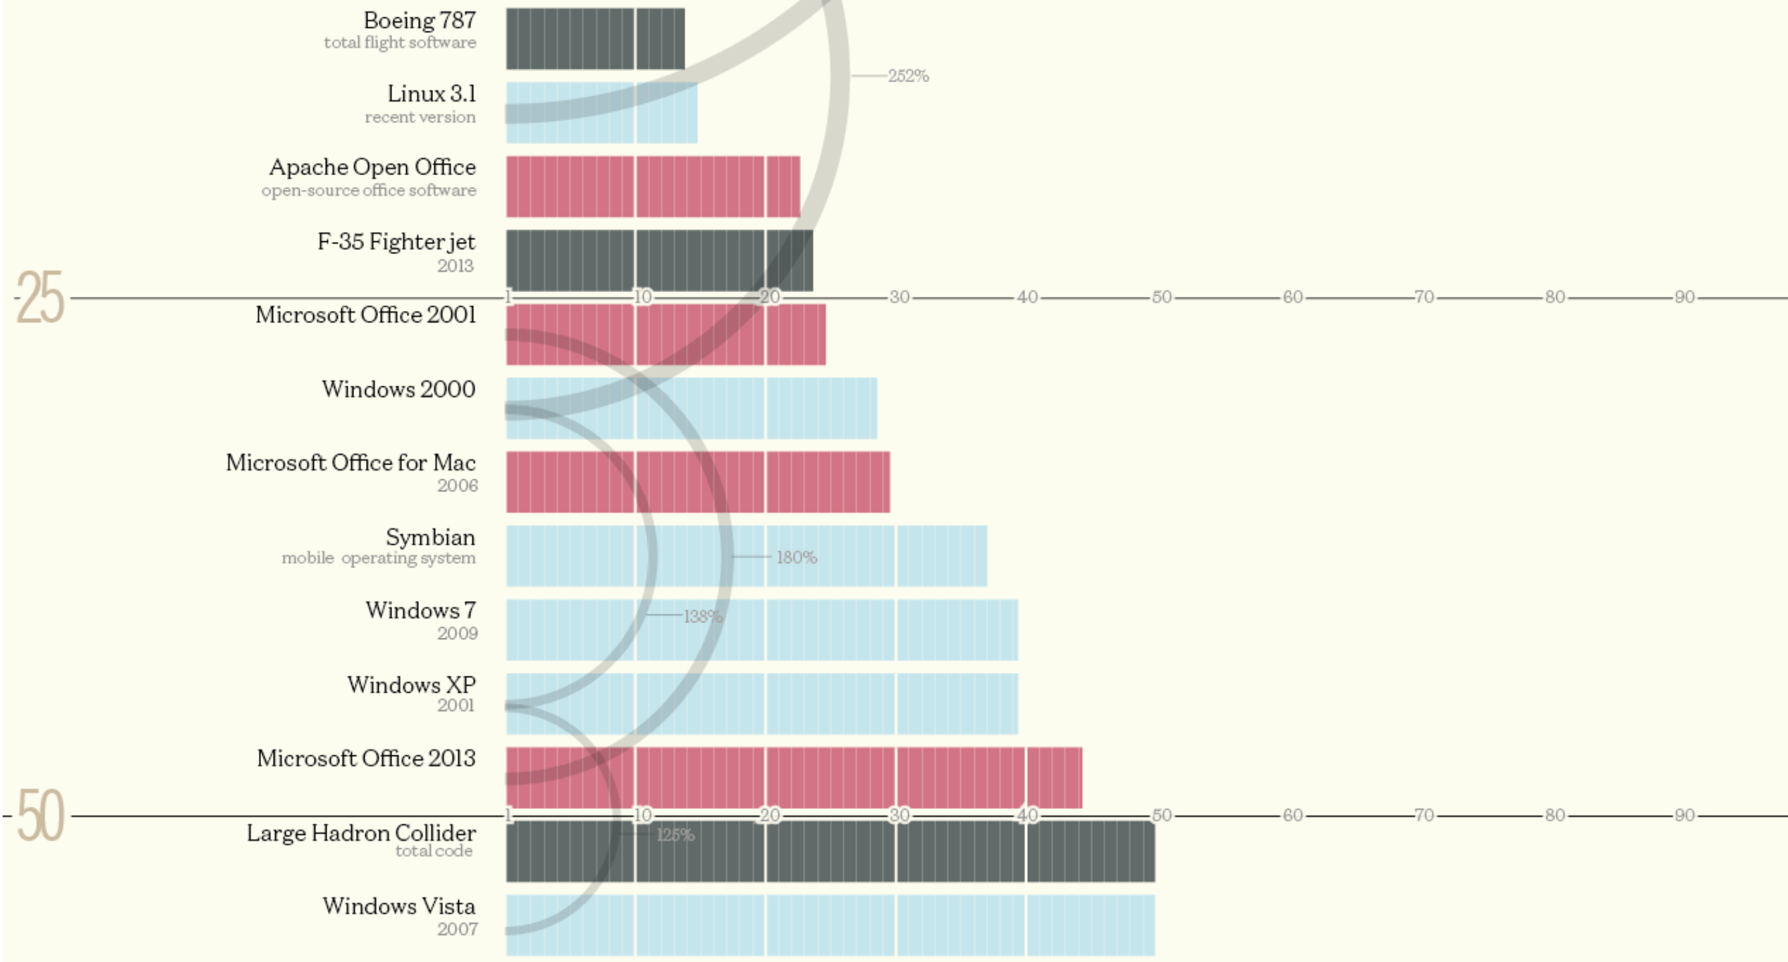
Software Size
* http://www.informationisbeautiful.net/visualizations/million-lines-of-code/

Slide 3
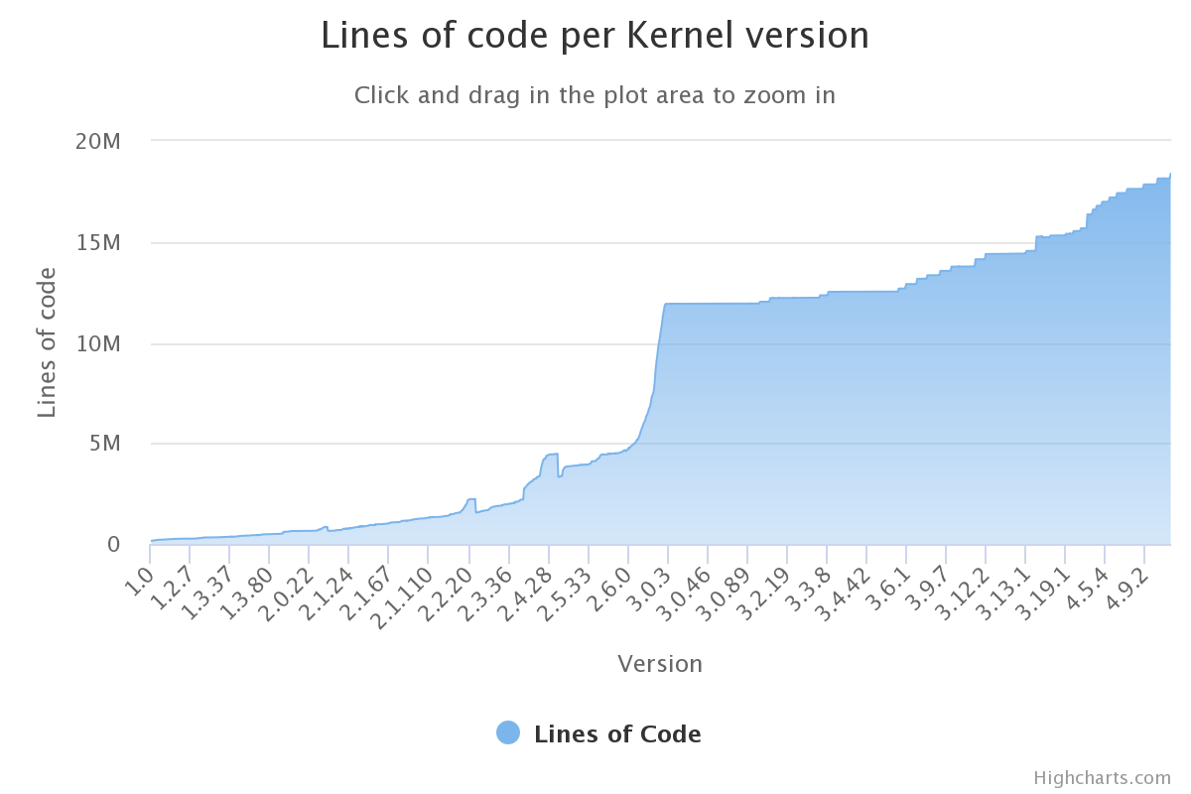
Software Size

Slide 4
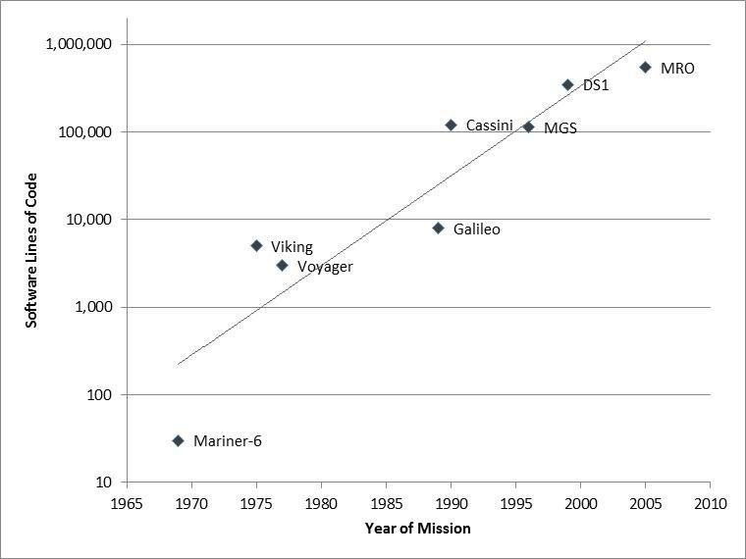
Software Size

Slide 5


Why OOP?

Slide 6
Why OOP?
Procedural programming languages (e.g., Pascal, C) are not suitable for building large software infrastructures
OOP addresses this issue and reduces development and maintenance costs for large and complex software projects

Slide 7
Errors / 1K SLOC
Industry Average
25 errors / 1K SLOC
Corporate Applications
5 errors / 1K SLOC
Cleanroom development technique
0.5 errors / 1K SLOC

Slide 8
Software crisis (1970)
The causes of the software crisis were linked to the overall complexity of hardware and the software development process. The crisis manifested itself in several ways:
Projects running over-budget
Projects running over-time
Software was inefficient
Software was difficult to maintain

Slide 9
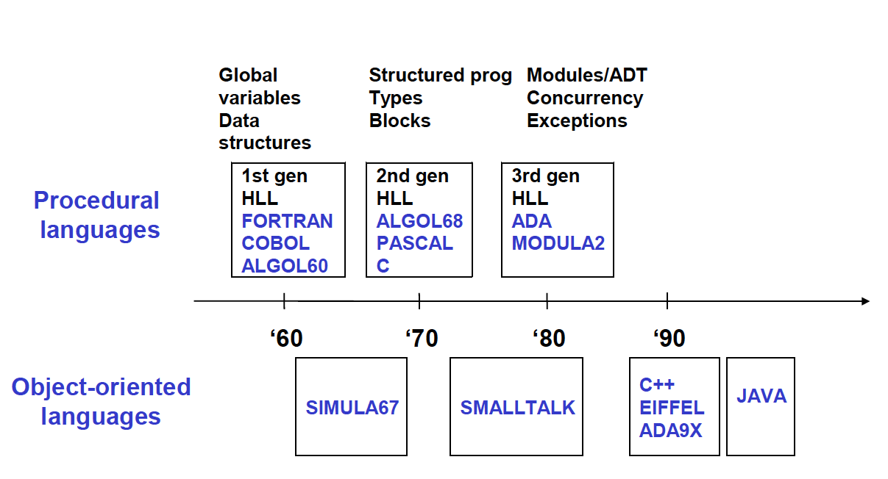
Languages Timeline

Slide 10
OOP Goal
Build software being secure, re-usable, flexible, documentable, extensible
Instead of focusing on algorithms, optimization and efficiency, OOP focus on programming techniques
OOP considers software as a set of well-defined entities containing both data and functions

Slide 11
Procedural Programming
int vect[20];
int i;
void sort() { /* sort */ }
int search(int n) { /* search */ }
void init() { /* init */ }
void main() {
init();
sort();
search(13);
}

Slide 12
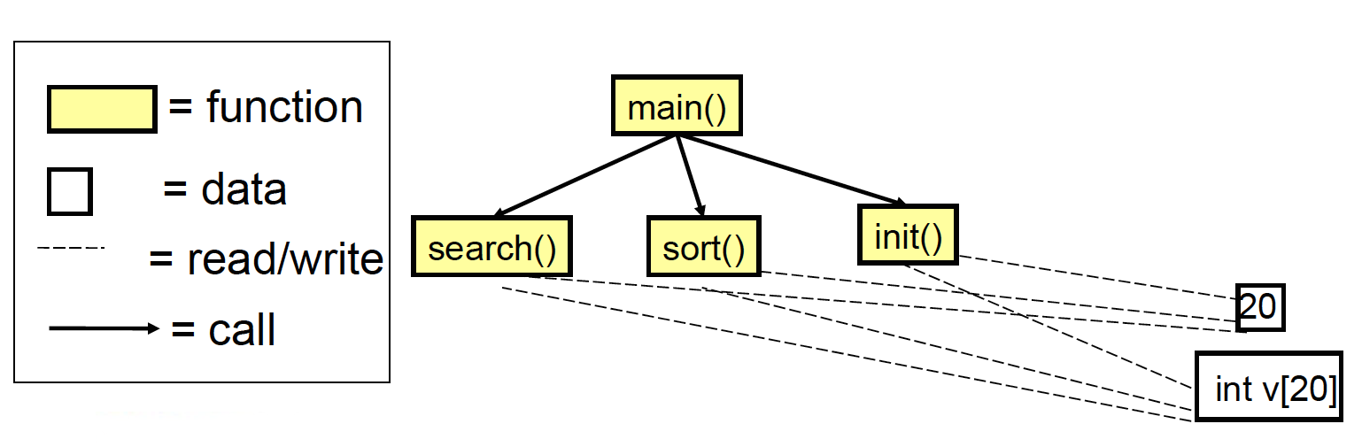
Modules and relationships

Slide 13
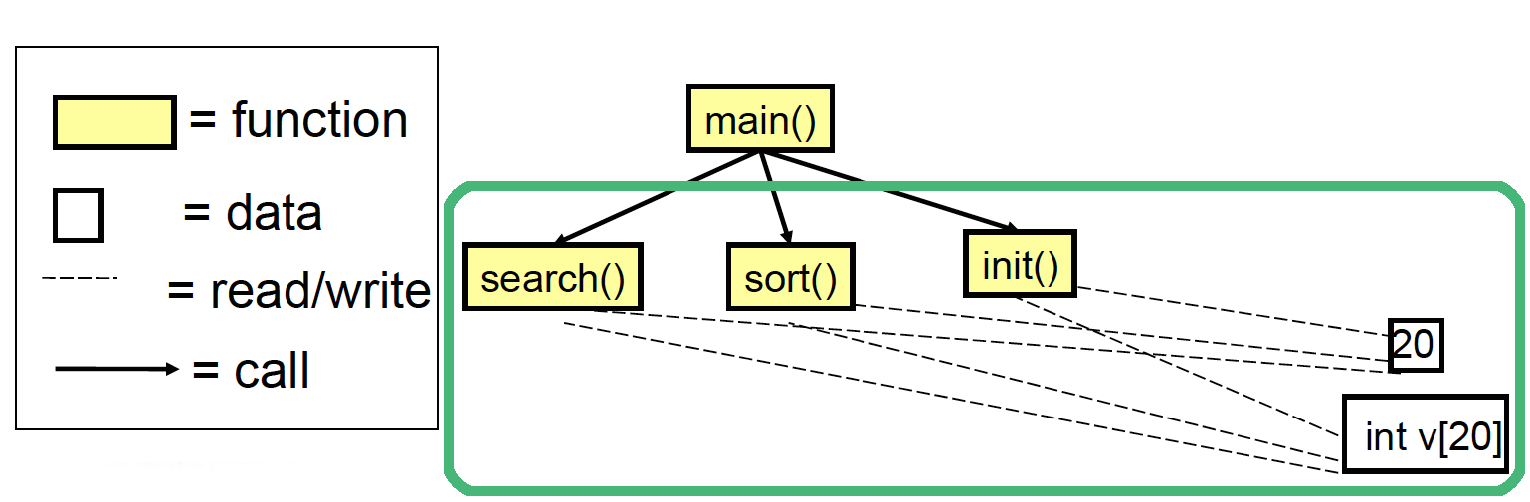
Issues
There is no clear relationship between:
Vectors ( int vect[20] )
Operations on vectors (search, sort, init)
There is no control over size:
for (i=0; i<=20; i++) { vect[i ]=0; };
Initialization
Actually performed?

Slide 14
Issues
It’s not possible to consider a vector as a primitive concept
Data and functions are not modularized

Slide 15
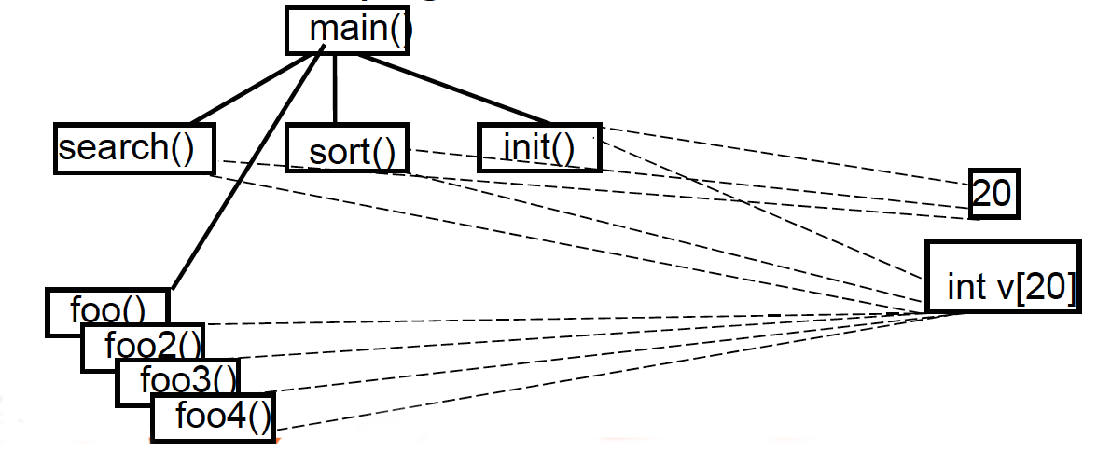
Issues, the long run
External functions can read/write vector’s data, leading to a growing number of relationships
Source code becomes difficult to understand and maintain
Spaghetti Code

Slide 16
Issues
Reuse of code limited
Data and procedures (functions) are separate. This makes it complex to reuse existing code in other projects
Data protection limited
Unprotected data accessible from vast portions of the source code. After a certain stage, debug becomes a nightmare!
Unsuitable for decomposition
Large scale projects require large scale working force (many teams). Unprotected data, separate from functions makes it hard to decompose

Slide 17
Object-Oriented approach
class Vector {
// internal data
private int v[20];
// external interface
public MyVector() {
/* init */
for(int i=0; i<20; i++) v[i]=0;
}
public sort() { /*sort*/ }
public search(int c) { /*search*/ }
}

Slide 18
Object-Oriented approach
MyVector v1 = new MyVector();
MyVector v2 = new MyVector();
v1.sort();
v1.search(22);
v1++; // Error: not an integer
v1.v[2] = 47; // Error: v[] is encapsulated

Slide 19
An engineering approach
Client-Server model
OOP implies a paradigm shift
Do not uses functions for processing data entities
Ask entities to deliver services
operation(object, params)
For example:
insert(vector, element)
object.operation(params)
For example:
vector.insert(element)

Slide 20
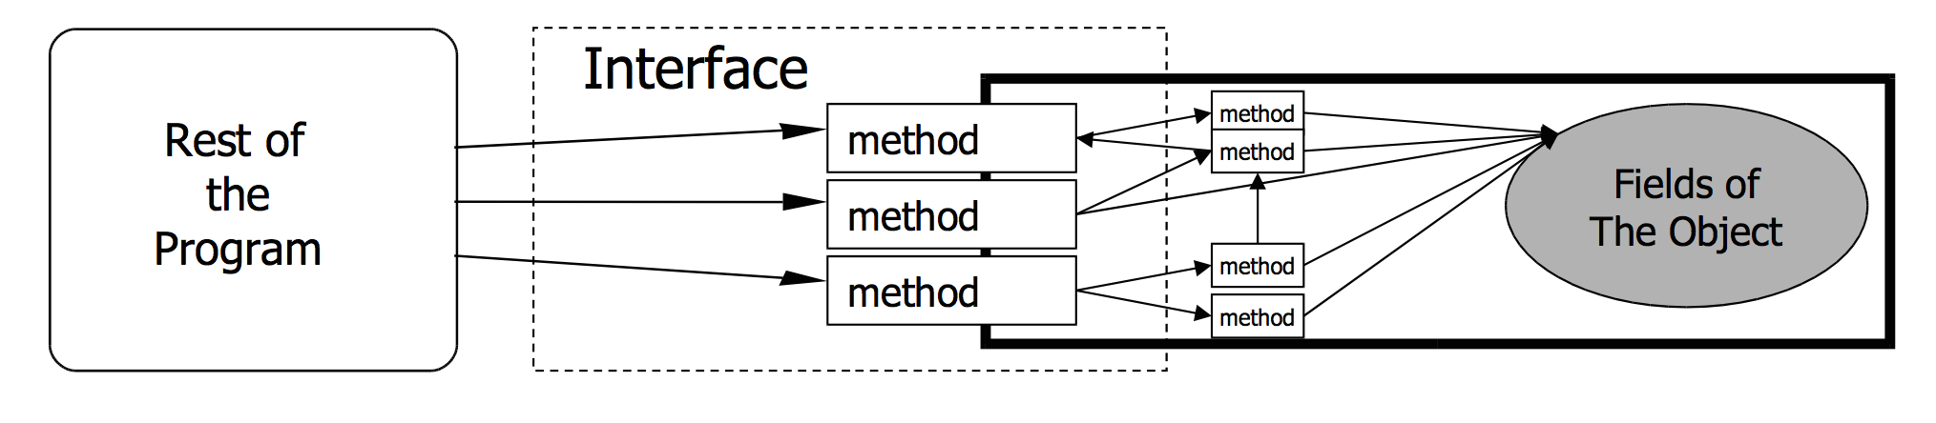
An engineering approach
Given a system, we have to:
Identify the components
Define component interfaces
Define how components interact each other through their interfaces
Minimize relationships among components

Slide 21
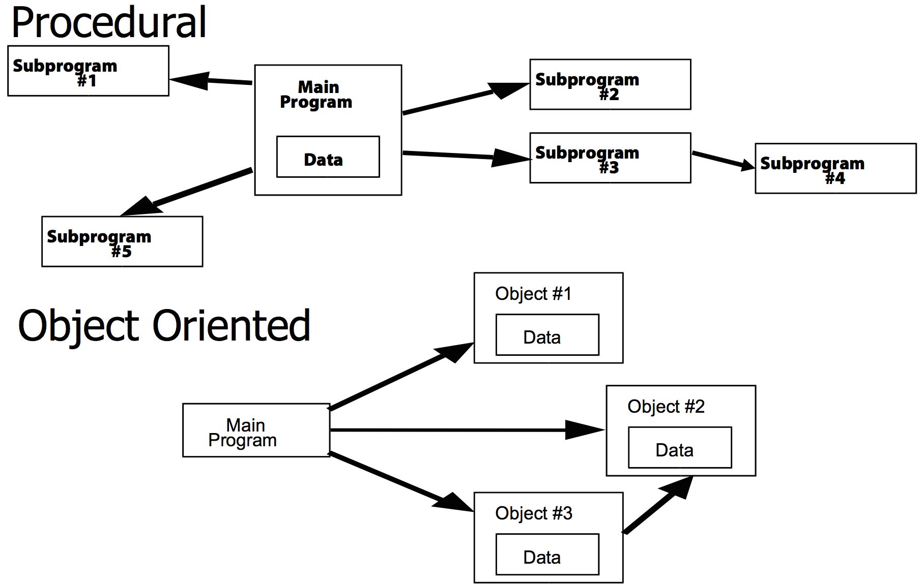
An engineering approach

Slide 22
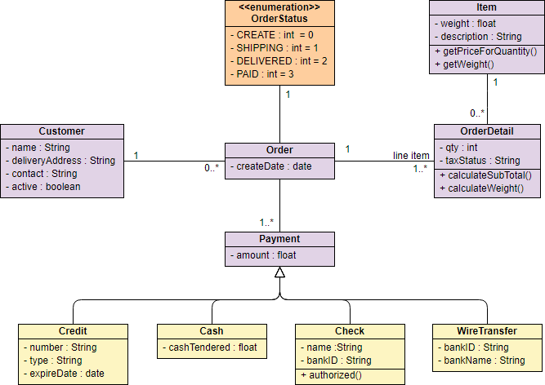
An engineering approach

Slide 23
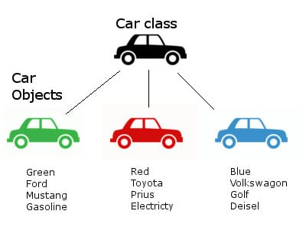
Class and object
public class Car {
String color;
String brand;
String model;
String fuel;
public Car(color, brand, model, fuel) {
this.color = color;
this.brand = brand;
this.model = model;
this.fuel = fuel;
}
/* ... */
}
Car c1 = new Car(Green, Ford, Mustang, Gasoline);
Car c2 = new Car(Red, Toyota, Prius, Electricity);
Car c3 = new Car(Blue, VW, Golf, Diesel);

Slide 24
Class and object
Class (the description of object structure, i.e. type ):
Data (ATTRIBUTES or FIELDS)
Functions (METHODS or OPERATIONS)
Creation methods (CONSTRUCTORS)
Object (class instance)
Identity
State

Slide 25
Class and object
A class is like a type definition. No data is allocated until an object is created from the class
The creation of an object is called instantiation. The created object is often called an instance
No limit to the number of objects that can be created from a class
Each object is independent. Changing one object doesn't change the others

Slide 26
OOP Key Features
Encapsulation
Inheritance
Polymorphism

Slide 27
Encapsulation
Each object “wraps” code and data
Each object handles its own data
Other objects can use the object’s interface to require services

Slide 28
Encapsulation
class MyVector {
// internal data (encapsulated data)
private int v[20];
// external interface (methods)
public MyVector() {
for(int i=0; i<20; i++) v[i]=0;
}
public sort() { /*sort*/ }
public search(int c) { /*search*/ }
}

Slide 29
Inheritance
A class can derive from another class by extending it
The derived class inherits variables and methods of the base class. The child class adds its own variables and methods
Simplify the code reuse, build relations among classes

Slide 30
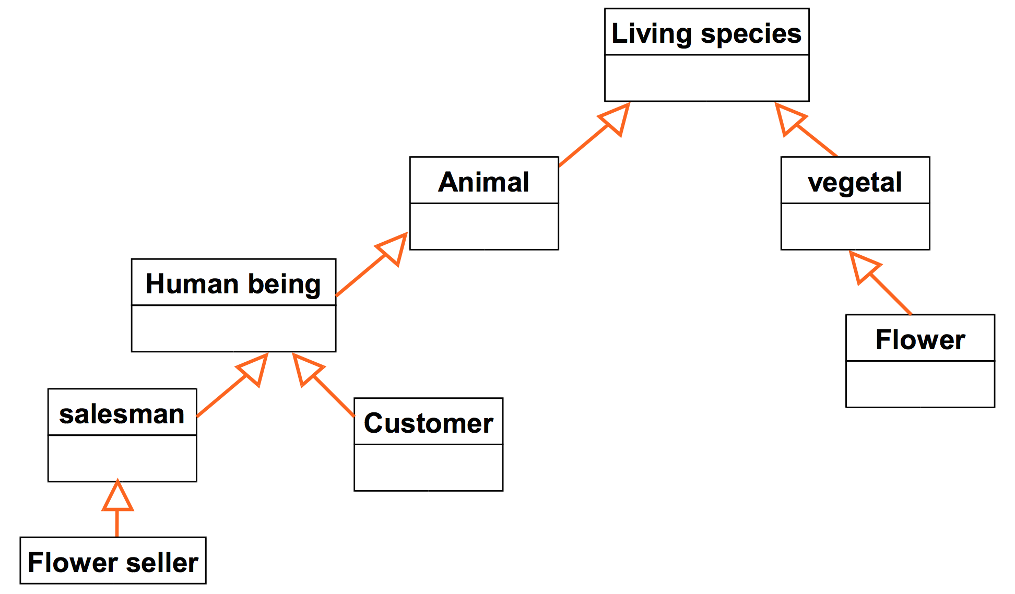
Inheritance

Slide 31
Inheritance
public class LivingSpecies {
private boolean isAlive;
}
public class Animal extends LivingSpecies {
. . .
}
public class HumanBeing extends Animal {
. . .
}

Slide 32
Polymorphism
Same requests for a method may lead to different behaviors depending on:
The actual object performing the operation (e.g., base class vs derived class)
Type of parameters passed as argument
Execution context

Slide 33
Polymorphism
class MyVector {
// internal data (encapsulated data)
private int v[20];
public MyVector() {
for(int i=0; i<20; i++) v[i]=0;
}
public MyVector(int[] v) {
for(int i=0; i<20; i++) this.v[i]=v[i];
}
public sort() { /*sort*/ }
public search(int c) { /*search*/ }
}

Slide 34
Advantages of OOP
Simplify the process of building software in a cooperative manner:
Different people developing different classes (on the same project!)
Simplify code management
Bugs on object data are easy to spot. Since data are not visible from the outside, errors mostly occurs in the object handling the data
Changes on a specific class do not impact other classes (unless the interface is not modified)
Support incremental design and development
Define new classes by extending the exsisting ones

Slide 35
Costs of OOP
Needs a Object Oriented way of thinking
Complex design (e.g., Which classes?, How many classes?)
Benefits only occur in large programs
Programs < 100 lines, spaghetti is understandable and faster to write
Programs > 1K lines, spaghetti is incomprehensible, probably doesn’t work, not maintainable

