Slide 1
OOP Inheritance
Università di Modena e Reggio Emilia
Prof. Nicola Bicocchi (nicola.bicocchi@unimore.it)

Slide 2

Motivation
They all move, have a shape, shields, and weapons. Can they share the same code?

Slide 3
Motivation
Frequently, a class is merely a modification of another class. Inheritance allows minimal repetition of the same code
A new design created by changing an existing design. (The new design consists of only the changes)
Localization of code
Fixing a bug in the base class automatically fixes it in the subclasses
Adding functionalities to the base class automatically adds them to the subclasses
Reduced chances of different (and inconsistent) implementations of the same operation

Slide 4
Inheritance
A class can be a sub-type of another class
The inheriting class contains all the attributes and methods of the class it inherited from
The inheriting class can define additional attributes and methods
The inheriting class can override the definition of existing methods by providing its own implementation
The code of the inheriting class consists only of the changes and additions to the base class

Slide 5
Example I (extension)
Class Car {
boolean isOn;
String licensePlate;
void turnOn() {…}
void turnOff() {…}
}
Class SDCar extends Car {
boolean isSelfDriving;
void turnSDOn() {…}
void turnSDOff() {…}
}
SDCar c = new SDCar();
c.turnOn(); // OK!
c.turnSDOn(); // OK!
*SD = Self Driving

Slide 6
Example II (override)
Class Car {
boolean isOn;
String licensePlate;
void turnOn() {…}
void turnOff() {…}
}
Class SDCar extends Car {
boolean isSelfDriving;
/* override */
void turnOn() {
turnSDOff();
/* … */
}
void turnOff() {
turnSDOff();
/* … */
}
void turnSDOn() {…}
void turnSDOff() {…}
}

Slide 7
Example III (override)
Class Car {
boolean isOn;
string licensePlate;
void turnOn() {…}
void turnOff() {…}
}
Class SDCar extends Car {
boolean isSelfDriving;
/* override */
void turnOn() {
turnSDOff();
super.turnOn();
}
void turnOff() {
turnSDOff();
super.turnOff();
}
void turnSDOn() {…}
void turnSDOff() {…}
}

Slide 8
Class SDCar
Inherits
attributes (isOn, licencePlate)
methods (turnOn, turnOff)
Adds
attributes (isSelfDriving)
methods (turnSDOn, turnSDOff)
Modifies (overrides)
methods (turnOn, turnOff)

Slide 9
this and super
this is a reference to the current object
super is a reference to the parent class

Slide 10
Terminology
Class one above
Parent class
Class one below
Child class
Class one or more above
Superclass, Ancestor class, Base class
Class one or more below
Subclass, Descendent class

Slide 11
Visibility and Inheritance

Slide 12
Visibility
Class Car {
private boolean isOn;
private string licensePlate;
public void turnOn() {…}
public void turnOff() {…}
}
Class SDCar extends Car {
void print() {
/* Do not work! Not visible! */
System.out.println(licencePlate);
}
}

Slide 13
Visibility
Class Car {
protected boolean isOn;
protected string licensePlate;
public void turnOn() {…}
public void turnOff() {…}
}
Class SDCar extends Car {
void print() {
/* Works! */
System.out.println(licencePlate);
}
}

Slide 14
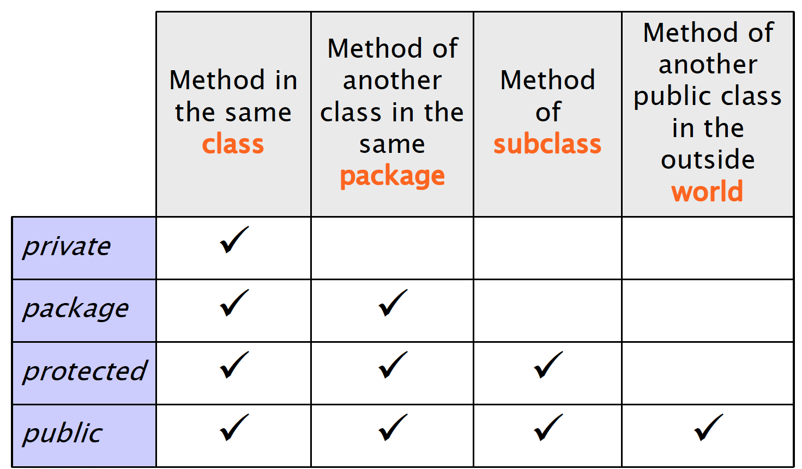
Recap

Slide 15
Inheritance and constructors

Slide 16
Construction of child objects
Since each subclass “contains” an instance of the parent class, the latter must be initialized
Java compiler automatically calls the default constructor (no params!) of parent class
The call is inserted as the first statement of each child constructor. If parent class disabled default constructor (by defining others) parent constructor must be called explicitly!

Slide 17
super()
Use super() to call constructors of parent class
Must be the first statement in child constructors

Slide 18
Example
class Car {
boolean isOn;
String licensePlate;
/* Default constructor enabled! */
}
Class SDCar extends Car {
boolean isSelfDriving;
/* Default constructor enabled! */
} // Works!

Slide 19
Example
class Car {
boolean isOn;
String licensePlate;
/* Default constructor enabled! */
}
Class SDCar extends Car {
boolean isSelfDriving;
/* Default constructor disabled! */
public SDCar() {
/* automatic call to parent default constructor here! */
}
} // Works!

Slide 20
Example
class Car {
boolean isOn;
String licensePlate;
/* Default constructor disabled! */
public Car(String licensePlate) {
this.licencePlate = licensePlate;
}
}
Class SDCar extends Car {
boolean isSelfDriving;
/* Default constructor disabled! */
public SDCar() {
/* automatic call to parent default constructor here! */
}
} // Not working!

Slide 21
Example
class Car {
boolean isOn;
String licensePlate;
/* Default constructor disabled! */
public Car(String licensePlate) {
this.licencePlate = licensePlate;
}
}
Class SDCar extends Car {
boolean isSelfDriving;
/* Default constructor disabled! */
public SDCar() {
Car(“DD543EF”);
}
} // Works!

Slide 22
Construction of child objects
Execution of constructors proceeds top-down along the inheritance hierarchy
In this way, when a method of the child class is executed (constructor included), the super-class is completely initialized already

Slide 23
Example
class Car{
Car() { System.out.println(“New Car created”); }
}
Class SDCar extends Car {
SDCar() { System.out.println(“New SDCar created”); }
}
class ECar extends SDCar {
ECar() { System.out.println(“New Ecar created”); }
}
ECar c = new ECar(); // Which output?

Slide 24
Dynamic binding and polymorphism
Car[] garage = new Car[4];
garage[0] = new Car();
garage[1] = new SDCar();
garage[2] = new SDCar();
garage[3] = new Car();
for(Car c : garage) {
c.turnOn();
/* which method is actually called
* is not knowable at compile time! */
}

Slide 25
Dynamic binding and polymorphism
When using collections of objects belonging to a hierarchy of classes, methods actually called are known only at runtime.
The same call (methods with the same signature) might have different results (polymorphism) depending on the actual class of the object.
* https://en.wikipedia.org/wiki/Late_binding

Slide 26
Object

Slide 27
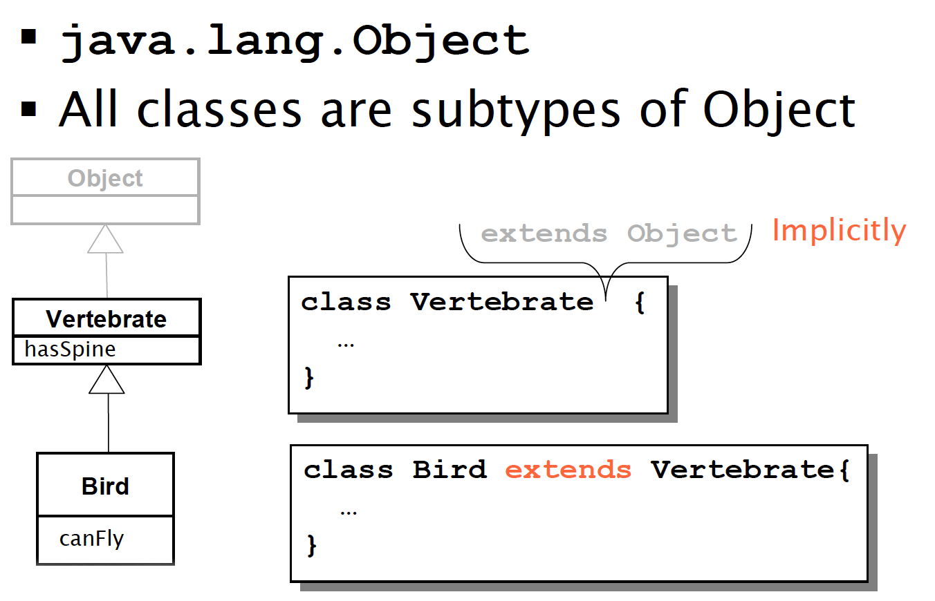
Dynamic binding and polymorphism

Slide 28
Java.lang.Object
All objects can be seen as Object instances
Object defines basic services, which are useful for all classes. They are often overridden in sub-classes. For example:
toString(): returns a string representation
equals(Object o): tests equality
clone(): returns a shallow copy of the object

Slide 29
toString()
class Car{
String toString(){…}
}
Car c = new Car();
// equivalent calls
System.out.println(c);
System.out.println(c.toString());
System.out.println() methods implicitly invoke toString() on all object parameters
Polymorphism applies when toString() is overridden

Slide 30
equals(Object o)

Slide 31
clone()

Slide 32
Casting

Slide 33
Types
Java is a strictly typed language, i.e., each variable has a type
float f;
f = 4.7; //legal
f = “string”; //illegal
Car c;
c = new Car(); //legal
c = new String(); //illegal

Slide 34
Specialization
class Car {};
class ECar extends Car{};
Car c1 = new Car(); // OK!
Ecar c2 = new ECar (); // OK!
But also…
Car c3 = new Ecar(); // OK?

Slide 35
Specialization
Car c3 = new Ecar(); // OK!
Specialization defines a sub-typing relationship (is a ). In Venn’s terms ECar type is a subset of Car type.
Car(s)
ECar(s)

Slide 36
Upcasting
Assignment from a more specific type (subtype) to a more general type (supertype)
class Car{};
class ECar extends Car{};
Car c = new ECar ();
Note well - reference type and object type are separate concepts. Object referenced by ‘c’ continues to be of ECar type! Only the interface changes!

Slide 37
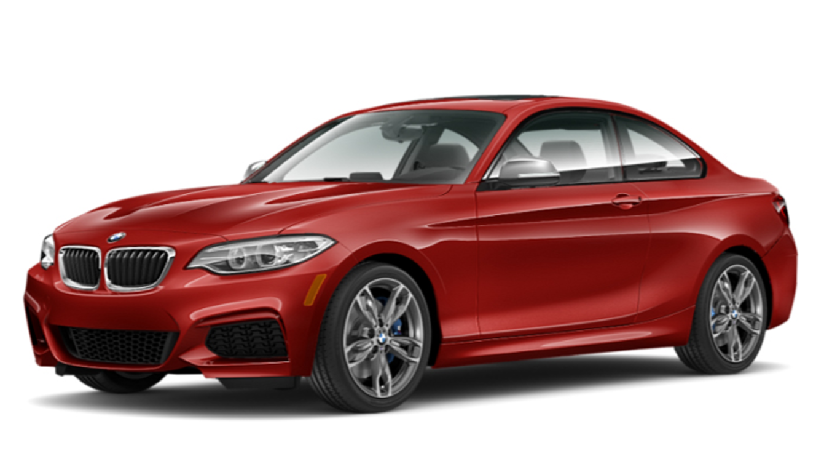

Upcasting
It is dependable
It is always true that an electric car is a car too
It is automatic (e.g., float f = (int) 3)
(1) Car c = new Car();
(2) ECar ec = new ECar ();
(3) c = ec;
c
ec
1
2
3

Slide 38
Example
Class Car {
boolean isOn;
string licensePlate;
void turnOn() {…}
void turnOff() {…}
}
Class ECar extends Car {
boolean isCharged;
boolean isSelfDriving;
void turnSDOn() {…}
void turnSDOff() {…}
}
ECar c1 = new ECar();
c1.turnSDOn() // OK!
Car c2 = c1; // Upcast
c2.turnSDOn() // Invalid! (Car public interface does not provide turnSDOn() call)

Slide 39
Downcasting
Assignment from a more general type (super-type) to a more specific type (sub-type)
Reference type and object type do not change
MUST be explicit
It’s a risky operation, no automatic conversion provided by the compiler (it’s up to you!)

Slide 40
Example
Class Car {
boolean isOn;
string licensePlate;
void turnOn() {…}
void turnOff() {…}
}
Class ECar extends Car {
boolean isCharged;
boolean isSelfDriving;
void turnSDOn() {…}
void turnSDOff() {…}
}
Car c1 = new ECar();
c1.turnSDOn() // Invalid!
ECar c2 = (Ecar)c1; // Downcast
c2.turnSDOn() // Accidentally OK!

Slide 41
Example
Class Car {
boolean isOn;
string licensePlate;
void turnOn() {…}
void turnOff() {…}
}
Class ECar extends Car {
boolean isCharged;
boolean isSelfDriving;
void turnSDOn() {…}
void turnSDOff() {…}
}
Car c1 = new Car();
c1.turnSDOn() // Invalid!
ECar c2 = (Ecar)c1; // Downcast
c2.turnSDOn() // Invalid! (Runtime!!)

Slide 42
Runtime is evil
Compilers aid developers in writing working code. Runtime errors cannot be identified by compilers. Developers must be careful!
Use the instanceof operator
Car c = new Car();
ECar ec;
if (c instanceof ECar){
ec = (ECar) c;
ec.turnSDOn();
}

Slide 43
Specialization
Specialization defines a sub-typing relationship (is a ). ECar type is a subset of Car type. All ECar(s) are Car(s). Not all Car(s) are ECar(s).
Upcast
Downcast
ECar(s)
Car(s)

Slide 44
Upcast to object
Each class is either directly or indirectly a subclass of Object
It is always possible to upcast any instance to Object type (see Collection)
AnyClass any = new AnyClass();
Object obj = (Object)any;

Slide 45
Abstract Classes and Interfaces

Slide 46
Abstract methods
You can declare an object without defining it:
Person p;
Similarly, you can declare a method without defining it (i.e., the body of the method is missing):
public abstract void draw(int size);
A method that has been declared but not defined is an abstract method

Slide 47
Abstract classes
Any class containing one or more abstract method is an abstract class
You must declare the class with the keyword abstract:
abstract class MyClass {...}
An abstract class is incomplete (It has missing method bodies)
You cannot instantiate (create a new instance of) an abstract class

Slide 48
Abstract classes
You can extend (subclass) an abstract class
If the subclass defines all the inherited abstract methods, it is concrete and can be instantiated
If the subclass does not define all the inherited abstract methods, it must be abstract too
You can declare a class to be abstract even if it does not contain any abstract methods
This just prevents the class from being instantiated

Slide 49
An example abstract class
public abstract class Animal { abstract int eat(); abstract void breathe(); }
This class cannot be instantiated
Any non-abstract subclass of Animal must provide the eat() and breathe() methods

Slide 50
Why use abstract classes?
Suppose you wanted to create a class Shape, with subclasses Oval, Rectangle, Triangle, Hexagon, etc. You don’t want to allow creation of a “Shape”
Only particular shapes make sense, not generic ones
If Shape is abstract, you can’t create a new Shape
You can create a new Oval, a new Rectangle, etc.
Abstract classes are good for defining a general category containing specific “concrete” classes

Slide 51
A problem
class Shape { ... }
class Star extends Shape { void draw() { ... } ... }
class Circle extends Shape { void draw() { ... } ... }
Shape s;
s = new Shape(); // Legal, but unwanted
s = new Star(); // Legal, because a Star is a Shape
s.draw(); // Illegal, Shape does not have draw()

Slide 52
Same problem, another view
Shape[] shapes = new Shape[16];
shapes[0] = new Circle();
shapes[1] = new Star();
…
for (Shape s : shapes) {
s.draw(); // Illegal, Shape does not have draw()
}

Slide 53
A solution
abstract class Shape { abstract void draw(); }
class Star extends Shape { void draw() { ... } ... }
class Circle extends Shape { void draw() { ... } ... }
Shape s;
s = new Shape(); // Illegal, Shape is abstract
s = new Star(); // Legal, because a Star is a Shape
s.draw(); // Legal, Shape does have draw()

Slide 54
Interfaces
An interface declares methods but does not supply implementations
All the methods are implicitly public and abstract. It may also contain constants (final attributes).
Cannot be instantiated (An interface is like a very abstract class)
interface AffineT { public void move(double x, double y); public void rotate(double angle); public void scale(double scaleFactor); }
interface SimilarT {
public void generateSimilar(); }

Slide 55
Implementing an interface
You can extend a class, but you have to implement an interface
A class can only extend (subclass) one other class, but it can implement many interfaces
class Star extends Shape implements AffineT, SimilarT {
public Star() {…}
…
}

Slide 56
Implementing an interface
class Star extends Shape implements AffineT, SimilarT {
public Star() {…}
public void move(double x, double y) {…}
public void rotate(double angle) {…} public void scale(double scaleFactor) {…}
public void generateSimilar() {…} }
When you say a class implements an interface, you are promising to define all the methods that were declared in the interface

Slide 57
Partially implementing an Interface
It is possible to implement some but not all of the methods defined in an interface
Since this class does not supply all the methods it has promised, it must be defined abstract
It is also possible to extend an interface (to add methods):
It is a new interface with additional methods

Slide 58
What are interfaces for?
A class can only extend one other class, but it can implement multiple interfaces
This lets the class fill multiple roles
In graphical interfaces (GUIs), it is common to have one class implementing several listeners (i.e., interfaces)
Example: class Application extends JFrame implements ActionListener, KeyListener { ... }

Slide 59
Problem
public class GroudVehicle {
activateWheels() {…}
…
}
public class WaterVehicle {
activateWaterFan() {…}
…
}
// Not allowed in Java!! Only one class can be extended!
public class Anphibian extends GroudVehicle, WaterVehicle {
…
}

Slide 60
Solution
public interface GroudVehicle {
activateWheels();
…
}
public interface WaterVehicle {
activateWaterFan();
…
}
// OK!
public class Anphibian implements GroudVehicle, WaterVehicle {
activateWheels() {…}
activateWaterFan() {…}
…
}

Slide 61
Interfaces and instanceof
instanceof is a keyword that tells you whether a variable “is a” member of a class or interface
class Dog extends Animal implements Pet {...}
Animal fido = new Dog();
fido instanceof Dog //OK!
fido instanceof Animal //OK!
fido instanceof Pet //OK!

Slide 62
Adapter classes
When you implement an interface, you promise to define all the functions it declares
There can be a lot of methods
interface KeyListener { public void keyPressed(KeyEvent e); public void keyReleased(KeyEvent e); public void keyTyped(KeyEvent e); }
What if you only care about a couple of these methods?

Slide 63
Adapter classes
Solution: use an adapter class
An adapter class implements an interface and provides empty method bodies
class KeyAdapter implements KeyListener { public void keyPressed(KeyEvent e) { }; public void keyReleased(KeyEvent e) { }; public void keyTyped(KeyEvent e) { }; }
You can override only the methods you care about. Java provides a number of adapter classes

Slide 64
Summary
We design a videogame allowing dogs to breathe, bark and move
interface movable {
public abstract void move(double x, double y);
}
class Animal {
public void breathe();
}
class Dog extends Animal implements movable {
public void bark();
}
Dog lessie = new Dog();
Animal a = lessie;
Movable m = lessie;

Slide 65
Summary
breathe()
a, the Animal reference
move()
breathe()
bark()
move()
m, the movable reference
the actual Dog object
breathe()
bark()
move()
lessie, the Dog reference

Slide 66
Vocabulary
abstract method—a method which is declared but not defined (it has no method body)
abstract class—a class which either (1) contains abstract methods, or (2) has been declared abstract
instantiate—to create an instance (object) of a class
interface—similar to a class, but contains only abstract methods (and possibly constants)
adapter class—a class that implements an interface but has only empty method bodies

Slide 67
Complexity has nothing to do with intelligence, simplicity does.
— Larry Bossidy
Ex CEO Honeywell
Perfection is achieved, not when there is nothing more to add, but when there is nothing left to take away.
— Antoine de Saint Exupery
Scrittore, aviatore francese

