Slide 1

Google’s Go Language
Presented By Matt Burton

Slide 2

Overview
Statically typed
Compiled language
Simple and efficient
High performance
Created by Ken Thompson and other google employees
Publically available in 2012
Notes:
Go is a statically typed compiled language, meaning that types are checked at compile time machine code is generated before it gets executed Go’s design philosophy is centered on being simple and efficient while maintaining high performance executables
Go shares similarities with the B and C languages as Ken Thompson helped design the three languages Go become publicly available in 2012, making it still relatively new in the programming scene

Slide 3
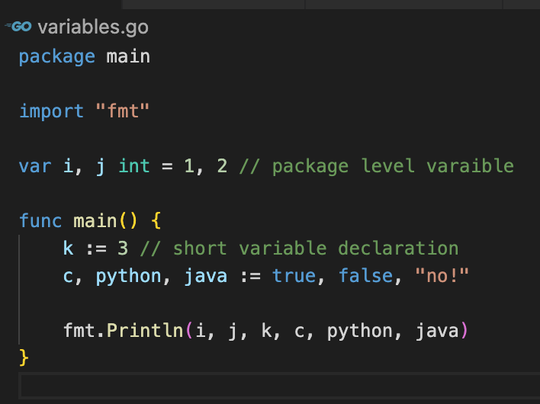
Benefits of Go
Fast compile times
Faster development cycles
Code readability
Concise syntax
Notes:
Some of the major benefits of Go include its fast compile times, its faster development cycles as a result of its simple syntax, its improved readability which benefits collaborative projects, and its concise syntax

Slide 4
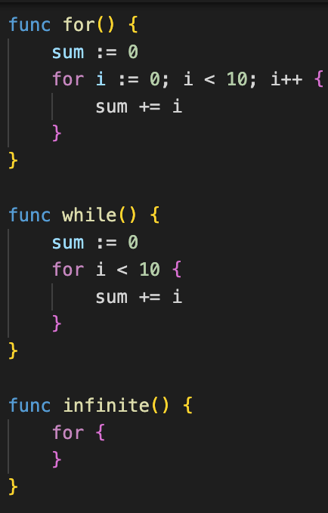
Development Improvements
Type inference
Simplified syntax
Detailed error messages
No pointer arithmetic
Return multiple values
Naked returns
Notes:
As a developer, some of the major improvements in Go include its type inference which doesn't require explicit types in variable declarations, its simplified syntax which removes unnecessary semicolons and parentheses, and its detailed error messages thanks to the standard library and its robust compiler. While Go does support pointers, Go does not allow for pointer arithmetic which greatly reduce the risk of unforeseen errors. A welcomed change from that of the C language is the ability to return any number of variables from functions.
To simplify things even further, a function that doesnt pass any arguments after its return statement will return every return variable as declared in the function’s signature

Slide 5
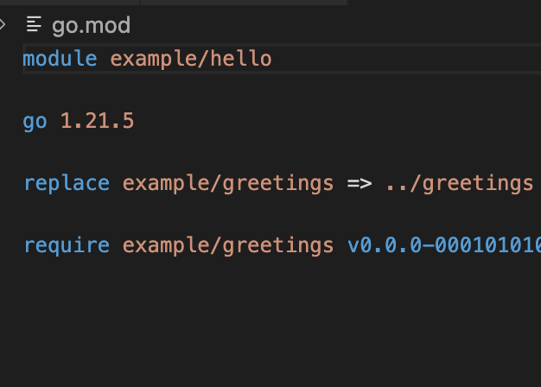
Innovations
Packages
Groups project source code
Modules
Dependency management
Goroutines
Multi-threading
Slices
Dynamic arrays
Methods
Replaces classes
Notes:
As a new language Go made many strides in innovating the programming language scene
Packages are a simple way to bundle source code into a single callable library
Modules revolutionize compile times by keeping track of dependency information in their own separate file
Goroutines are Go’s approach to concurrency, and their accessible within the standard library
Slices fill the need for dynamically sized arrays while still being memory efficient
And methods replace the traditional C class structure with type received functions

Slide 6
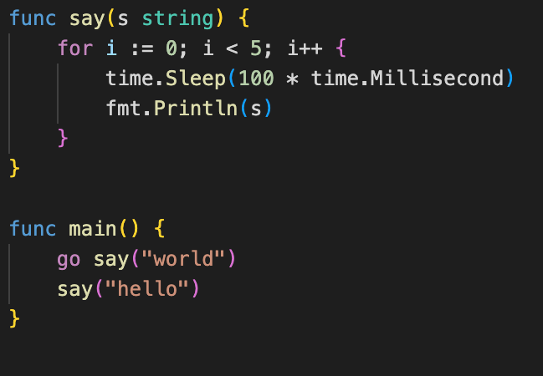
Concurrency
Goroutines
Multi-threading
Channels
Block read and write
Select()
Waits on multiple operations
sync.Mutex
lock() and unlock() library
Notes:
Goroutines are as simple as calling a function preceded by the keyword go
Channels are a useful tool for sending and receiving data in concurrent projects as it blocks access to that data until its operation is complete
The select function listens to multiple communicating operations and blocks other processes when handling a message
The sync library offers a mutex alternative for more fine tuned control over locking and unlocking data

Slide 7
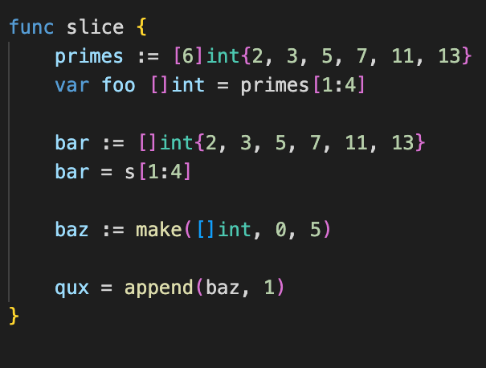
Slices
Dynamic size
Describes underlying array
Bounds
Low and high, not inclusive
Length
How many elements in slice
Capacity
How many elements in underlying array after first index
Append
Returns a new slice
Notes:
Slices are Go’s solution to dynamically sized arrays
While potentially more complicated than vectors, they benefit by using less memory overall
Slices can be initialized with a lower and upper bound denoting the indices of the underlying array which it has access to
There are two functions to retrieve information about a slice, length and capacity
Length returns the number of elements within the bounds of a given slice
Capacity however returns the number of elements in the underlying array following the first element in the slice
Finally, the append function is a built in procedure which adds elements to an existing slice and returns the newly created slice and will allocate space for a new array is necessary

Slide 8
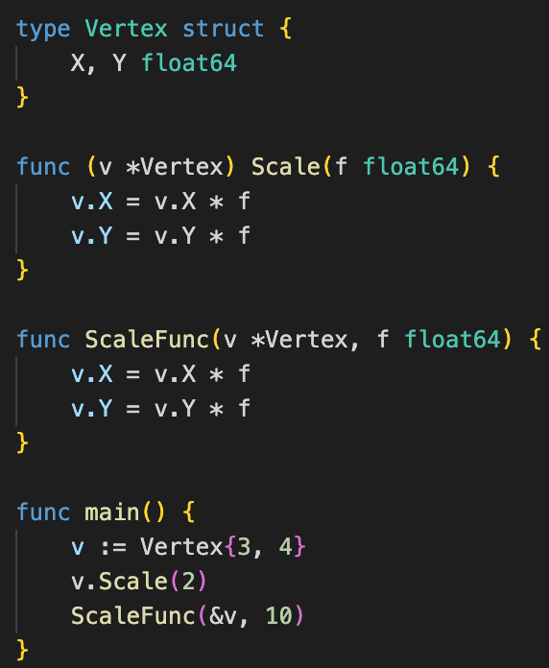
Methods
Methods
Go does not have classes
Receiver argument
Types
Pointer indirection
Values and pointers
Pointer receiver
Mutates data
Notes:
Lastly, methods are Go’s alternative to classes from C
Methods are essentially just functions but the key difference is their receiver argument
A receiver argument defines the type of variable that this function can be applied to
Using pointer indirection a method can either return a value or be directly applied to a variable
It is important to note that directly applying a method to a variable by using a pointer receiver will cause the value of the variable to mutate

Slide 9


